Slide 1
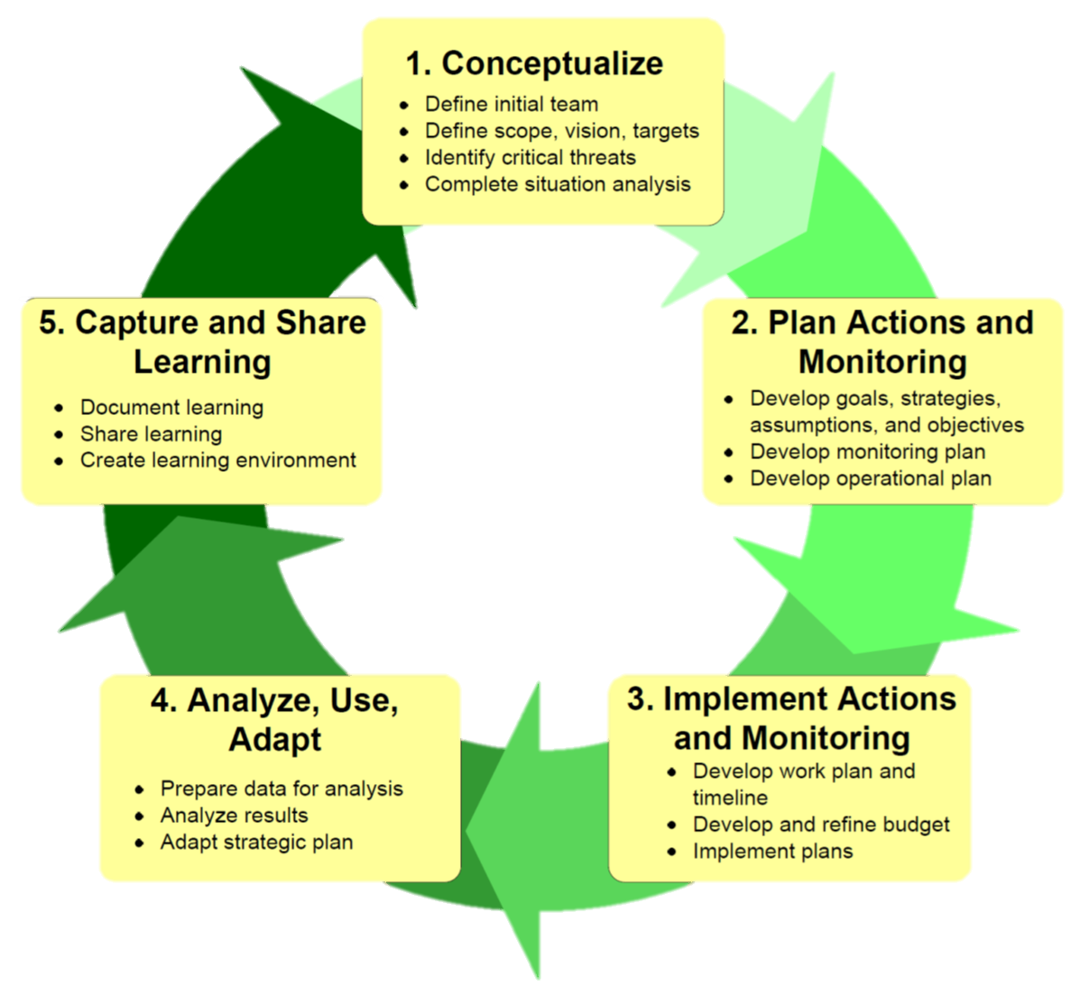
Pre-planning
Vision & Scope
Targets
Threats
Situation
Deciding what the plan is about
Record what we learn
Share what we learn
Help others to share what they learn
Goals
Strategies
Results chains
Measures
Telling ourselves and others
Making the plan
Getting data
Looking at results
Adapting the plan
Work Plan & Timeline
Budget
Implement
Deciding if the plan is working
Doing and monitoring the work
Open Standards
Conservation Measures Partnership
Healthy Country Planning
Adapted for participation & cross cultural situations

