Slide 1
Actions, time & budgets
Implementing the plan

Slide 2
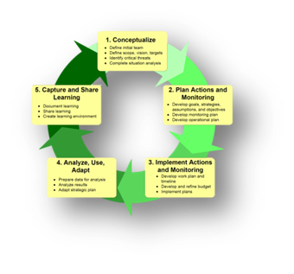
Deciding what the plan is about
Telling ourselves and others
Making the plan
Work Plan & Timeline
Budget
Implement
Deciding if the plan is working
Doing and monitoring the work

Slide 3
Doing and Monitoring the Work
Actions, time & budgets
Operations Plan
Why we do this step?
  build a clear work program with credible budget, timeline and capacity understanding
  develop a detailed annual budget and workplan for (with) the people who will implement your plan
  Check capacity and review as needed

Slide 4
Doing and Monitoring the Work
Actions, time & budgets
Who should be involved
Person with overall responsibility for the plan succeeding (Manager)
Person / people responsible for doing the work (rangers etc)
Someone with an understanding of budgets / finances
Can be done by one person, but checked with the above
Is a straightforward step:
who, when, how much, resources/preconditions

Slide 5
Doing and Monitoring the Work
Actions, time & budgets
Implementing the plan
After all this planning…
  What do we specifically need to do?
  Who will be responsible for each task?
  What resources do we need?

Slide 6
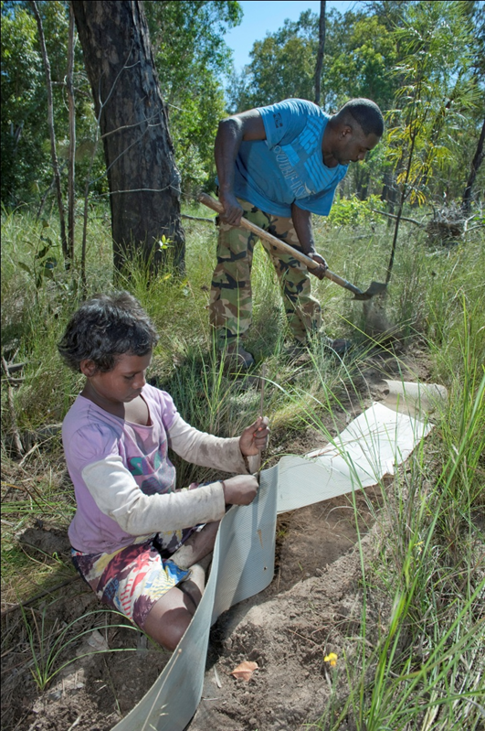
Doing and Monitoring the Work
Actions, time & budgets
What we need is…
A list of the key actions and monitoring tasks, especially those needing to take place in the near future
Tasks allocated to specific individual(s) and a rough timeline.
A rough project budget
A brief summary of project capacity
If needed, new objectives and strategies for enhancing project resources

Slide 7
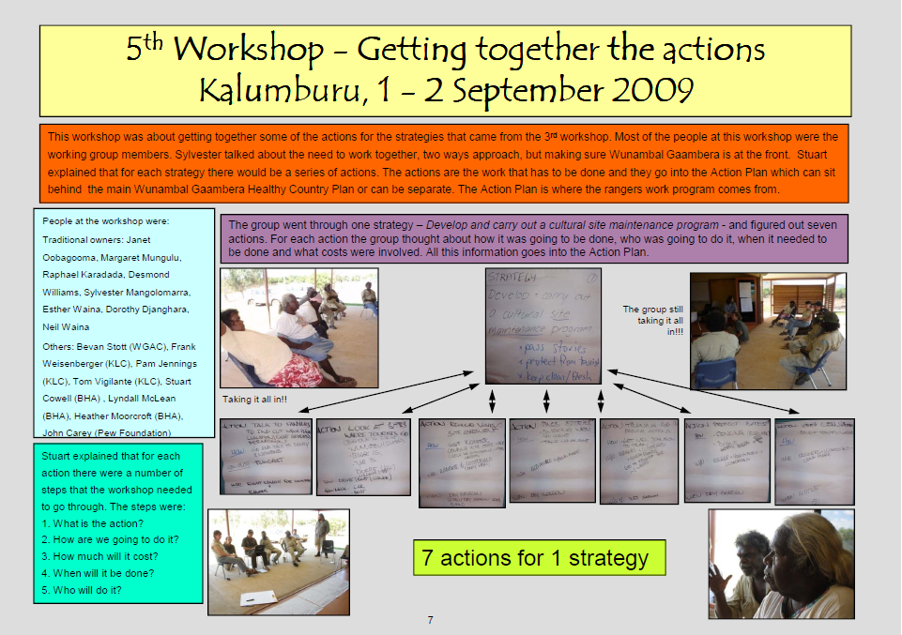

Slide 8
Doing and Monitoring the Work
Actions, time & budgets
Key steps: high level operations
Specify the timeframe for your project and chart out which strategies will happen when
For each strategy, identify who should be involved
Broadly estimate the human, financial, and material resources needed to implement each strategy
Add any other major expenses you think are likely
Add general operational costs and total your costs across all strategies
Review that your work plan includes all the strategies you need to implement
Check needs against available and review
Notes:
FEEDBACK--Ask group what they’ve learned from the group work about financial planning and/or the link between strategic and financial planning.
Reveal bulleted list of key lessons/takeaways.

Slide 9
Doing and Monitoring the Work
Actions, time & budgets
Key Lessons
Results chains should be detailed enough to make a good action plan
Action plans provide the activities for making a budget
Key stakeholders should have input eg rangers, managers, finance
Notes:
FEEDBACK--Ask group what they’ve learned from the group work about financial planning and/or the link between strategic and financial planning.
Reveal bulleted list of key lessons/takeaways.

Slide 10
Doing and Monitoring the Work
Actions, time & budgets
Making the workplan from the result chain
Media
Campaign
Campaign
reaches
target
audience
Demand
for
caviar
drops
Price
for
caviar
drops
Sturgeon
not
over-fished
Healthy
Sturgeon
population
WHO | Bob | Bob | Media co. | Bob
START | now | After the first task finished | 6 mths | 18 mths
FINISH | soon | 2 years | 9 mths | 20 mths
COST | Not much | $20,000 | etc | etc
COMMENT | Essential 1st step | Need funds for next step | etc

Slide 11
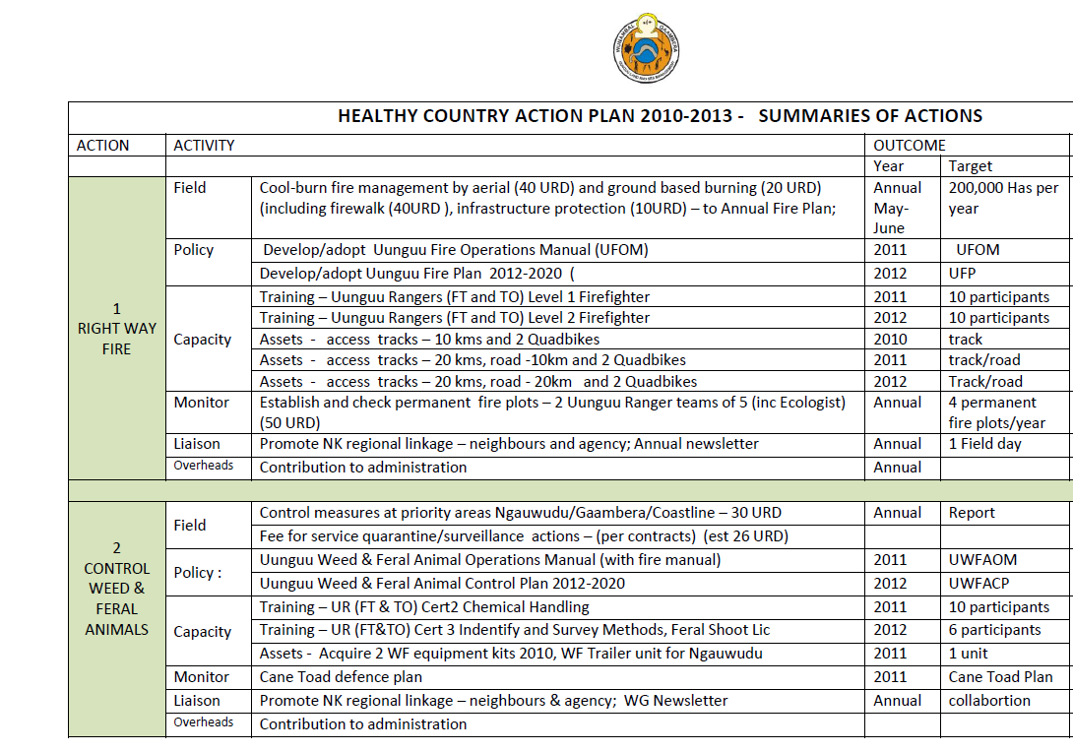
Doing and Monitoring the Work
Actions, time & budgets
Uunguu example

Slide 12
Doing and Monitoring the Work
Actions, time & budgets
Build the work plan
1. Identify specific action steps that need to be done
2. Define “who” will be responsible for each action step
3. Determine when each action step will take place
4. Estimate resources required for each action step
5. Revisit and revise the workplan on a regular basis

Slide 13
Doing and Monitoring the Work
Actions, time & budgets
What should be in the work plan
List of action steps needed to accomplish a strategy
List of monitoring tasks needed to implement measures
Start and end date for each action step and frequency, timing and location for each monitoring task
Description of the method to be used to accomplish each action step or monitoring task
Current status of the step/task
Identification of person(s) responsible
Estimate of labor and other costs associated with the action step, monitoring task or strategic action

Slide 14
Doing and Monitoring the Work
Actions, time & budgets
Key Lessons
Strategic planning is the foundation for financial planning
Results chains should be detailed enough to yield good action plans
Actions plans provide the activities for costing in a financial plan
Key stakeholders should have input on main parameters for a financial plan (timeframe, geography, etc.)
Endeavor to keep plans simple while trying to meet the needs of all stakeholders
Notes:
FEEDBACK--Ask group what they’ve learned from the group work about financial planning and/or the link between strategic and financial planning.
Reveal bulleted list of key lessons/takeaways.

Slide 15
Doing and Monitoring the Work
Actions, time & budgets
Documenting and allocating tasks
Variety of subsidiary plans depending on scale
  Works plans
    may be one higher level
    several more detailed
    annual workplan
  Monitoring plan
    may be part of work plan, but could be separate
  Detailed budgets
  Business plans

Slide 16
Doing and Monitoring the Work
Actions, time & budgets
Understanding Capacity
A workplan is only as good as the resources available
Assess project resources & develop ways to address unmet needs
Capacity needs include:
  project leadership and staff availability, funding, community support, legal framework, partner capacity, buy in from leaders.
Consider how current capacity matches the resources required to achieve the plan.
If your needs are more than your capacity, reduce your plans or develop new resources.
Notes:
FEEDBACK--Ask group what they’ve learned from the group work about financial planning and/or the link between strategic and financial planning.
Reveal bulleted list of key lessons/takeaways.

Slide 17

Doing and Monitoring the Work
Actions, time & budgets
Understanding Capacity
People
  Leader
    Focused staff responsibility — project director who has the “core competencies” needed
  Team
    Access to experienced talent in land management, government relations, operations & experienced conservation manager

Slide 18
Doing and Monitoring the Work
Actions, time & budgets
Understanding Capacity
Internal Support
  Organisational Leadership
    A community group, private organization, government agency, or some combination is providing leadership at the area
  Funding
    Startup funds & sustainable funding sources

Slide 19
Doing and Monitoring the Work
Actions, time & budgets
Understanding Capacity
External Support
  Legal support
    An appropriate framework of tools and policy instruments exists, and is either being deployed, or has the potential to be deployed at the project area.
  Community Support
    Engagement of community/key constituencies in healthy country management
    and compatible uses

Slide 20
Liderazgo y apoyo al projecto
Responsabilidad enfocada del personal a los sitios de acción
4: Un miembro del personal tiene (1) responsabilidad y autoridad claramente definida para conservar el sitio, (2) experiencia adecuada, y (3) suficiente tiempo para enfocar en el desarrollo e implementación de las estrategias de conservación en el sitio.
3: Un miembro del equipo cuenta con cualquiera de dos, pero no todos los tres componentes de responsabilidad enfocada del personal (responsabilidad, experiencia, tiempo).
2: Un miembro del equipo cuenta con no más de uno de los tres componentes de responsabilidad enfocada del personal (responsabilidad, experiencia, tiempo).
1: Ningún miembro del personal tiene responsabilidad de trabajo designada para conservación del sitio.
TNC Staff Responsibility for Site: A staff member or staff members from the lead institutions have clearly assigned responsibility, authority, and accountability for conserving the site, with adequate experience and sufficient time to focus on developing and implementing site-based conservation strategies.
4 Staff member(s) have (1) clearly assigned responsibility, authority, and accountability for conserving the site, (2) adequate experience, and (3) sufficient time to focus on developing and implementing conservation strategies at the site.
3 Staff member(s) have any two, but not all three elements of focused staff responsibility (responsibility, experience, time).
2 Staff member(s) have no more than one of the three elements of focused staff responsibility (responsibility, experience, time).
1 No staff member(s) with designated job responsibility for site conservation.
Institutional Leadership: An NGO, government agency, private sector institution, or some combination of institutions is providing leadership for developing and implementing conservation strategies at the project site.
4 There is clear leadership provided by one or a combination of institutions that (1) have established clear responsibility and (2) developed adequate capacity to implement conservation strategies. If multiple institutions are involved they must also have a shared vision of success and successful collaboration mechanisms in place.
3 Institutional leadership is being provided but assignment of responsibility or adequate capacity is not at a sufficient level. If multiple institutions are involved, there may be some difficulties in collaboration.
2 Institutional leadership is failing to provide adequate capacity to implement conservation strategies even though responsibility for site is has been accepted by one our more institutions. If multiple institutions are involved, one is not providing adequate conservation capacity.
1 No institution has clear responsibility or adequate capacity to implement conservation strategies.
Multidisciplinary Team – The project receives regular, high-level assistance from a full-service, experienced, multidisciplinary support team, with appropriate expertise in fields required for implementing site conservation strategies. E.g., conservation science, protection, land & water management, applied research, government relations/public funding, community conservation, development, finance and operations
4 The project receives regular assistance from a full-service, experienced support team (e.g. on-site staff, state, country, international program or partner organization staff).
3 The project receives assistance from a support team – but regular assistance is not available in a few important programmatic area needed for successful strategy implementation.
2 The project receives assistance from a support team – but regular assistance is not available in many important programmatic areas needed for successful strategy implementation.
1 The project receives insufficient assistance in several programmatic areas.
Conservation Targets, Threats, and Strategies: Project director and multidisciplinary team have completed a thorough assessment of the conservation targets and their threats and have developed strategies that are directly linked to these identified priorities to improve biodiversity health and abate threats. Where appropriate, the site team should complete an assessment of the key stakeholders and the motivational forces operating on the stakeholders and apply this information to the development of key conservation strategies.
4 Site director and multidisciplinary team have completed a thorough assessment of the conservation targets, their integrity, and threats, and have developed strategies that are directly linked to this analysis and take into account key stakeholder interests. These results are documented in a site conservation plan and appropriate site maps.
3 Site director and multidisciplinary team have applied only a “rapid” assessment of the conservation targets and their viability and threats and needed strategies, with preliminary or incomplete documentation of plan and/or with insufficient site maps.
2 Site staff have participated in a site conservation planning meeting or other effort – but have not worked with a multidisciplinary team to complete a target and threat assessment or site conservation plan.
1 Site staff has not yet participated in strategic site planning focused on the targets, threats, and related strategy development.
Monitoring and Adaptive Management: Baseline measures of conservation impact such as the biodiversity health of conservation targets, threat status, and conservation capacity have been established and are being monitored, progress assessed, and strategic adjustment made in conservation activities at the site.
4 Baseline measures of biodiversity impact and capacity have been established and are being monitored, and multidisciplinary project team meets regularly (e.g. quarterly, biannually, or annually) to assess progress, evaluate results, review & test strategic hypotheses, and make necessary strategic adjustments.
3 Baseline measures have been established but only some components of biodiversity impact or conservation capacity are being monitored. A multidisciplinary project team has met within past two years to assess progress, evaluate results, review strategic hypotheses and make necessary strategic adjustments.
2 Baseline measures are incomplete and monitoring of biodiversity impact and capacity is unfocused; or project director has met only informally with others to assess progress and to re-assess the strategic plan (systems, stresses, sources and strategies).
1 No baseline measures established and key components of the conservation impact and capacity are not being monitored, or no review or update of strategic plan is taking place.
Legal Framework for Conservation: The appropriate combination of legally declared conservation areas and regulatory or policy instruments have been authorized at the appropriate level necessary to protect key conservation targets. The legal declaration of conservation areas can take many including national, state or local parks or conservation area; ownership by a conservation organization; or a private reserve. Conservation ownership can be in fee or through a partial interest such as a conservation easements. Regulations and other policy instruments will vary but may include zoning, permits and no-take fisheries zones, for example.
4 An effective combination of official declaration of conservation area and regulatory and policy instruments necessary to implement conservation strategies are obtained at appropriate level. Ownership or effective control of the areas assigned to an established conservation organization or agency
3 Proposal for official declaration of conservation area and appropriate regulatory and policy instruments submitted to proper authorities, no declaration or ownership transfer yet obtained or implementation of needed policies or regulations
2 Formal plans for declaration of protected status of a core conservation area decree are underway and identification of regulatory and policy instruments completed.
1 No core conservation area designation or regulatory and policy instruments exists
Community Support: Site project management teams have developed strategies to gain the support of site constituencies and have their programs favorably received and supported so there are no major obstacles to strategy implementation due to stakeholder resistance.
4 The project management team and its program is favorably received and supported by key stakeholders, and there are no major obstacles to strategy implementation due to community resistance.
3 The project management team and its program is largely favorably received and supported by key stakeholders, but there is some important opposition to strategy implementation due to community resistance.
2 The project management team and their program have mixed support in the community and there is some significant community opposition to strategy implementation.
1 The project management team and their program have very little support in the community and there is some significant community opposition preventing most key strategy implementation.
Funding – A conservation area must have operational funding that is adequate to support the staff and operating costs, as well as program funding that is adequate to implement and sustain key strategies. For the long-term, project managers need to build a base of diversified funding sources. Funding may come from both private and public sectors and be available through a variety of mechanisms and sources, such as membership, endowment, multi-year grants, and environmentally and socially compatible enterprises.
4 Funding to implement key conservation strategies and for core operations has been secured, pledged, or is highly probable for at least two years, and the project has developed sources of long-term funding to sustain core costs and key conservation strategies for the next 5 years.
3 Funding to develop and launch key conservation strategies and for core operations has been secured, pledged, or is highly probable for at least two years, and the project has undertaken the necessary financial planning and achieved partial success in developing sources of long-term funding to sustain core costs and key conservation strategies for the next 5 years.
2 Funding has been secured or pledged for core operations for at least one year and some planning underway to develop diversified sources of long-term support for operations and conservation strategies.
1 Funding has not been secured or pledged for core operations for one-year and no planning or implementation of long-term funding sources.
Liderança e Apoio do Projeto
Responsabilidade Focalizada de Funcionários para o Sítio de Ação
4: O funcionário tem (1) responsabilidade e autoridade claramente designadas de conservar o sítio, (2) experiência adequada e (3) tempo suficiente para concentrar-se no desenvolvimento e implementação de estratégias no sítio.
3: O funcionário tem dois dos três elementos de responsabilidade focalizada de funcionários (responsabilidade, experiência, tempo).
2: O funcionário tem apenas um dos três elementos de responsabilidade focalizada de funcionários (responsabilidade, experiência, tempo).
1: Não há um funcionário encarregado da conservação do sítio.
Liderança e Apoio do Projeto
Gerente ou Mentor de Conservação -- Envolvimento de mentor ou gerente experiente com resultados comprovados na conservação de outros sítios com o mesmo nível de complexidade – ou seja, no desenvolvimento e implementação de estratégias para reduzir (ou combater) ameaças.
4: O projeto conta com o envolvimento regular, suficiente e contínuo de um gerente ou mentor de conservação experiente (ou seja, com pelo menos 5 anos de experiência e resultados comprovados na conservação de sítios com nível similar de complexidade).
3: O projeto conta com o acesso regular à orientação e conselho de um gerente ou mentor experiente (ou seja, com pelo menos 5 anos de experiência e resultados comprovados na conservação de sítios com nível similar de complexidade).
2: O projeto conta com o acesso regular à orientação e conselho de um gerente ou mentor menos experiente (ou seja, com menos de 5 anos de experiência e alguns resultados promissores na conservação de sítios com nível similar de complexidade).
1: O projeto não conta com, ou conta apenas esporadicamente com, um gerente ou mentor de conservação.
Liderança e Apoio do Projeto
Equipe de Apoio ao Projeto – por exemplo: ciência da conservação, manejo de terras e águas, pesquisa aplicada, relações governamentais/recursos públicos, captação de recursos, operações
4: O projeto recebe assistência regular e de alto nível de uma equipe de apoio multidisciplinar e experiente (por exemplo: pessoal próprio, de outras instituições ou consultores)
3: O projeto recebe a assistência de uma equipe de apoio – mas uma assistência regular e de alto nível não está disponível em uma área funcional importante necessária para a implementação bem-sucedida da estratégia.
2: O projeto recebe assistência de uma equipe de apoio – mas uma assistência regular e de alto nível não está disponível em duas áreas funcionais importantes necessárias para a implementação bem-sucedida da estratégia.
1: O projeto recebe assistência insuficiente em várias áreas funcionais.
Abordagem Estratégica ao Projeto
Compreensão/Aplicação da metodologia dos Cinco “S” (sistemas/systems, estresses/stresses, fontes/sources, estratégias/strategies, sucesso/success)
4: O diretor do projeto e uma equipe multidisciplinar completaram uma avaliação detalhada dos cinco “S” e desenvolveram um plano para a conservação do sítio suficientemente documentado, assim como mapas apropriados do sítio.
3: O diretor do projeto e uma equipe multidisciplinar fizeram uma avaliação “rápida” dos cinco “S”, com documentação preliminar ou incompleta e/ou mapas insuficientes do sítio.
2: O encarregado do projeto participou de uma reunião de planejamento para a conservação do sítio ou outro esforço similar – mas não trabalhou com uma equipe multidisciplinar para completar uma avaliação rápida dos Cinco “S” ou um plano para a conservação do sítio.
1: O encarregado do projeto ainda não participou de um planejamento estratégico.
Abordagem Estratégica ao Projeto
Abordagem Reiterada e Adaptável ao Desenvolvimento e Implementação de Estratégias-Chave de Conservação (Nota: este fator não se aplica a um sítio novo de ação durante seu primeiro ano)
4: Componentes chave de sistemas ecológicos e a situação de ameaça estão sendo monitorados e a equipe multidisciplinar do projeto se reúne regularmente (por exemplo: a cada quatro meses, semestralmente ou anualmente) para avaliar o progresso e os resultados, rever e testar hipóteses estratégicas e fazer os ajustes estratégicos necessários.
3: Componentes-chave de sistemas ecológicos e a situação de ameaça estão sendo monitorados e a equipe multidisciplinar do projeto se reuniu dentro dos últimos dois anos para avaliar o progresso e os resultados, rever e testar hipóteses estratégicas e fazer os ajustes estratégicos necessários.
2: Monitoramento ocasional dos sistemas ecológicos e da situação de ameaça, ou o diretor do projeto reuniu-se informalmente com outras pessoas para avaliar o progresso e reavaliar o plano estratégico (sistemas, estresses, fontes e estratégias).
1: Os componentes-chave dos sistemas ecológicos e a situação de ameaça não estão sendo monitorados, ou não foi feita uma revisão ou atualização do plano estratégico.
N/A: Este fator não se aplica a um sítio novo de ação durante seu primeiro ano.
Financiamento do Projeto
Recursos Iniciais ou de Curto Prazo – Adequação e previsão para operações e programas
4: Recursos foram obtidos, assegurados ou têm alta probabilidade de serem obtidos para custear as principais operações por pelo menos dois anos, idem para recursos significativos de fontes privadas ou públicas para implementar as principais estratégias de conservação.
3: Recursos foram obtidos, assegurados ou têm alta probabilidade de serem obtidos para custear as principais operações por pelo menos dois anos, idem para recursos significativos de fontes privadas ou públicas para desenvolver e iniciar as principais estratégias de conservação.
2: Recursos foram obtidos ou assegurados para custear as principais operações por pelo menos um ano.
1: Recursos não foram obtidos ou assegurados para custear as principais operações por um ano.
Financiamento do Projeto
Apoio Sustentável – Desenvolvimento de uma base de suporte financeiro de longo prazo, apoio da comunidade e parceiros institucionais que garantirão a continuidade da implementação das estratégias no sítio.
4: O projeto desenvolveu suficientemente uma combinação de suporte financeiro de longo prazo (ampla base de doadores, fundo de poupança ou recursos previsíveis), apoio comunitário e parceiros institucionais.
3: O projeto desenvolveu suficientemente dois elementos de apoio sustentável (financiamento, apoio comunitário ou parceiros).
2: O projeto desenvolveu suficientemente um elemento de apoio sustentável (financiamento, apoio comunitário ou parceiros).
1: O projeto não tem nenhum dos elementos de apoio sustentável suficientemente desenvolvido.
Financiamento de proyecto
Financiamiento de arranque o de corto plazo – adecuación y predictibilidad de las operaciones y programas
4: El financiamiento ha sido asegurado, comprometido o es muy probable para las operaciones medulares de por lo menos dos años, así como el financiamiento de principales fondos privados o públicos para implementar estrategias de conservación claves.
3: El financiamiento ha sido asegurado, comprometido o es muy probable para las operaciones medulares de por lo menos dos años, así como el financiamiento de principales fondos privados/públicos para desarrollar y lanzar estrategias de conservación claves.
2: El financiamiento ha sido asegurado o comprometido para las operaciones medulares de por lo menos un año.
1: El financiamiento no ha sido asegurado ni comprometido para las operaciones medulares de un año.
Enfoque estratégico al proyecto
Enfoque iterativo, adaptativo al desarrollo e implementación de estrategias claves de conservación (Nota: este factor no es aplicable a un nuevo sitio de acción durante su primer año)
4: Los componentes claves de sistemas ecológicos y el estado de amenaza están siendo monitoreados, y un equipo multidisciplinario de proyecto se reúne regularmente (trimestral, bianual o anualmente) para evaluar el progreso, evaluar resultados, revisar y probar hipótesis estratégicas, y realizar ajustes estratégicos necesarios.
3: Los componentes claves de sistemas ecológicos y el estado de amenaza están siendo monitoreados, y un equipo multidisciplinario de proyecto se ha reunido en los dos últimos años para evaluar el progreso, evaluar resultados, revisar y probar hipótesis estratégicas, y realizar ajustes estratégicos necesarios.
2: Los componentes claves de sistemas ecológicos y el estado de amenaza han sido monitoreados casualmente, o un miembro del personal – director de proyecto se ha reunido informalmente con otros para evaluar el progreso y re-evaluar el plan estratégico (sistemas, presiones, fuentes y estrategias).
1: Los componentes claves de sistemas ecológicos y el estado de amenaza no están siendo monitoreados, o no se ha revisado o actualizado el plan estratégico.
N/A: Este factor no es aplicable a un nuevo sitio de acción durante su primer año.
Enfoque estratégico al proyecto
Comprensión/aplicación del marco de trabajo de cinco componentes: sistemas, presiones, fuentes, estrategias, éxito (Five-S framework)
4: Un miembro del personal - director de proyecto y un equipo multidisciplinario han completado una evaluación cuidadosa de los cinco componentes (sistemas, presiones, fuentes, estrategias, éxito) y han desarrollado un plan de conservación del sitio suficientemente documentado y con mapas del sitio apropiados.
3: Un miembro del personal - director de proyecto y un equipo multidisciplinario han aplicado una evaluación rápida de los cinco componentes (sistemas, presiones, fuentes, estrategias, éxito) a través del programa Efroymson Fellowship Program o de otra manera, con documentación preliminar o incompleta y/o con mapas del sitio insuficientes.
2: Personal del proyecto ha participado en una reunión de planificación para la conservación de sitios u otro esfuerzo -- pero no ha trabajado con un equipo multidisciplinario para completar una evaluación rápida de los cinco componentes (sistemas, presiones, fuentes, estrategias, éxito) o un plan para la conservación del sitio.
1: Personal del proyecto no ha participado aún en planificación estratégica.
Liderazgo y apoyo al projecto
Equipo de apoyo al proyecto – ejemplo, ciencia de la conservación, protección, manejo de suelo y agua, investigación aplicada, relaciones con el gobierno/financiamiento público, desarrollo, operaciones
4: El proyecto recibe asistencia regular y de alto nivel de un equipo de apoyo experimentado de servicio completo (ejemplo: personal en el sitio, personal estatal, nacional, de programa internacional o de organizaciones socias)
3: El proyecto recibe asistencia de un equipo de apoyo – pero una asistencia regular de alto nivel no está disponible en una importante área funcional necesaria para la implementación exitosa de la estrategia.
2: El proyecto recibe asistencia de un equipo de apoyo – pero una asistencia regular de alto nivel no está disponible en dos importantes áreas funcionales necesarias para la implementación exitosa de la estrategia.
1: El proyecto recibe asistencia insuficiente en varias áreas funcionales.
Liderazgo y apoyo al projecto
Administrador o mentor de conservación – Involucramiento de un administrador o mentor experimentado con resultados comprobados de conservación en otros sitios con similar nivel de complejidad – por ejemplo, desarrollo e implementación exitosa de estrategias para abatir amenazas.
4: El proyecto cuenta con involucramiento regular, suficiente , en marcha y de intervención directa de un administrador o mentor experimentado – por ejemplo, con al menos 5 años de experiencia y resultados comprobados de conservación en sitios con similar nivel de complejidad).
3: El proyecto cuenta con acceso regular, asesoría y consejería de un administrador o mentor experimentado – por ejemplo, con al menos 5 años de experiencia y resultados comprobados de conservación en sitios con similar nivel de complejidad).
2: El proyecto cuenta con regular acceso, asesoría y consejería de un administrador o mentor menos experimentado (por ejemplo, con menos de 5 años de experiencia y algunos resultados prometedores de conservación en sitios con similar nivel de complejidad).
1: El proyecto no tiene acceso, o tiene sólo acceso esporádico, a un administrador o mentor de conservación.
Doing and Monitoring the Work
Actions, time & budgets
Understanding Capacity

Slide 21
Doing and Monitoring the Work
Actions, time & budgets
Enhancing Capacity
Two broad options
  review action plan/plan to adapt to existing capacity
  develop goal and strategy to enhance critical deficiencies

Slide 22
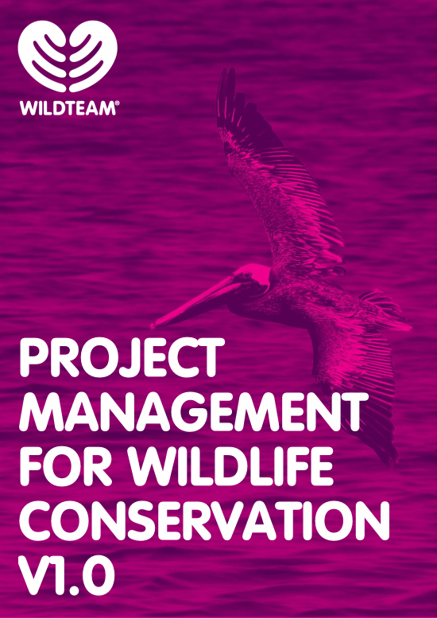
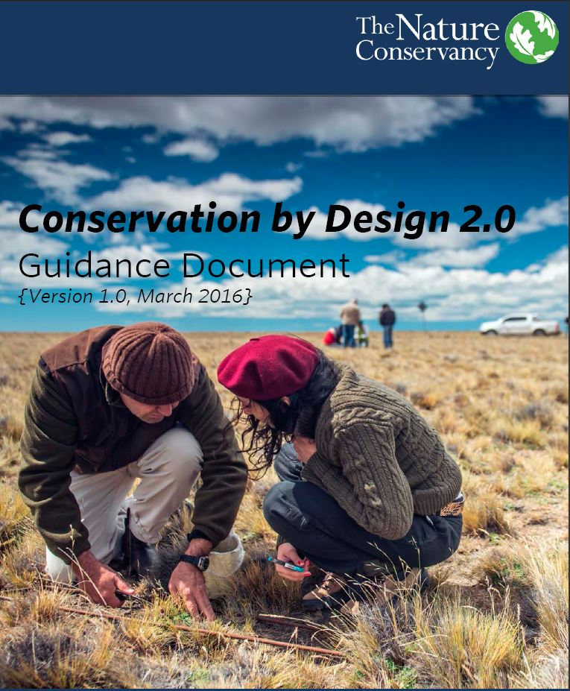

Doing and Monitoring the Work
Actions, Time & Budgets
Additional Resources

