Slide 1
Threats to our Targets
Session 05:
Problems and their Causes
Notes:
*Note: This presentation can be shortened by focussing on the following pages: 5, 6, 7, 8, 11, 12, 14

Slide 2
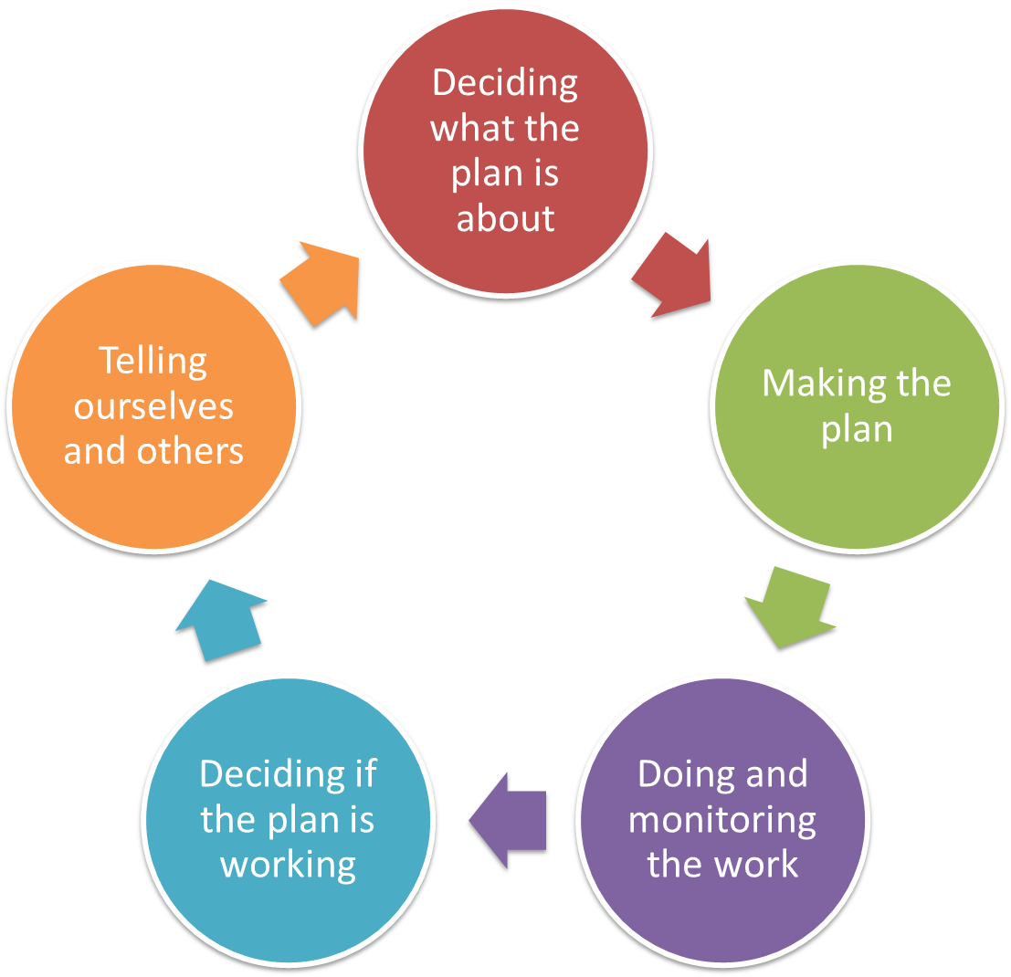
Deciding what the Plan is about
Problems & Causes
Overview
Pre-planning
Dream & Area
Targets & Health
Problems & Causes
Situation Analysis
In the Open Standards “Problems & Cause” refers to “Stresses & Threats
Notes:
Problems and causes are referred to as Stresses and Threats in the Open Standards. This step builds on the health assessment of targets and helps prepare the scene for the situation analysis.

Slide 3
Deciding what the Plan is all about
Problems & Causes
Overview presentation
What are Problems and Causes?
Prioritising Threats by ranking Problems and Causes
Alternative Approaches
Additional Resources & Exercise
Notes:
The first part of this presentation explores the concept of a problem and a cause – stresses and threats. It then shows two ways of ranking threats – simple threat ranking and ranking of stresses and sources.

Slide 4
Deciding what the Plan is all about
Problems & Causes
Problems and their causes
Why we do this step?
  To identify the most critical threats to our targets that are stopping us from having healthy country
  To focus on the causes of problems as a path for action, not just the problem itself
Note
  This step builds on our work with Health
Notes:
This step in the process is building on the viability – together these steps help projects to ensure that they are strategic.
By focussing on the causes of a problem we ensure that we work on the source of a problem not the problem itself.
This step build on the health-session: a problem is the inverse of an health attribute. We will look at this later.

Slide 5
Deciding what the Plan is all about
Problems & Causes
What are Problems and Causes
A Threat is the thing that is stopping our target from being healthy
A threat is made up of two parts:
  when one of the attributes / indicators is getting worse that is a problem
  whatever is making the problem happen is called a cause
Simplified: Threat = Problem + Cause
We usually work on causes

Slide 6
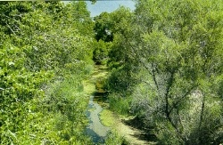
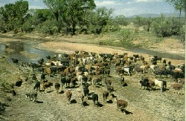
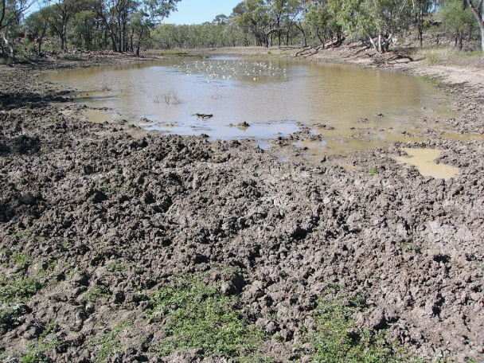
Deciding what the Plan is all about
Problems and their causes
Problems & Causes
Targets
Problems
Causes
Problems:
Hurt the health of targets —e.g. erosion, trampling
Causes: The thing that makes the problem happen — e.g. cows in the stream
Notes:
When we looked in the previous step at the health of a target, we described what the most important components of a target are that make them healthy. For the example target “River” we’ve chosen as an attribute for connectivity “Riparian Vegetation”.
A stress for the attribute “Riparian Vegetation” for our target “River” is a change to the riparian vegetation, e.g. damage to the vegetation from trampling and subsequent erosion.
We then need to identify the sources of stress. In this example case, the trampling and erosion of riverbanks and riparian vegetation comes from cows that access the stream for water and cause the damage with their hooves.
First of all this links the cause to a problem to the health of a target. Secondly this link will be ranked in the following steps so that we know which of those links is the most critical, the least critical and so on, to help prioritise threats.

Slide 7
Deciding what the Plan is all about
Problems & Causes
What are Problems?
Problems are what degrade or impair attributes and / or indicators
Examples -- Problems:
  Habitat destruction -- affects area of habitat or occurrence area (Size)
  Changed riparian vegetation -- affects characteristic native species (Condition)
  Altered fire regime – affects fire intensity (Context)
  Loss of knowledge – affects cultural practices (Culture)
Notes:
The attributes of a target are the traits of a target to be healthy. The Problem is what degrades or impairs the attribute – when we identify problems we “invert” the attribute and turn it into a negative (opposite). Here are a few examples.
A “natural” example: one attribute of our target River are the animal species that live in the riparian zone. Changes to the vegetation in the riparian zone will affect those characteristic species.
A “cultural” example: a cultural attribute of the River can be the Traditional Ecological Knowledge of the Indigenous People living along the River. As long as this Knowledge is used and practices it is maintained. When this Knowledge is not practised, there is a risk that some of the TEK can be lost.

Slide 8
Deciding what the Plan is all about
Problems & Causes
What are Causes?
Causes are the direct thing making a problem happen
  Examples:
    Invasive Weeds
    Incompatible tourism
    Incompatible operation of dams/reservoirs
    Fire suppression
    Lack of access / opportunities to pass on TEK
    Feral Animals
We always have to address Causes!
Notes:
Causes are the sources of our problems. Aside from geological events like earthquakes and volcanic eruptions most if not all causes relate to processes from humans or things that humans introduced to the landscape or a project.
For our example, the “River”, with riparian vegetation as an attribute and changes (or worst loss of) to the vegetation from erosion and trampling as a problem, the cause of the issue are feral animals – that either have been introduced and abandoned or badly managed to cause the damage.
For a cultural example, the lack of access to certain parts of country by Indigenous People or the lack of opportunities to pass on TEK to the younger generation while on country, can be the reason for the problem “Loss of knowledge”
We always focus on the causes to be effective – erosion control in this example would be ineffective without managing the cause of erosion - the cattle. In a cultural sense, while recording of information may prevent the loss, practicing knowledge requires that the information is often passed on in a certain way by certain people – purely recording knowledge would not ensure that knowledge is practiced and applied.

Slide 9
Deciding what the Plan is all about
Problems & Causes
Hints
The best way to do this step is with a small well-informed and knowledgeable team
Use information from any previous steps to identify stresses / sources (problems / causes)
Either use the software tools (e.g. Miradi) to help rank the threats, or rank threats using criteria from the guide
For Rapid approach: Skip the stresses step and identify possible causes and rank them using severity and scope. This will save a lot of time.
You will need a good sense of humour for this step

Slide 10
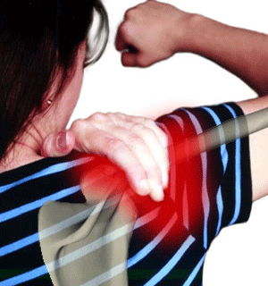
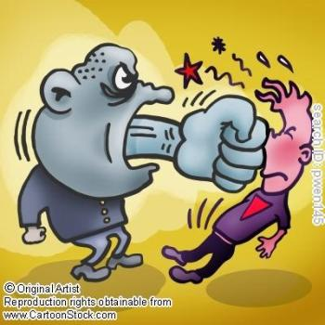

Deciding what the Plan is all about
Threats
Why identify causes?
PROBLEM
Shoulder pain
Being hit
Swimming
CAUSE:
MANAGEMENT:
Avoid the person
Stop swimming
Notes:
Different causes require different management: We may suffer from shoulder-pain; this pain could come from being repeatedly hit / or from swimming. The way to manage the shoulder pain differs largely and could involve either avoiding someone aggressive around me or by me stopping to swim.

Slide 11
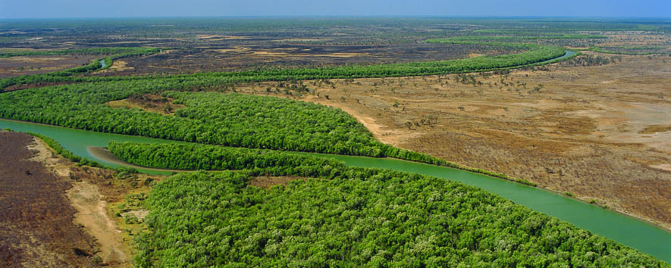
Target: River
Deciding what the Plan is all about
Threats
Example Problem
Attribute: Riparian Vegetation
Problem: Change to Riparian Vegetation
(Trampling / Erosion)
Cause: Cows in the River (Feral Animals)
Notes:
Here are now all elements together in one slide: target, attribute, problem and cause.

Slide 12
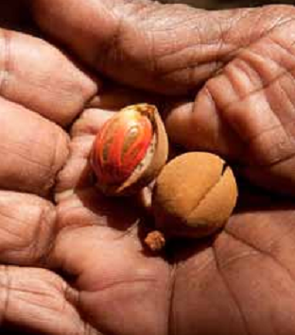
Target: Cultural Knowledge
Deciding what the Plan is all about
Threats
Example Problem
Attribute: Transmission of Cultural Knowledge
Problem: Lack of transmission of Cultural Knowledge
Cause: Lack of access to country
Notes:
Here are now all elements together in one slide: target, attribute, problem and cause.

Slide 13
Deciding what the Plan is all about
Problems & Causes
Overview presentation
What are Problems and Causes?
Prioritising Threats by ranking Problems and Causes
Alternative Approaches
Additional Resources & Exercise
Notes:
Now that problems and causes are identified we move on to the second step of this planning phase: prioritising threats by ranking problems and causes.
This will help the project to foremost work on priority threats before spending time and resources on low-ranked threats.

Slide 14
Deciding what the Plan is all about
Problems & Causes
Ranking
How bad and area of damage reasonably expected within 10 years under current circumstances
Amount of Damage (Scope)
Very widespread —everywhere the target is
Widespread
More local
Very local
How bad (Severity)
    Destroy or eliminate
    Seriously degrade
    Moderately degrade
    Slightly impair
Very High
High
Medium
Low
Very High
High
Medium
Low
Is it Fixable (Irreversibility)
  Not fixable, for all intents and purposes
  Fixable but really expensive
  Fixable with reasonable commitment of resources
  Easily fixable at relatively low cost
Very High
High
Medium
Low
Notes:
There are different ways to rate and rank threats. We will show others later on, but the general approach in workshops is ranking the amount of damage (the scope), the severity and the irreversibility of a Threat / Problem:
When assessing and ranking threats we look generally from present day time about 10 years into the future. Under current circumstances what damage can be expected within 10 years.
It is important to note, that we are not considering the past impact. Past impact of threats is already reflected in a lower health rating of a target and is NOT considered again in the threat rating.
When we look at severity of a threat we look at how bad the threat affects the target: will it destroy the target or – on the other side of sequence only slightly impair a target. E.g. in our example – land-clearing alongside the river has the ability to destroy riparian vegetation. Invasive Animals may seriously degrade the riparian vegetation, while invasive plants only slightly impair the target.
The scope of a problem / threat is how much of the target the threat is affecting. Is the damage across all occurrences of a target or only very localised? E.g. Feral Animals may only affect one pastoral lease along the lengths of the river, while some of the invasive plants have spread with the current of the river along the entire lengths of the river.
The third rating criteria is addressing the question whether a problem is fixable – or irreversible. In our example the damage from cattle may be relatively easily fixable by installing fences, maybe it requires more commitment and the installation of alternative watering points. A threat is generally not fixable when it leads to total destruction of a target – e.g. the conversion of a wetland into a residential zone – or the destruction of a cultural site by e.g. a mine.

Slide 15
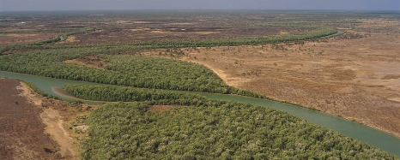
Target: River
Deciding what the Plan is all about
Problems & Causes
Example Problem
Attribute: Riparian Vegetation
Problem: Change to Riparian Vegetation
Causes | Amount | How bad | Fixable | Total
Invasive Animals | 2 | 2 | 2 | 8
Invasive Plants | 1 | 2 | 3 | 6
Land Clearing | 1 | 4 | 4 | 16
Rank | Score
Low | 1 - 12
Medium | 13 - 24
High | 25 - 36
Very High | 36 - 64
Notes:
In a workshop environment projects would draw similar tables as this one where a figures from 1 (the lowest) to 4 (the highest) represent the rating from the previous slide. To calculate the threat-rank, each cell is multiplied.
Comparing for this example the 3 threats, land clearing is the highest threat – invasive animals having a lesser impact and invasive plants the least impact.
In reality for a project this would mean to firstly mitigate land clearing – by avoiding it all together, and managing cattle in the river prior to committing many resources to invasive plant management.
What has been done in this table for 3 threats for one target has to be done for all targets and all threats that are linked to targets through their stresses.

Slide 16
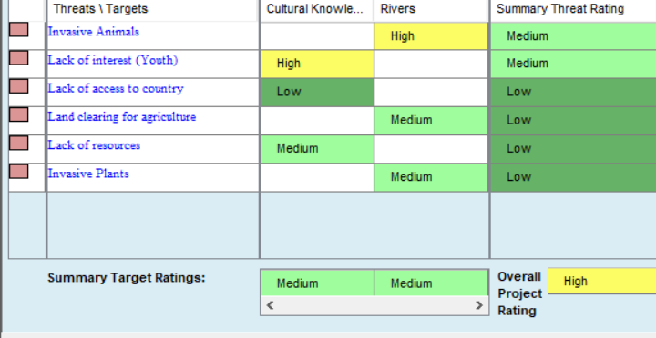
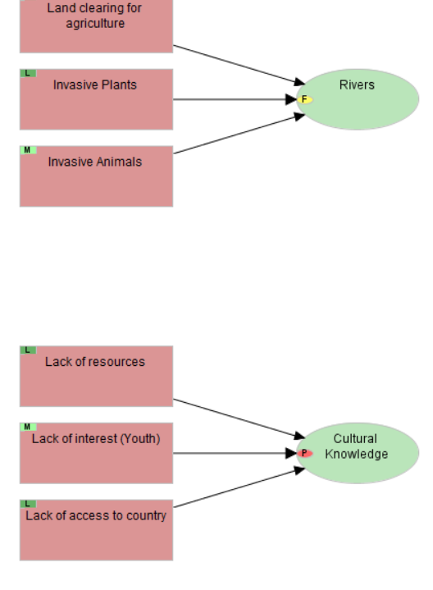
Deciding what the plan is about
Problems & Causes
Example in Miradi
Miradi Diagram View:
Causes (Threats) linked to Targets
Miradi Threat Rating View:
Summary table that shows impact of threats on targets
Notes:
In the diagram view of Miradi we link direct threats to targets – in our example a selection of threats affecting the target river and a selection of threats affecting cultural knowledge. This is only an example and not meant to be an exhaustive list of threats.
Either using the Stress-Based or the Simple-Threat Rating, Miradi then aggregates a ranked summary threat table that shows how threats affect targets.

Slide 17
Deciding what the Plan is all about
Problems & Causes
Final Product: Summary Threat Table
Notes:
The total of a threat-rank in Miradi is not displayed with a number how it is calculated in a workshop, but Miradi refers instead to a low, medium, high or very high threat rank.
This table shows the targets of a project as columns and all threats as rows. Each cell with a threat rank identifies firstly that a threat affects a target – and the rank shows the strength of the impact. Cells that are “clear” are not linked – not all threats will apply to all targets. Some threats are very specified and may only apply to one target.
Miradi then calculates the threat rank of each individual cell up to an overall threat rank (the last column) of this table. Threats are then sorted by their threat rank.
AS well interesting on this table is the bottom row of the table – how much a target is overall impacted by a range of threats. Later on in the planning process we need to ensure that goals, strategies and actions address those targets that have a “high” or “very high” threat rank.

Slide 18
Deciding what the Plan is all about
Problems & Causes
Overview presentation
What are Problems and Causes?
Prioritising Threats by ranking Problems and Causes
Alternative Approaches
Additional Resources & Exercise
Notes:
As previously mentioned, ranking threats by scope, severity and irreversibility is only one way to rank threats – in this part of the presentation we look at other ways to rank threats.

Slide 19
Deciding what the Plan is all about
Approach # 1
Ranking Problem and Cause
Problems & Causes
How bad and area of damage reasonably expected within 10 years under current circumstances
Amount of Damage (Scope)
    Very widespread —everywhere the target is
    Widespread
    More local
    Very local
Very High
High
Medium
Low
How badly Damaged (Severity)
    Destroy or eliminate – where it operates
    Seriously degrade
    Moderately degrade
    Slightly impair
Very High
High
Medium
Low
Notes:
This version splits the ranking into two stages:
First Problem is ranked – the scope of the problem – how much of the target it affects;
Secondly how badly the problem damages the target.

Slide 20
Deciding what the Plan is all about
Threats
Approach # 1
Ranking Problem and Cause
Contribution – how much of the problem does it cause
    Very large contributor
    Large
    Moderate
    Low
Very High
High
Medium
Low
Fixable -- Can the problem this cause creates be fixed?
    Not fixable, for all intents and purposes
    Fixable but really expensive
    Fixable with reasonable commitment of resources
    Easily fixable at relatively low cost
Very High
High
Medium
Low
Notes:
In a second step the cause is ranked:
First the contribution of the cause to the problem is assessed
Secondly the irreversibility of the threat is considered.
This ranking approach differs from the approach previously shown, by explicitly assessing the contribution of a cause to a problem. It may be a more suitable approach when a project encounters a long list of causes to a limited number of problems and needs to determine the most significiant threats that contribute to an issue.

Slide 21
Deciding what the Plan is all about
Problems & Causes
Hints
Encourage teams to refer often to the definitions of Very High, High, Medium, and Low to ensure consistency
Teams often over-rank future threat by letting current condition creep into their consciousness; this is already accounted for in a “Poor” or “Fair” Viability rank
Probe for specificity of High-ranked direct threats
  sooner or later the devil will be in the details
Another test to consider for stress-based rankings...
  A “Very High” stress should reduce a key attribute to “Poor”
  A “High” stress should reduce a key attribute to “Fair”
Notes:
The first time around workshop participants still have to translate in their heads what a low, or high rating means, but the more often terms are utilised the more consistent the application of the terms is and the easier the communication about the project.
In a workshop setting, write out the rating guide or use instead icons that represent the rating categories.

Slide 22
Deciding what the Plan is all about
Problems & Causes
Overview presentation
What are Problems and Causes?
Prioritising Threats by ranking Problems and Causes
Alternative Approaches
Additional Resources & Exercise

Slide 23
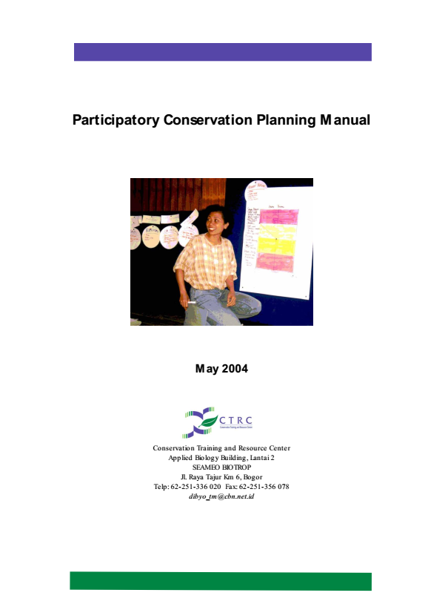
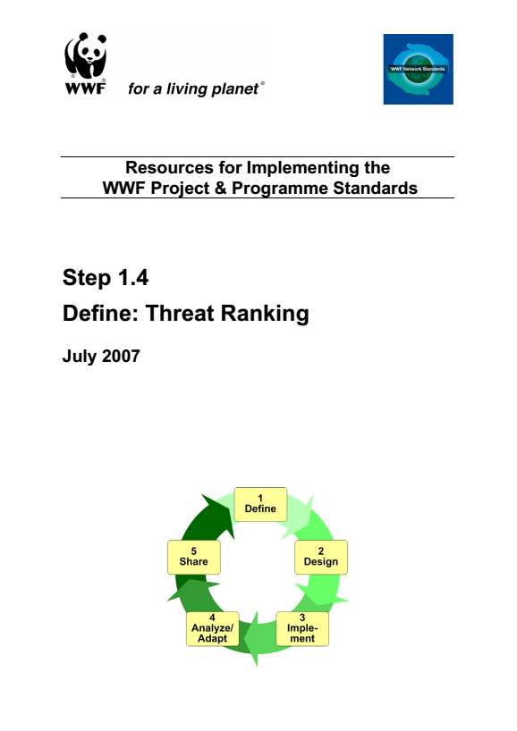
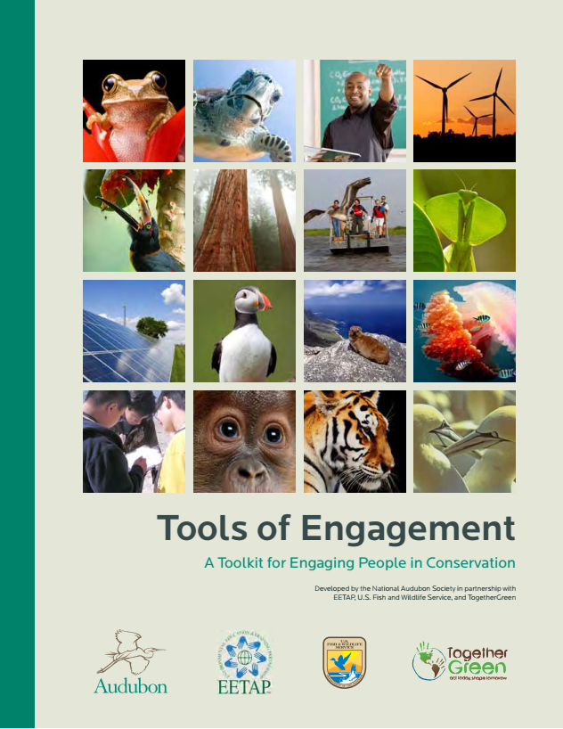
Deciding what the Plan is all about
Problems & Causes
Additional Sources

Slide 24
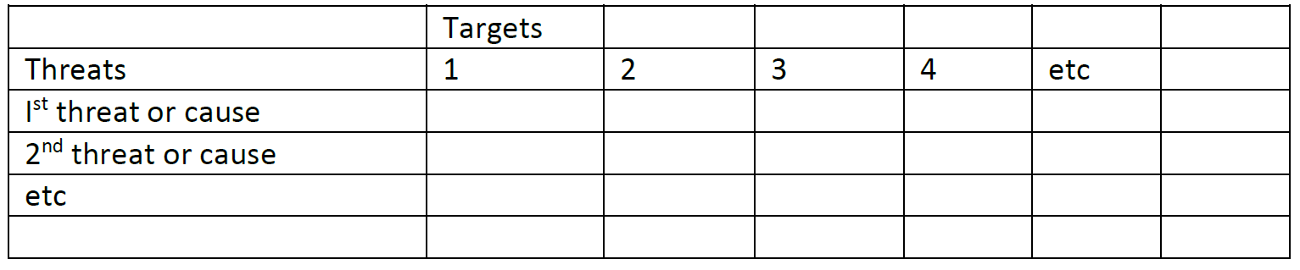
Deciding what the Plan is all about
Problems & Causes
Work Shop Exercise
SUMMARY: This exercise is about keeping it simple and minimising the steps to get to the completion of a rough first cut of a targets and threats table – bit like speed dating for targets and threats.
OBJECTIVE: To identify and prioritise the threats affecting our two targets.
INSTRUCTIONS: Work in your groups to develop and rank threats to your targets to complete the threat table:
For each target brainstorm the problems that may impact the health (use cards or flip-chart)
For each target brainstorm the causes of the problem. The causes are your threats.
Put threats and targets into a table:
Rank threats using table in workbook to decide: Amount of damage / How badly damaged / Fixable scores;
Use Ranking guideline to assign category (very high, high, medium, low) to each of the individual threat/target-links
Notes:
We anticipate for this exercise a time of 45 minutes

Slide 25
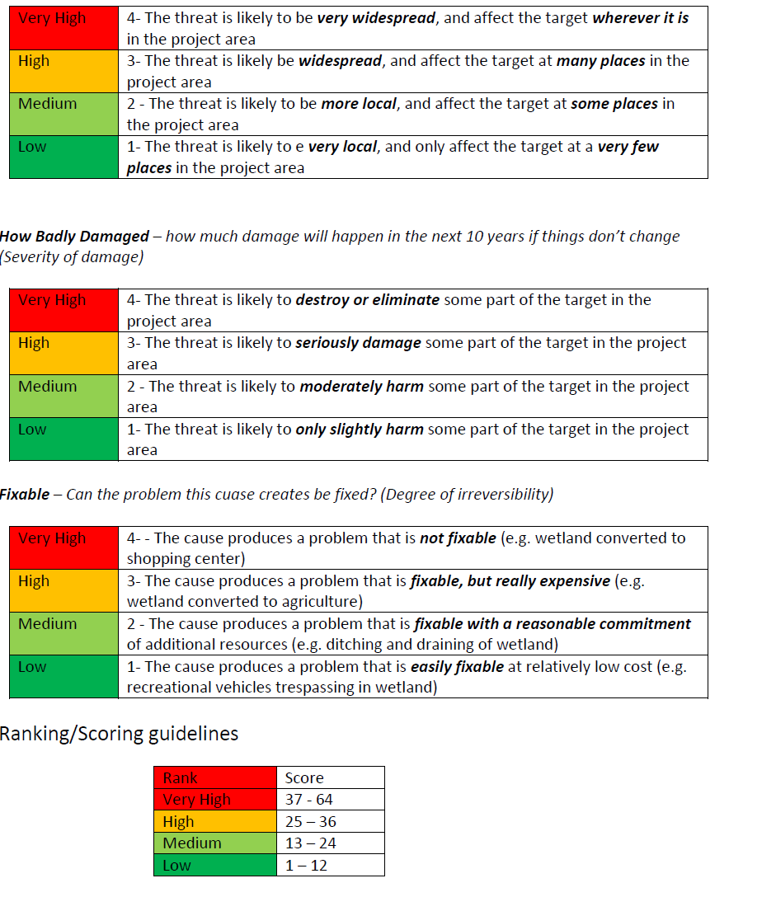
Deciding what the Plan is all about
Problems & Causes
Ranking Guidelines in Workbook

Slide 26

Attribution
Product of the Conservation Coaches Network, 2019
These presentations were adopted of materials from members of the Conservation Coaches Network.
CCNet strongly recommends that this presentation is given by experts familiar with the adaptive management process presented by the Conservation Measures Partnership’s Open Standards for the Practice of Conservation / Community of Practice – Indigenous OS projects and OS projects on Indigenous Land and Waters.
You are free to share this presentation and adapt it for your use. Please attribute the work to CCNet. If you significantly alter, transform, or build upon this work, it may be appropriate to remove the HCP logo.
Notes:
Version 3.0 was published in April 2013 and was a joint effort between many individuals and organizations.

