Slide 1
Situation Analysis
Understanding the Context for Strategy Development
Notes:
*Note: This presentation can be shortened by focussing on the following pages: 6, 7, 12, 13, 16;

Slide 2
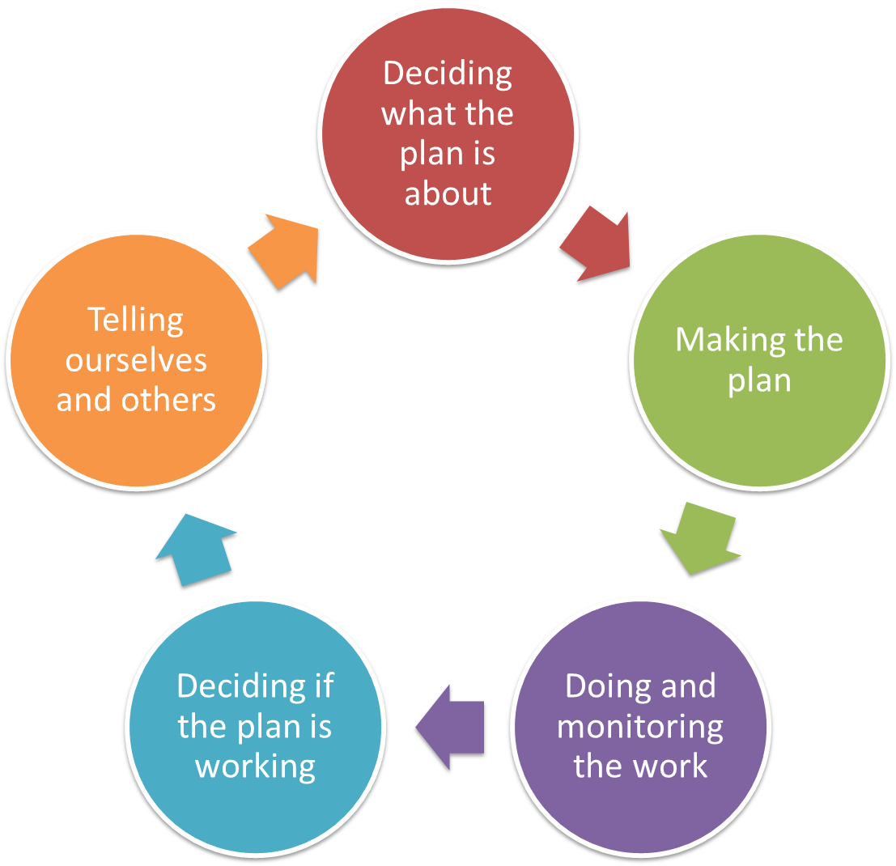
Deciding what the Plan is all about
Situation Analysis
Overview
Pre-planning
Dream & Area
Targets & Health
Problems & Causes
Situation Analysis
In the Open Standards “Situation Analysis” refers to “Conceptual Models”
Notes:
This is the last step of “Deciding what the plan is about” In the Situation Analysis we combine the thinking from the previous steps to draw a picture / conceptual model of the situation of the conservation project.
In the Open Standard this step is referred to sometimes as well as Conceptual Models

Slide 3
Deciding what the Plan is all about
Overview presentation
Situation Analysis
Why doing a Situation Analysis
How to do a Situation Analysis
Example and Tips
Stakeholder Analysis
Resources for this step
Notes:
This presentation first looks at why a situation analysis is helpful, then we explain how to undertake a situation analysis, followed by examples and tips. Building on the Situation Analysis it is helpful to undertake a stakeholder analysis – this step explains how.

Slide 4
Deciding what the Plan is all about
Situation Analysis
Identifying who / what causes the problems
Why we do this step?
  Talking about the links between targets, threats, and the causes of those threats helps Strategies be more focused
  Using a diagram can help to explain to people how we see the things working, where key points for our strategies are, and can form the start of our later work making a road map.
Three Basic Questions for every threat:
  What is causing this thing to happen?
  Who is involved -- directly or indirectly (Stakeholders)?
  Why are they doing it (contributing factor)?
You must “analyse the situation” and probe for opportunities and not only threats to develop robust strategies.
Notes:
A situation analysis is often a diagram that links all the elements of the Healthy Country Plan – target, problems, causes and contributing factors. Collating this information in this step is required for the project team to identify and formulate relevant strategies in step 8 based on the situation analysis.
The situation analysis constitutes as well the basis for road maps that are developed later on.
It is really easy to over-complicate this step – keep it simple

Slide 5
Deciding what the Plan is all about
Overview presentation
Situation Analysis
Why doing a Situation Analysis
How to do a Situation Analysis
Example and Tips
Stakeholder Analysis
Resources for this step

Slide 6
Deciding what the Plan is all about
Elements of a Situation Analysis
Situation Analysis
Healthy Country Planning Steps
Step 6 & 8
Step 6
Step 5
Step 4 & 5
Step 3
Indirect Threat
Target
Strategy
changes
Cause
causes
Stress
affects
Opportunity
Contributing
Factor
Direct Threat
Notes:
Most of the information from previous steps is required to undertake a situation analysis.
Generally you begin by picking a target (identified in step 3)
The stress of a target relates back to KEA of a target (step 4).
The previous HCP step, (step 5) identified the causes;
Firstly in this step we collate the information from step 3-5, but here try and identify the contributing factors – the indirect threats that contribute to the cause of a threat or opportunities that will support mitigating a threat – and who the drivers (stakeholders) behind those contributing factors are.
Often these contributing factors become the pressure points to which we apply the strategies we develop in Step 8. When we ask the Question: “What is causing the direct threat occur to our target?” we try to arrive at the root-problem.
Step 6 (this step) provides the first opportunity to brainstorm strategies while in Step 8 Strategies are properly developed and then ranked.

Slide 7
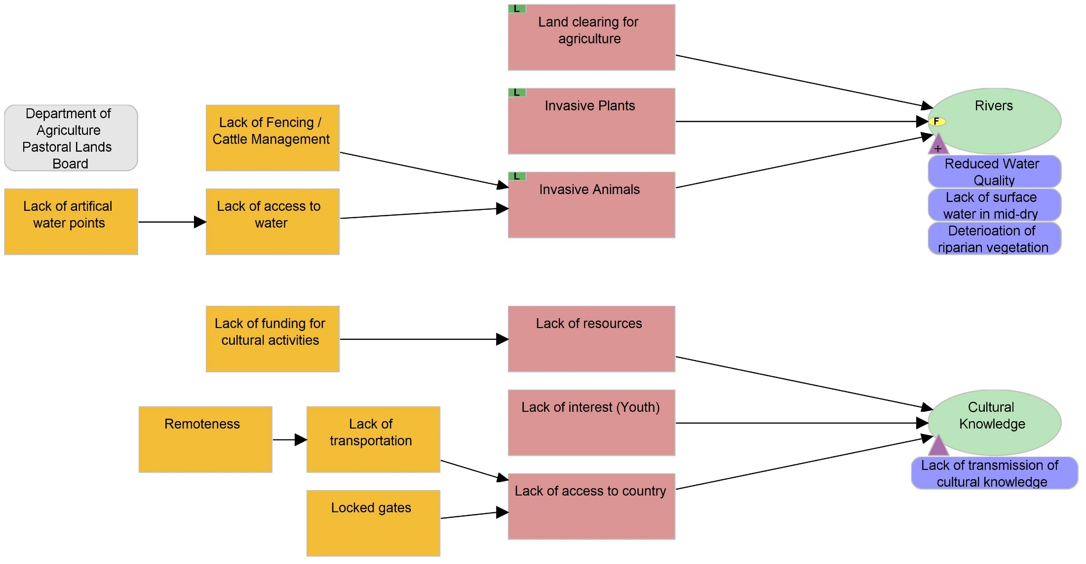
Deciding what the Plan is all about
Situation
Using a Box and Arrow Diagram
What is causing
this threat?
Threat
Contributing Factor
Target
Who is
involved?
Who else cares?
Notes:
Content is more important than format. The quality of a conceptual model is only as good as the quality of a project team’s understanding of the situation. A good conceptual model will greatly facilitate strategy selection.
A good conceptual model contains the target condition on one side, and a number of factors (problems and causes) and strategies linked to this target condition.
First we create a Initial Conceptual Model, which describes the site’s target condition, factors (stresses and sources) and relationships prior to the start of you project. Later we will add project strategies (including goals and objectives) to come up with your Project Conceptual Model.

Slide 8
Deciding what the Plan is all about
Situation Analysis
Identifying who causes the problems
There is no one right way…
Some teams use box & arrow diagrams
But everyone uses probing questions
Situation diagramming is a way of capturing a the thinking behind a project
Notes:
A box and arrow diagram can be powerful to visualise complex situations. The wider the field of targets / threats the more likely a box and arrow diagram will help to keep a record of connections and linkages.

Slide 9
Deciding what the Plan is all about
Overview presentation
Situation Analysis
Why doing a Situation Analysis
How to do a Situation Analysis
Example and Tips
Stakeholder Analysis
Resources for this step

Slide 10
Deciding what the Plan is all about
Situation
Example
Stick the threats up on the wall / tarp, one at a time, and link them to the targets they most impact.
Use threats that have a direct impact.
Now add new cards describing who or what is causing the threats
Look for key influence, links etc, as well as review previous work for low viability or high threat

Slide 11
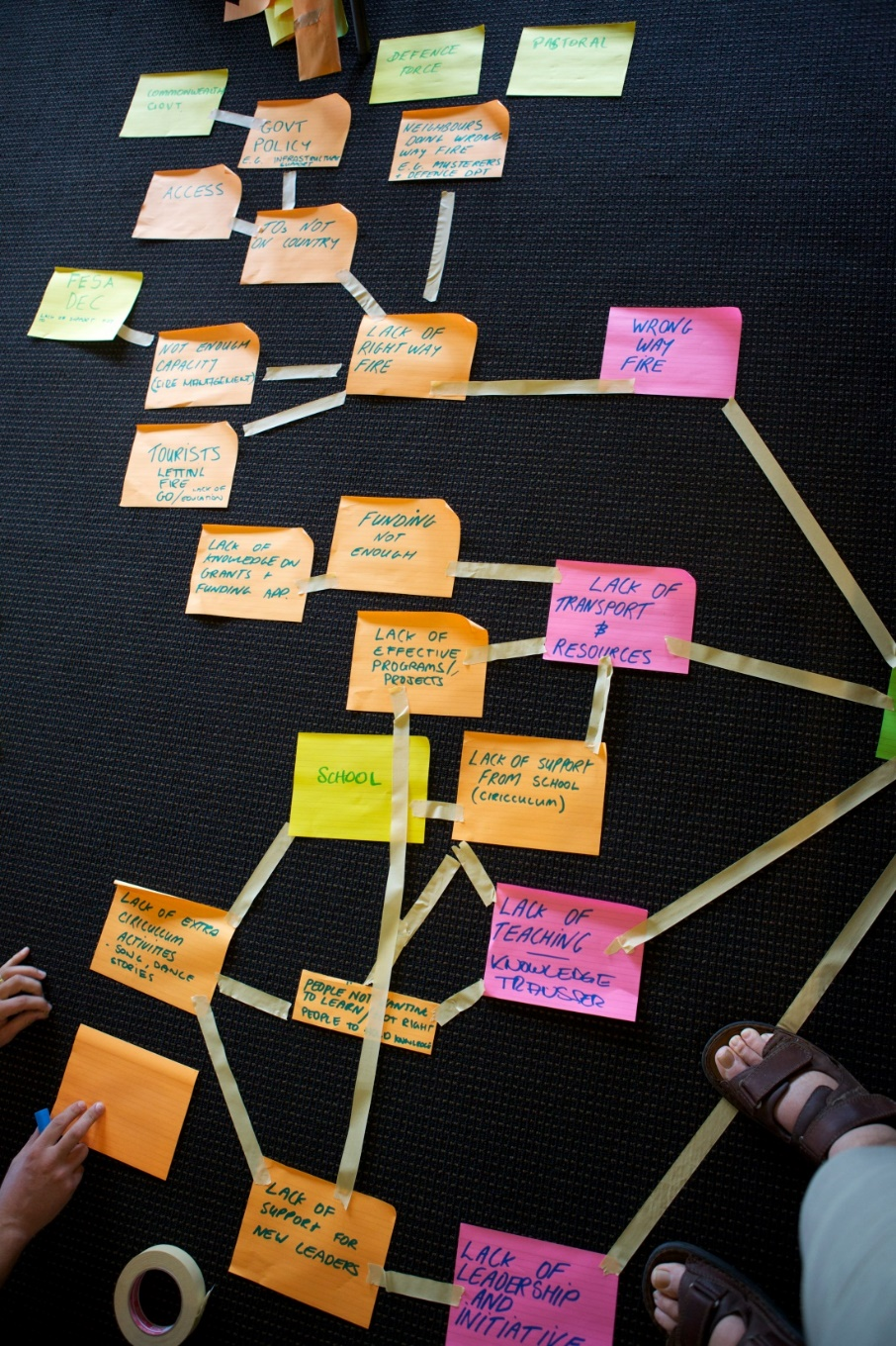
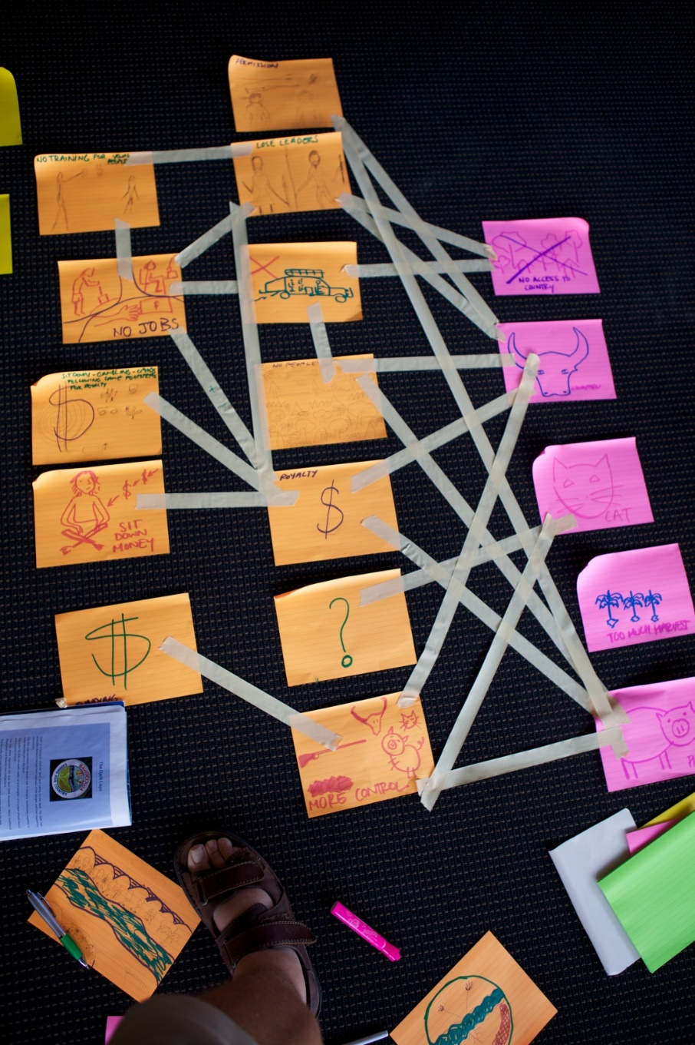
Deciding what the Plan is all about
Situation Analysis
Workshop examples
Notes:
Some people use walls, others room dividers or sticky tarp – there are different solutions depending on the circumstance.
For some audiences, it is appropriate to write out the elements of a situation analysis, in other situations you may have to use icons to ensure the workshop is accessible for everyone.

Slide 12
Deciding what the Plan is all about
A couple of tips
Situation Analysis
Making a situation diagram is a very hands-on activity
It involves creating a picture of the links between the Targets, their immediate threats, and the causes of those threats
You can do this with the whole group if there are not many targets, but if there are a lot break it up
Too much detail can make a conceptual model into a spaghetti-mess (<10 threats / <25 factors).
Notes:
You have seen from previous photos, a conceptual model for an entire project can become easily overwhelming.
Focus on key threats in the workshop.
After you have taken a photo from the workshop output from this exercise, transcribe into Miradi using the Diagram view.
Here you can start including other “lower” ranking threats that have not been yet actively workshopped.

Slide 13
Deciding what the Plan is all about
A couple of tips
Situation Analysis
This is an iterative process, so the team can (and SHOULD!) change their model as new or different information becomes available.
Best to analyse one target and high-ranked threat at a time to identify the contributing factors of a threat are.
Use Probing Questions (Why?)
Ensure to capture factors that contribute to more than one threat or target
Probe for opportunities not only threats – these will inform the development of suitable strategies.
  Opportunity: factors independent of you that could contribute to reducing a threat;
  Strategy: actions you will take to e.g. reduce a threat
Notes:
For a facilitator it is important to plan across workshop days and sessions – it it helpful to have the conceptual model always handy to record assumptions and findings throughout the process. People will come back to the conceptual model many times over the time of a planning process.
Once a target/threat has been worked on, look first for targets that are similar (ecology / culture) or affected by similar threats.
Once a cluster has been discussed ensure all information has been recorded (photo / Miradi), it may be necessary to clean the wall for the next set of targets and threats;

Slide 14
Deciding what the Plan is all about
Hints
Situation Analysis
Preparing (before you get together):
Involving the right people is KEY. To develop robust strategies in Step 8, you must have knowledgeable people involved who can help you to understand what factors are driving the current situation
This step should be given enough time so that your team can adequately understand key issues for strategy development. This may involve more than one round of discussion, so plan accordingly.
Notes:
The Situation Analysis is used to develop the right set of robust strategies.
When developing a situation analysis ensure that the right mix of people is involved who know about implementation as much as the wider context as well.

Slide 15
Deciding what the Plan is all about
Reflect on the discussion
Situation Analysis
Does the situation analysis focus on the factors contributing to critical threats and/or targets with impaired viability?
Have all relevant types of factors been considered? (e.g., economic, political, cultural, institutional)
Have inconsequential, irrelevant or redundant factors been excluded?

Slide 16
Deciding what the Plan is all about
Overview presentation
Situation Analysis
Why doing a Situation Analysis
How to do a Situation Analysis
Example and Tips
Stakeholder Analysis
Resources for this step

Slide 17
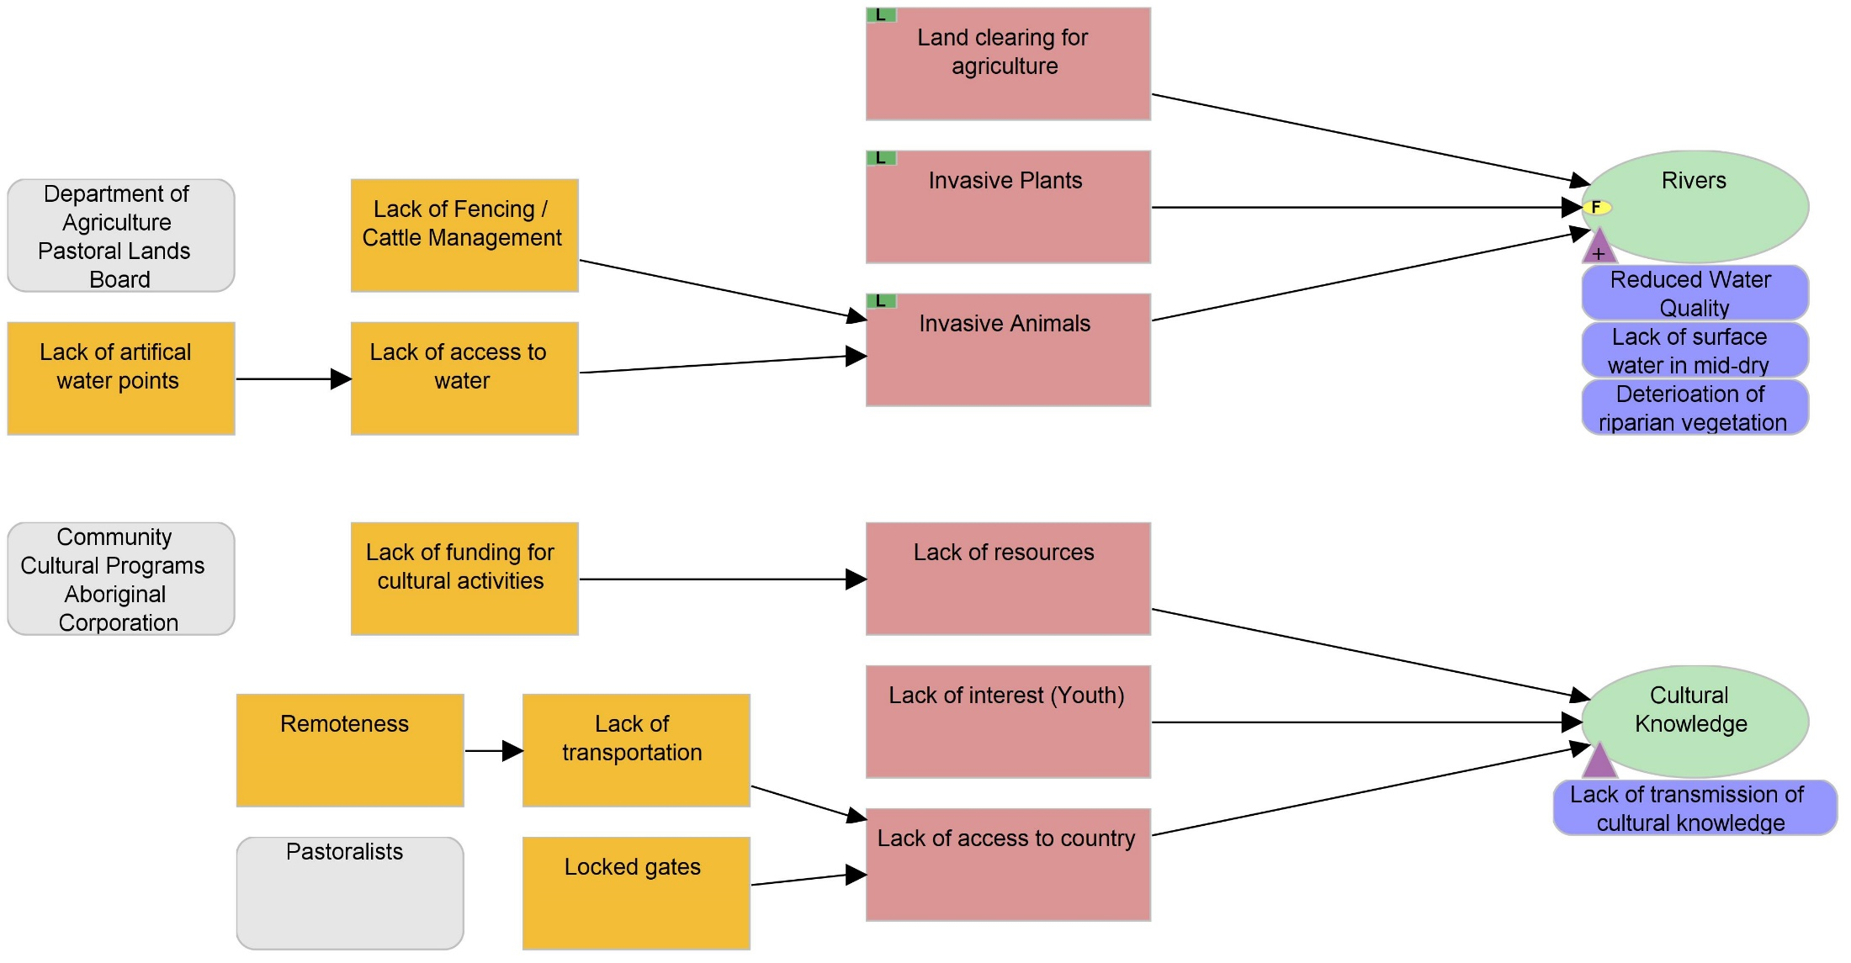
Deciding what the Plan is all about
Situation
Identifying who causes the problems
Who are the key stakeholders with vested interest in the project, what factors are driving critical threats, and what opportunities exist?

Slide 18
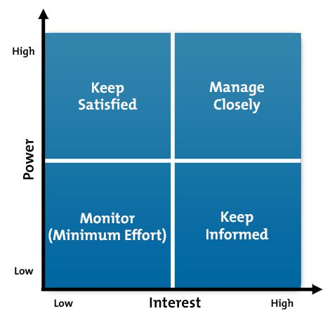
Deciding what the Plan is all about
Stakeholder Analysis
Situation Analysis
High power, less interested people (Keep Satisfied): put enough work in with these people to keep them satisfied, but not so much that they become bored with your message.
High power, highly interested people (Manage Closely): you must fully engage these people, and make the greatest efforts to satisfy them.
Low power, less interested people (Monitor): again, monitor these people, but don’t bore them with excessive communication
Low power, highly interested people (Keep Informed): adequately inform these people, and talk to them to ensure that no major issues are arising. People in this category can often be very helpful with the detail of your project.
Notes:
Once you have completed the situation analysis you can look at your stakeholder list and think about how you might work with them
Power – How much influence does a stakeholder have; The power a stakeholder has to facilitate or impede the achievement of an activity’s objective. The extent to which the stakeholder is able to persuade or coerce others into making decisions, and following a certain course on action.
Interest – How much are the impacted by the project – how much do they have an interest for the project - The priority given to this topic / issue / problem;
If a 4 scale approach to rank stakeholders is preferred, the following categories for each axis apply:
No Power / Little Power / Some Power / Significant Power; No interest / Little Interest / Some Interest / Significant Interest
Manage closely – key player, focus effort on this group, involve in governance / decision making, engage and consult regularly;
Keep Satisfied – engage and consult on interest area, try to increase level of interest;
Keep informed – make use of interests in low-risk areas; keep informed and consult on interest area, potential supporter / goodwill ambassador;
Monitor – inform via general communication;
General Aim to move Keep Satisfied and Monitor across to right hand side;

Slide 19
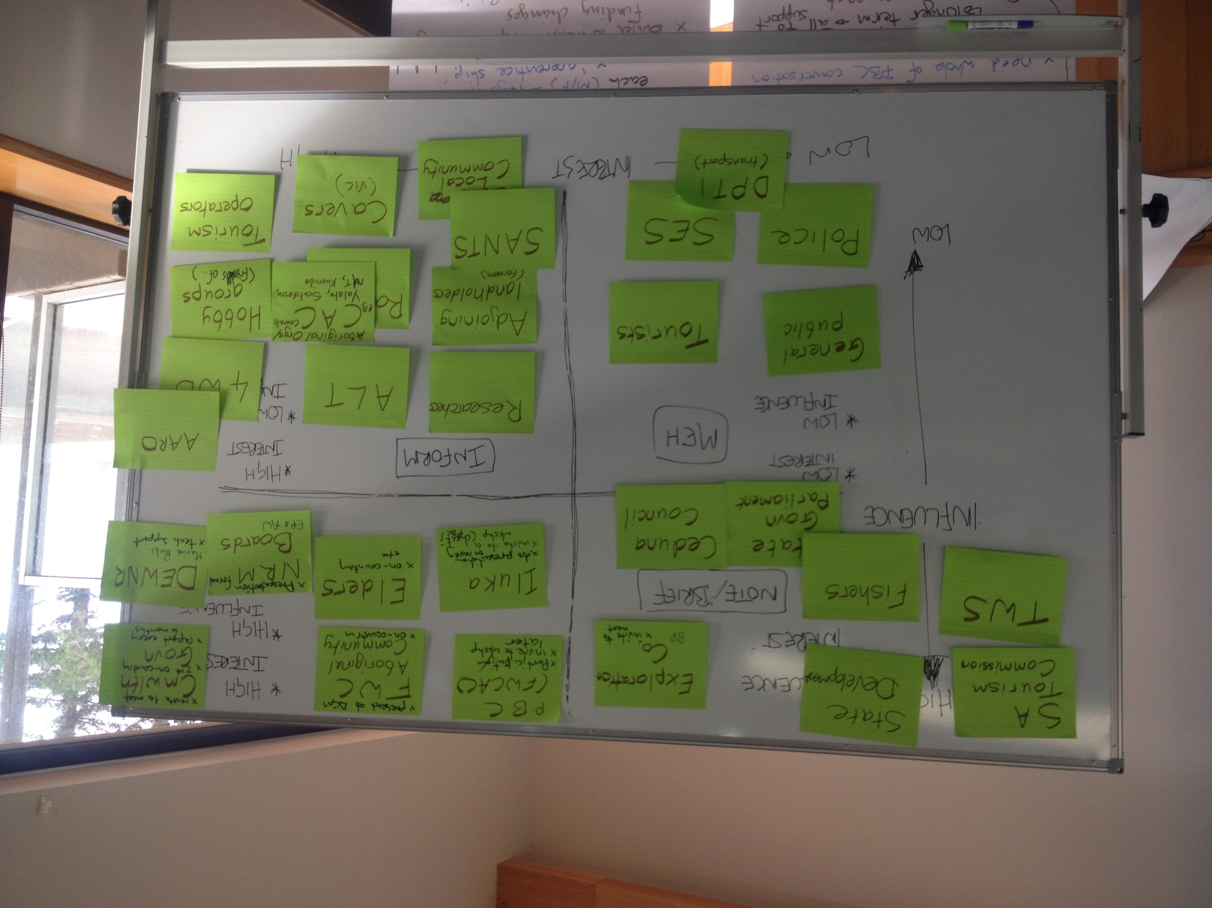
Deciding what the Plan is all about
Stakeholder Analysis in a workshop
Situation Analysis
Notes:
Depending on the group size, a stakeholder analysis can be undertaken on a white board, across a wall with masking tape to show the axis or by using a data-projector and sticky-notes on the projection.

Slide 20
Deciding what the Plan is all about
Overview presentation
Situation Analysis
Why doing a Situation Analysis
How to do a Situation Analysis
Example and Tips
Stakeholder Analysis
Resources for this step

Slide 21

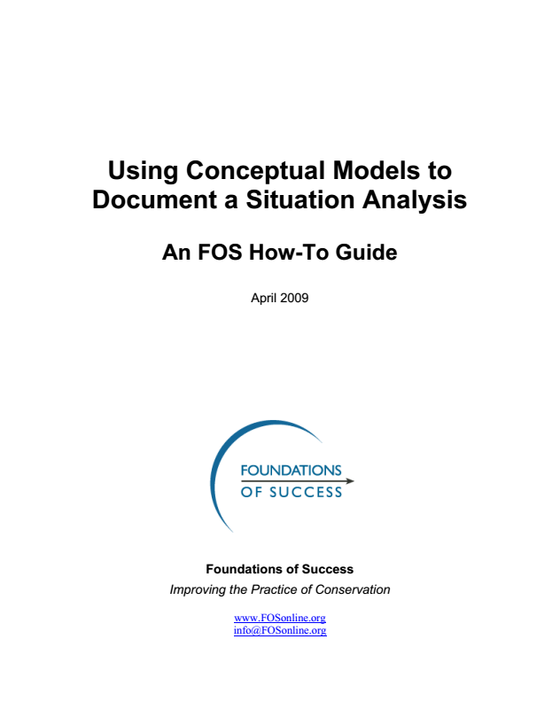
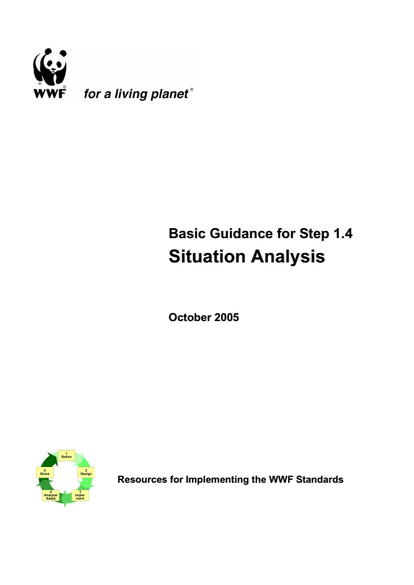
Deciding what the Plan is all about
Situation
Additional resources
Notes:
FOS How to guide break the process of developing a conceptual model down into 7 steps and give handy tips along the way on how to develop a situation analysis.

Slide 22
Deciding what the Plan is all about
Situation
Workshop Exercise
Completing a Situation Analysis:
Review previous work and select a priority threat;
Select all the targets affected by the threat;
Begin probing the situation:
  What is driving the threat?
  Who is really behind it?
  Why are they doing it?
Arrange target, threat, contributing factors in diagram (on wall / floor / butchers paper);
Time: 60 minutes

Slide 23

Attribution
Product of the Conservation Coaches Network, 2019
These presentations were adopted of materials from members of the Conservation Coaches Network.
CCNet strongly recommends that this presentation is given by experts familiar with the adaptive management process presented by the Conservation Measures Partnership’s Open Standards for the Practice of Conservation / Community of Practice – Indigenous OS projects and OS projects on Indigenous Land and Waters.
You are free to share this presentation and adapt it for your use. Please attribute the work to CCNet. If you significantly alter, transform, or build upon this work, it may be appropriate to remove the HCP logo.
Notes:
Version 3.0 was published in April 2013 and was a joint effort between many individuals and organizations.

