Slide 1
Other Support
When too much planning is not enough
Notes:
A strength of the Open Standards is the wealth of resources and networks that are associated with the Open Standards. In this presentation we give an overview of the different platforms to access support and further information.

Slide 2
Overview
Analog
  How-to Guides
  Standards
Desktop
  Excel Workbook
  Miradi Project Management
Cloud
  MiradiShare
  Conservation Gateway
  Online training
Crowd sourcing
  Coaches network
  FOS
  CMP
Other tools
  GIS / MARXAN
  INFERR / CSIRO
  I-Tracker

Slide 3
Analog
Notes:
With analog information we refer to literature – manuals and other publications – that guide and support the Open Standards.

Slide 4


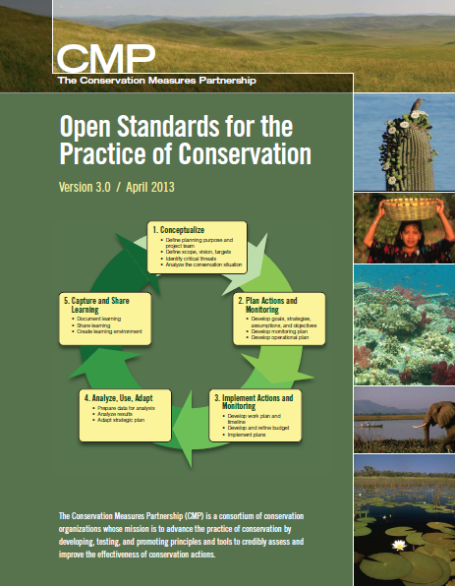
Open Standards
Notes:
The current version of the Open Standards for the Practice of Conservation is version 3.0 that has been released in April 2013 by the Conservation Measures Partnership (logos an example of members of the CMP)

Slide 5
Conservation Action Planning handbook
Notes:
The CAP Handbook is intended as a guidance resource to support the implementation of The Nature Conservancy's Conservation Action Planning (CAP) Process - a powerful instrument for helping practitioners get to effective conservation results.

Slide 6
Audubon
Tools of
Engagement
Notes:
The Audubon Tools of Engagement are published by the Audubon Society and are a step-to-step guide to planning that is based on the Open Standards. In addition the book contains a large depository of tools, cheat-sheets etc.

Slide 7
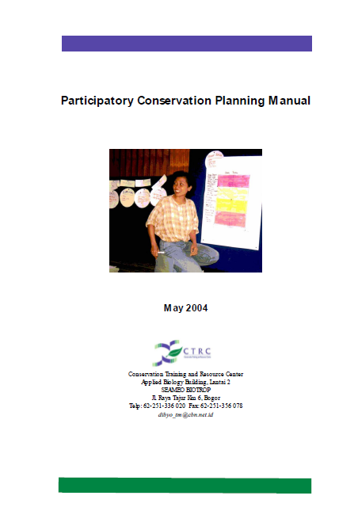
Participatory
Conservation
Planning

Slide 8
Desktop
Notes:
In the category of desktop solutions fall the software Miradi and the Excel-based Conservation Action Planning Workbook.

Slide 9
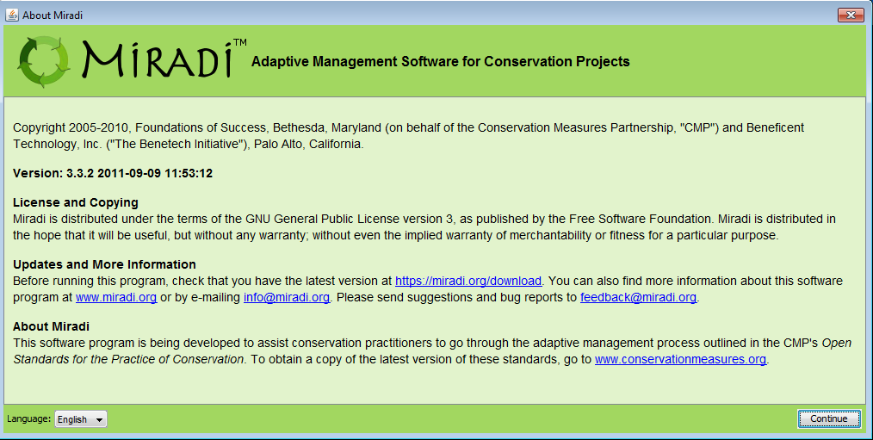
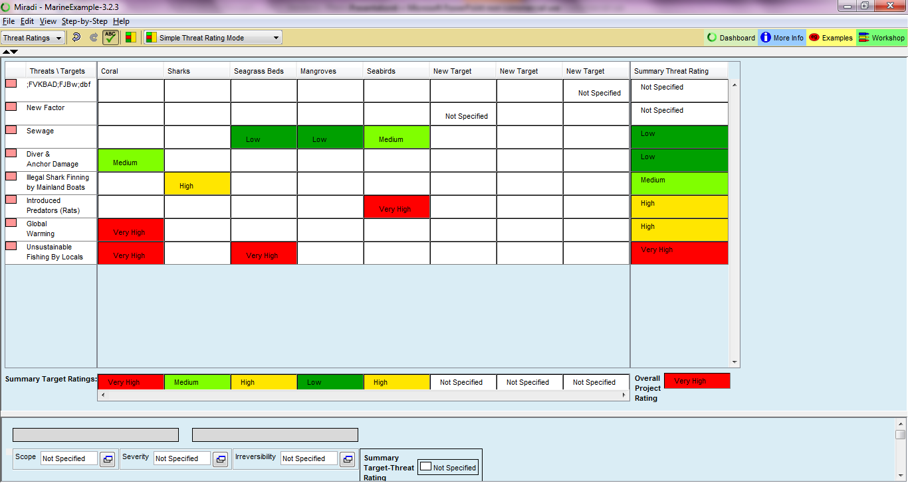
Miradi miradi.org
Notes:
The Miradi software program is a joint venture between the Conservation Measures Partnership (CMP) and Sitka Technology Group. Miradi is a user-friendly program that allows nature conservation practitioners to design, manage, monitor, and learn from their projects to more effectively meet their conservation goals, following a process laid out in the Open Standards for the Practice of Conservation.
You can download a 30-day trial version from their homepage or purchase annual individual or organizational licenses. There are many online resources (e.g. youtube channel, self-guided powerpoint manuals) that explains the functionality of Miradi in detail.

Slide 10
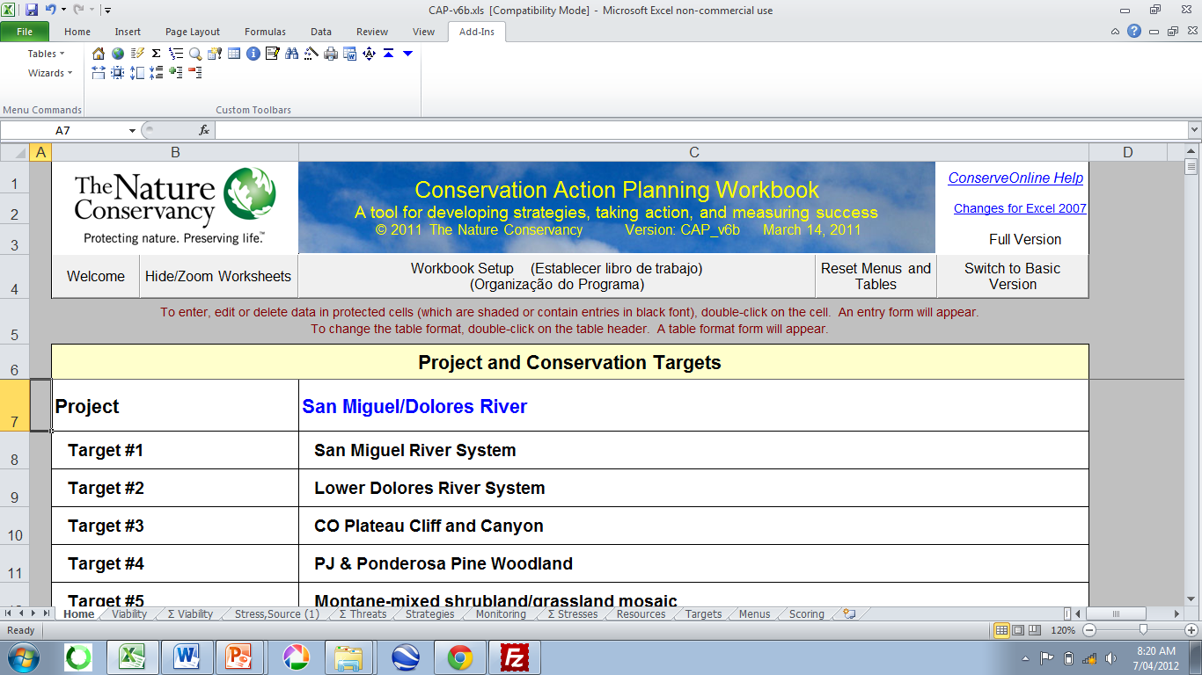
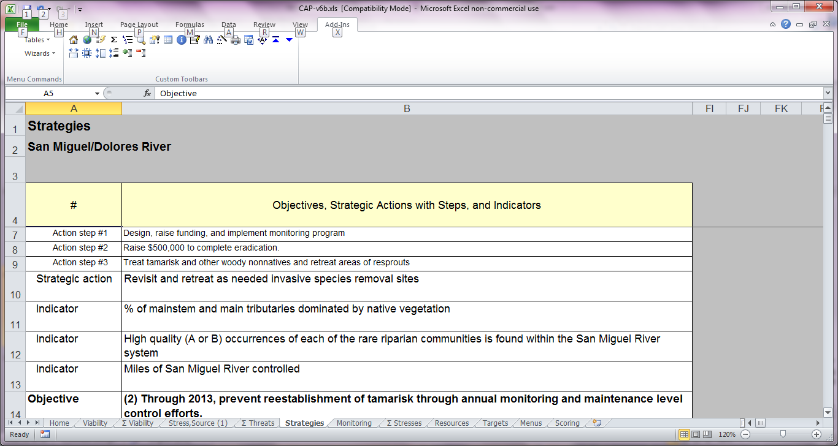
CAP Workbook www.conservationgateway.org/Documents/San%20Miguel%20CAP_v6b.zip
Notes:
While not currently supported, the CAP Workbook is a Excel Workbook. With the help of add-in wizards the user enters information from the HCP steps into the worksheet.
While not supported the tool (or steps of the tool) still are relevant (e.g. strategy rating / regional roll-up).

Slide 11
Web / Cloud

Slide 12
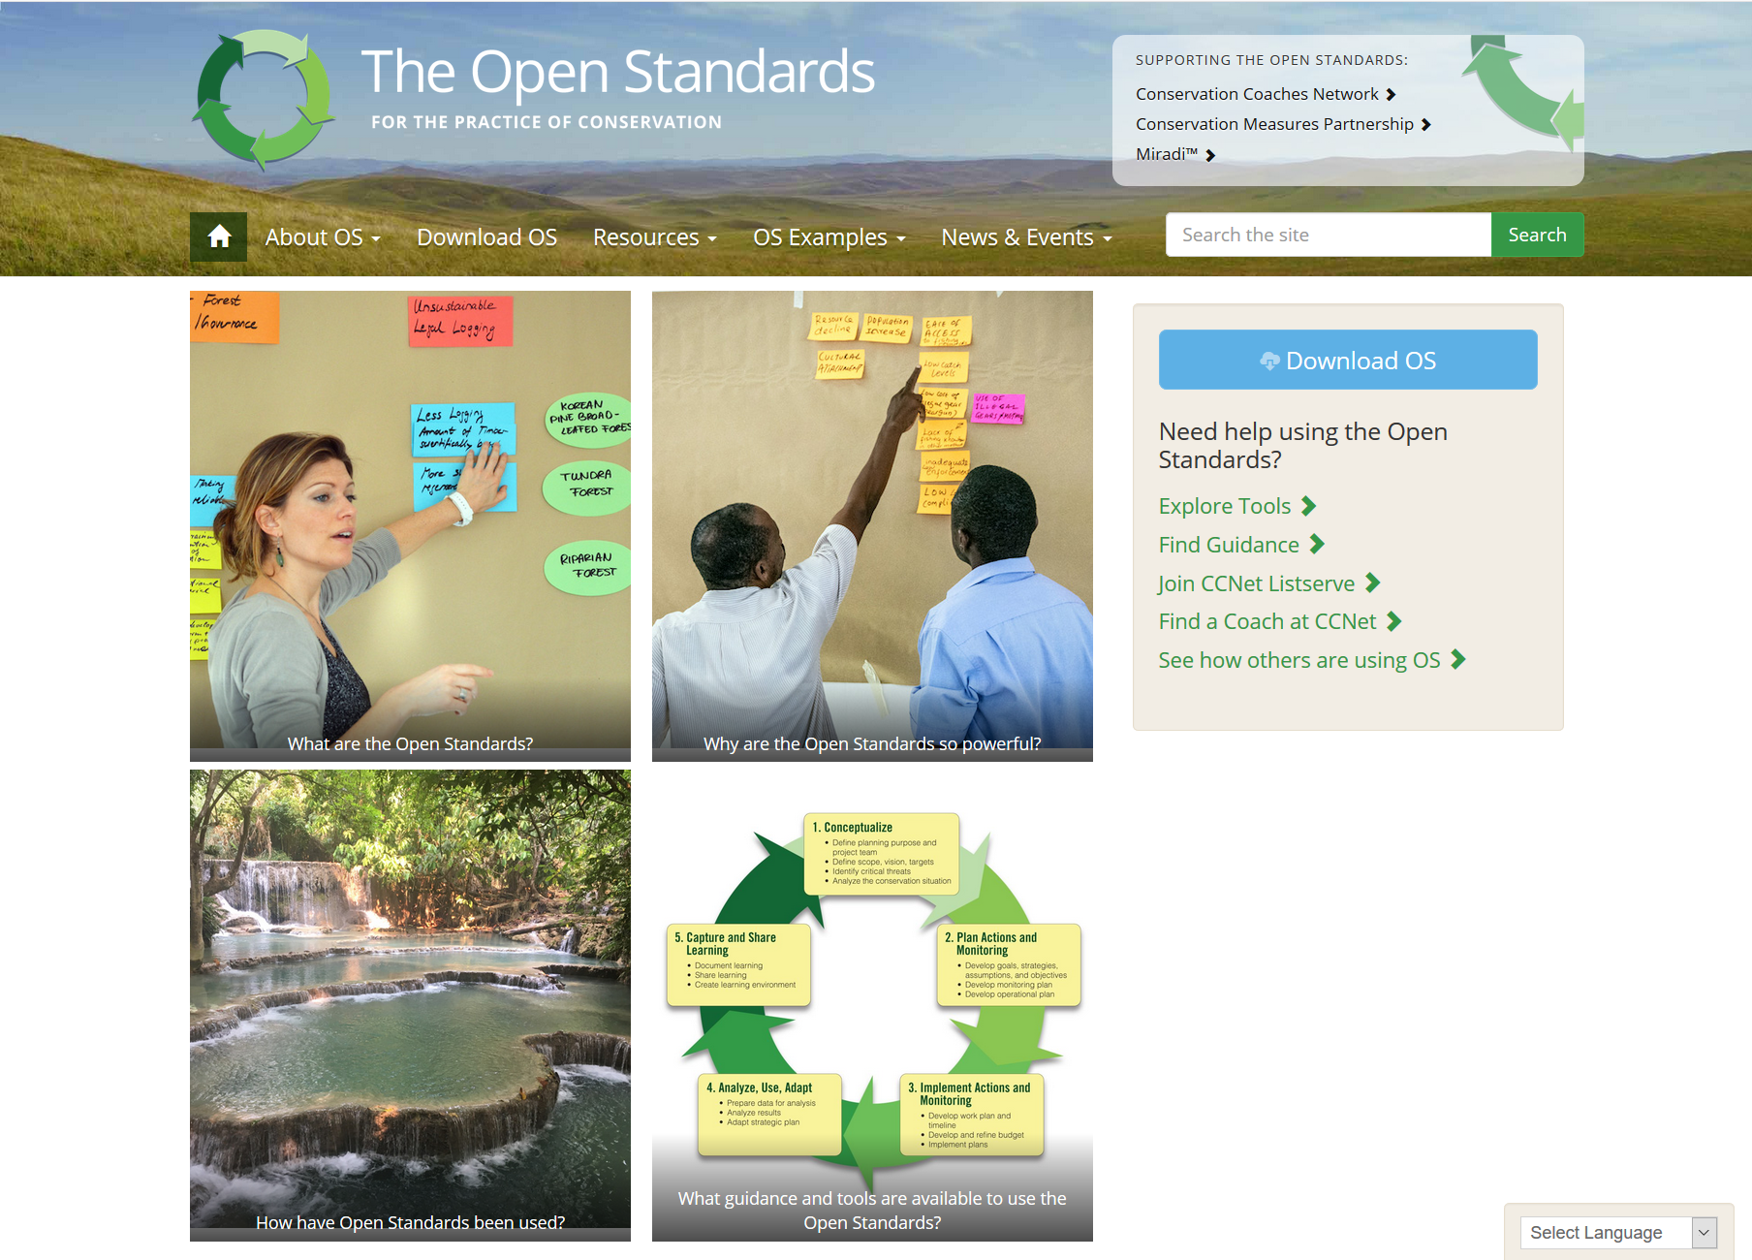
Open Standards www. cmp-openstandards.org
Notes:
The Open Standards website curates the best resources for guidance on implementing steps, tools to help use the OS and case studies. It is actively updated and also has links to many other resources.

Slide 13
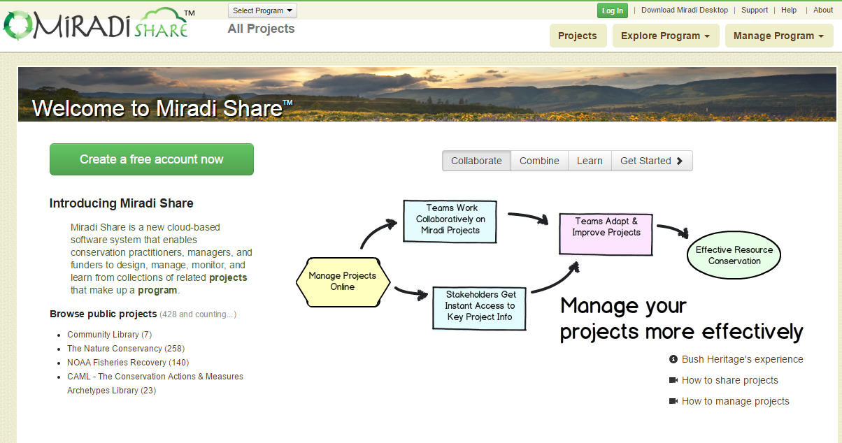
MiradiShare www.miradishare.org
Notes:
Miradi Share is a new cloud-based software system that enables conservation practitioners, managers, and funders to design, manage, monitor, and learn from collections of related projects that make up a program.
You have to sign up to create a Miradi Share account – worthwhile to have.

Slide 14
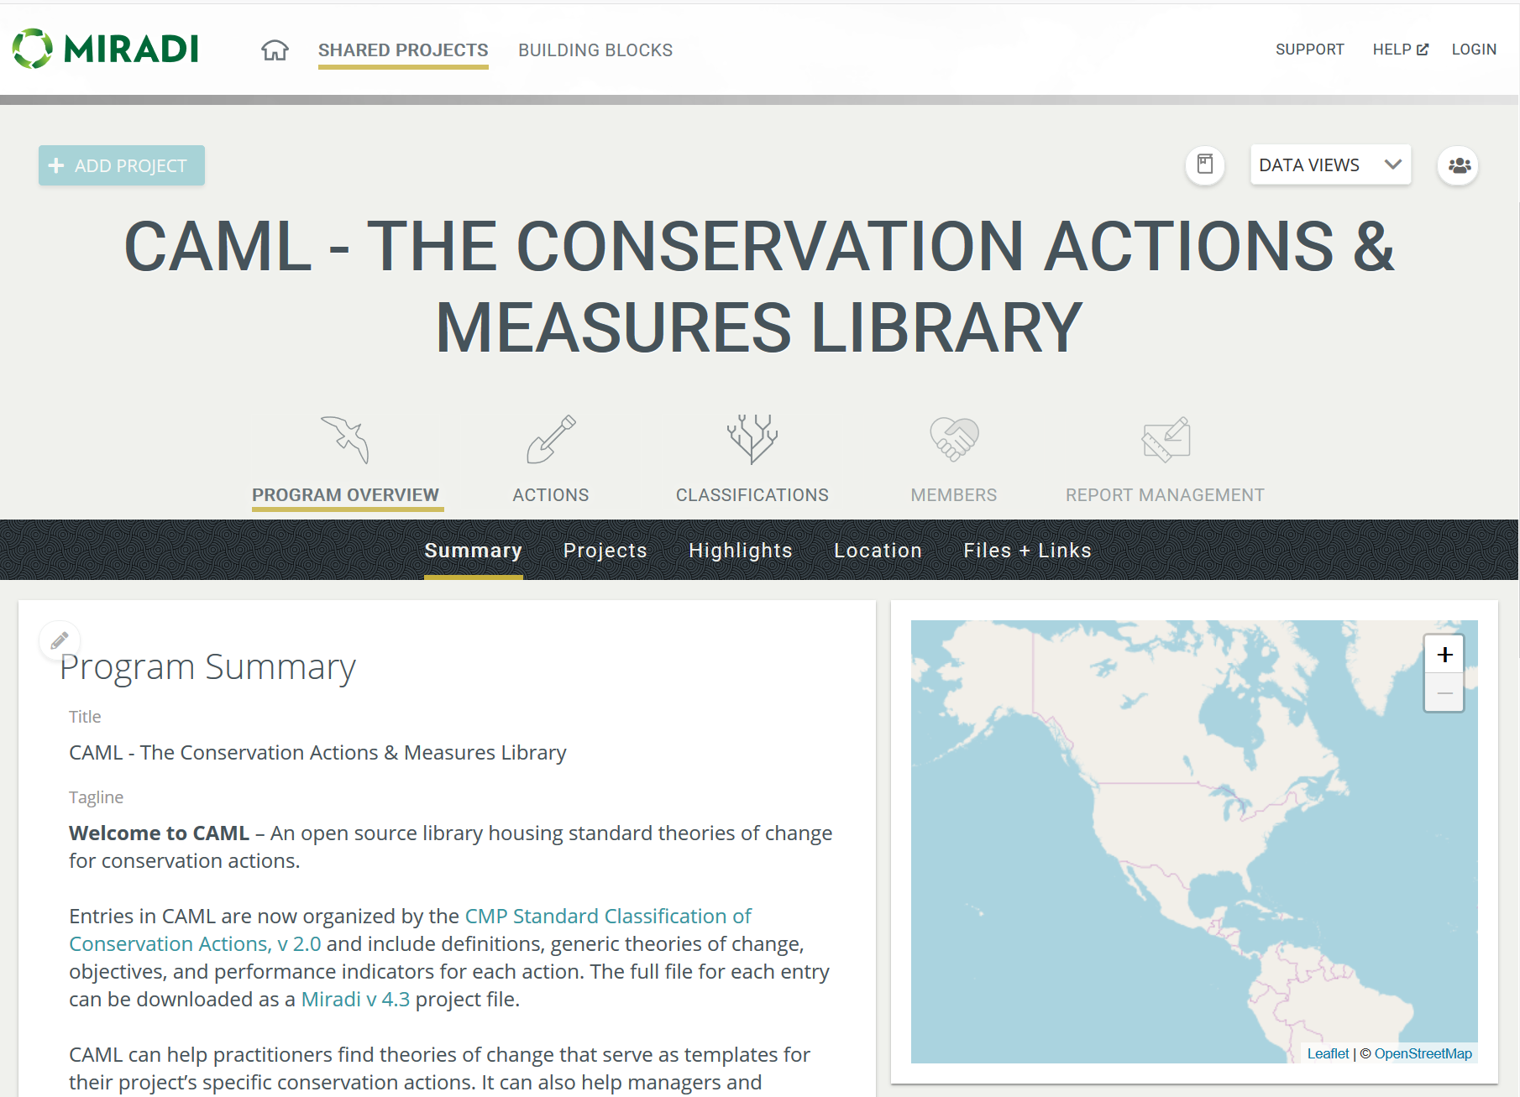
CAML www.miradishare.org
Notes:
On Miradi Share is as well the CAML data-base with results-chains (roadmaps) for standard conservation strategies.

Slide 15
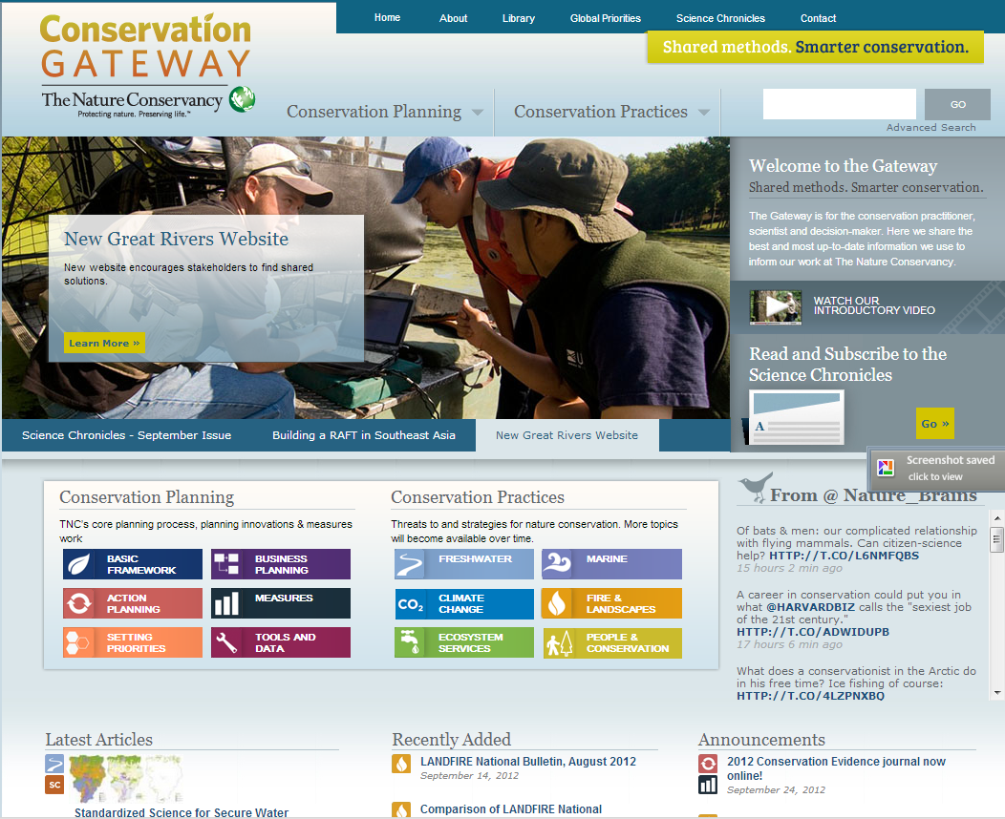
Conservation Gateway www.conservationgateway.org
Notes:
The Gateway is for the conservation practitioner, scientist and decision-maker. Here we share the best and most up-to-date information we use to inform our work at The Nature Conservancy.
Here you can find different information on conservation planning (e.g. CAP), conservation practice and a large database of TNC authored science articles.

Slide 16
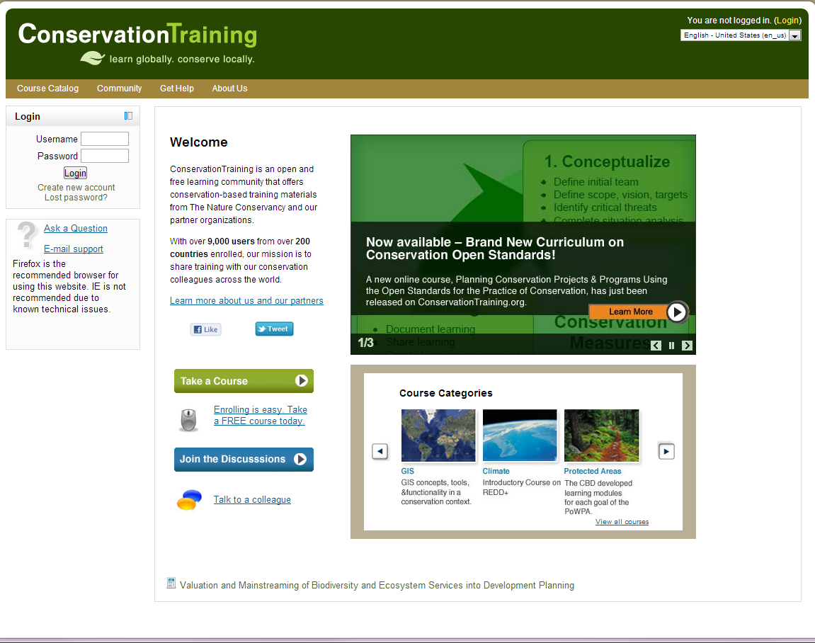
Training www.conservationtraining.org
Notes:
When you create an account with Conservation Training you can participate in an online course for CAP.
This curriculum is based on the Conservation Measures Partnership (CMP) Open Standards and covers Step 1 and Step 2 of the standards. These standards are the product of inputs, field tests, discussions, and debates among many CMP members and their partners.
You may choose to complete any of the lessons below; however, to receive a certificate of completion for either Step 1 or Step 2 you must complete the step assessment with a minimum score of 70%.

Slide 17
Crowd Sourcing
Notes:
The community of HCP practitioners is growing – and the bigger network of OS practitioners spans the entire globe.

Slide 18

Conservation Coaches Network
Email List Serv’s to connect practitioners:
Conservation Coaches Network
Community of Practice Indigenous OS Projects

Slide 19
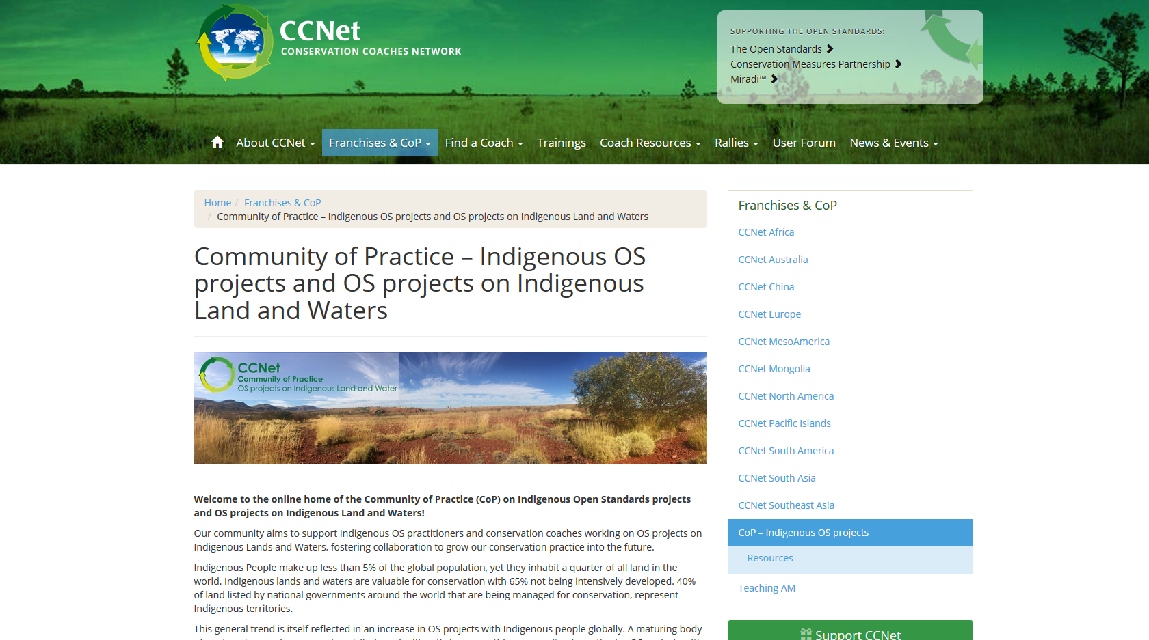
Conservation Coaches Network www.ccnetglobal.com
Notes:
The CCNET Global homepage contains many helpful resources – a coach handbook with resources for every step, a coach database, a back-catalogue of the discussion forum. Within the CCNET Global homepage is the Community of Practice – Indigenous OS Projects located which holds presentations, workshop materials and other resources around Healthy Country Planning.

Slide 20
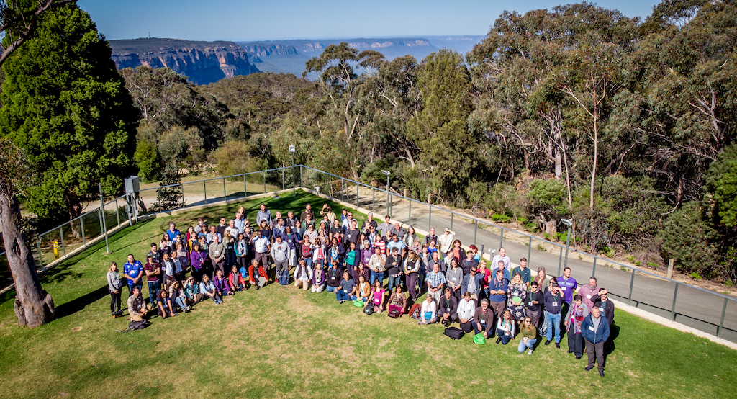
Conservation Coaches Network Rally
©Felix Cybulla
Mission - catalyze effective conservation worldwide through action planning, coaching, knowledge sharing, and innovation
Notes:
Approximately every 2 years, Conservation Coaches from across the world come together to a Conservation Coaches Network Rally to learn from each other, network and innovate the practice of conservation. The previous Rally in 2018 was held in Leura (Blue Mountains) in Australia. The next Rally in 2020 will be in Victoria BC, May 17 – 20.

Slide 21
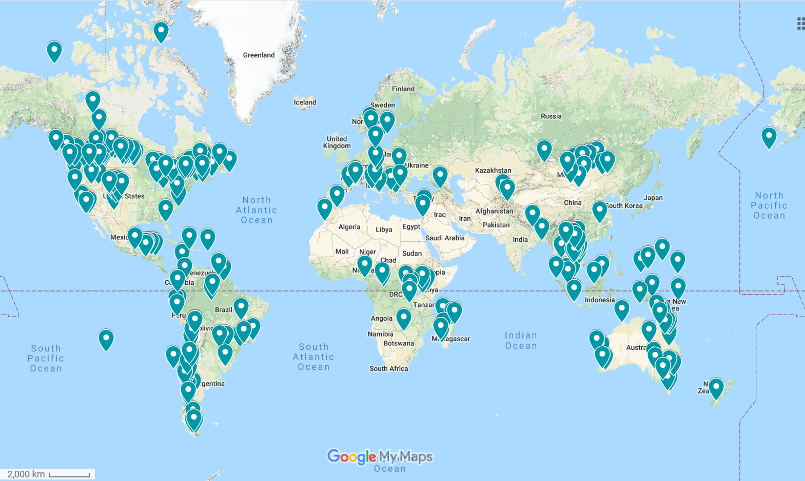
Miradi Projects Map
Notes:
This is a live map of some of the projects around the world that use or have used Miradi and/or Miradi Share for planning and management. Please note that this map is user-curated so feel free to browse and add your own project to the map!

Slide 22
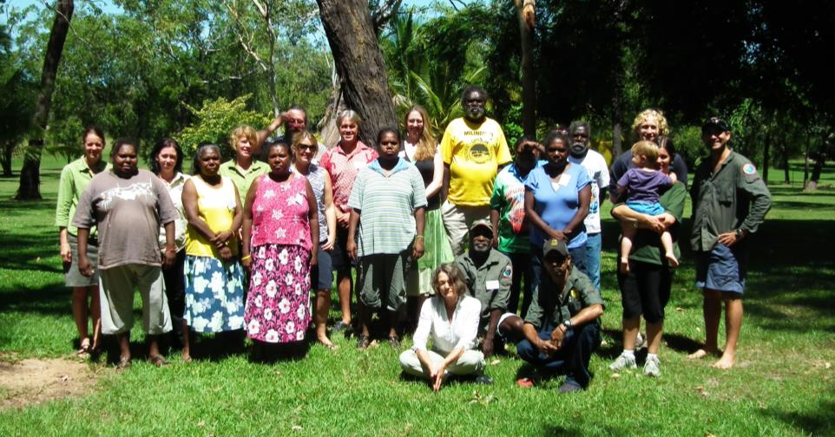
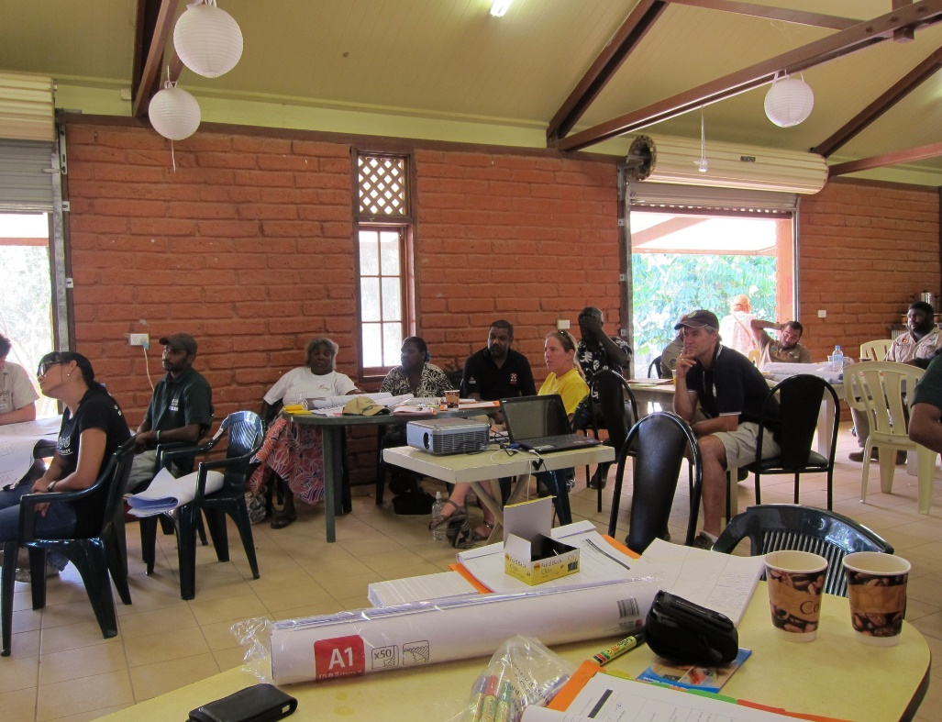
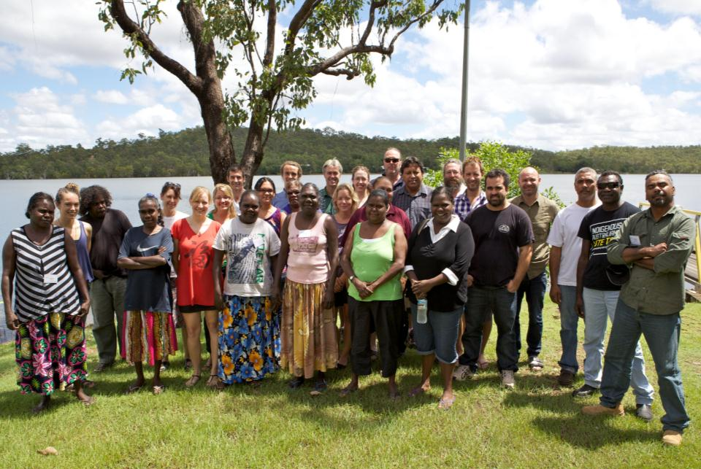
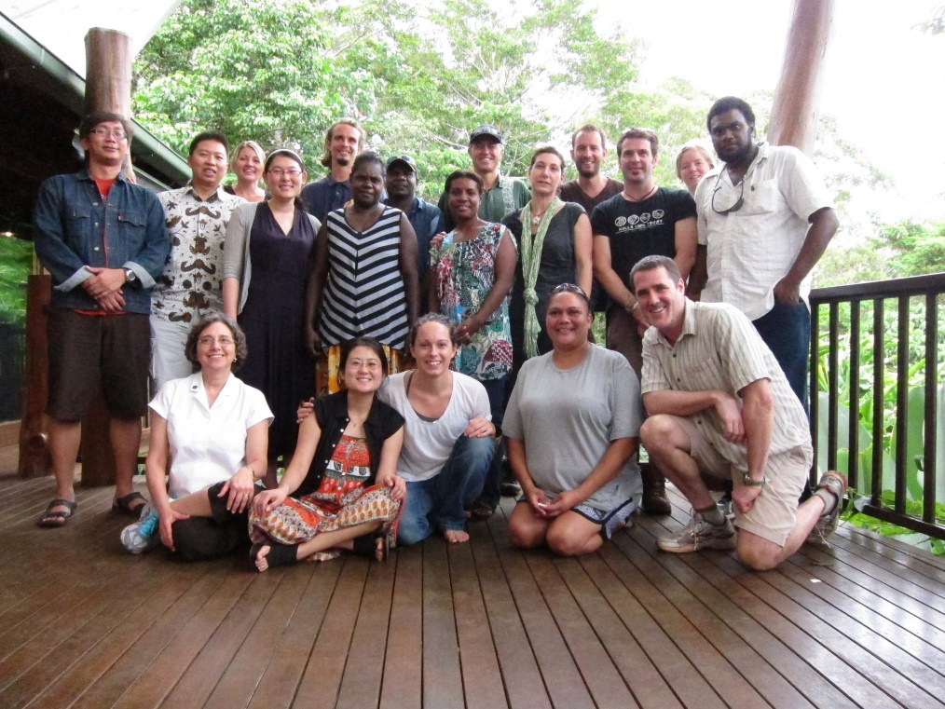
Healthy Country Planning
Notes:
Through different means the CCNET is attempting to conduct Healthy Country Planning Training Workshops – sometimes this training is funded, at other times training is paid by the participants.

Slide 23
Other useful homepages

Slide 24
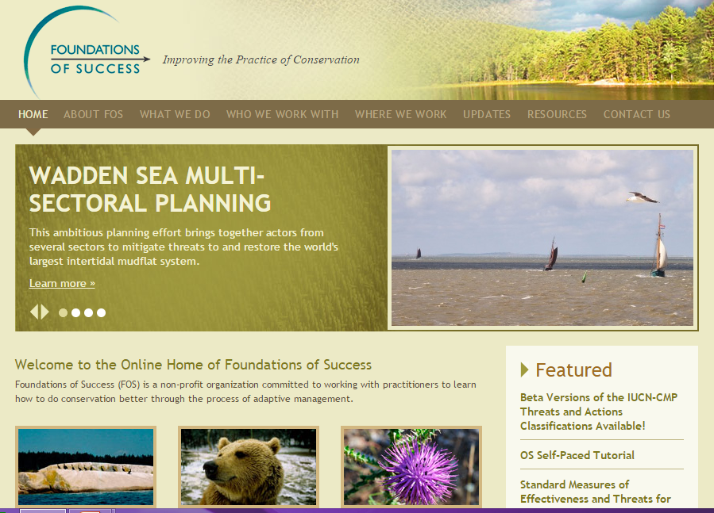
Foundations of Success www.fosonline.org/
Notes:
The Homepage of Foundation of Success is a great starting point to find guidance on the open standards in general and to very specific steps of the OS.

Slide 25
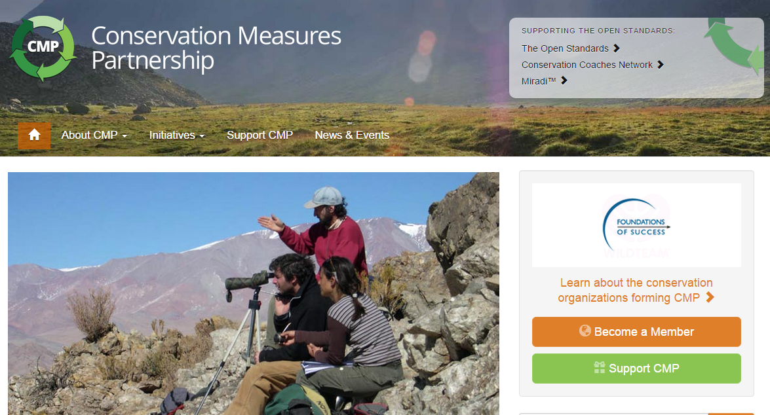
Conservation Measures Partnership www.conservationmeasures.org

