Slide 1
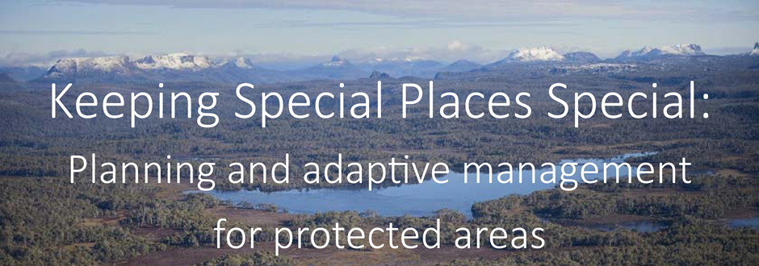





Slide 2
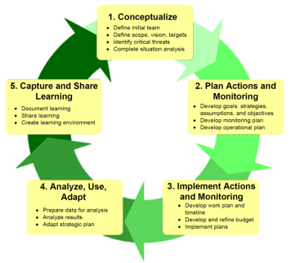

Open Standards for the Practice of Conservation
Planning, Managing, Monitoring, and Learning from Projects (and Programs) at All Scales
Bronte Park, Tasmania
January 2017

Slide 3
Attribution
Product of the Conservation Coaches Network, 2012
These presentations were developed based on materials from Foundations of Success (FOS), The Nature Conservancy (TNC), and World Wildlife Fund (WWF).
CCNet strongly recommends that this presentation is given by experts familiar with the adaptive management process presented by the Conservation Measures Partnership’s Open Standards for the Practice of Conservation.
You are free to share this presentation and adapt it for your use. Please attribute the work to CCNet or FOS, TNC and WWF. If you significantly alter, transform, or build upon this work, it may be appropriate to remove the CCNet logo.

Slide 4
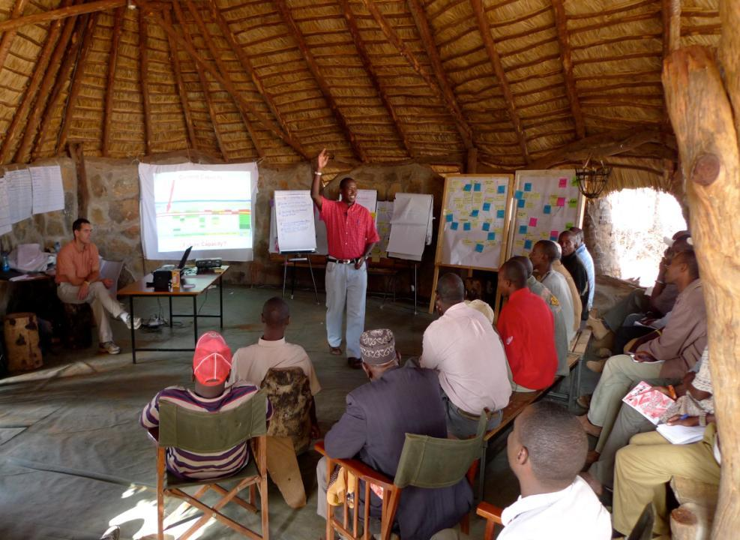
CAP Stories from around the World
Why we like CAP
Northern Kenya Rangelands
Notes:
Tribal leaders and local people across adjacent 2 million acres of communal lands are coming together to develop a shared approach to managing the precious forage, wildlife resources and water that they all depend on using this method. And as one tribal leader said “The CAP [Open Standards] workshop has shown us how to move forward. By setting priorities with our neighboring conservancies, there is real hope that we can make progress.” (they call their collectives “land conservancies”.)

Slide 5
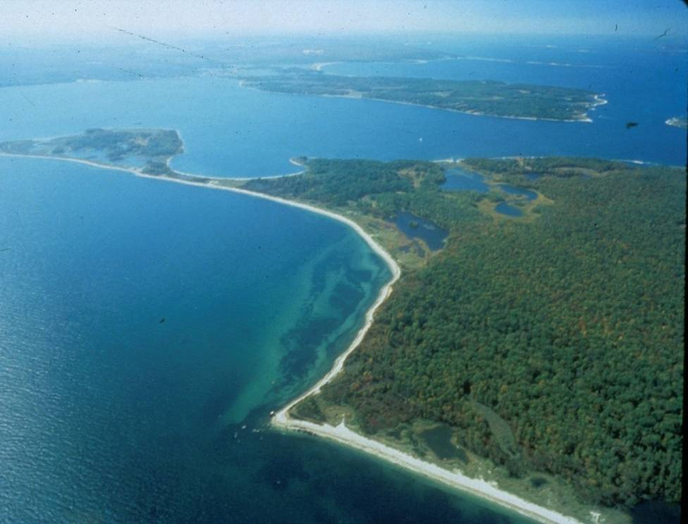
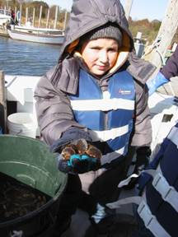
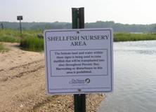
Peconic Estuary, New York
Notes:
In the Peconic Estuary,
Oystermen, fishermen, Town councilors, NGOs got together using CAP [Open Standards] to forge a plan for their estuary and now …..new scallop spawning sanctuaries have been created and scallop harvest regulations have been modified.
Baymen and Long Island towns have banded together to fund the purchase of clams to release into the new sanctuaries
And the Scallop and hard clam populations are increasing in the Estuary.

Slide 6
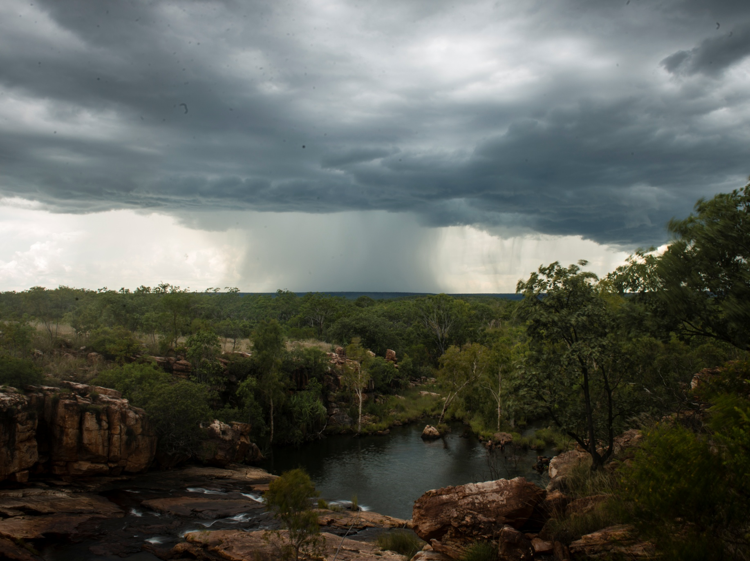
Willingin
Central Kimberley
Notes:
Wilinggin country is made up of a wide variety of landscapes from basalt ranges and sandstone cliffs and gorges

Slide 7
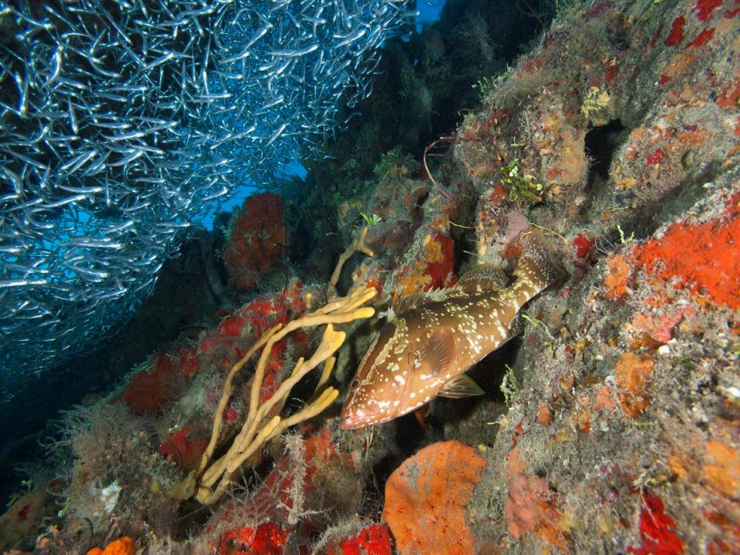
Mesoamerican Reef
Notes:
At the Cayos Cochinos National Monument, Fisherman, tourism operators, government and NGO representatives hadn’t even finished their Protected Area plan which used the CAP [Open Standards] framework and the group had all agreed to and pushed for expansion of the sanctuary boundaries to include four critical spawning areas.
The process revealed clearly for all to see that it was in all of their best interest to protect his additional area in the sanctuary.

Slide 8
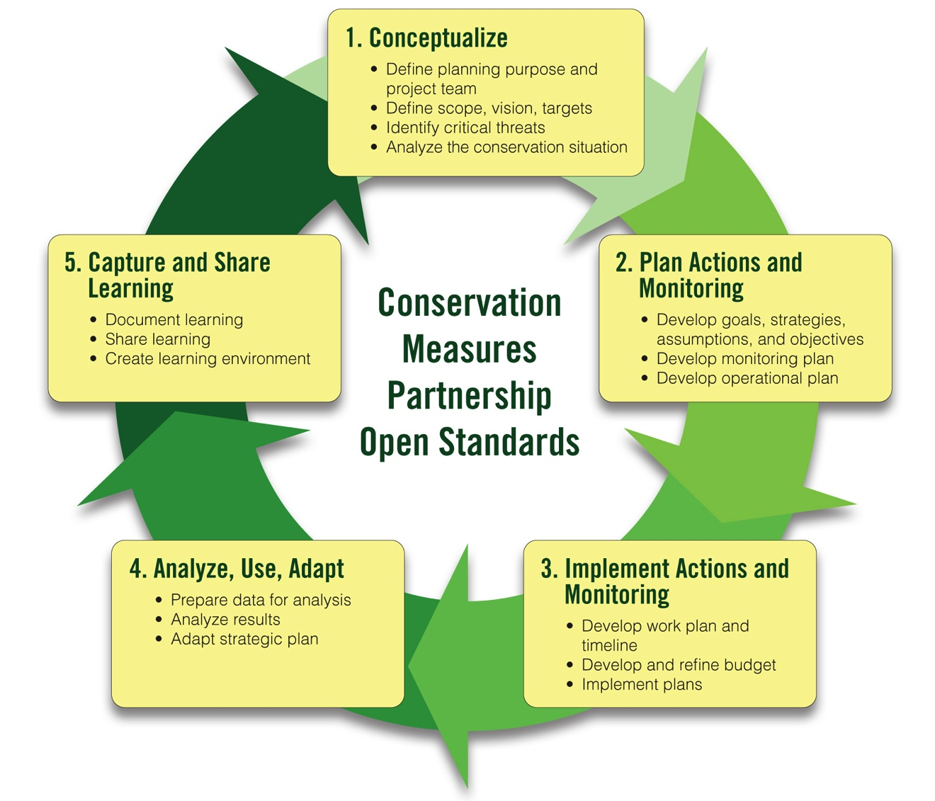
CMP Open Standards for the Practice of Conservation
www.conservationmeasures.org
Notes:
What all of these projects – and many more – have in common is the use of the Conservation Measures Partnership’s Open Standards for the Practice of Conservation.

Slide 9
Why Plan?
Planning links knowledge to action
Friedmann (1973)

Slide 10
Planning links where I am to where I want to be
What is planning?
TODAY
PLANNING
TOMORROW

Slide 11
A longer list
To Improve Results - “Studies have consistently shown that developing a clear vision, planning and setting clear goals and strategies greatly improves organizational performance and success.”
It allows the community to develop a shared vision, mission, goals and activities
It helps clarify roles and responsibilities
It enables the development of clear management strategies that can be monitored and measured to determine whether they are working or not (eg abating a threat or improving target)
It helps communities solve problems.
It helps build stronger teams and helps communities to get organized.
It helps groups to attract resources.

Slide 12
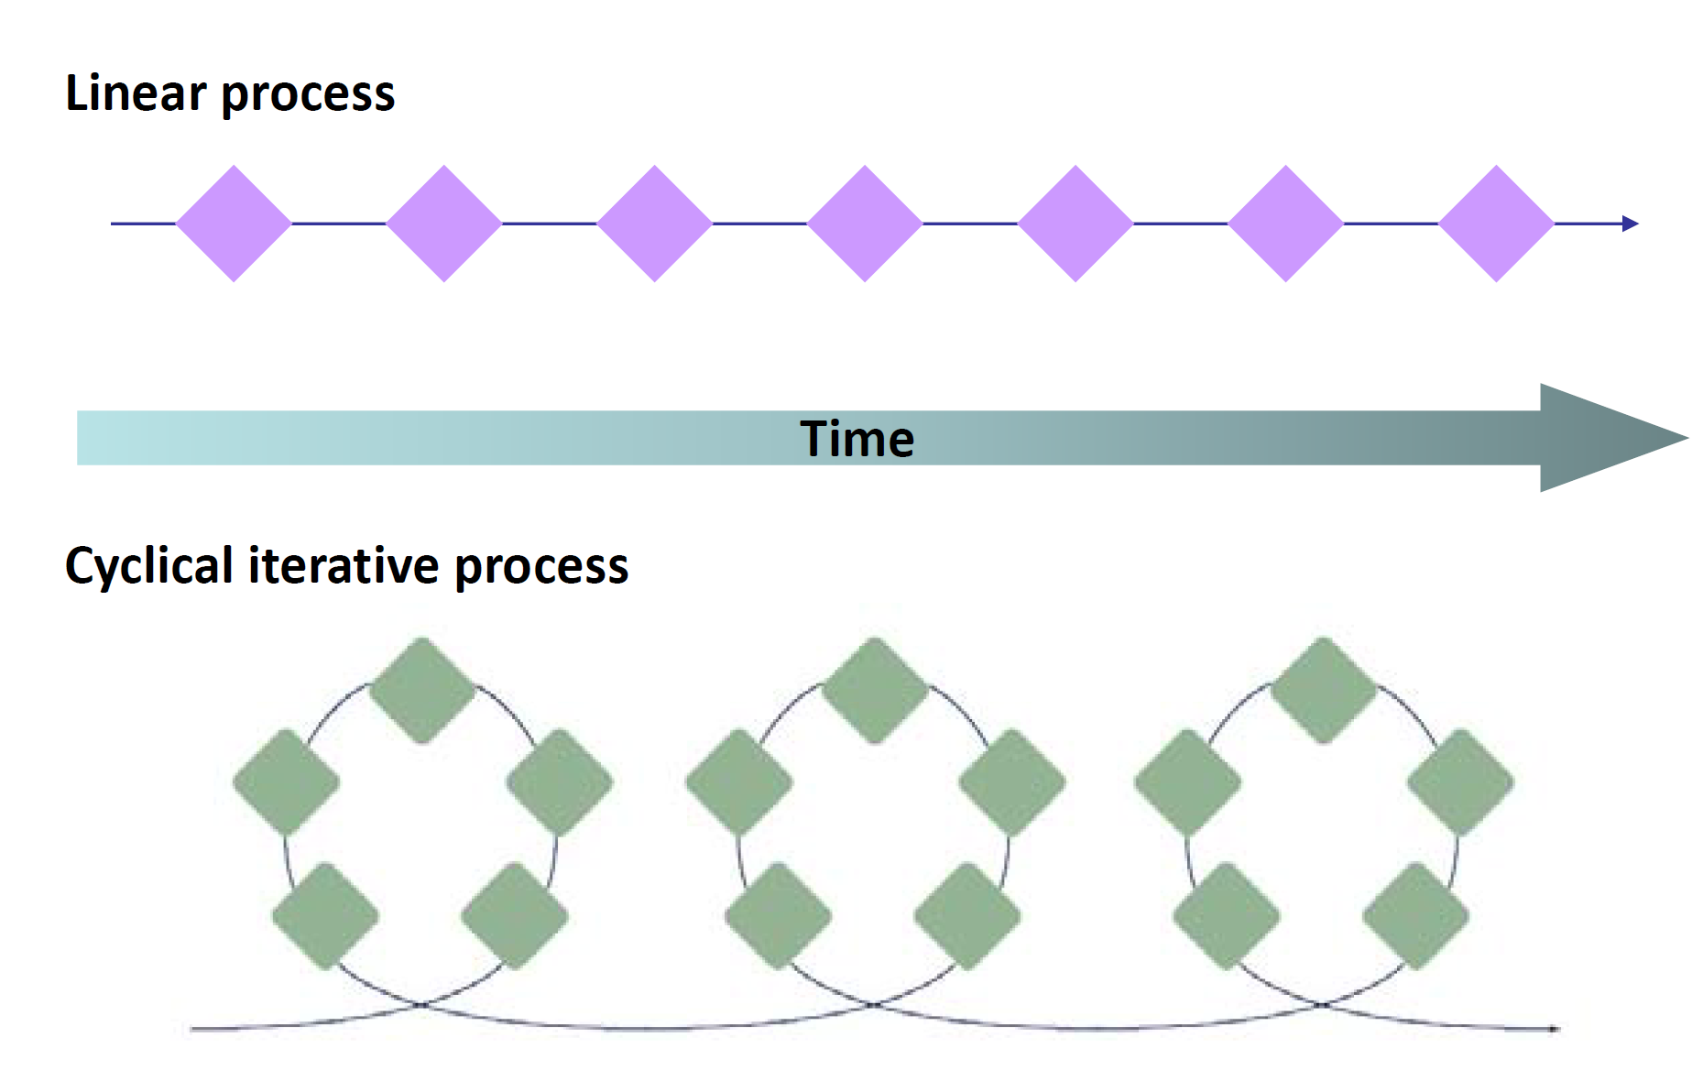
Adaptive management

Slide 13
What is Adaptive Management?
The integration of project or program planning, management, and monitoring to provide a framework for:
  Testing assumptions
  Learning
  Adapting
Notes:
Adaptive management is designed to answer the questions on the previous slide. Adaptive management allows teams to change quickly when no going in the right direction rather than waiting until the end of a project to determine it did not work.
There are different definitions of adaptive management out there. This is the Conservation Measures Partnership’s definition.

Slide 14
Adaptive Management
Combines Action and Research

Slide 15
The Basic Project Management Cycle
Notes:
The basic project management/adaptive management cycle includes these 4 steps (some groups add a “share” step after adapt).

Slide 16
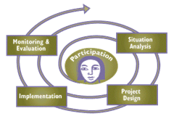
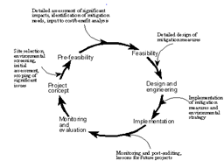
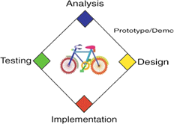
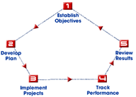
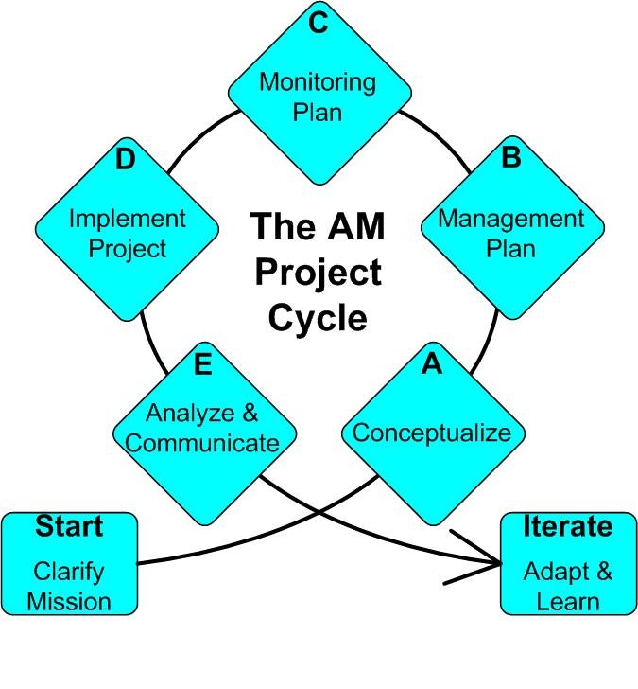
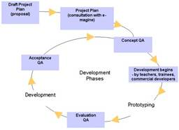
Many Versions of Adaptive Management in Practice
Notes:
Point is – there are a lot of different cycles out there, but if you really look closely at them, they are conceptually very similar. Once you learn one cycle, you probably know 90% of what you would see in any other cycle.
It doesn’t matter which cycle you use – what’s important is that you follow a systematic process

Slide 17























The Conservation Measures Partnership (CMP)
Notes:
The Conservation Measures Partnership (CMP) was formed in 2002 by representatives of the organizations on the top line of this slide: Foundations of Success (FOS), The Nature Conservancy (TNC), World Wildlife Fund (WWF), African Wildlife Foundation (AWF), Wildlife Conservation Society (WCS) and Conservation International (CI). CMP has grown since then and each year there are new organizational members – which makes it hard to keep this slide up to date! (This is the 2013 version.) Several private foundations – some of whom used to provide financial support for CMP – are now members of the partnership.

Slide 18
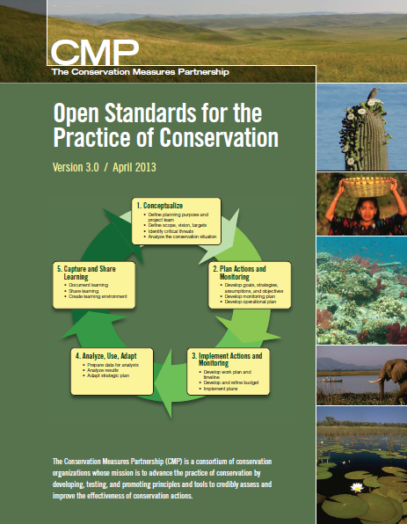
Open Standards for the Practice of Conservation
Developed by leading orgs & agencies
Draws on many fields
Open source &
common language
Used around the world
  State Wildlife Agencies
  National Park Systems
  Donor Funding Programs
  Academic Training
Notes:
Version 3.0 was published in April 2013 and was a joint effort between many individuals and organizations.

Slide 19
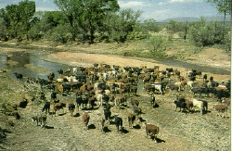
We Need Standard Terms to Describe Conservation
Cows?
Cattle?
Livestock?
Grazing?
Ranching?
Notes:
Just as doctors have standard terms to describe illnesses, conservation practitioners need standard terms to describe threats to biodiversity and conservation strategies.
If we use different terms to describe the threats we are addressing and the strategies we are implementing, then it will be harder for people who are working on the same threats / implementing the same strategies to find one another and learn from one another. For example, if I call the threat cattle ranching and you call it grazing, then it will be harder for us to find another

Slide 20
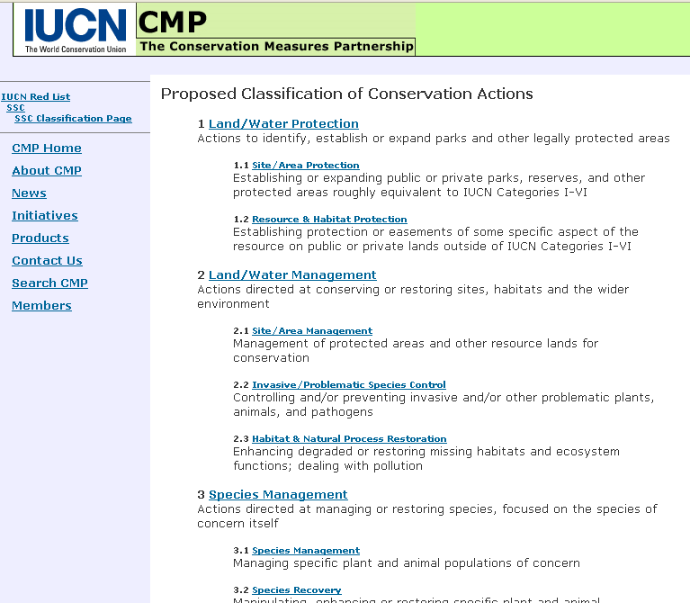
CMP-IUCN Standard Classifications
CMP-IUCN Taxonomy of Conservation Actions
Notes:
To meet this need, CMP and IUCN have worked together to develop a Taxonomy of Conservation Actions and a Taxonomy of Direct Threats to Biodiversity. In using this taxonomy of conservation actions, conservation teams use their own name for a strategy (e.g., translocation of endangered species) but then use the taxonomy to CLASSIFY their strategy as an example of Species Management.

Slide 21
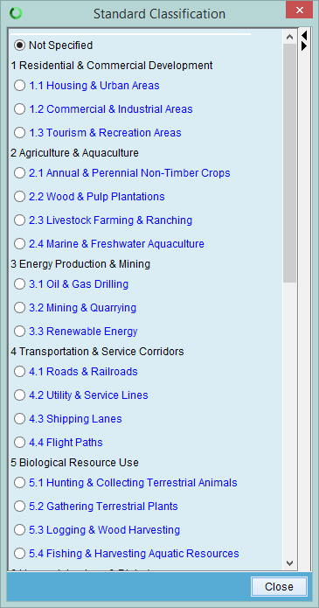
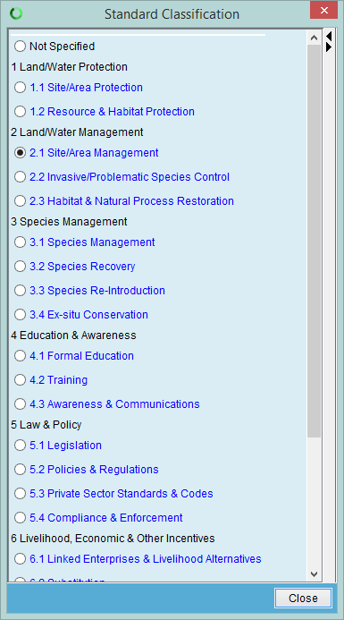
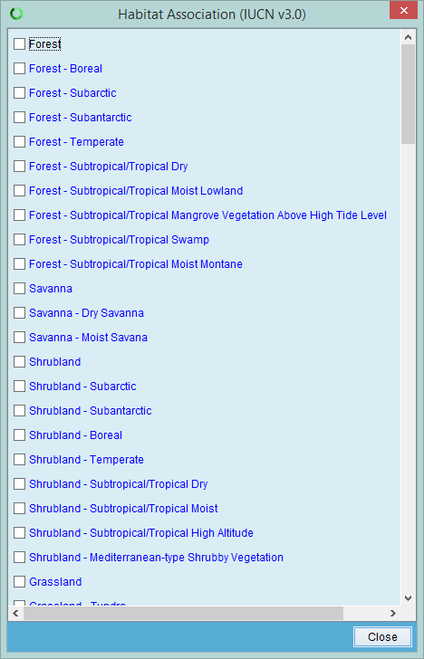
Unified Classifications
Threats
Actions
Comparison and sharing between projects
Linkage between scales
Aggregation of data across projects
Systems
Notes:
CAP is consistent with the Open Standards for Conservation Practice which has been adopted by over 15 major NGO’s and now some government agencies to harmonize our individual conservation approaches. So that we can learn and share across the greater conservation community with more agility.
This group of parties calls themselves the Conservation Measures Partnership.

Slide 22
So what ?
Clear insight into where resources (people, $s) are required, and why
Better sharing of information across organisations
Greater efficiency & quality in planning, budgeting & forecasting
Improve reporting
More resources for more effective impact
Notes:
clear insight into where resources are required, and why
clear logic behind what we want to do, and what we expect to achieve by doing it
can look at items in the Organisation’s budget and follow it back to Strategies & expected outcomes
can assess volunteer needs
using Results Chain diagrams to show Volunteers how their Activities contribute to conservation outcomes
clear priorities, within projects and across the organisation
Information being shared across the organisation
more information available for fundraisers; use Miradi to see what projects are planned; and see progress
everyone can see how projects are tracking
field staff can easily let people know what they are doing; they now have a direct line right through to Directors
Greater efficiency
hard to quantify, but as an example, our central budget effort went from a 10 week process to 3 weeks
starting to improve reporting to donors
all reporting is still internal; now moving to publishing it on website

Slide 23
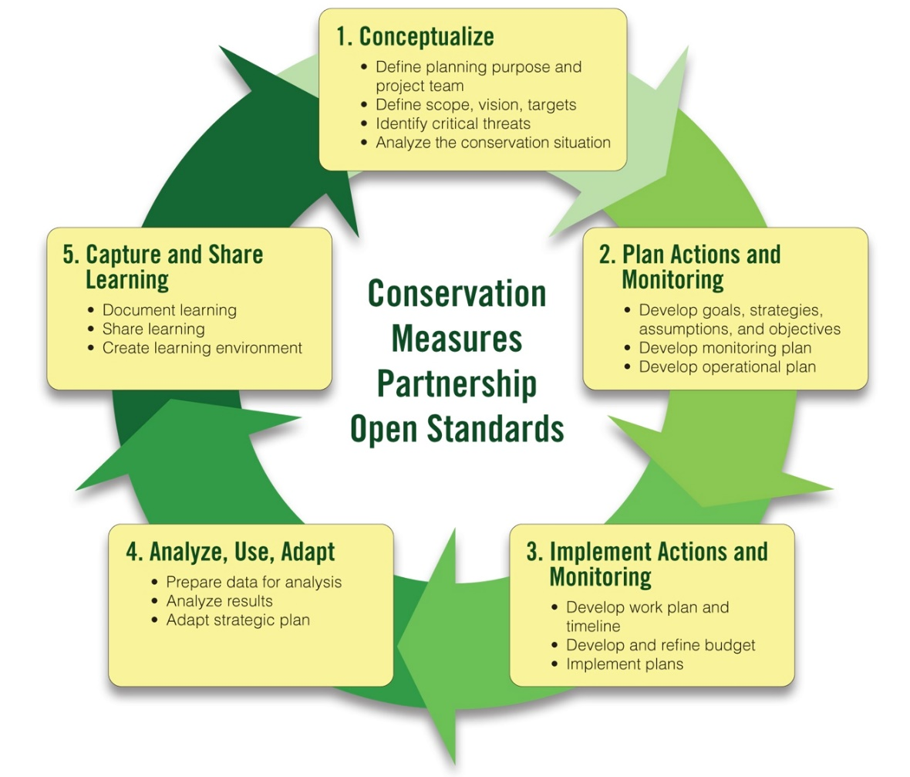
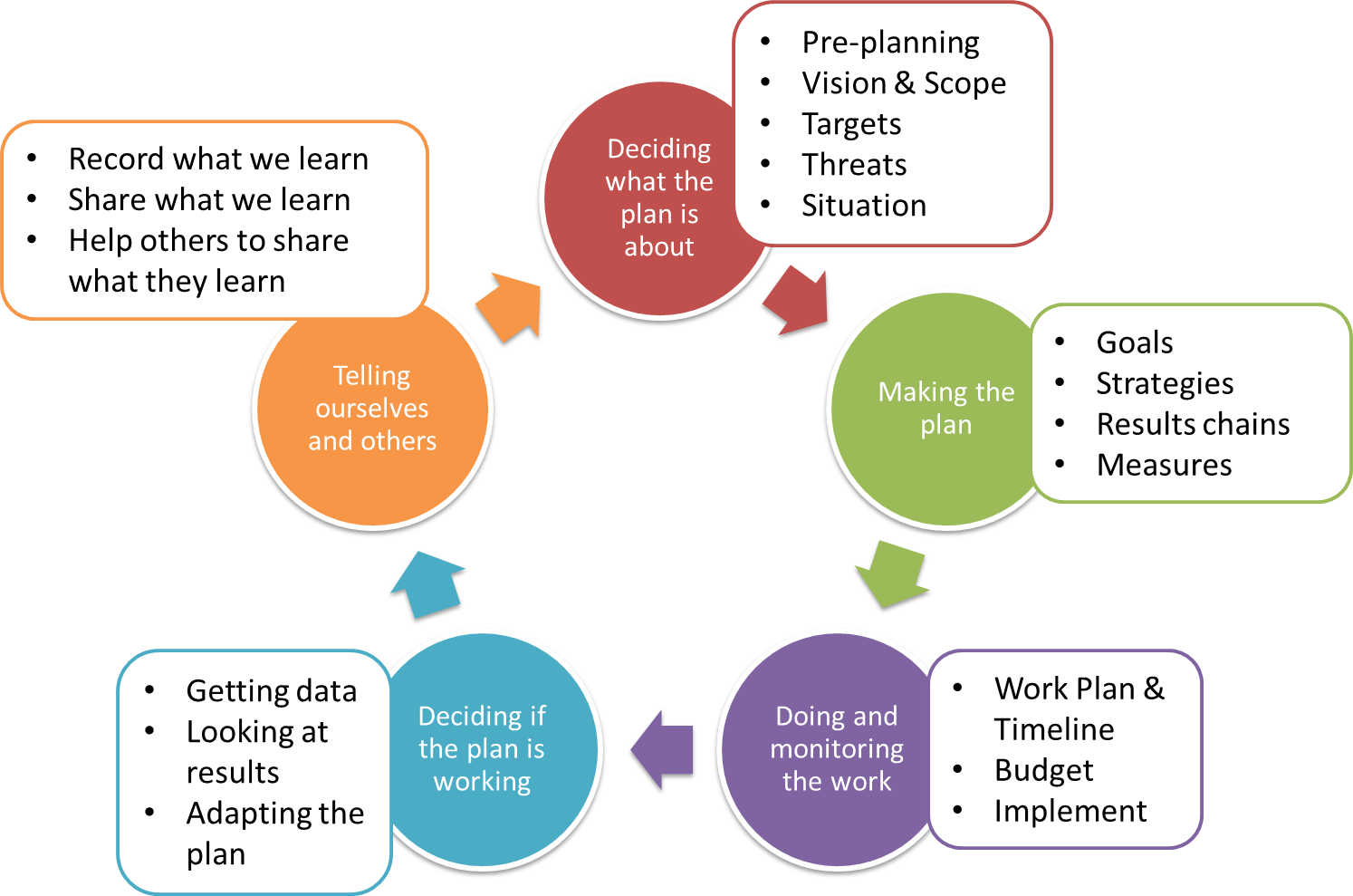
What is Our Approach to Adaptive Management?
Healthy Country Planning
Open Standards

Slide 24
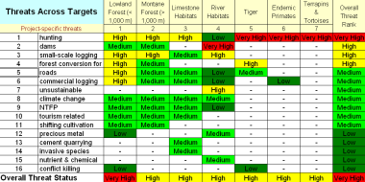
Brief Summary of the Open Standards
Summarize what you want to conserve
Understand current & desired condition
Identify and rank threats
Develop a general model of socioeconomic-ecological system
Identify strategies based on the general model
Define theories of change to show how strategies will work
Implement the strategies, checking as you go
Adjust
Notes:
Diagram icons are there to refer to the steps in Miradi (you could remove if you are not using the software but they might also be helpful).

Slide 25
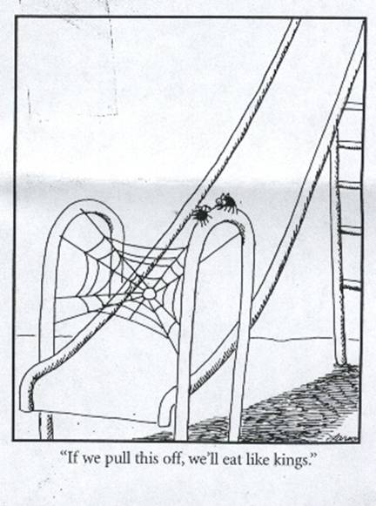
1. Summarize what you want to conserve

Slide 26
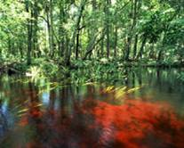
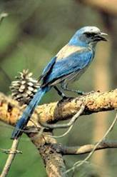
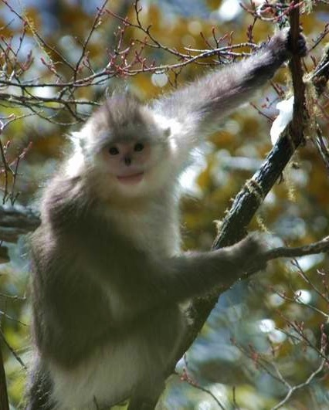
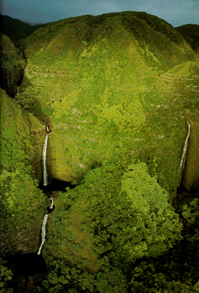
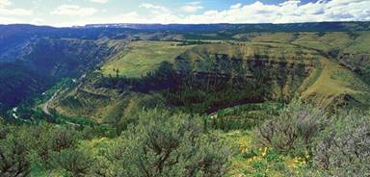
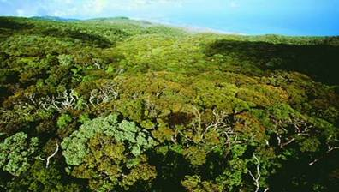
1. Summarize what you want to conserve
Notes:
Conservation targets can include
Species
communities,
and ecological systems.
Conservation targets are selected to encompass and represent the needs of the broader set of biodiversity occurring within the project.

Slide 27
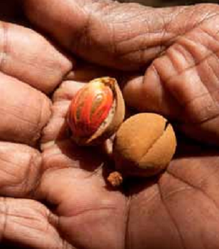
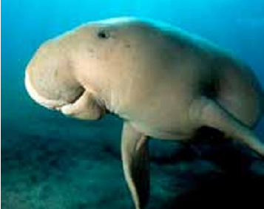
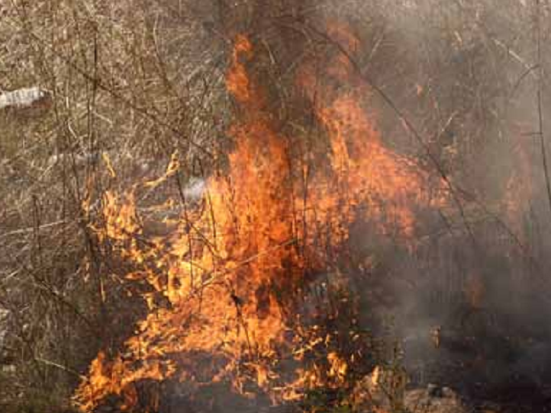
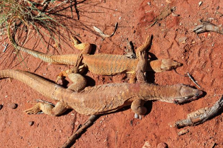
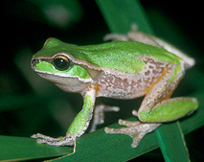
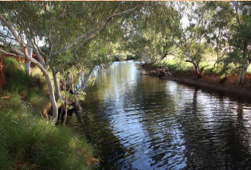
1. Summarize what you want to conserve
CULTURAL PRACTICE
WATAYI (DUGONG)
RIGHT-WAY FIRE
KUWIYI (BUSH FOOD)
THREATENED SPECIES
KALYU (WATER PLACES)

Slide 28
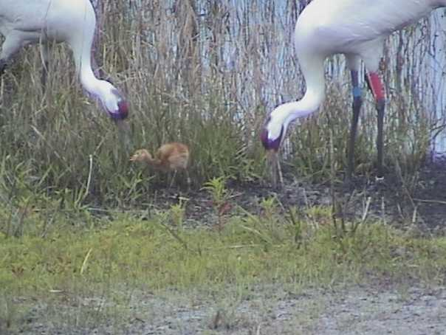
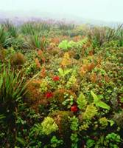
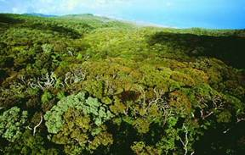
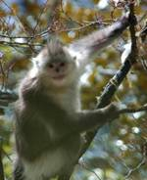
2. Understand Current & Desired State of What You Want to Conserve
What do you want to conserve?
What is your best estimate of how it’s doing?
Viability Summary
East Molokai
Targets |  | Landscape Context | Condition | Size | Viability Rank
1 | North Shore Forests & Cliffs | Fair | Good | Fair | Fair
2 | Montane Wet Forest | Fair | Very Good | Fair | Good
3 | South Slope Mesic Forest & Shrubland | Poor | Good | Poor | Fair
Overall Biodiversity Health Rank |  |  |  |  | Fair
Notes:
The Open Standards approach asks us to consider:
What is it we want to conserve (the conservation targets)?
What is our current best understanding of what these things need to be “healthy”?
What condition is our system in right now?

Slide 29
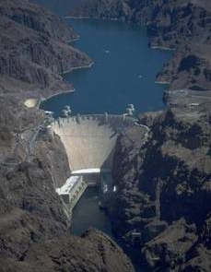
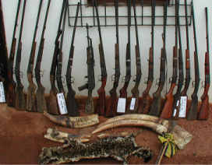
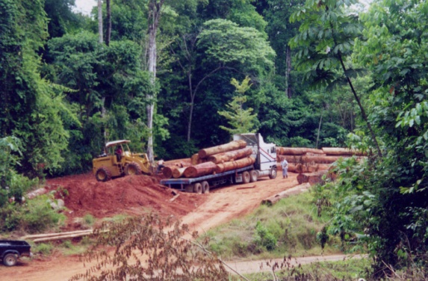
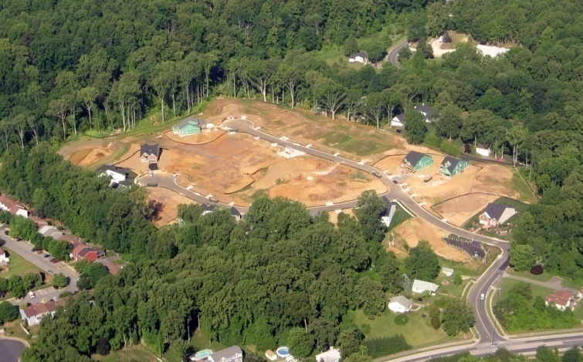
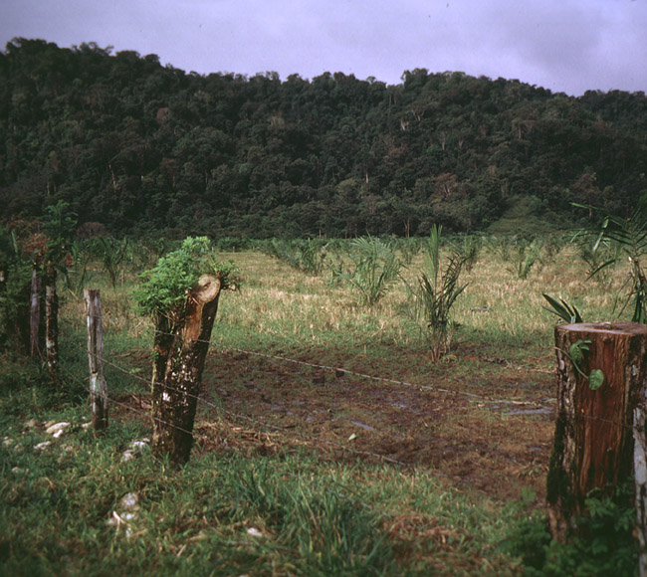
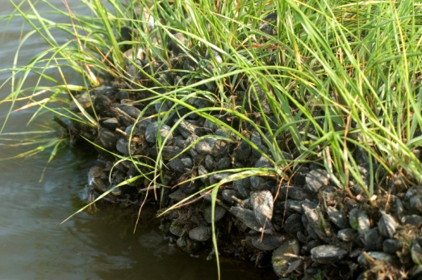
Identify and Rank Threats
Unsustainable Logging
Unsustainable harvest
Operation of Dams
Exotic/Invasive Species
Residential Development
Incompatible Livestock Grazing
Photo: Adrian Jones,
IAN Image Library
Notes:
threat ranking methodology
3-5-7 Rule
3 H = 1 VH
5 M = 1 H
7 L = 1 M
Plus 2-prime rule
Criteria for Direct Threat Rankings
Scope – Most commonly defined spatially as the geographic scope of impact on the conservation target at the site that can reasonably be expected within 10 years under current circumstances (i.e., given the continuation of the existing situation).
Very High: The direct threat is likely to be very widespread or pervasive in its scope, and affect the conservation target throughout the target’s occurrences at the site.
High: The direct threat is likely to be widespread in its scope, and affect the conservation target at many of its locations at the site.
Medium: The direct threat is likely to be localized in its scope, and affect the conservation target at some of the target’s locations at the site.
Low: The direct threat is likely to be very localized in its scope, and affect the conservation target at a limited portion of the target’s location at the site.
Severity – The level of damage to the conservation target that can reasonably be expected within 10 years under current circumstances (i.e., given the continuation of the existing situation).
Very High: The direct threat is likely to destroy or eliminate the conservation target over some portion of the target’s occurrence at the site.
High: The direct threat is likely to seriously degrade the conservation target over some portion of the target’s occurrence at the site.
Medium: The direct threat is likely to moderately degrade the conservation target over some portion of the target’s occurrence at the site.
Low: The direct threat is likely to only slightly impair the conservation target over some portion of the target’s occurrence at the site.
Irreversibility – The degree to which the effects of a direct threat can be restored. Note that irreversibility refers to the "effects of the direct threat on the target" not the direct threat itself – you can think of it as the "recoverability" of the target from the effects of the threat.
Very High: The effects of the direct threat are not reversible (e.g., wetlands converted to a shopping center).
High: The effects of the direct threat are reversible, but not practically affordable (e.g., wetland converted to agriculture).
Medium: The effects of the direct threat are reversible with a reasonable commitment of resources (e.g., ditching and draining of wetland).
Low: The effects of the direct threat are easily reversible at relatively low cost (e.g., off-road vehicles trespassing in wetland).

Slide 30
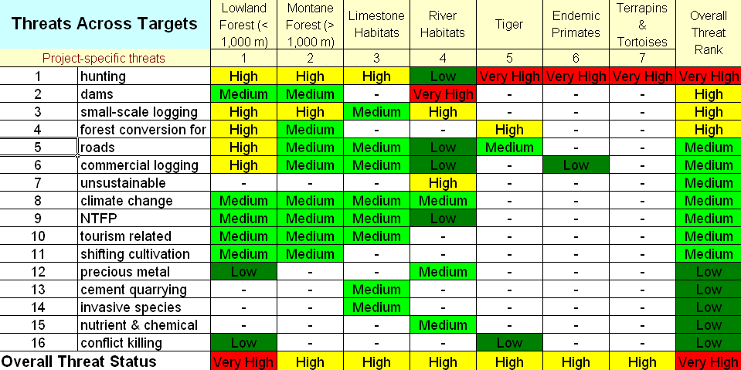
Identify and Rank Threats
Notes:
threat ranking methodology
3-5-7 Rule
3 H = 1 VH
5 M = 1 H
7 L = 1 M
Plus 2-prime rule
Criteria for Direct Threat Rankings
Scope – Most commonly defined spatially as the geographic scope of impact on the conservation target at the site that can reasonably be expected within 10 years under current circumstances (i.e., given the continuation of the existing situation).
Very High: The direct threat is likely to be very widespread or pervasive in its scope, and affect the conservation target throughout the target’s occurrences at the site.
High: The direct threat is likely to be widespread in its scope, and affect the conservation target at many of its locations at the site.
Medium: The direct threat is likely to be localized in its scope, and affect the conservation target at some of the target’s locations at the site.
Low: The direct threat is likely to be very localized in its scope, and affect the conservation target at a limited portion of the target’s location at the site.
Severity – The level of damage to the conservation target that can reasonably be expected within 10 years under current circumstances (i.e., given the continuation of the existing situation).
Very High: The direct threat is likely to destroy or eliminate the conservation target over some portion of the target’s occurrence at the site.
High: The direct threat is likely to seriously degrade the conservation target over some portion of the target’s occurrence at the site.
Medium: The direct threat is likely to moderately degrade the conservation target over some portion of the target’s occurrence at the site.
Low: The direct threat is likely to only slightly impair the conservation target over some portion of the target’s occurrence at the site.
Irreversibility – The degree to which the effects of a direct threat can be restored. Note that irreversibility refers to the "effects of the direct threat on the target" not the direct threat itself – you can think of it as the "recoverability" of the target from the effects of the threat.
Very High: The effects of the direct threat are not reversible (e.g., wetlands converted to a shopping center).
High: The effects of the direct threat are reversible, but not practically affordable (e.g., wetland converted to agriculture).
Medium: The effects of the direct threat are reversible with a reasonable commitment of resources (e.g., ditching and draining of wetland).
Low: The effects of the direct threat are easily reversible at relatively low cost (e.g., off-road vehicles trespassing in wetland).

Slide 31
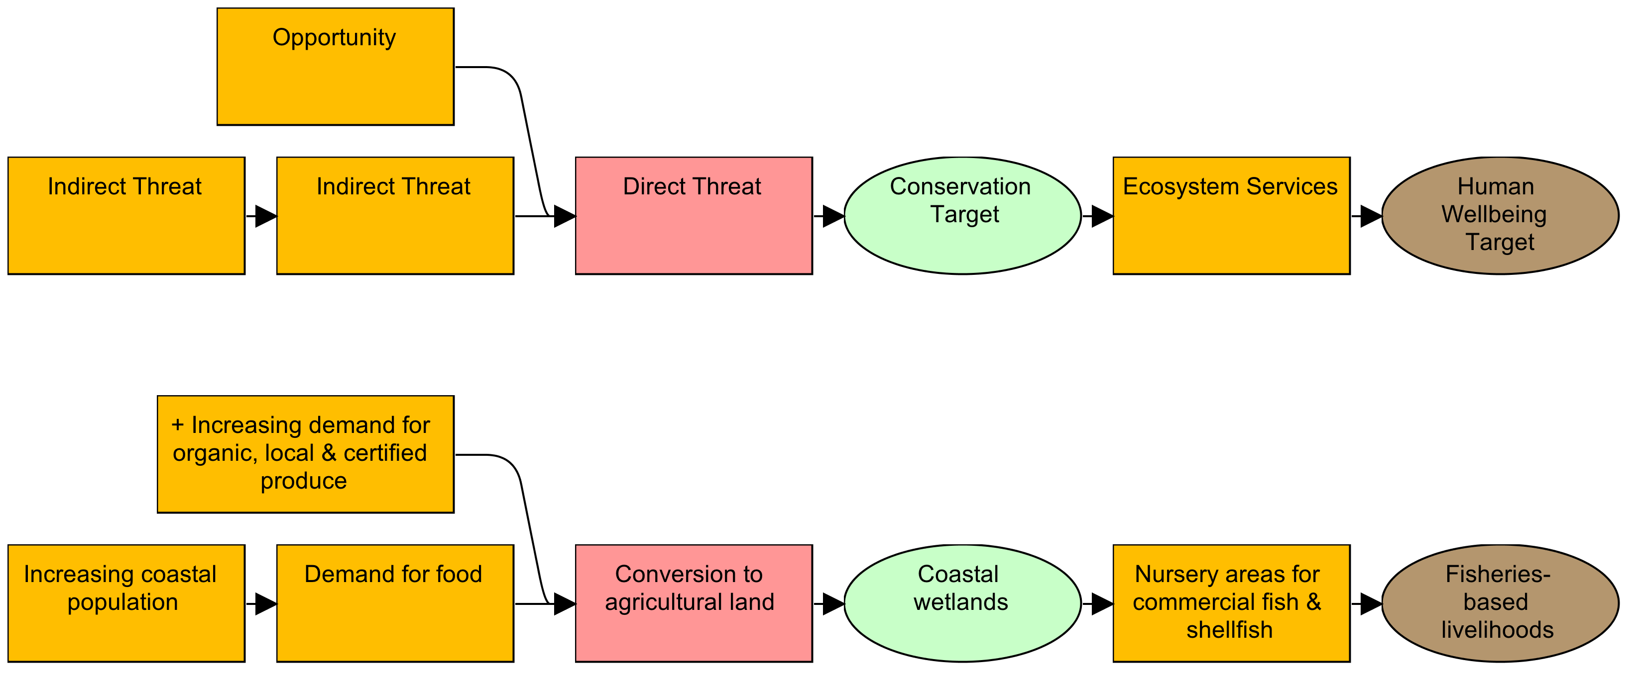



Develop a General Model of Socioeconomic-Ecological System
Notes:
Don’t forget about opportunities – factors that can contribute to reducing your direct threat. These are examples of certification programs that are responding to the opportunity.

Slide 32


5. Identify Strategies Based on the General Model

Slide 33



6. Theories of Change to Show How Strategies Will Work

Slide 34


7. Learn from Your Project
Analyze project monitoring data & apply findings to improve current & future projects
Adapted from WWF Southwest Amazon Ecoregion
X
X
X

Slide 35



Keeping the Plan Alive

Slide 36








Every step has a spatial element
Map scope, vision & key factors
Share maps
GIS analysis to develop & refine strategies
Use maps and GIS to analyse, adapt
Capture spatial data

Slide 37





Examples of Guidance & Training Materials

Slide 38


Miradi Software
TM
Adaptive Management Software
for Conservation Projects
www.Miradi.org or info@Miradi.org
CMP
The Conservation Measures Partnership
Notes:
The Miradi software was developed as a tool for implementing the Open Standards. It was developed by CMP in partnership with Benetech, a software non-profit.

Slide 39


Conservation Coaches Network
Mission - catalyze effective conservation worldwide through action planning, coaching, knowledge sharing, and innovation

Slide 40

Coaches Around the World
290 Coaches 82 Organizations
57 Countries
(As of May 2013)
Notes:
Conservation Coaches Network – engaged board
Active list serve
Materials accessed and downloaded - 8000 hits/month

Slide 41

Audubon Tools of
Engagement
Resources (eg only)
Participatory
Conservation
Planning
Community Planning Handbook

Slide 42












Graduate Courses in Adaptive Management
Building capacity to do good Adaptive Management from the beginning of conservation careers
Notes:
Academic courses based on the Open Standards have been developed at all of these universities, to give graduate students (and in some cases undergraduates) the opportunity to learn how to design, plan and monitor conservation projects, as they are just beginning their careers in conservation.

Slide 43

Teaching Adaptive Management
Learning Network http://teachadaptivemanagement.pbworks.com
Notes:
The Teaching Adaptive Management (TAM) network is a resource for people who are working to develop academic courses based on the Open Standards. TAM has a website with curricula from past and existing courses.

Slide 44
Our Workshop Objectives
Introduce you to the Open Standards process
Provide opportunities for people to use OS elements
Expanding the circle of practitioners
Meet others and share experiences of what has worked in different types of processes.

Slide 45
Friday Presentations
Through the week, each team to prepare a ‘plan’ based on the sessions
Should culminate in objectives and actions for a particular focal issue or theme
Each team to have 30 minute to present and do Q&A on their plan
Aim to:
  Present a professional standard seminar
  Effectively address the task (Identify focal issues or targets; assessed viability and key threats; logical and powerful results chain; goals and measurable objectives linked with implementable actions; specified implementation requirements)

Slide 46
Ground Rules
Participate
Don’t Dominate
Tough Love… but
“Boss-Free Zone”
Everyone advocates; project team decides
Mobiles/E-mail off; no side conversations
Have Fun!

