Slide 1

Pre-planning
Planning to plan (and adapt)
Implementation starts Here!

Slide 2
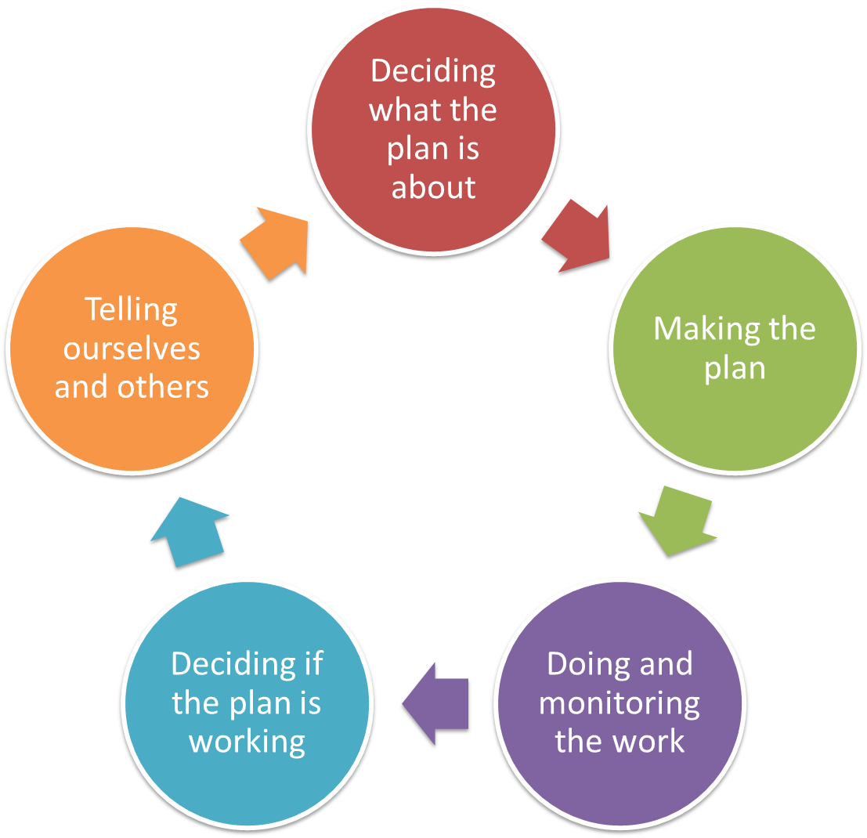
Pre-planning
Vision & Scope
Targets & Health
Threats
Situation
Notes:
Pre-planning is 1st step, irrespective of the ‘entry point’

Slide 3
Deciding what the Plan is all about
Pre-planning
Work out how you want to do the plan
Why do this step?
  create a rough work plan and approach to make sure the project gets done
  look at capacity and community needs
  be really clear with yourself and others why you want to do the plan
  identify key participants in planning and implementation
Making a plan can use a lot of time and money, so it is important to really think about how you will do it

Slide 4
Deciding what the Plan is all about
Pre-planning
Work out how you want to do the plan
Use culturally appropriate techniques
  Pre-plan meeting to build relationships & awareness
  Use 2 or more facilitators – male / female
  Use approaches to hear from all participants
  Plan to take digital photos of paper products for a record – but ask permission for all photos
  Allow time for review and feedback between meetings
Work with a smaller team on complicated steps
Don’t make first workshop your first meeting with community

Slide 5
Deciding what the Plan is all about
Pre-planning
Work out how you want to do the plan
Purpose: Why are we doing the plan?
Roles: Who should be involved in the plan
  Team, Sponsor, Coordinator, Facilitators, Partners
Process: How will we ‘do’ the work?
  Level of engagement, training
Timeline: What tasks done by when?
Products: What comes out the end?
Capacity: can we do this ourselves?

Slide 6
Deciding what the Plan is all about
Pre-planning
Clarity of Purpose: Why are we doing the plan?
Need a clear understanding of everyone’s reasons and goals for being in the plan
Examples of different purposes
  Project team developing biodiversity conservation strategies and measures for a single property
  Group of partners come together to develop a shared plan for a region (eg Gondwana Link)
  A community plan that can help work with other people to manage traditional lands (Indigenous Protected Area Management Plan)
  Project plan to protect important cultural
  sites (eg Guatemala)

Slide 7
Deciding what the Plan is all about
Pre-planning
Roles: Who should be involved in the plan
Project Team
Sponsor
Coordinator
Facilitators
Partners
Check list

Slide 8
Deciding what the Plan is all about
Pre-planning
Roles: Who should be involved in the plan

Slide 9
Deciding what the Plan is all about
Pre-planning
Project Team
Good if you can have these in your team
  Someone who will lead the planning
  Someone who will put the plan into action
  Community leadership
  People who know the community and environment
  People good at thinking about problems / answers
  Others (e.g. partners) critical to implementation of strategies and/or measures
  Someone comfortable with computer software (desirable)

Slide 10
Deciding what the Plan is all about
Pre-planning
Sponsor
Sponsor gives authority to the plan
Can be person or group (eg elders)
They set overall purpose & any special goals
Agree on program budget, might pay or provide funding
Validate the overall process and the Project Team

Slide 11
Deciding what the Plan is all about
Pre-planning
Coordinator
Schedule and manage logistics for meetings and workshops, in consultation with the sponsor and the facilitator
Secure facilities, accommodation & meals
Maintain list & email addresses of participants
Send out announcements, reports & info
Assemble materials
Coordinate with host sites on field trip arrangements

Slide 12
Deciding what the Plan is all about
Pre-planning
Facilitators
Co-Facilitators Recommended – “Buddy System”
Together they will usually have...
Experience in developing and implementing strategies
Good understanding of the tools you are using
Can use / learn planning software
Good listening, thinking & questioning skills
Happy to work where answers are not clear
Experience working with a variety of area plans & partners
in order to adapt workshops and approach as needed
Good facilitation skills

Slide 13
Deciding what the Plan is all about
Pre-planning
Partners
When do I involve partners?
Must perceive some benefit to their involvement
Need clarity of the objective/outcome
  NOTE. If partners desire different outcomes, need a clear understanding of their objectives and a process for arriving at collaborative outcomes
Not usually a “first date” with partners
  Unless the purpose and design of the agenda is well thought-through and vetted with partners and they understand the process and outcomes

Slide 14
Deciding what the Plan is all about
Pre-planning
Process: How will we ‘do’ the work?
Process: How will we ‘do’ the work?
  Level of engagement, training

Slide 15
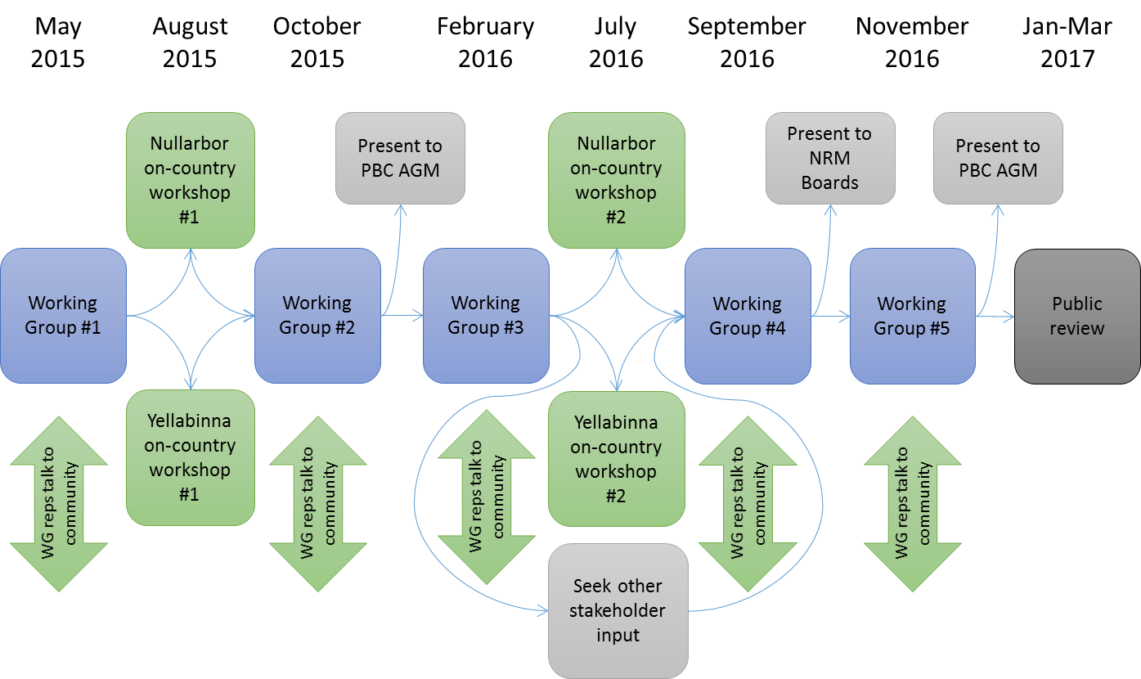
Deciding what the Plan is all about
Pre-planning
Timeline: What tasks done by when?

Slide 16

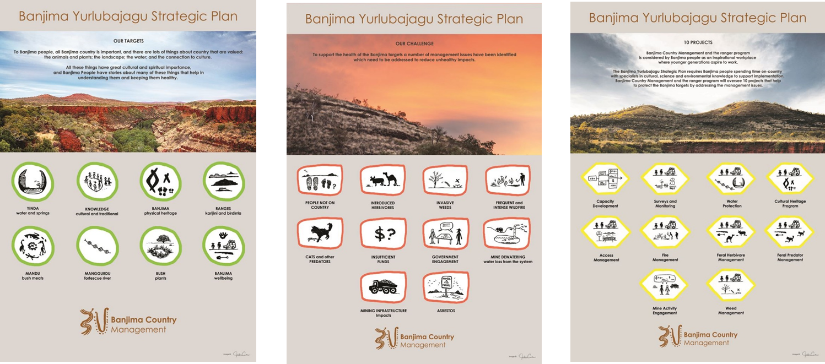
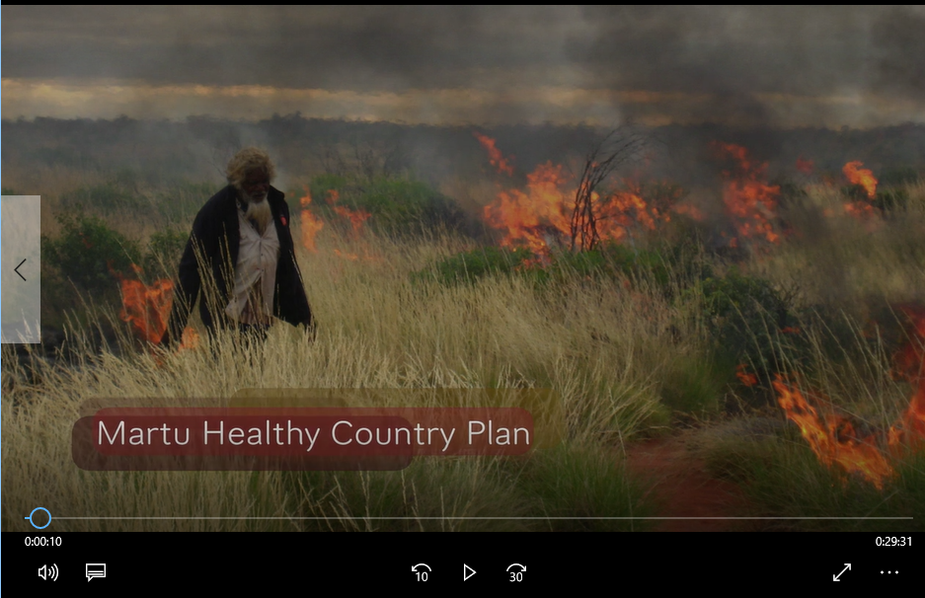
Deciding what the Plan is all about
Pre-planning
Products: What comes out the end?

Slide 17
Deciding what the Plan is all about
Pre-planning
Capacity: can we do this ourselves?
Capacity: can we do this ourselves?
    Funding for help
    Remote help for process

Slide 18
Deciding what the Plan is all about
Pre-planning
Key things to consider
Establish clear goals for the process
Respect participants time
Use enough facilitators and co-facilitators
Allow time for review and feedback
Discuss location – on-country / town
Work with a sub-group of the community on complicated steps
Preparation is the Key

Slide 19
Deciding what the Plan is all about
Pre-planning
A 12 month example
Step | Who | When | Cost | Preparation
Stage of HCP | Specific people to be involved | Approx. time to complete | Budget | What needs to be done
Preparation | Elders / PBC / rangers etc | April 2011 1 day | 2 staff for 2 days plus $2k | Prepare maps, send process guide
Mapping / background | Elders, rangers, external experts | May-July 2011 2 x 1 week field | 1 staff x 10 days, plus $50k | Logistics
Boundary / Dream/ Targets | Community | July 2011 4 days | 2 staff for 10 days plus $20k | Camp site, catering, background reports
Health / Threats + review | Staff | Aug - Sept 2011 5 days | 1 staff x 5 days | Complete Targets
Situation Analysis + review | Steering Group | Sept 2011 2 days | 1 staff x 5 days plus $5k | Complete Viability
Goals / Strategies + review | Community | October 2011 4 days | 2 staff for 10 days plus $20k | Camp site, catering, background reports
Action Planning + review | Steering Group | November 2011 4 days | 2 staff x 5 days plus $5k | Complete Strategies
Drafting | Staff | Dec-Mar 2011/12 20 days | 1 staff x 20 days plus $15k | All stages completed
Approval | Community | April 2012 2 days | 2 staff for 5 days plus $20k | All stages completed

Slide 20
Deciding what the Plan is all about
Pre-planning
Workshop Activity
Look at the Sheet and consider:
  Questions that can help us in this part
  Considerations for planning on country
  Products generated in this step
Discuss the questions
Draw-up plan to plan

Slide 21



Deciding what the Plan is all about
Pre-planning
Additional resources

