Slide 1
Threats to our Targets
Problems and their Causes

Slide 2
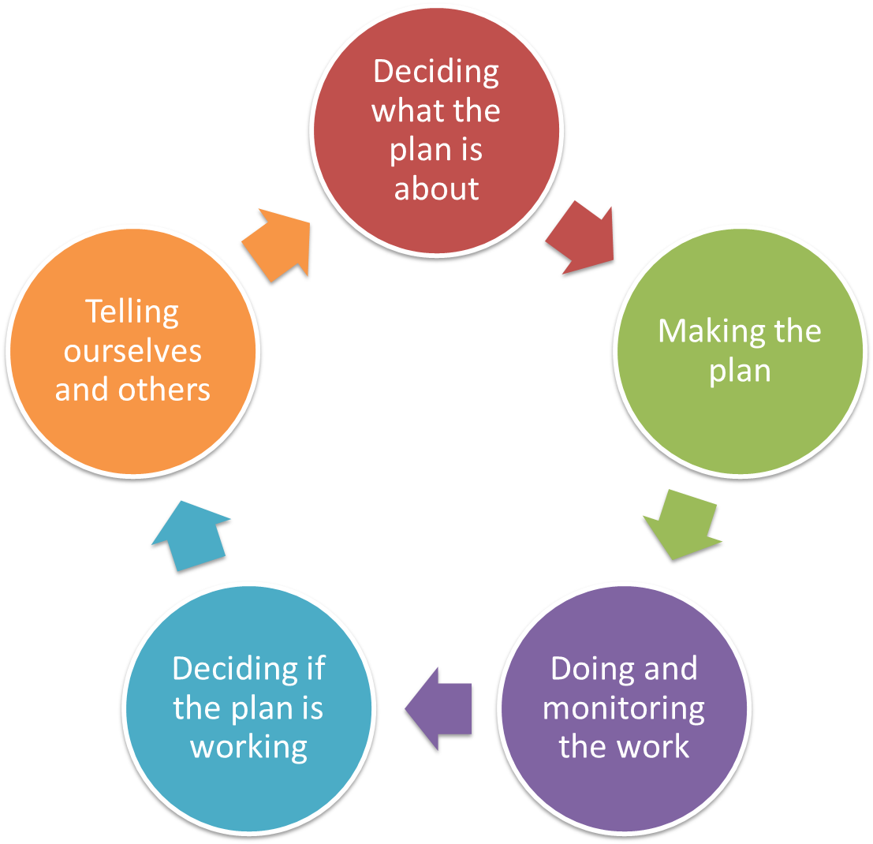
Pre-planning
Vision & Scope
Targets & Health
Threats
Situation
Notes:
Pre-planning is 1st step, irrespective of the ‘entry point’

Slide 3
Deciding what the Plan is all about
Threats
Problems and their causes
Why we do this step?
To identify the most critical threats to our targets that are stopping us from having healthy country
To focus on the causes of problems as a path for action, not just the problem itself
Note
This step builds on our work with Viability

Slide 4
Deciding what the Plan is all about
Threats
Problems and their Causes
A Threat is the thing that is stopping our target from being healthy
A threat is made up of two parts:
when one of the attributes / indicators is getting worse that is a problem
whatever is making the problem happen is called a cause
The cause is what we would call a Threat
Can also be Threat = Stress + Source
We usually work on causes

Slide 5
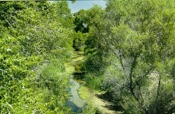
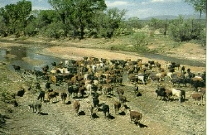
Deciding what the Plan is all about
Threats
Problems and their causes
Targets
Problems
Causes
Problems: Hurt the health of targets —e.g. erosion, trampling
Causes: The thing that makes the problem happen — e.g. cows in the stream
Notes:
The conservation targets for a site are the same types of targets as used in ecoregional planning: species, communities, ecological systems. Once identified, we assess the viability of the target occurrences at the site, just like in ecoregional planning.
EXAMPLE: at the upper San Pedro River site in Arizona, one of the targets is the riparian forest system that includes all of the plant communities that occur in the floodplain.
After we’ve set our targets and done our viability assessment, we need to identify and assess the stresses to the target (I.e. how they are degraded). Stresses on the riparian forest at the San Pedro site include:
direct loss of riparian forest habitat, and
alteration of natural processes (flow, sedimentation) that maintain the forest
We then need to identify the sources of stress. To do this, we consider two factors:
the contribution that the source makes to the stress
the irreversibility of the stress
In our San Pedro example, inappropriate grazing is causing, or is the source of, the loss of habitat and alteration of ecological processes. Just as the setting of targets, goals, and viability helped us to describe and understand our ecoregion, the 5-S framework is the descriptive component of the site planning process.

Slide 6
Deciding what the Plan is all about
Threats
Problems
Problems are what degrade or impair attributes / indicators
Examples -- Problems:
Habitat destruction -- affects area of habitat or occurrence area (Size)
Changed riparian habitat -- affects characteristic native species (Condition)
Altered fire regime – affects fire intensity (Context)
Loss of knowledge – affects cultural practices (Culture)

Slide 7
Deciding what the Plan is all about
Threats
Causes
Causes are the direct thing making a problem happen
Examples:
Invasive Weeds
Incompatible tourism
Incompatible operation of dams/reservoirs
Fire suppression
Incompatible fishing
Feral Animals
Causes are the actual threats we must address!

Slide 8
Deciding what the Plan is all about
Threats
Hints
The best way to do this step is with a small well-informed and knowledgeable team
Use information from any previous steps to identify stresses / sources (problems / causes)
Either use the software tools (eg Miradi) to help rank the threats, or rank threats using criteria from the guide
For Rapid approach: Skip the stresses step and identify possible causes and rank them using severity and scope. This will save a lot of time.
You will need a good sense of humour for this step

Slide 9
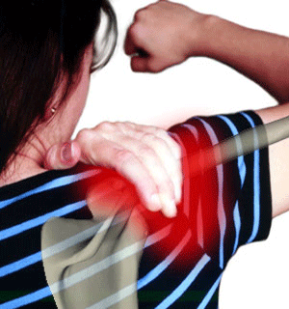
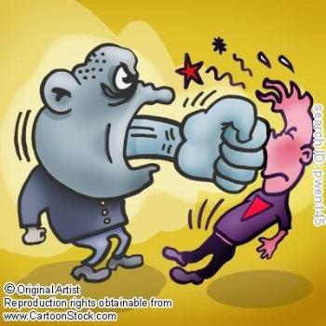
Deciding what the Plan is all about
Threats
Why identify causes?
PROBLEM
Shoulder pain
Being hit
Swimming
CAUSE:
MANAGEMENT:
Avoid the person
Stop swimming

Slide 10
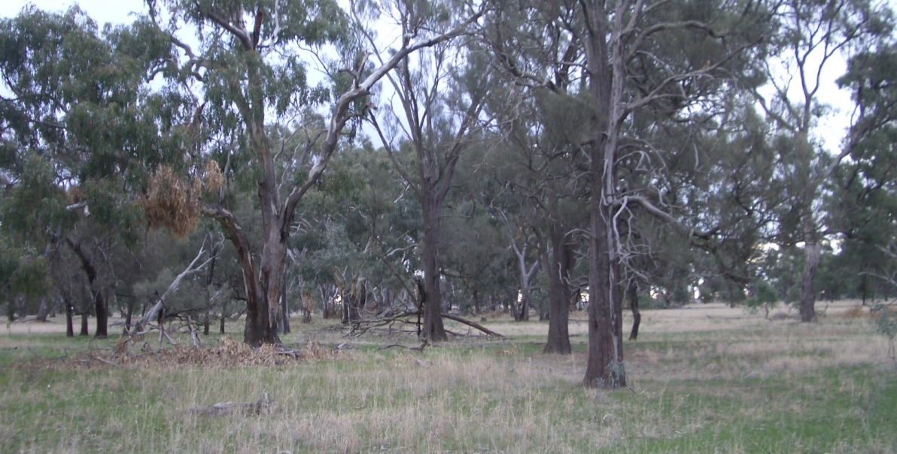
Target: Eucalypt Woodland
Deciding what the Plan is all about
Threats
Example Problem
Indicator: Fire Regime

Slide 11
Target: Eucalypt Woodland
Deciding what the Plan is all about
Threats
Example Problem
Indicator: Fire Regime
Problem: Changed fire regime

Slide 12
Target: Eucalypt Woodland
Deciding what the Plan is all about
Threats
Example Causes
Indicator: Fire Regime
Problem: Changed fire regime
Causes: Over Grazing, campers
neighbours fires

Slide 13
Deciding what the Plan is all about
Threats
Ranking
How bad and area of damage reasonably expected within 10 years under current circumstances
How bad (Severity)
Destroy or eliminate
Seriously degrade
Moderately degrade
Slightly impair
Amount of Damage (Scope)
Very widespread —everywhere the target is
Widespread
More local
Very local
Is it Fixable (Irreversibility)
Not fixable, for all intents and purposes
Fixable but really expensive
Fixable with reasonable commitment of resources
Easily fixable at relatively low cost

Slide 14
Deciding what the Plan is all about
Threats
Example Ranking Causes
Target: Eucalypt Woodland
Indicator: Fire Regime
Problem: Changed fire regime
Causes | Amount | How bad | Fixable | Total
Grazing | 2 | 2 | 2 | 8
Campers | 1 | 2 | 2 | 6
Neighbours | 2 | 2 | 1 | 4

Slide 15
Deciding what the Plan is all about
Threats
Final Product: Summary of Threats
Example – Gondwana Link – Fitz-Stirling
Threats Across Targets | Creeks | Proteaceous rich communities | Tammars and Black-gloved Wallabies | Mallet and moort woodlands | Flat-topped Yate or Swamp yate | Fresh Water Systems | Overall Threat Rank
Project-specific threats | 1 | 2 | 3 | 4 | 5 | 6
Fragmentation | Medium | High | High | Low | High | Medium | High
Climate change | Medium | High | - | High | High | Medium | High
Inappropriate fire management | Low | High | High | High | Medium |  | High
P.cinnamoni and other pathogens |  | Very High |  |  |  | Medium | High
Predation by feral species |  | Low | Very High |  |  | Low | High
Invasive Non-Native/Alien Species (weeds) | Medium | Medium |  |  | High | Low | Medium
Clearing-induced hydrological change | Medium |  |  |  | High | Medium | Medium
Unknown Yate decline factor |  |  |  |  | High |  | Medium
Cropping practices | Low | Medium |  | Medium | Low | Medium | Medium
Grazing practices | Low | Medium |  | Low | Medium | Medium | Medium
In stream barriers | Low |  |  |  |  |  | Low
Threat Status for Targets and Project | Medium | Very High | High | High | High | Medium | High

Slide 16
Alternative approaches

Slide 17
Deciding what the Plan is all about
Threats
Approach # 1
Ranking Problem and Cause
How bad and area of damage reasonably expected within 10 years under current circumstances
Amount of Damage
Very widespread —everywhere the target is
Widespread
More local
Very local
How badly Damaged
Destroy or eliminate – where it operates
Seriously degrade
Moderately degrade
Slightly impair

Slide 18
Deciding what the Plan is all about
Threats
Approach # 1
Ranking Problem and Cause
Contribution – how much of the problem does it cause
Very large contributor
Large
Moderate
Low
Fixable -- Can the problem this cause creates be fixed?
Not fixable, for all intents and purposes
Fixable but really expensive
Fixable with reasonable commitment of resources
Easily fixable at relatively low cost

Slide 19
Deciding what the Plan is all about
Threats | Approach # 2 Participatory Conservation Planning (threat/target)
On a wall / tarp, put a card up with the Target
Discuss immediate threats (problems)
Then discuss causes of those problems
Rate each of the links
Very High = 4
High = 3
Medium = 2
Low =1
Cropping
Grazing
3
2
Less frequent fire
2
4
Loss of grass area
Grasslands
3
4
Regulation
Clearing

Slide 20
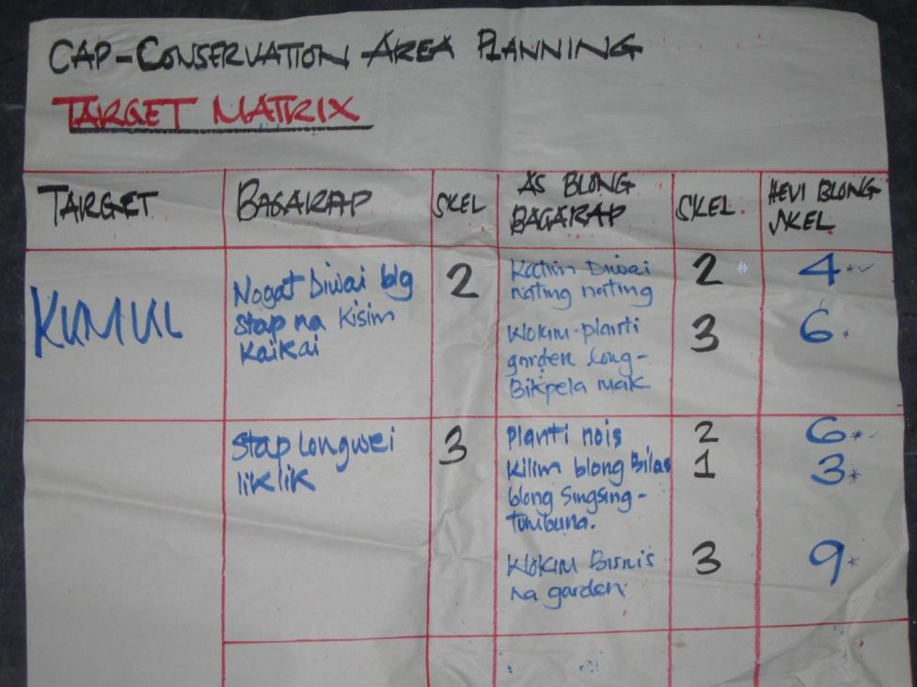
Deciding what the Plan is all about
Threats | Approach # 2 Participatory Conservation Planning (summary)
 |  | TARGETS |  |  |  |  | Level of Threat
CAUSES
Grasslands | Art Site | Dugong | Tidal zone | Waterholes
Cropping
Grazing
Campers
Poor Fire
Exploration
25 | 6 | 8 | 6 | 14
12 | 14 | 4 | 8 | 16
10 | 18 | 4 | 6 | 14
16 | 12 | 8 | 4 | 10
8 | 8 | 4 | 12 | 16
59
54
52
50
48

Slide 21
Deciding what the Plan is all about
Threats
Approach # 2
Threat Analysis of Cultural Targets
Problem: Deterioration effects
Loss of Conceptual Meaning
Destruction
Loss of traditional knowledge
Causes of Deterioration
Weathering
Looting
Inadequate management of tourism
Lack of institutional support for local/native culture
Prioritization criteria:
Severity or Intensity
Scope
Prioritization criteria:
Contribution
Irreversibility
Notes:
Adapting CAP to include cultural targets: Experiences and Lessons from Mesoamerica and the Caribbean
Estuardo Secaira and Maria Elena Molena

Slide 22
Deciding what the Plan is all about
Threats
Hints
The best way to do this step is with a small well-informed and knowledgeable team
Use information from any previous steps to identify stresses / sources (problems / causes)
Either use the software tools (eg Miradi) to help rank the threats, or rank threats using criteria from the guide
For Rapid approach: Skip the stresses step and identify possible causes and rank them using severity and scope. This will save a lot of time.
You will need a good sense of humour for this step

Slide 23
Deciding what the Plan is all about
Threats
Hints
Encourage teams to refer often to the definitions of Very High, High, Medium, and Low to ensure consistency
Teams often over-rank future threat by letting current condition creep into their consciousness; this is already accounted for in a “Poor” or “Fair” Viability rank
Probe for specificity of High-ranked direct threats
sooner or later the devil will be in the details
Another test to consider for stress-based rankings...
A “Very High” stress should reduce a key attribute to “Poor”
A “High” stress should reduce a key attribute to “Fair”

Slide 24
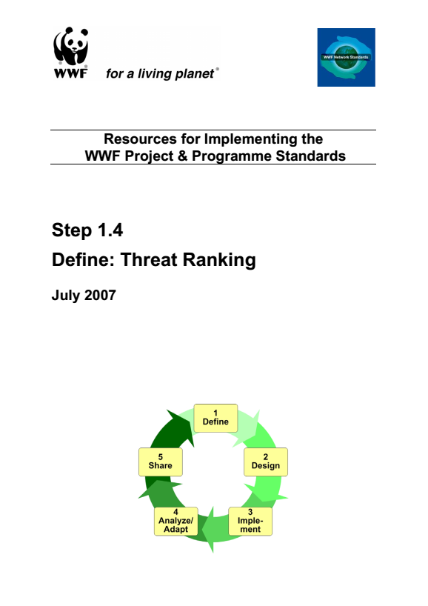
Deciding what the Plan is all about
Threats
Additional Sources

