Slide 1
Situation Analysis
Understanding the Context for Strategy Development

Slide 2
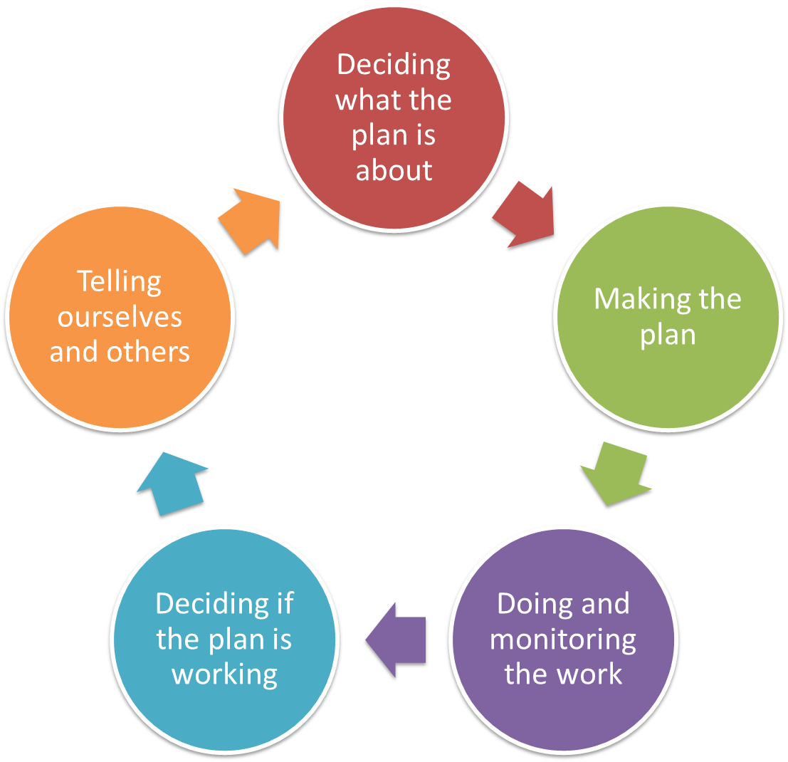
Pre-planning
Vision & Scope
Targets & Health
Threats
Situation
Notes:
Pre-planning is 1st step, irrespective of the ‘entry point’

Slide 3
Deciding what the Plan is all about
Situation
Identifying who / what causes the problems
Why we do this step?
  Talking about the links between targets, threats, and the causes of those threats helps our Strategies be more focused
  Using a diagram can really help to explain to people how we see the things working, and can form the start of our later work making a results chain.
Note
  This is the final step in ‘Deciding what the plan is all about’ before moving on to ‘Making the Plan’
  It is really easy to over-complicate this step – keep it simple

Slide 4
Deciding what the Plan is all about
Situation
Identifying who / what causes the problems
Three Basic Questions for every threat:
  What is causing this thing to happen?
  Who is involved -- directly or indirectly?
  Why are they doing it?
You must “analyze the situation” to develop robust strategies

Slide 5
Deciding what the Plan is all about
Situation
Identifying who / what causes the problems
Situation analysis is intended to help develop more robust strategies…
  Test our thinking
  Check the importance of things that cause threats or impair targets
  Identify stakeholders
Focus on critical threats or target viability
Probe for opportunities, not just causes

Slide 6
Deciding what the Plan is all about
Situation
Using a Box and Arrow Diagram
Who is
involved?
Who else cares?
What is causing
this threat?
Why?
Direct
Threat
Target
Dive
Tour
Boats
Tourism
Assoc
No
Moorings
Anchor
Damage
Offshore
Reefs
Notes:
A good conceptual model contains the target condition on one side, and a number of factors (stresses and sources) and strategies linked to this target condition.
First we create a Initial Conceptual Model, which describes the site’s target condition, factors (stresses and sources) and relationships prior to the start of you project. Later we will add project strategies (including goals and objectives) to come up with your Project Conceptual Model.

Slide 7
Deciding what the Plan is all about
Situation
Identifying who causes the problems
There is no one right way…
Some teams use box & arrow diagrams
Others use probing questions
Situation diagramming is a way of capturing a situation analysis

Slide 8
Deciding what the Plan is all about
Situation
Example
Stick the threats up on the wall / tarp, one at a time, and link them to the targets they most impact.
Use threats that have a direct impact.
Now add new cards describing who or what is causing the threats
Look for key influence, links etc, as well as review previous work for low viability or high threat
Cropping
Consumer Demand
Grasslands
Pastoral Co
Grazing
Art Site
Feral Cattle
Campers
Dugong
Tenure
No TO Access
Tidal Zone
State Gov
Poor Fire
Tourism Body
Tourism Strategy
Waterholes
Exploration

Slide 9
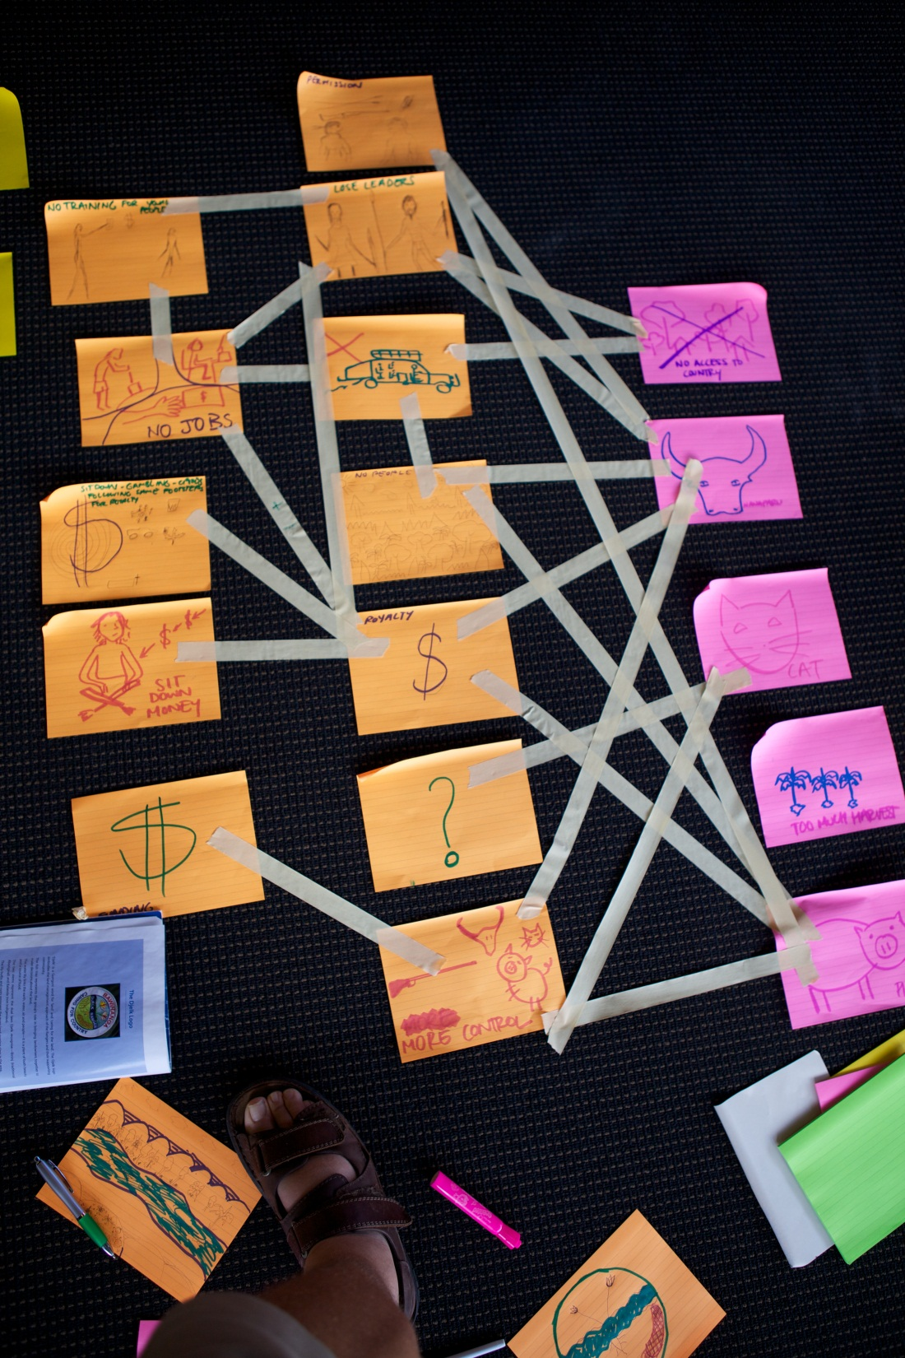
Deciding what the Plan is all about
Situation
Example

Slide 10
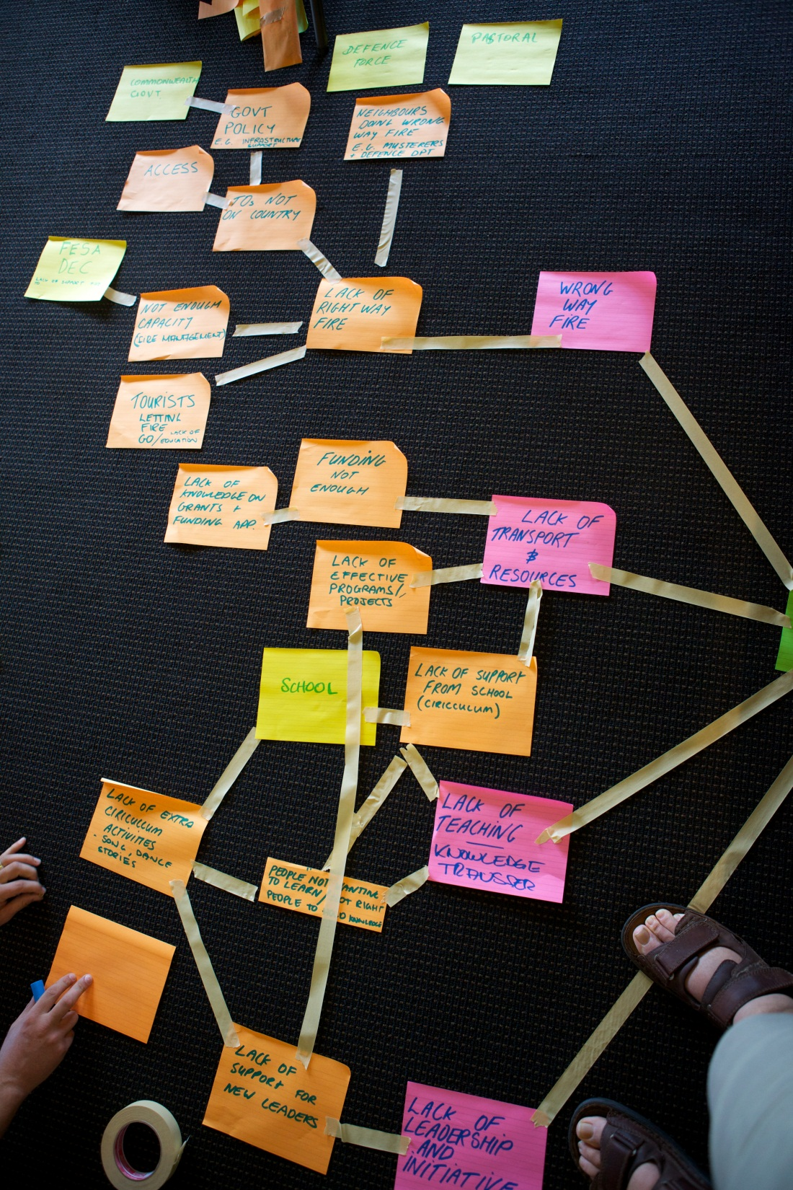
Deciding what the Plan is all about
Situation
Example

Slide 11
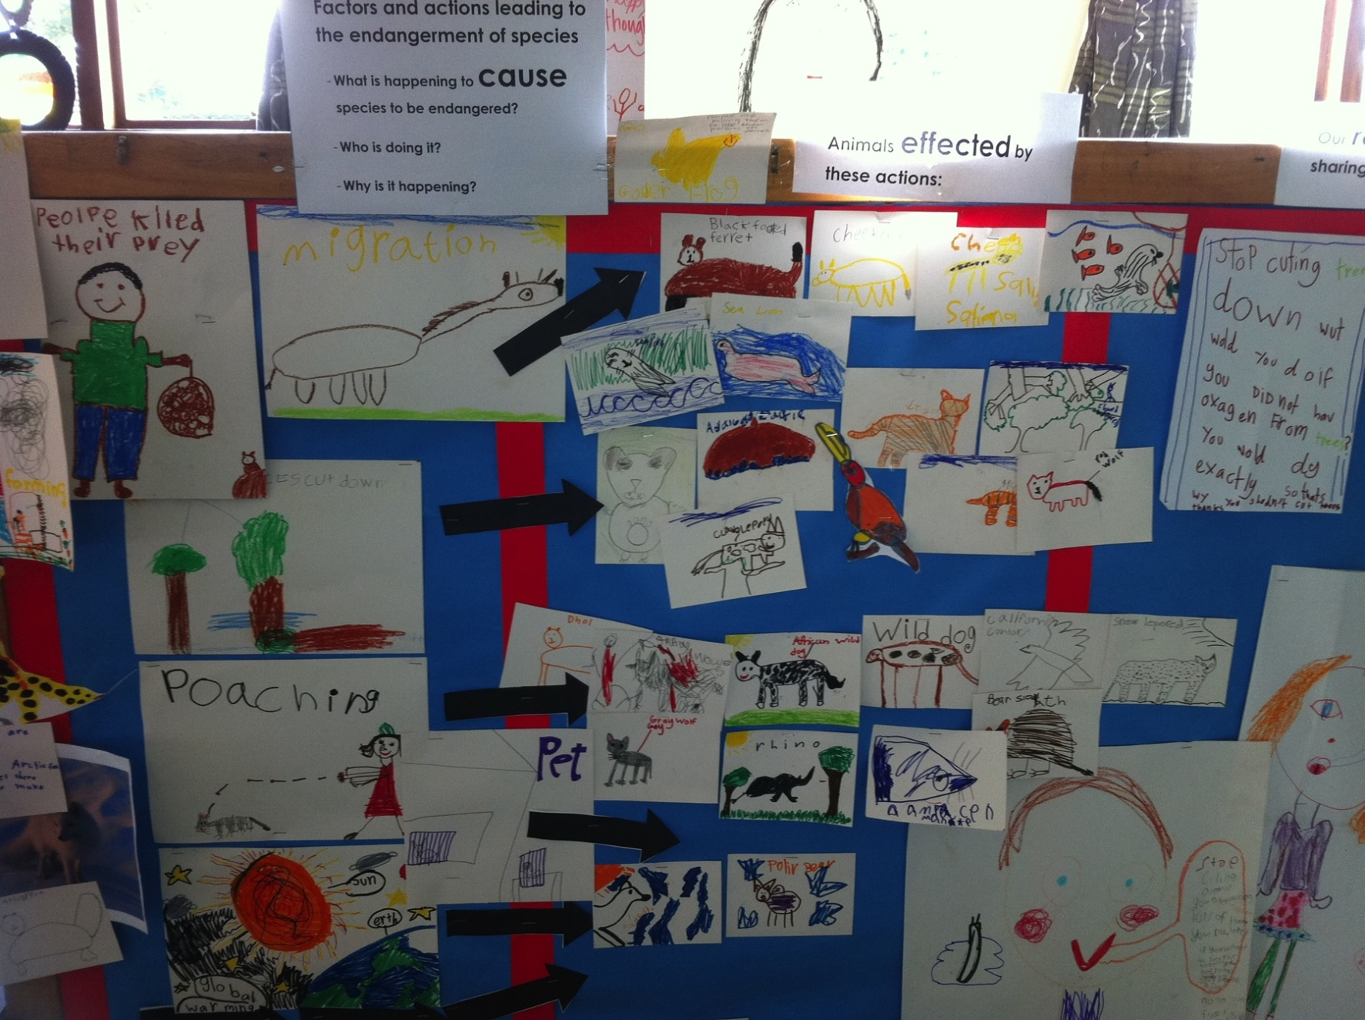
Deciding what the Plan is all about
Situation
Example
„Stop cutting down trees.
What would you do if you did not have oxygen from trees?
You would die, exactly! So thats why you shouldn‘t cut trees. Thanks!“

Slide 12
Deciding what the Plan is all about
Situation
A couple of tips
Making a situation diagram is a very hands-on activity
It involves creating a picture of the links between the Targets, their immediate threats, and the causes of those threats
You can do this with the whole group if there are not many targets, but if there are a lot break it up

Slide 13
Deciding what the Plan is all about
Situation
A couple of tips
Too much detail can make a conceptual model into a spaghetti-mess (<10 threats / <25 factors).
This is an iterative process, so the team can (and SHOULD!) change their model as new or different information becomes available.
Best to analyze one target and critical threat at a time… but make sure that you capture factors that contribute to more than one threat

Slide 14
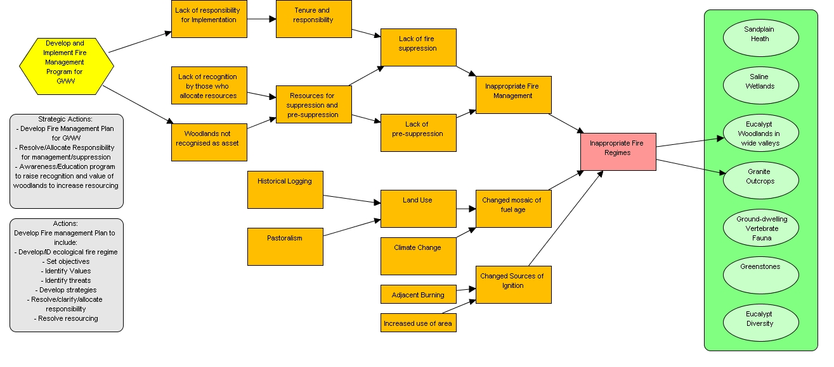
Deciding what the Plan is all about
Situation
Identifying who causes the problems
Who are the key stakeholders with vested interest in the project, what factors are driving critical threats, and what opportunities exist?

Slide 15
Deciding what the Plan is all about
Situation
Stakeholder Analysis
Once you have completed the situation analysis you can look at your stakeholder list and think about how you might work with them
 | Significant Influence | Some Influence | Little Influence | No Influence
Significant Importance
Some Importance
Little Importance
No Importance
Pastoral Co
State Gov
Mining Co
Campers
Shire
IPA Team
Tourism Body
Rec Fishers
Media

Slide 16
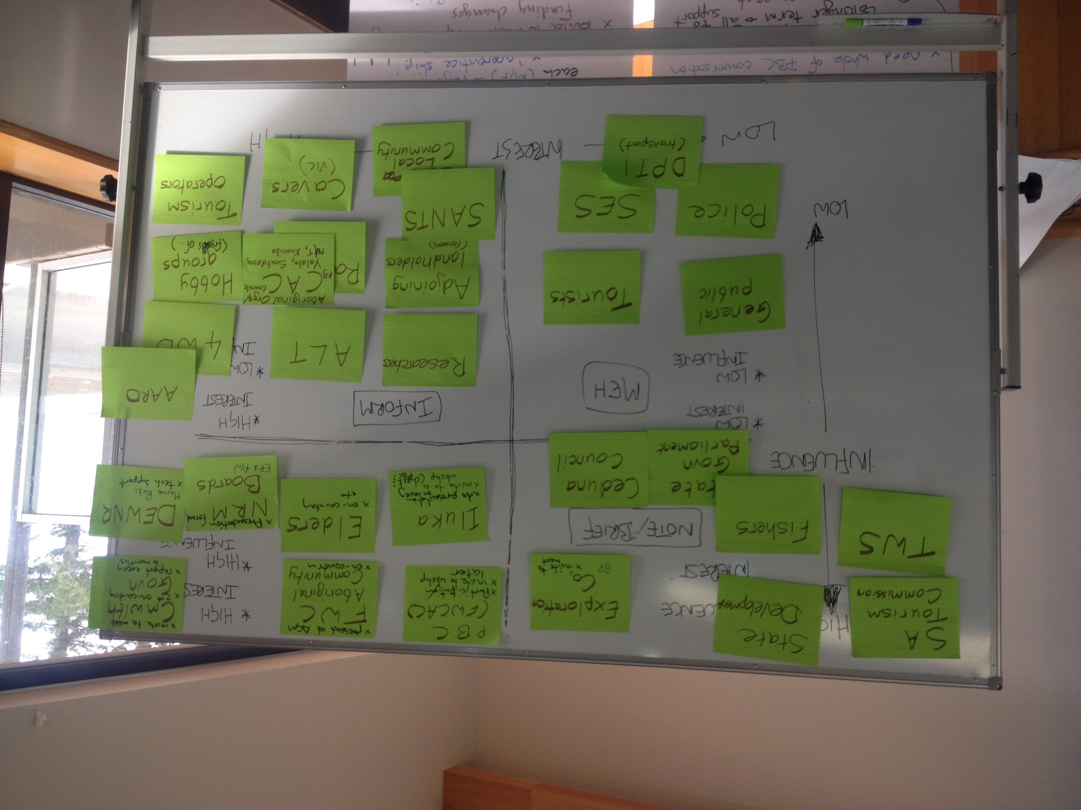
Deciding what the Plan is all about
Situation
Stakeholder Analysis

Slide 17
Deciding what the Plan is all about
Situation
Hints
Preparing (before you get together):
Involving the right people is KEY
  To develop robust strategies, you must have knowledgeable people involved who can help you to understand what factors are driving the current situation
This step should be given enough time so that your team can adequately understand key issues for strategy development. This may involve more than one round of discussion, so plan accordingly.

Slide 18

Deciding what the Plan is all about
Situation
Hints
Facilitating the Discussion:
Start with a target and a critical
threat ranked Very High or High
What is driving this threat? Who? Why, why why?
Probe for opportunities, not just
indirect threats
There is no one right way to facilitate this step…
Some coaches and teams use conceptual models to capture and stimulate discussion
Others find it more valuable to allow a free flowing discussion and capture key points on a flip chart page
All use probing questions

Slide 19
Deciding what the Plan is all about
Situation
Hints
Reflecting on the Discussion:
Does the situation analysis focus on the factors contributing to critical threats and/or targets with impaired viability?
Have all relevant types of factors been considered? (e.g., economic, political, cultural, institutional)
Have inconsequential, irrelevant or redundant factors been excluded?

Slide 20

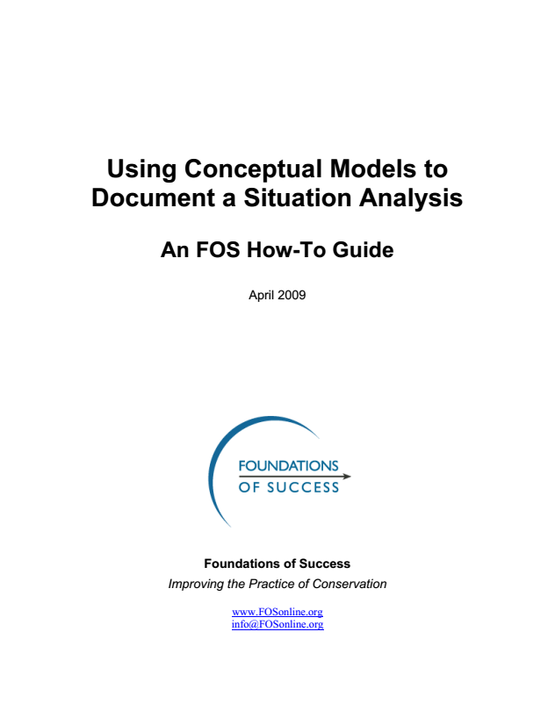
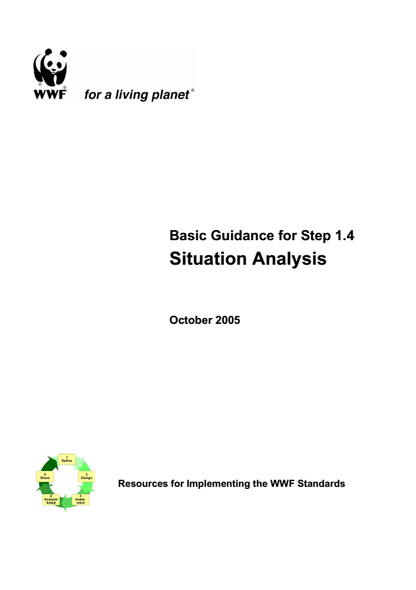
Deciding what the Plan is all about
Situation
Additional resources

