Slide 1
Goals
The first step in
Making the Plan

Slide 2
Deciding what the plan is about
Goals
Strategies
Results chains
Measures
Telling ourselves and others
Making the plan
Deciding if the plan is working
Doing and monitoring the work

Slide 3
Making the Plan
Goals
Recap
We have established our Project Area and Vision – where we are working and why
We have identified our Targets – what is important to look after on country
We have said how we know if our Targets are healthy, and how healthy they are
We have identified what the threats are, and which ones are most important
We have made a diagram to look at who is influencing our targets and threats.
These all give us the information we need to make a good plan.

Slide 4
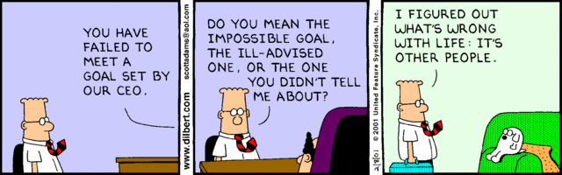
Making the Plan
Goals
Achievable goals

Slide 5
Making the Plan
Goals
What’s next is ….
Describe our desired Goals to guide us
Brainstorm Strategies to reach our Goals
Select the best Strategies based on benefit / cost
Develop project roadmap to make sure our strategy will get us to our Goal
Describe the Actions we need to do to make our Strategies happen
Monitor our work to tell us when we reach our Goals

Slide 6
Making the Plan
Goals
A note about language
Different places use different language for ‘goals’, ‘strategies’, ‘actions’ etc
Don’t sweat it! Use what you are comfortable with.

Slide 7
Making the Plan
Goals
Example
Goal: To be able to provide dinner for the family tonight
Strategy: Go fishing this afternoon
Actions: 1. Sneak out of home; 2. Borrow mates boat; 3. Borrow other mate’s gear etc
Monitor: Did I catch fish? Did family eat?

Slide 8
Making the Plan
Goals
Example
Goal: To reduce the population of camels by 90% within 10 years.
Strategy: Eliminate all camels within 20km of any water point
Actions: 1. Map water points; 2. Buy gun; 3. Training; 4. Shoot
Monitor: How many did I shoot? Did the population go down?

Slide 9
Making the Plan
Goals
Why do we do this step?
Goals and Strategies are absolutely key to shifting to solution-focused thinking!
Goals
  What you want to accomplish
Strategies
  How you are going to get there

Slide 10
Making the Plan
Goals
Each Goal is designed to
Improve the health of a target (Poor or Fair)
  Health Goals should typically describe the “Good” rating for an attribute
Reduce a critical threat (Very High or High)
  Threat Goals should describe what is required to reduce a threat to at least a “Medium” ranking

Slide 11
Making the Plan
Goals
One goal leads to another
Not all targets will need to have a Goal – only priority ones
Not all threats will have a goal – only priority ones
Usually you will need to reach Threat Goals before reaching Target Goals
Usually you will need to meet more than 1 threat goals to meet one Target goal

Slide 12
Making the Plan
Goals
One goal leads to another
THREAT 1 GOAL
TARGET 1 GOAL
THREAT 2 GOAL
VISION
TARGET 2 GOAL
THREAT 3 GOAL
TARGET 3
THREAT 4 GOAL

Slide 13

Making the Plan
Goals
Few is good!
The job is to get the “colors” in the
Health and Threat tables from
Red & Yellow to Green –
often a life’s journey
3 to 5 well-crafted Goals / Strategies =
a lot of work!!!

Slide 14
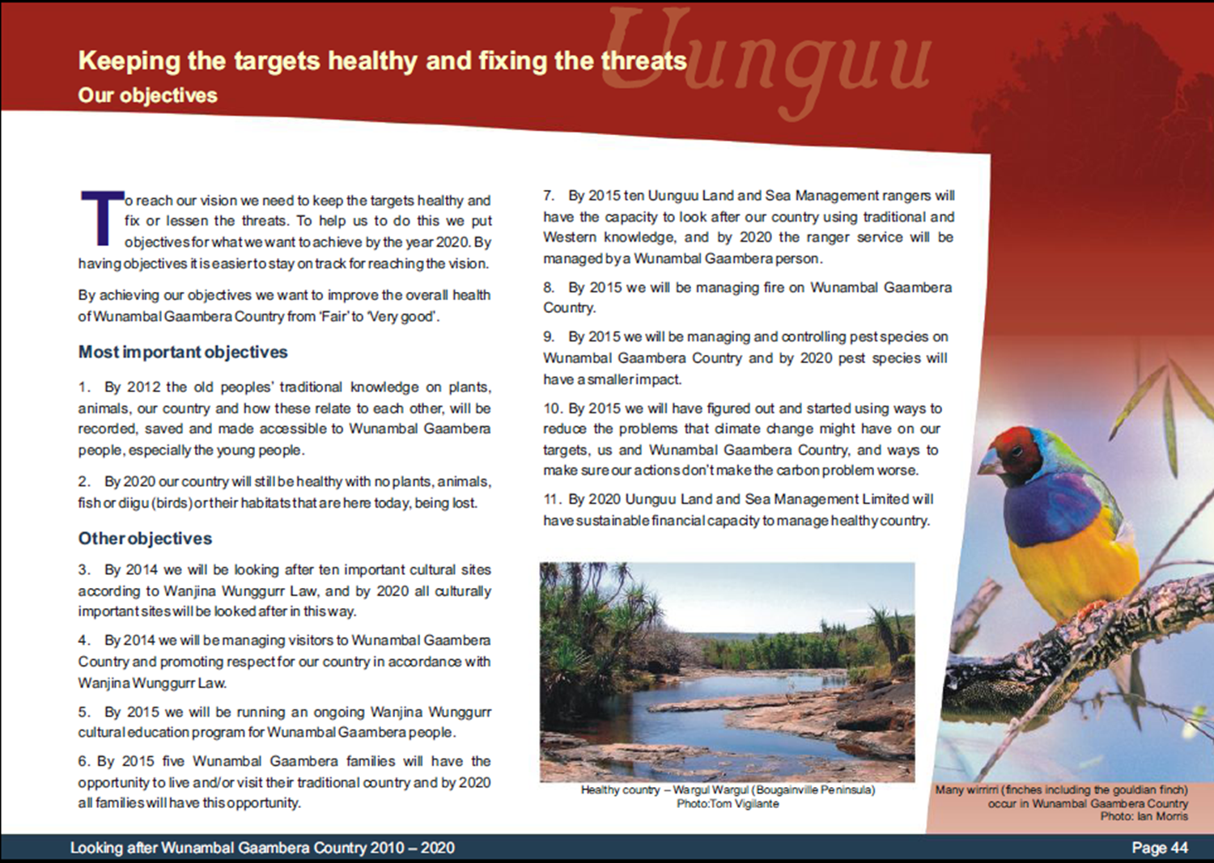
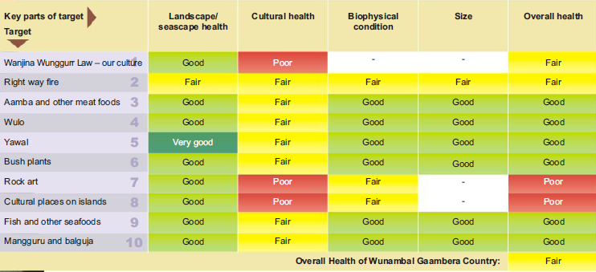
Making the Plan
Goals
Goal to improve health
Uunguu Health Summary

Slide 15

Making the Plan
Goals
use Attributes and Indicators to set Goals
Objective: By 2025, ensure “Good” base flows in summer (Dec-Mar) so that no sections of river go dry
Attribute = Hydrologic regime

Slide 16
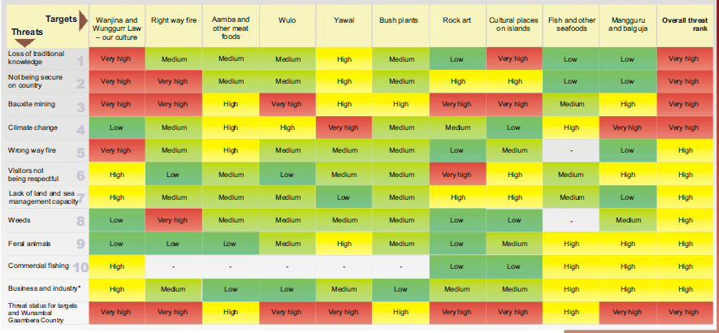
Making the Plan
Goals
Goal to deal with threats
Uunguu Threat Summary

Slide 17
Making the Plan
Goals
What are we trying to do?
Problem
Health Attribute
Target A
Cause
Problem
Health Attribute
Target B
Cause
Problem
Health Attribute
Health Goal
Threat
Goal
Threat Goal
+ Restoration
Benefit
Health
Goal
Different Types of Goals … Can be Developed at Varied Spots in the Targets-Health-Threats “Chain”

Slide 18
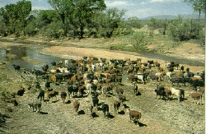
Making the Plan
Goals
Outcome-oriented Goals
Before: Reduce impacts from cattle grazing
After: Between 2012 and 2017, maintain cattle-free conditions within 100m along 75 kilometres of the Fitzroy River.
Notes:
This is a key part of the CAP process. To me, it is the most important single step.
There is guidance on how to develop good measurable objectives: e.g., measurable, time bound, feasible, etc…I won’t repeat them here.
Despite the guidance and training, this still proves difficult for many practitioners. If you remember, during the development of the 3 YIPs, for example, this was one of the most closely critiqued part of the process from a peer-to-peer perspective.
This is a simple example of what many strategies are often initially described as…and how they get turned into a measurable objective.
This is important because these measurable objectives form a basis for strategy effectiveness measures in the results chain.
In short – our CAP Process should generate the strategy effectiveness measures we need.

Slide 19
Making the Plan
Goals
Examples of Goals
Eliminate feral goats in 90% of woodlands within 10 years
Within 5 years reduce the rate of forest converted to other land uses by 50%
Reduce sediment loading to normal TDML levels on 60% of the 47 “hot spots” on Upper River
Within 10 years, achieve and maintain 60% elimination of foxes to improve recruitment of mallefowl to “good” levels (tbd)
Eliminate human disturbances (fishing, birding, jogging, dog walking) at key feeding locations (see map) during 4-week bird migration time period

Slide 20
Making the Plan
Goals
Helpful Hints...
Work hard to get the Goals right before spending time discussing Strategies.
Use To Be Determined (TBD) or “x” (or ‘dunno’) when we don’t know the answer
  Finding the answer becomes Job #1 -- a research priority
Avoid using words like “protect” in Goals - the outcome is not explicit

Slide 21
Making the Plan
Goals
Helpful Hints...
All Goals (and strategies) should be SMART
    S – Specific
    M – Measurable
    A – Actionable
    R – Realistic
    T – Timebound
Use this as a simple test
Getting this right will make the next steps much easier
    Also note that people talk about goals throughout the process, so capture them as they come up
    Developing SMART goals in a big group can be difficult – get close and tidy up later

Slide 22
Making the Plan
Goals
Which meet our criteria?
By 2010, no water concessions in identified critical grasslands and associated wetlands are granted.
Promote community wellbeing and health in the area surrounding the Indah Biosphere Reserve.
To establish a sustainable enterprise-based conservation and development project that meets the needs of local people while protecting biodiversity in the region surrounding the Indah Biosphere Reserve.
By the end of the project, annual household income for all families participating in non-timber forest product harvesting enterprises has increased by at least 20%.

Slide 23
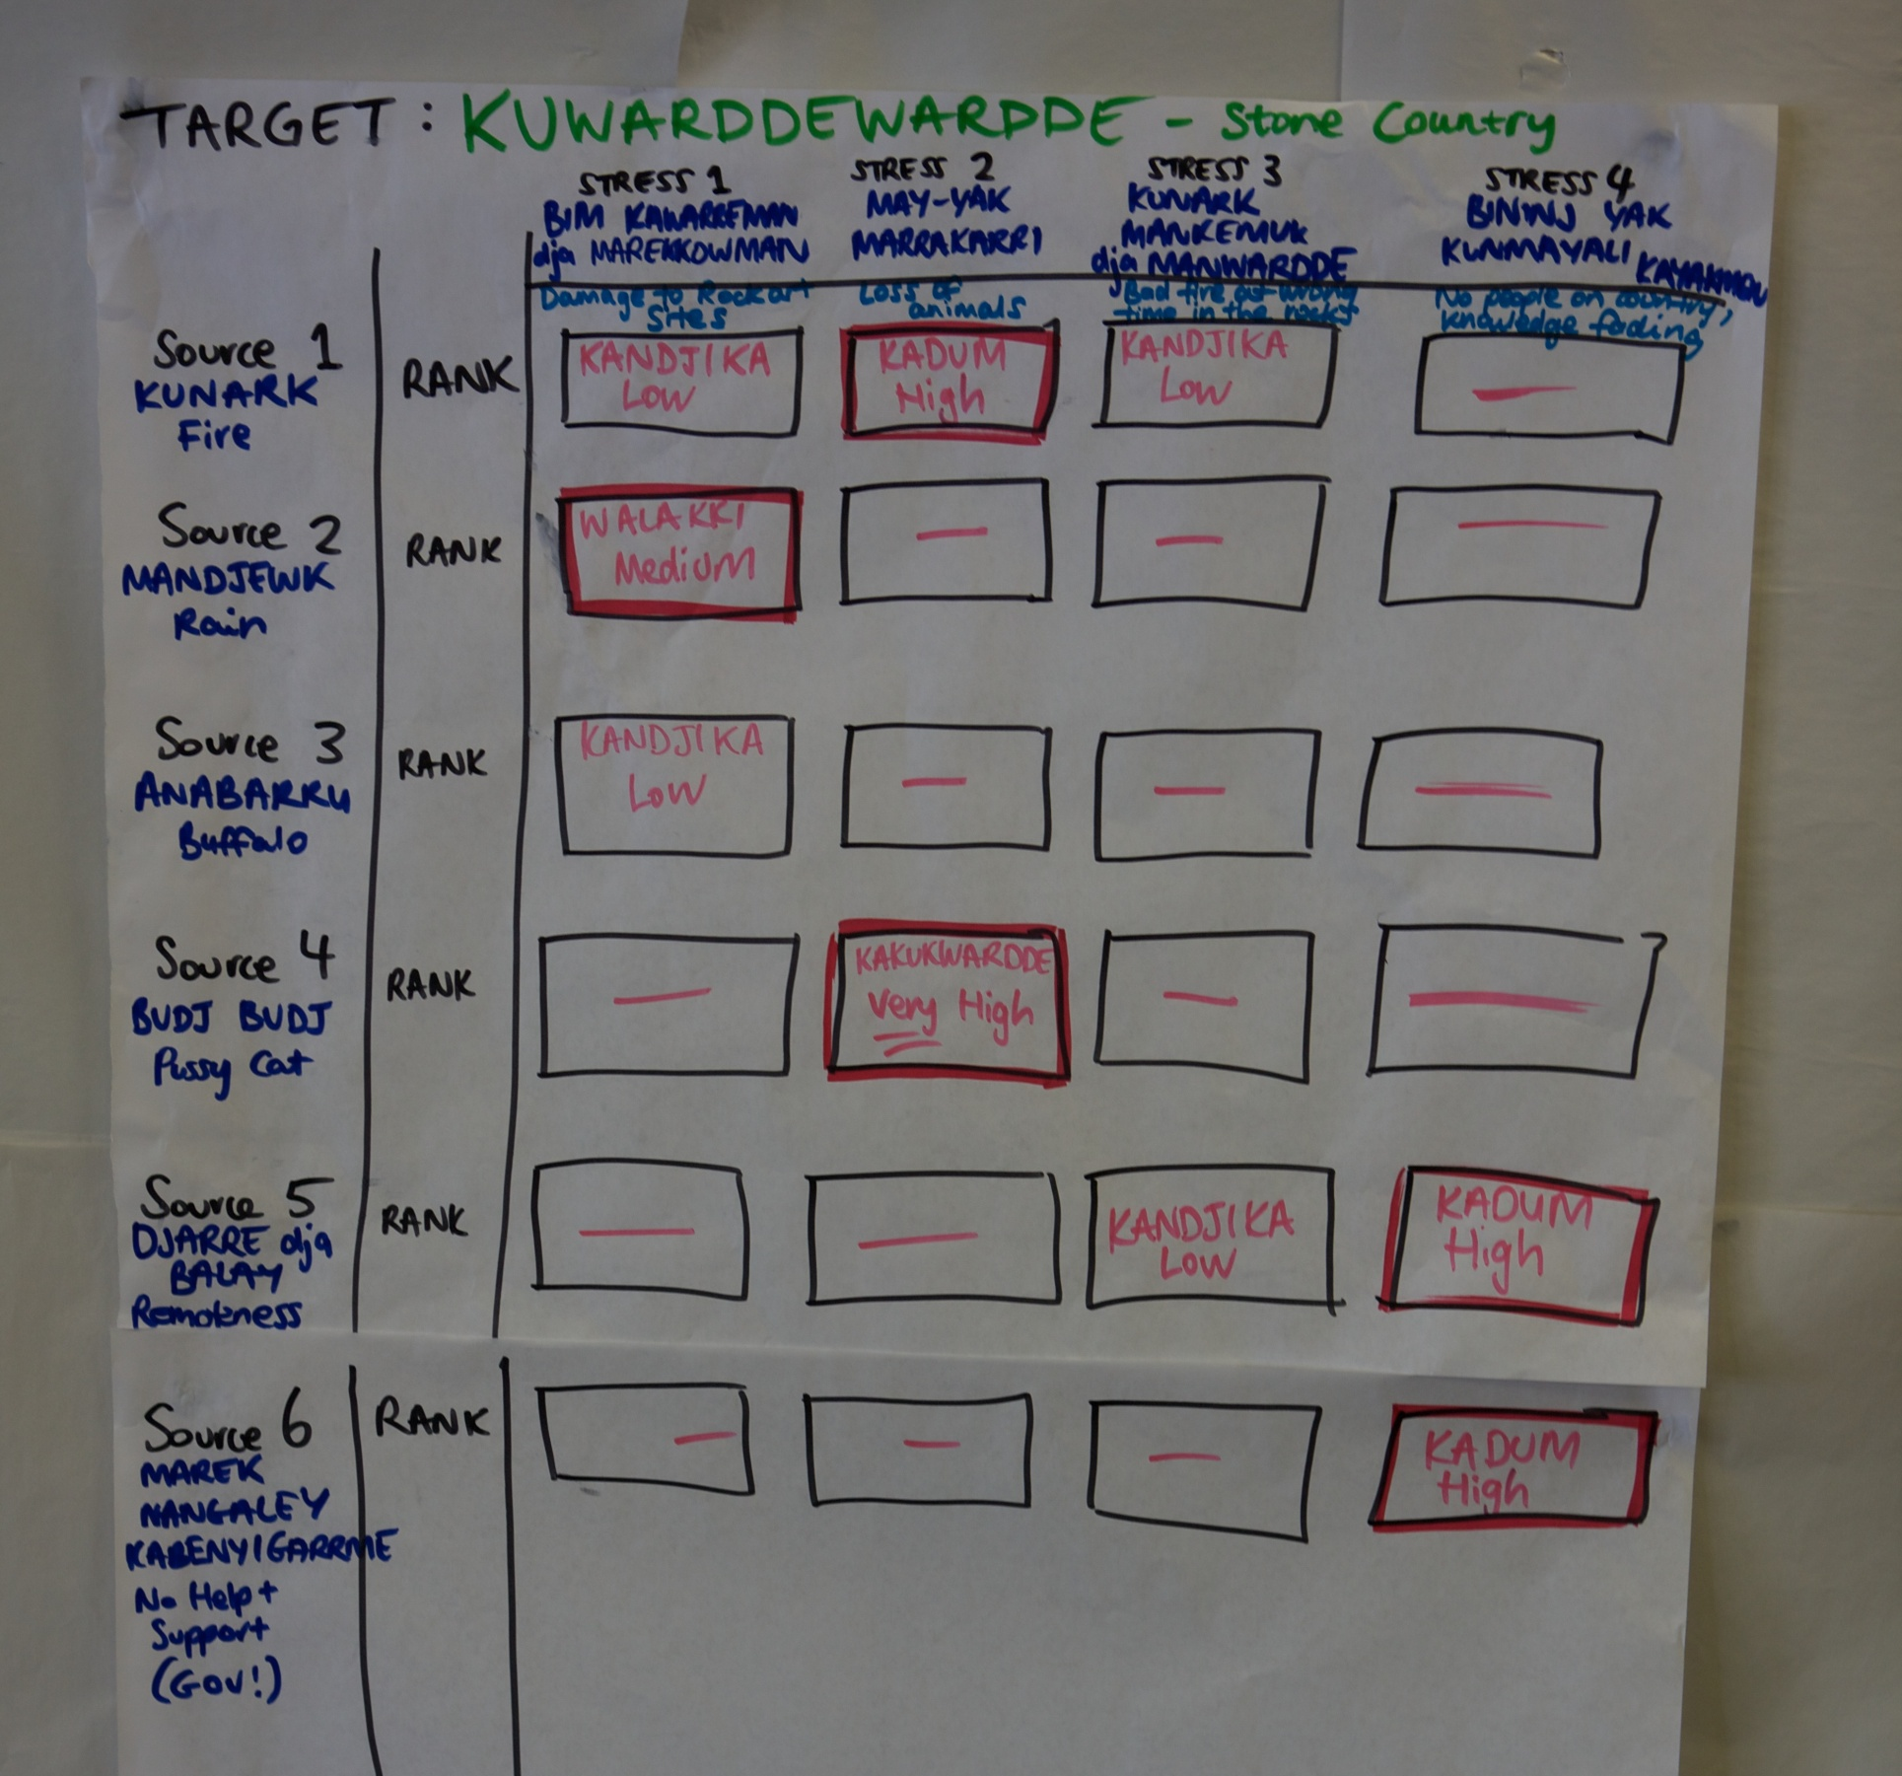
Making the Plan
Goals
Examples of Goals
The population of budj budj is reduced by 50% in the kuwarddewardde by 2016.
But, is it SMART?

Slide 24
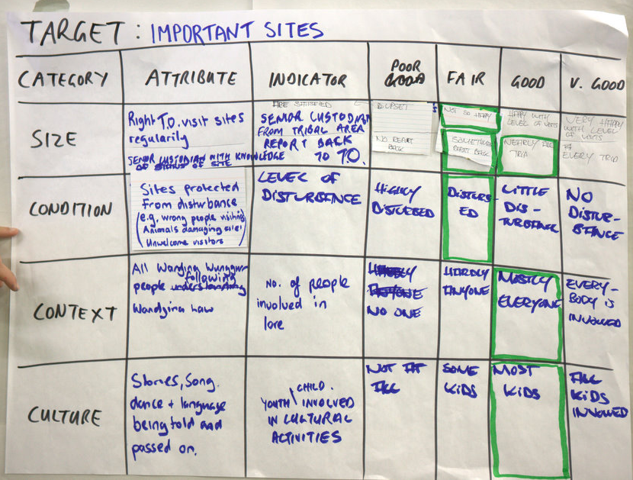
Making the Plan
Goals
Examples of Goals
Most Important Sites have little disturbance
by the wrong people
within 5 years
But, is it SMART?

Slide 25
Making the Plan
Goals
Demonstration
Target | Attribute | Indicator | Poor | Fair | Good | Very Good
Kundred dja Djang (Places & Dreamings) | Condition of landscape around Kundred dja Djang | Absence of balanda problems (weeds and ferals) from important places | Lots of signs of ferals and weeds | ✓ |  | No signs of ferals and weeds
 | Good fire regime (gamak gunark) | Disturbance of Kundred dja Djang by fire | Most places disturbed by bad fire | ✓ |  | No places disturbed by bad fire
 | (Culture) People behaving right way at places | Satisfaction of key people | Most people not behaving right way |  | Most people behaving right way
 | (Culture) People know names and stories for places | Satisfaction of key people |  | Not many people know | Most places known and named
 | (Culture) Right people are visiting sites - country not empty | Site visitation statistics |  | Most sites not visited as needed |  | All sites visited as needed
 | (Culture) Traditional resources healthy | Availability of resources |  |  | Resources available nearly all the time when needed and expected
 | Disturbance of any bim, artefacts or signs of occupation | Bim and signs of occupation not disturbed | Highly disturbed |  | Limited disturbance

Slide 26
Making the Plan
Goals
Hints
People talk Goals and Strategies throughout process – record them and who suggested them
SMART in a large group can be hard (you don’t want to tell a room full of people they are not smart!) – get close and fix later
Have as minimum, good Objectives/Goals for all critical threats and unhealthy targets that your project will take action to address.
One or more evaluated Strategy for each Goal

Slide 27

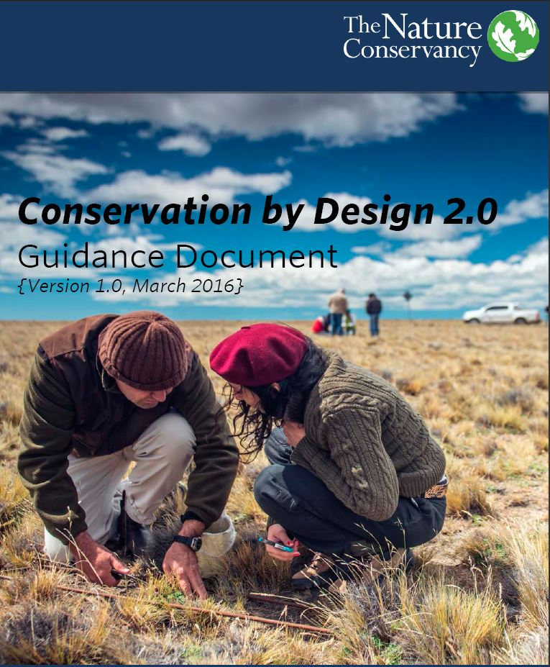
Making the Plan
Goals
Resources

