Slide 1
Strategies
Achieving our Goals

Slide 2
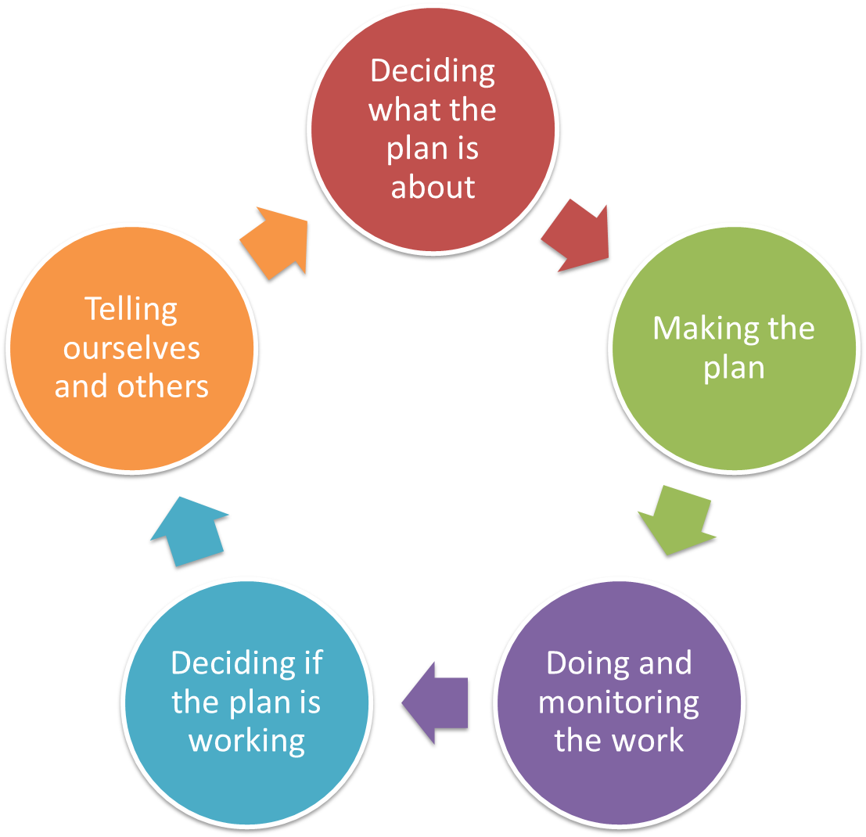
Goals
Strategies
Results chains
Measures

Slide 3
Making the Plan
Strategies
Achieving our Goals
Why we do this step?
To identify key Strategies that will move us directly to achieving our Goals
To evaluate strategies to see if they are feasible and will have an effect

Slide 4
Making the Plan
Strategies
Why and who
Start of actual plan, based on previous work
Goals and Strategies are absolutely key to shifting to solution-focused thinking
Core planning team (or even 1 person)
At least one person who is good at thinking about strategic solutions
Probably not scientists
Reality test with implementers

Slide 5
Making the Plan
Strategies
Achieving our Goals
What you do to achieve the Goal or Objective?
Strategies are a broad course of action designed to restore targets, reduce threats, and/or develop capacity.
A strategy is typically used as an umbrella term to describe a set of specific actions.

Slide 6
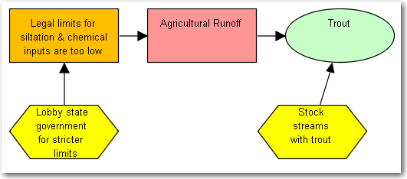
Making the Plan
Strategies
Two General Types of Strategies
Strategy Selection
Mitigation
(to reduce a threat)
Restoration
(to build health)

Slide 7
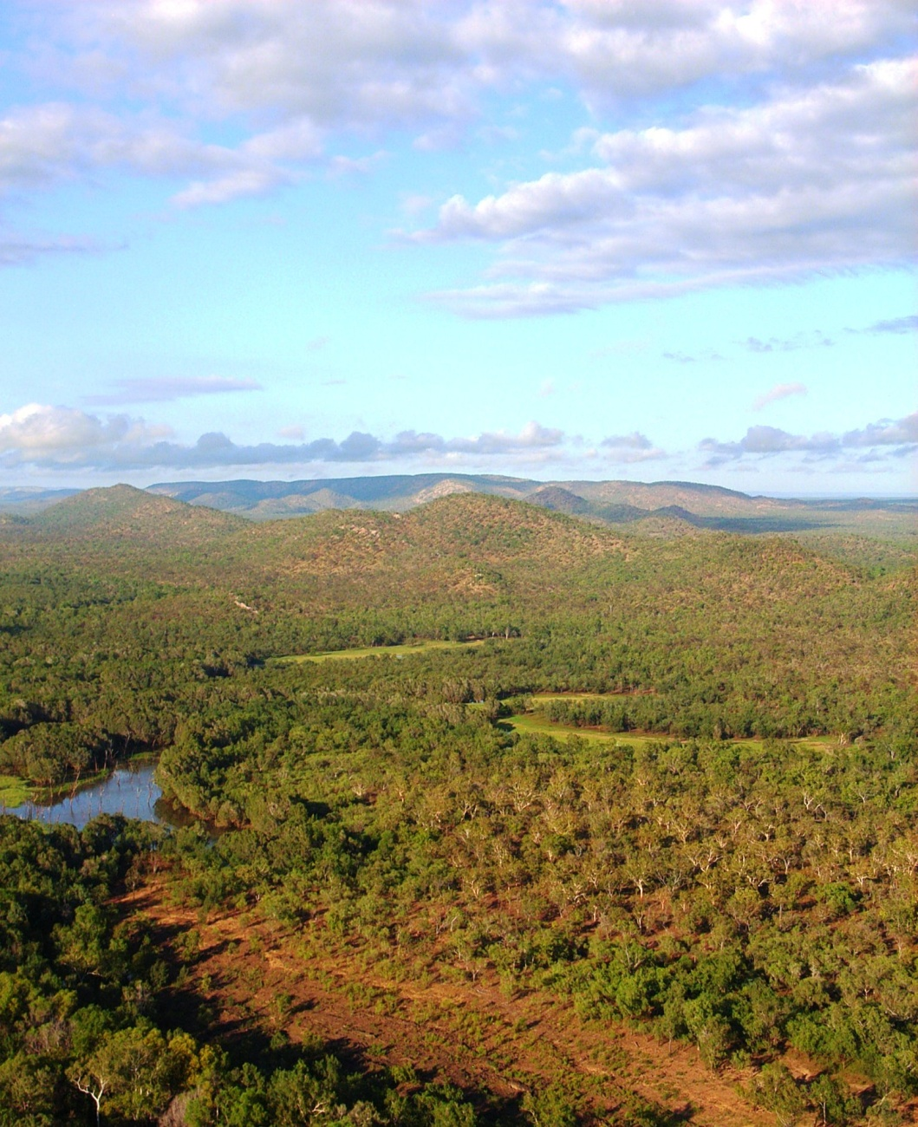
Making the Plan
Strategies
Land/water protection
Indigenous Protected Area
Joint Management
Purchase land
Purchase of Water Rights
Covenants and easements

Slide 8
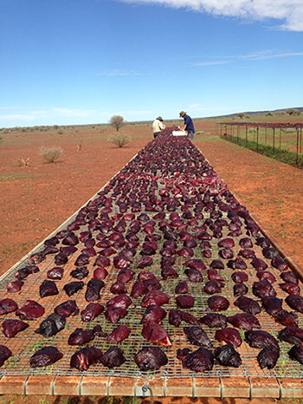
Making the Plan
Strategies
Land/water management
Fire Management
Introduced Species Control
Tourism strategy
Restoration
Influencing neighboring Management

Slide 9
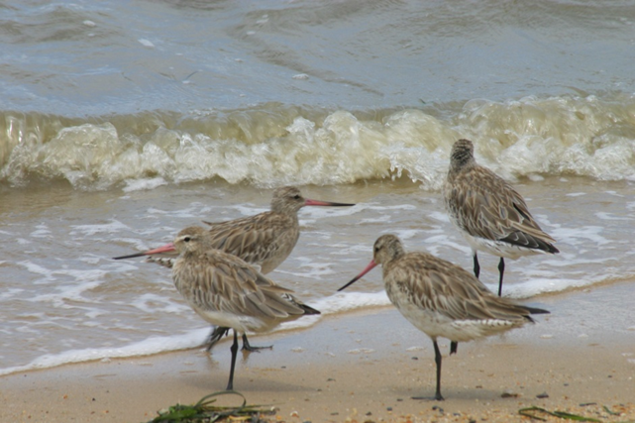
Making the Plan
Strategies
Species management
Enhancing or restoring specific plant and animal populations
Reintroducing species
Ex-situ (off-site)

Slide 10
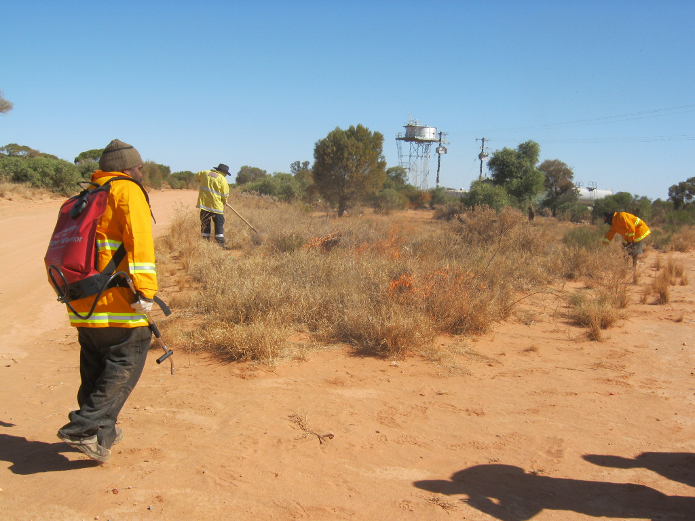
Making the Plan
Strategies
Livelihood, economic and other incentives
Enterprises that directly depend on the maintenance of natural resources
Alternative products and services that substitute for environmentally damaging ones
May also build support for a policy or other strategy

Slide 11
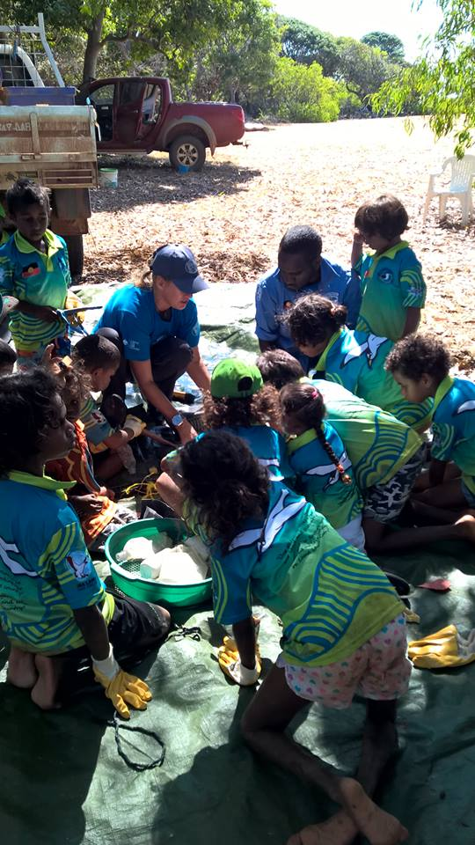
Making the Plan
Strategies
Education and awareness
knowledge, skills and information exchange
raising environmental awareness
providing information through various media

Slide 12
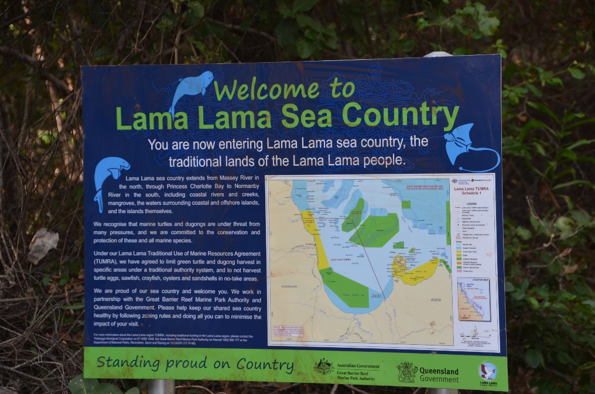
Making the Plan
Strategies
Law and policy
Legislation
Policies and regulations
Private sector standards and codes
Compliance and enforcement

Slide 13
Making the Plan
Strategies
External capacity building
Creating new local land trusts
Forming and facilitating partnerships
Raising and providing funds

Slide 14
Making the Plan
Strategies
Selecting Strategies
Complex projects & problems typically require more than one strategy
e.g., halt overfishing & dredging (threats) to save reef (target)
Strategies might need to:
demonstrate alternative practices
change policy
Communicate / educate to provide pressure from consumers
engage influential partners in a strategic alliance

Slide 15
Making the Plan
Strategies
Five Steps: mine your earlier work
Check Vision/Dream and Scope/Area
Use Situation Analysis to explore the social, political, and economic context
Review Goals
Brainstorm potential strategies that might accomplish each Goal, or multiple Goals;
Finally, select Strategies based on benefits, feasibility and costs.

Slide 16
Making the Plan
Strategies
Brainstorm, probing questions to identify strategies
Ask...
Is there an underlying cause - social, individual, cultural, economic?
Who is involved?
What are their needs?
Who else is likely to be effected +/- ?
Who will determine the outcome?
What motivates the key players?
What’s the ballpark cost? How many zeros?

Slide 17
Making the Plan
Strategies
Constructing Strategies
Certification
VS.
Change forest
code to permit
certification
Start with a verb
If useful, specify who
Clearly describing the strategy may require a longer name - or (better) a description in “details” (in Miradi)
WCS
will change forest code to permit certification
Complete legal analysis
and work with Forest
Department to change
forest code to
permit certification

Slide 18
Making the Plan
Strategies
Criteria for Strategies
Key interventions: Directly affects one or more key intervention points in your situation analysis
Focused: Outlines specific courses of action that need to be carried out
Feasible: Can be done with the project's resources and constraints.
Appropriate: Acceptable to and fitting within your cultural, social, and biological norms.

Slide 19
Making the Plan
Strategies
Deciding which one(s)
Not all ideas are gold
Need to decide between different ideas in a way that is clear
Depends on a number of factors:
Cost
Time
Capacity
Capability
Influence

Slide 20
Making the Plan
Strategies
Deciding which one
Lots of Methods for comparing alternatives
Simple voting
Constructed scales
Rating on 1-10 scale
Poor, Fair, Good, Very Good
Natural scales
Costs
Area
Pick one that works for your situation
Might use more than one

Slide 21
Making the Plan
Strategies
Deciding which one
TNC CAP
Level of contribution a strategy made to one or more objectives
Estimated viability rating improvement
Estimated threat rating reduction
Duration of benefit
Leverage
Feasibility based on lead individual / institution
Feasibility based on ease of implementation
Feasibility based on ability to motivate key constituencies
Cost estimates

Slide 22
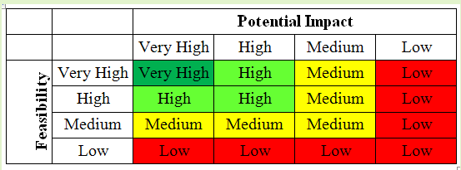
Making the Plan
Strategies
Using a simple scale
Potential Impact – how much will the strategy (if we do it) actually lead to changes we want in our project
Feasibility – how much our project team can do the strategy within likely ethical, financial/staffing, and technical / time constraints

Slide 23
Making the Plan
Strategies
Using a simple scale
Potential Impact – Degree to which the strategy (if implemented) will lead to desired changes in the situation within the scope of your project
Very High – completely mitigate a threat or restore a target.
High – help mitigate a threat or restore a target.
Medium – possibly help mitigate a threat or restore a target.
Low –probably not contribute to meaningful threat mitigation or target restoration.
Feasibility – Degree to which your project team could implement the strategy within likely ethical, financial/staffing, and technical/time constraints
Very High – ethically, technically, AND financially feasible.
High – ethically and technically feasible, but may require some additional financial resources.
Medium – ethically feasible, but either technically OR financially difficult
Low – not ethically, technically, OR financially feasible.

Slide 24
Making the Plan
Strategies
Evaluating Strategies
“If you get even two good objectives and a set of strategic actions for each that you can and will execute in five years, you will make reasonable progress.”
Greg Low

Slide 25
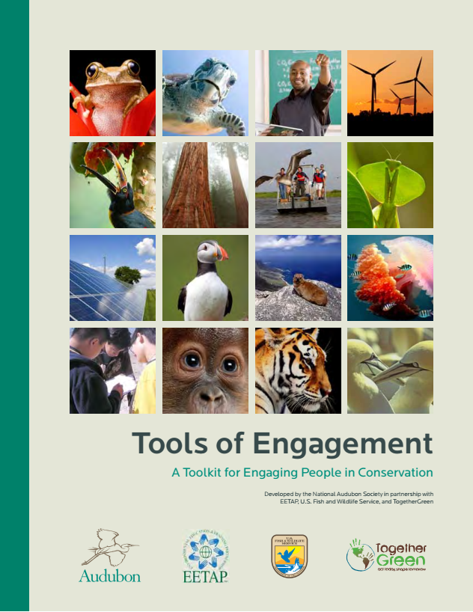
Making the Plan
Strategies
Additional Resources

