Slide 1
Creating results chains
Checking our thinking

Slide 2
Deciding what the plan is about
Goals / Objectives
Strategies
Results chains
Measures
Telling ourselves and others
Making the plan
Deciding if the plan is working
Doing and monitoring the work

Slide 3
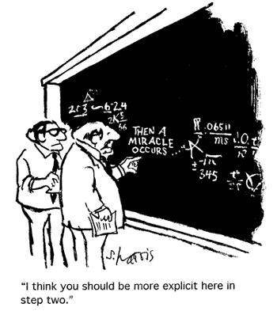

Slide 4
Making the Plan
Results chains
Linking strategies and actions to outcomes
Why we do this step?
  To be confident that the Strategies we have chosen will get the result that we want
  To be clear about the tasks we have to do
  Because we want to see results, not just effort

Slide 5
Making the Plan
Results chains
Recap – what is planning
TOMORROW
TODAY
Strategies
Actions
Measures
Reporting
Targets
Threats
Situation
Dream / Vision
Goals

Slide 6
Making the Plan
Results chains
Linking strategies and actions to outcomes
What is a Results Chain?
A diagram we create to help us work out if our Strategies are likely to have the effect we thought they would
Like a road map
Notes:
FIRST – We want to introduce the concept of results chains. If you have already seen examples of results chains, we hope this will serve as a refresher. If not, we hope this introduction will help to demonstrate the value of following this approach to developing strategy effectiveness measures.
What is a Results Chain?
It is a simple tool that clarifies the assumptions about how conservation strategies contribute to reducing threats and achieving the conservation of targets.

Slide 7
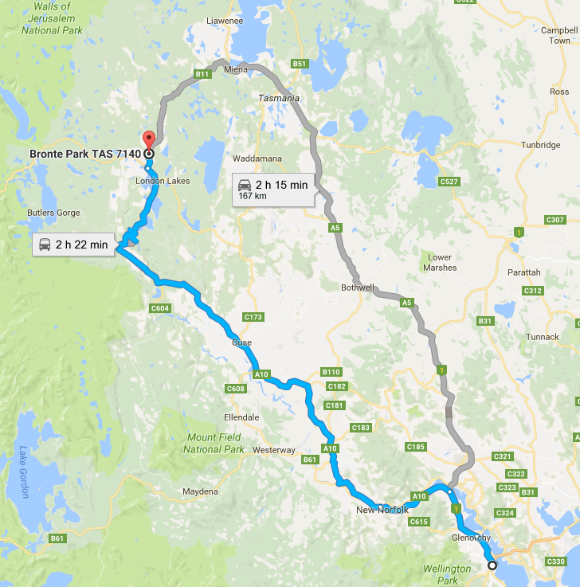
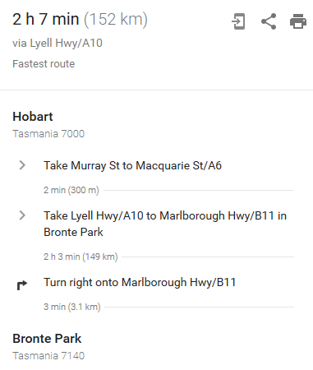
Making the Plan
Results chains
Linking strategies and actions to goals
Like a road map for your work
Helps to show the way the things you do are connected to the result you want to see
Helps build your workplan and your monitoring plan

Slide 8
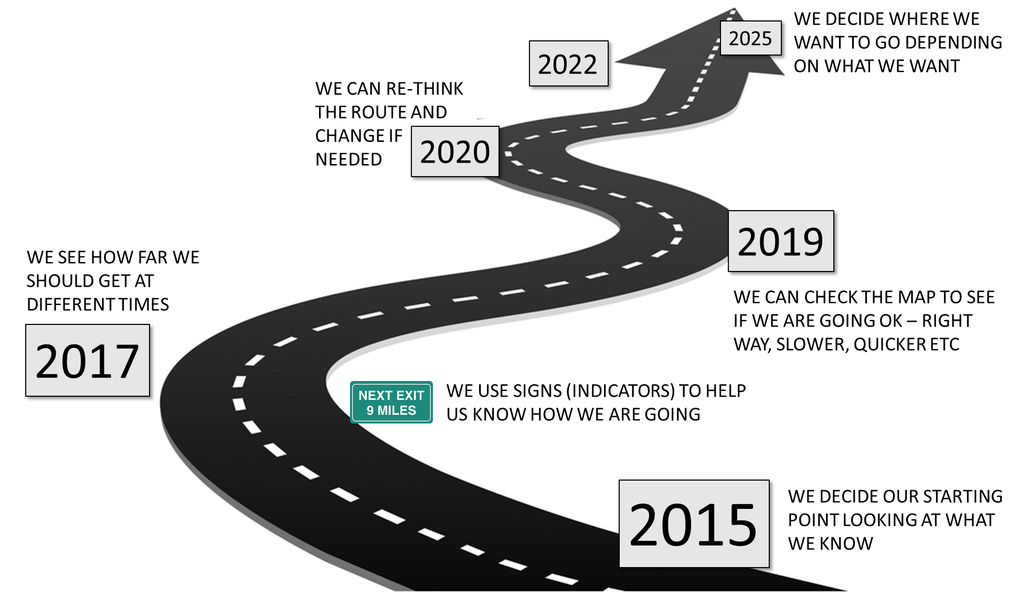
Making the Plan
Results chains
Linking strategies and actions to goals

Slide 9
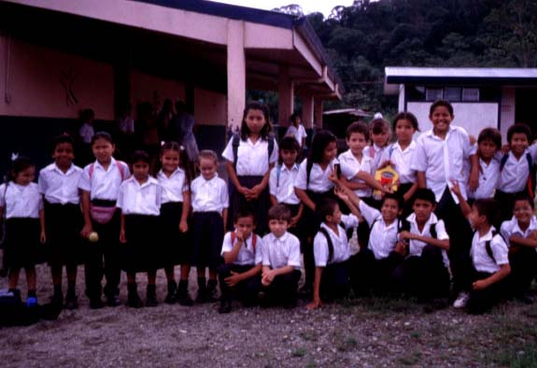
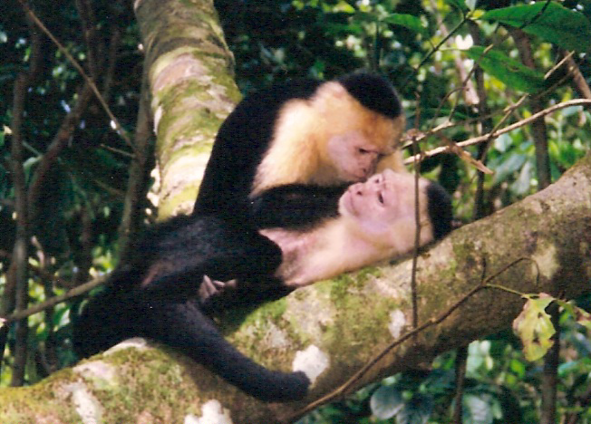
Making the Plan
Results chains
Testing our assumptions
Things we assume

Slide 10
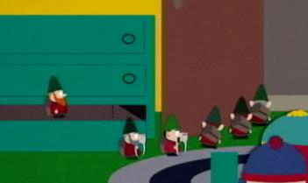
Underpants Gnomes

Slide 11
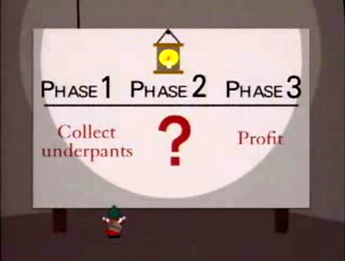

Slide 12
Making the Plan
Results chains
The Basic Components of a Results Chain
Strategy
Target
Result
Result
Result
Indirect
Threat
abated or
opportunity seized
Indirect
Threat
abated or
opportunity seized
Direct
Threat
Objective
achieved
Impact of Actions achieves/maintainsViability

Slide 13
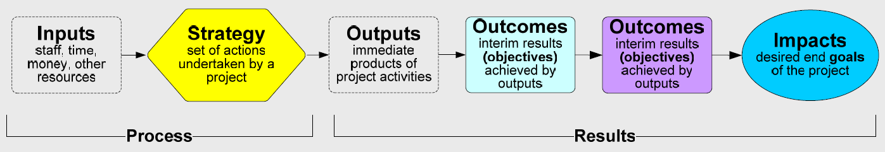
Making the Plan
Results chains
Program logic / MERI by another name
Notes:
The FIRST benefit is simply describing the assumptions behind the strategy – how the strategy will impact biodiversity – so that others can easily understand the intent. As we know, many of our policy strategies have suffered from the fact that such explicit statement of the strategy’s impact on biodiversity has been lacking.

Slide 14
Making the Plan
Results chains
Simple example
Threat Goal: To reduce by 75% the consumption of fuel wood collected from biologically sensitive forests in the project area in 10 years
Strategy
result
result
Threat
abatement result
Notes:
Once the plan is identified, teams must commit to follow through.
Here is an example from NW Yunnan in China, where they developed an ambitious objective of reducing by 75% the consumption of fuel wood collected from biologically sensitive forests in the project area in 10 years
I’ve used this classification scheme to summarize the measures efforts for the fuel-reduction strategy in NW Yunnan where TNC is working with the Chinese government to cut fuel wood collection.
The simplified results chain to support this strategy is indicated in the diagram… that we will step through in the following slides…

Slide 15
Making the Plan
Results chains
How to construct a results chain
Step 1. Select a target and threat you want to work on
Step 2. Set a Goal that your team believes will successfully address that threat or improve the target
Step 3. Select a high priority strategy that is designed to achieve that goal

Slide 16
Making the Plan
Results chains
How to construct a results chain?
Step 4. Look at your situation analysis and identify the main things that cause the direct threat that must be changed
Factors might include:
  market forces
  social issues
  people’s level of knowledge of appropriate practices
  Politics
  Policies
  Enforcement issues
  In the case of invasive species – means by which they spread

Slide 17
Making the Plan
Results chains
How to construct a results chain?
Step 5. Working from the strategy to the goal, or the goal back to the strategy
Ask what the immediate results or outcomes of the strategy / actions should be?
What are the next outcomes you expect these
actions to produce?
What additional outcomes are necessary to
reduce your threat?
If you get stuck, ask “what would you do next?” and “if you do that activity well, what will be the result?”
Notes:
Another way is to work from right to left, asking what needs to happen to reduce the threat, what outcomes are needed to make that happen, etc.
Yet another way is to brainstorm intermediate results and then organize them along the chain, assuring that there are clear “if…then” linkages between each pair of results.

Slide 18
Making the Plan
Results chains
How to construct a results chain?
Left to Right or Right to Left?
Right to Left may be better for a new strategy – to ensure that the goals are met
Left to Right may better for a familiar strategy where the focus is on how it will get done
Either way can work – you decide
Notes:
Another way is to work from right to left, asking what needs to happen to reduce the threat, what outcomes are needed to make that happen, etc.
Yet another way is to brainstorm intermediate results and then organize them along the chain, assuring that there are clear “if…then” linkages between each pair of results.

Slide 19
Making the Plan
Results chains
How to construct a results chain?
STRATEGY
how are we
going to travel
if we do this…
then we do this…
ACTIVITY
(and tasks)
ACTIVITY
(and tasks)
we should reach this…
finally reach this…
which helps these
DESTINATION
(result)
DESTINATION
(outcome)
TARGET
SIGNPOST
(indicator)
SIGNPOST
(indicator)
SIGNPOST
(indicator)
we can check these…
CHECK
CHECK
CHECK
by this time…
by this time…
by this time…
Notes:
Another way is to work from right to left, asking what needs to happen to reduce the threat, what outcomes are needed to make that happen, etc.
Yet another way is to brainstorm intermediate results and then organize them along the chain, assuring that there are clear “if…then” linkages between each pair of results.

Slide 20
Making the Plan
Results chains
Example

Slide 21
Making the Plan
Results chains
Good Results Chains are…
Results oriented: Boxes contain desired results (e.g., reduction of hunting), and not activities (e.g., conduct a study).
Connected in a “causal” manner: There are clear connections of “if…then” statements between each pair of boxes.
Demonstrate changes: Each box describes how you hope the relevant factor will change (e.g. increase or decrease).
Notes:
Analysis of hundreds of results chains has identified a few characteristics of good results chains that include:
ONE - They are Results oriented: Boxes contain desired results (e.g., reduction of hunting), and not activities (e.g., conduct a study).
TWO – They are Connected in a “causal” manner: There are clear connections of “if…then” statements between each pair of successive boxes.
THREE – They Demonstrate changes: Each box describes how you hope the relevant factor will change (e.g., improve, increase, or decrease).

Slide 22
Making the Plan
Results chains
Good Results Chains are…
Relatively complete: There are sufficient boxes to construct logical connections but not so many that the chain becomes overly complex.
Simple: There is only one result per box.
Notes:
FOURTH – They are relatively complete – Teams do tend to make these overly complex – and it requires some skill to prevent large spaghetti chains.
FINALLY – like all good models – they are best when simple. They focus on the bare essentials – only one result per box - and should be limited to what you can reasonably influence. For example…not the occurrence of sun spots…

Slide 23
Making the Plan
Results chains
Not a results chain
Results chains focus on
achieving a result
not
doing activities
Media
Campaign
Campaign
reaches
target
audience
Demand
for
caviar
drops
Price
for
caviar
drops
Sturgeon
not
over-fished
Healthy
Sturgeon
population
Notes:
In comparison, what is NOT a results chain? It is not an implementation flow diagram.
An implementation flow diagram might look like this:
I'm going to implement a media campaign. First, I'm going to implement a media campaign. So, first I’m going to identify my target audience, then I'm going to produce educational materials, then I'm going to distribute educational materials. This is a series of activities. If you try to read this chain in an if=then manner, you will see there are not causal linkages between the boxes. For example, if I identify my target audience, then I will produce educational materials? No, this is not a direct causal result of identifying my target audience.
Reading your chain as a series of if-then relationships is a good way to make sure that components of your results chain are not an implementation chain. This is a very common mistake.

Slide 24
Making the Plan
Results chains
Which of the Following is NOT a Results Chain?
Notes:
Now, it’s your turn to determine which of these three chains does not meet the criteria for good results chains. Please look at these chains and then select one of the following responses. Be sure to click the “submit” button to see if your response is correct. To advance to the next slide you will then need to click the “continue” button. If needed, you can go back to previous slides to review the criteria.
Chain A is not a results chain. It mixes implementation steps with results. For the most part, it shows a series of activities the team will do. These activities, or implementation steps, include: identify key decision makers, educate decision makers, and research and develop regulations. The chain does include a few boxes that are more results-oriented. These include: decision makers pass laws, no wildlife trade, and jaguar populations increased.

Slide 25
Making the Plan
Results chains
Your Turn: Add the Missing Result
Notes:
NEW AUDIO, ADD IN BRAINSHARK, NOT PPT
Now it’s your turn again. Look at the following results chain and think about what result is missing in the box marked by a question mark. Type your response in the box and click submit when you are done to see if your answer is correct.

Slide 26
Making the Plan
Results chains
Your Turn: Add the Missing Result
Notes:
The correct answer is:
Loggers use certified harvesting methods
Did you have a similar response? If not, make sure that your result follows an if-then relationship with the results on either side

Slide 27
Your Turn: Create a Results Chain Using the Following Results
Results Chains
Citizens eradicate invasive plants
Healthy native wetland vegetation
Citizens have skills to eradicate invasive plants
Train citizens to eradicate invasive plants
Citizens knowledgeable of local invasive plants
Invasive plants decreased

Slide 28
Your Turn: Create a Results Chain Using the Following Results
Results Chains
Notes:
The correct answer is that “invasive plants decreased” should go in the purple box, because it describes the threat you will reduce, and “Healthy native wetland vegetation” should go in the oval, as your conservation target.
Your complete results chain would look like this.
You may want to take a moment to read the results chain from left to right and make sure that it meets all of the criteria – that all the boxes are results, not implementation steps, they are simple (one result per box), and the if-then causal logic holds well.
PAUSE (15 SEC) TO LET PEOPLE READ THE CHAIN.

Slide 29
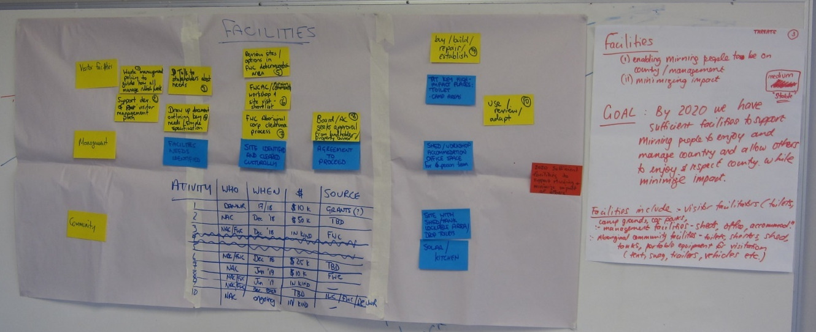
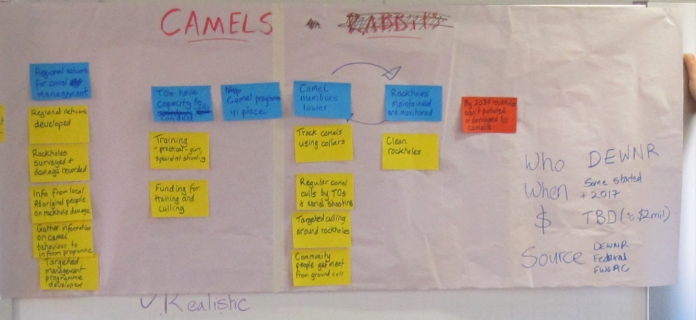
Making the Plan
Results chains
Examples
Projects need Road maps

Slide 30
Making the Plan
Results chains
Types of failure

Slide 31
Making the Plan
Results chains
Checking progress
The project team assumed:
If we train local fishermen as fly fishing guides and we give them fly fishing gear, then they will have the skills and gear to be guides
If they have the skills and gear, then they will work as fly fishing guides
If they are able to work as fly fishing guides, then they will increase their income
If they have increased income, they will not need to fish so much and there will be less unsustainable fishing practices
If there are less unsustainable fishing practices, then the coral reef ecosystem will be more conserved.

Slide 32
Making the Plan
Results chains
Checking progress and adapting
What else did the fishermen need to become fly fishing guides?
Clients – tourists and tourism operators needed to know about the fly fishing guides
English speaking skills
Etc.

Slide 33
Making the Plan
Results chains
How we use a roadmap
WHAT is in the PLAN | WHAT do we DO | WHAT do we CHECK / LEARN
Workplan – jobs, who will do them, resources | Day-to-day on-ground and other work | Is work being done? Are there issues, changes?
Objectives - what changes if we do the jobs | Team leaders / managers use this to guide work | Is destination is getting closer? Are we on the right path?
Goals – what happens to our values if we do the jobs | Team leaders / managers use this to guide work | Are the values are getting better / worse? Why?
Indicators – what will we measure, who, how, resources | Monitoring activities – eg surveys, mapping – capture and store | What does the evidence tell us?
Monitoring Plan – who, when, how will we review | ‘Toolbox’ meetings / workplan meetings | When do we do check each of these?
STRATEGY
ACTION
DESTINATION
VALUES
SIGNPOST
CHECK

Slide 34
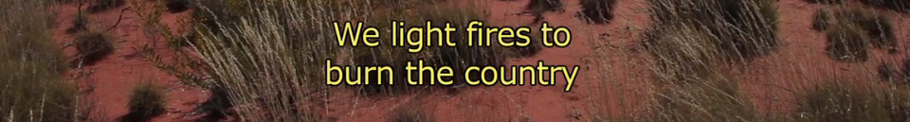
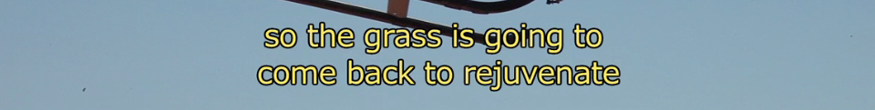
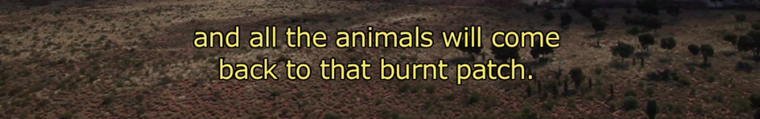
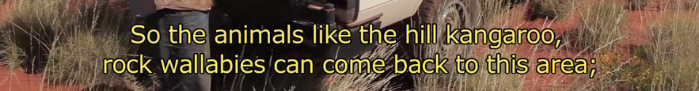
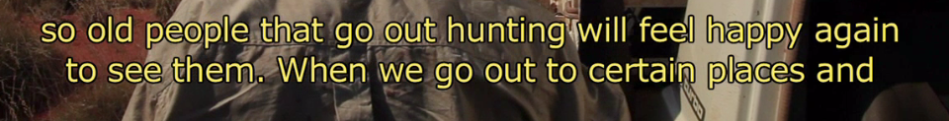

Slide 35
Making the Plan
Results chains
A final example
https://www.youtube.com/watch?v=b_8d_GB6WDY

Slide 36

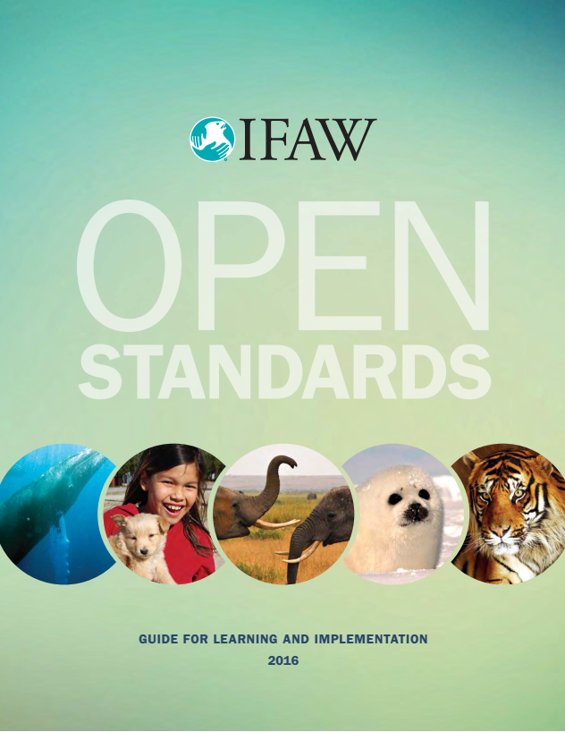
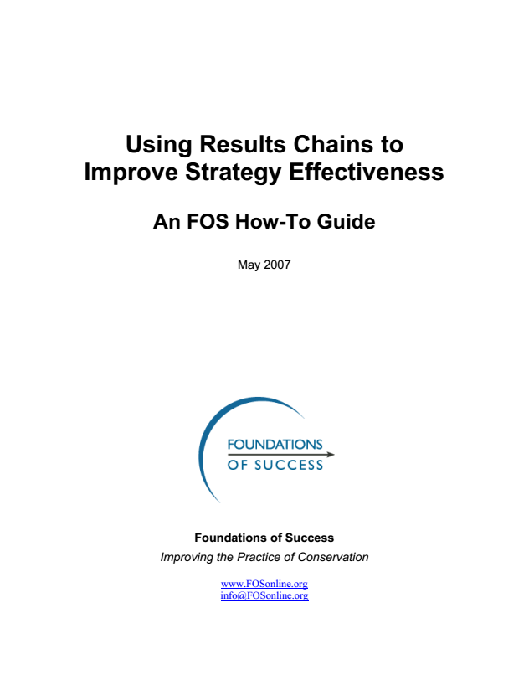
Making the Plan
Results chains
Additional Resources
Notes:
The correct answer is:
Loggers use certified harvesting methods
Did you have a similar response? If not, make sure that your result follows an if-then relationship with the results on either side

