Slide 1
Monitoring
How will I know if I am getting anywhere?

Slide 2
Deciding what the plan is about
Goals / Objectives
Strategies
Results chains
Measures
Telling ourselves and others
Making the plan
Getting data
Looking at results
Adapting the plan
Work Plan & Timeline
Budget
Implement
Deciding if the plan is working
Doing and monitoring the work

Slide 3
Making the Plan
Monitoring
Knowing if our plan is working
Monitoring help us to know:
Are our actions working?
Is our work being effective & efficient?
Are our targets or the threats getting better or worse?
Can we correct course if we need to?
Is it all worthwhile?
Donors, partners and managers are demanding greater transparency and accountability

Slide 4
Making the Plan
Monitoring
Knowing if our plan is working
Monitoring seen as last step - often neglected
Many examples of ineffective monitoring failing to inform ineffective management
Notes:
Our interest in developing improved measures of success comes runs counter to a common approach where measures of success is often the neglected last step. There are many examples of ineffective monitoring that has not provided the information needed to improve management decisions. This has given monitoring a bad name among some managers and some funding agencies will refuse to fund monitoring projects – they want to see all of their money put into action.

Slide 5
Making the Plan
Monitoring
Knowing if our plan is working
Some intact, unthreatened landscapes with no actions have LARGE status monitoring budgets
Notes:
Some intact, unthreatened landscapes with no conservation actions have HUGE status monitoring budgets
There’s no end to what you can spend money on doing status monitoring. Consider some remote Alaska wilderness area – you can establish detailed vegetation monitoring, and studies of large mammals, small mammals, birds, insects… but what is the conservation impact of all this status monitoring information? It may be quite limited. Certainly, some studies of intact systems are needed to serve as reference areas or to establish baseline conditions if future impacts are anticipated. However, investment of limited conservation resources in this type of status monitoring should be carefully evaluated. We have strong applied effectiveness monitoring needs in many of the places were we work.

Slide 6
Making the Plan
Monitoring
Knowing if our plan is working
Some projects have serious threats and/or high risk actions and NO monitoring activities
Notes:
Other conservation projects have serious threats and/or high risk conservation actions where there are NO or very limited monitoring activities
Reintroduction of fire
Large-scale Herbicide treatments
Large-scale stream or wetland restoration

Slide 7
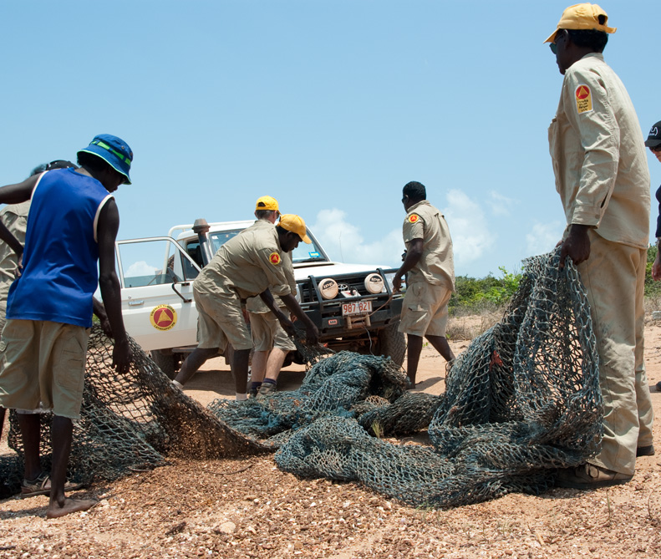
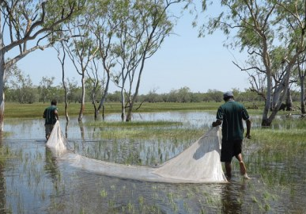
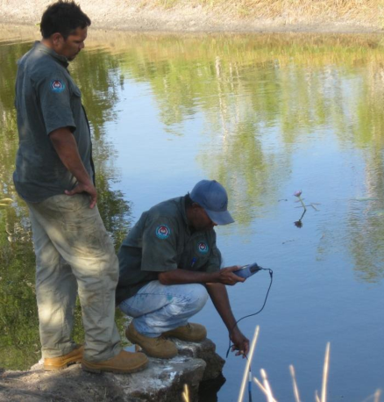
Making the Plan
Monitoring
Knowing if our plan is working
Monitoring is a key part of knowing the impact of our work
We need to monitor the things that will improve management
And actually use that monitoring to improve management

Slide 8
Making the Plan
Monitoring
Three ‘layers’ of monitoring
Implementation (Process)
Are we using the plans we have made?
Effectiveness (Process)
Are our actions having their intended impact?
Status (Impact)
How is the country we care about doing?
How are threats to country changing?
Is the capacity to improve country changing?

Slide 9
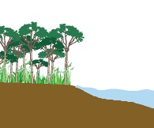
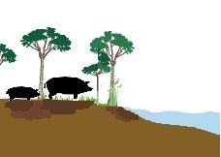
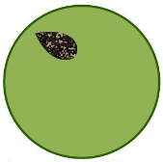
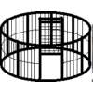
Making the Plan
Monitoring
Three ‘layers’ of monitoring
Healthy Country (vision)
Wetlands healthier
Vision/ Targets
Status
(5-10 years)
By 2020 pigs have less impact on country
Less country is impacted by pigs
Goals
Effectiveness
(1-3 years)
Implement feral animal control
Feral control being done
Strategies
Implementation
(every year)
Pig control in wetlands
Record pig management efforts
Actions

Slide 10
Making the Plan
Monitoring
Three ‘layers’ of monitoring
6
5
4
3
2
1. STATUS: Numbers of adults returning to spawn
2. EFFECTIVENESS: Water flow measurements
3. EFFECTIVENESS: Volume of water withdrawn for agricultural purposes
4. EFFECTIVENESS: Hectares of farm land converted from water-intensive crops to low-water need crops
5. IMPLEMENTATION: Strategic Actions and Action Steps implemented
6. IMPLEMENTATION: Resources Spent (Staff & $$$)

Slide 11
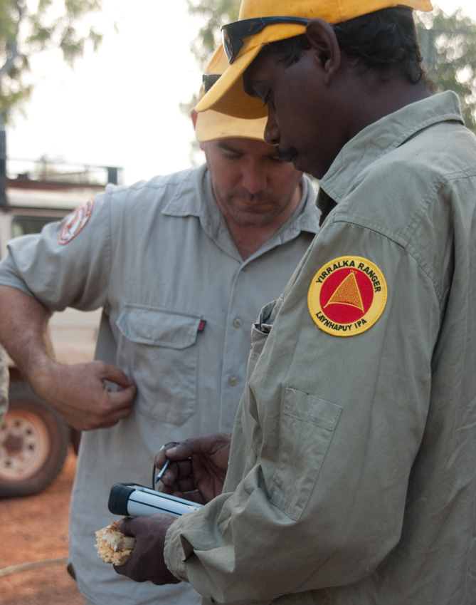
Making the Plan
Monitoring
How we do this step
Figure out who you need to report to (define audience and interest)
Select which indicators you will use (what)
Work out how to collect information on your indicators
Schedule who needs to do what and when (when, where, and who)
Target = Healthy Wetlands
Threats = Pigs
Record data
# of pigs shot
Pig damage ↓
Notes:
Everyone talks about needing to measure, but few actually do it in a considered way.
and can waste a lot of both – spend time now writing a monitoring plan as part of the overall plan can save a lot of time and money.
Pig Damage = is it reducing
# of pigs shot =

Slide 12
Making the Plan
Monitoring
Who needs to know?
Who will see and review the information and data you collect
Helps you consider the monitoring design and methods
Audiences are: Project team (rangers / managers); funders; Executive / Board; Partners

Slide 13
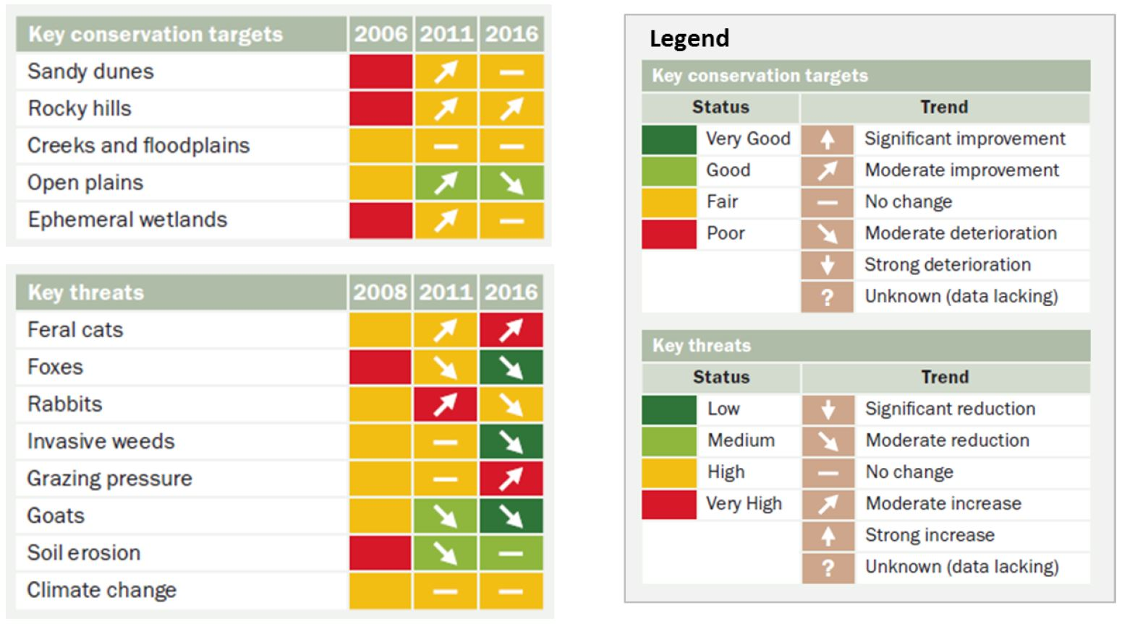
Making the Plan
Monitoring
Example for Board / funders

Slide 14
Making the Plan
Monitoring
Selecting your indicators
What are you actually going to measure?
Use the minimum resources to provide you with the minimum information needed to best adapt
Reduce, reuse, recycle – ‘mine’ the road map
Indicators from the work you’ve already done
Look to your Targets, Threats and Goals
Good (SMART) Goals and Strategies will lead to good indicators
Notes:
Priorities – indicators that these are being managed properly -

Slide 15
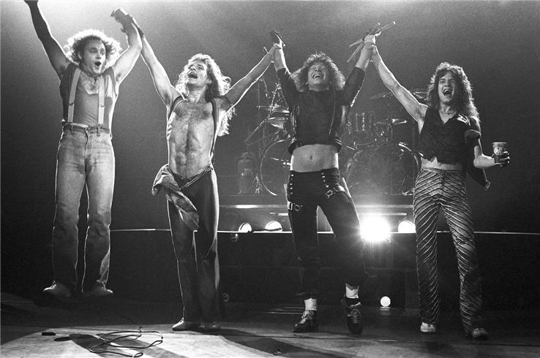
Making the Plan
Monitoring
Picking indicators

Slide 16
Making the Plan
Activity
Use your result chain to make a monitoring plan
Step 1. Look at your Result chain
Step 2. Identify the critical places you need an indicator
Step 3. Think about the indicators and which ones are Implementation, which ones are effectiveness and which are status

Slide 17
Making the Plan
Monitoring
Using the road map
Focus monitoring efforts on the core assumptions you have made in your project – represented by the result chain
Regional pig trapping program
More traps set up
Increased numbers of pigs caught in traps
Reduced numbers of pigs
Healthy wetlands
Ranger time on pig traps
# traps purchased
$ on program
# traps deployed
Area traps deployed
# pigs caught
# trap set
Reduction in pig damage
Increase in vegetation cover and fish caught

Slide 18
Making the Plan
Monitoring
Lessons from the School of Hard Knocks!
The Health table is a good place to find ideas for indicators but you won’t need to monitor everything there.
Beware a monitoring plan you will never do. Or worse, one you will do for a year or two and then stop.
Never monitor something you can’t or won’t do anything about.

Slide 19
Making the Plan
Monitoring
A good indicator
A good indicator should meet the following criteria:
Measurable: you can record something and analyzed it.
Precise: Defined the same way by all people.
Consistent: Consistent over time so that it always provides comparable measurements.
Sensitive: Changes in response to actual changes in what you are measuring.
Sustainable: able to be used with the resources you have

Slide 20
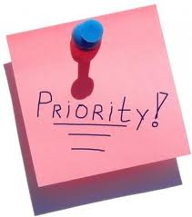
Making the Plan
Monitoring
Prioritize your monitoring budget
Keep it as simple as possible - focus on essential monitoring
Where possible prioritise measures that address a number of items (goals, threats etc) or activities with co-benefits
Consider available resources
Where possible, incorporate monitoring into existing work or research
Consider availability of base-line data
Invite someone with experience to peer review monitoring plan

Slide 21
Making the Plan
Monitoring
A good method
Accurate: Gives minimal or no error
Reliable: Results obtained using the method are consistently repeatable
Cost-effective: Not overly expensive for the data the method yields or for the resources the project has
Feasible: Project team has people who can use the method, as well as the material and financial resources to use the method
Appropriate: Appropriate to the environmental, cultural, and political context of the project

Slide 22
Making the Plan
Monitoring
Examples of Monitoring Methods
To obtain quantitative data
Tracking project records
Formal survey
Cyber-tracker
To obtain qualitative data:
Key informant interview
Focus group discussion
Direct observation
Social (participatory) mapping

Slide 23
Making the Plan
Activity
Creating a Monitoring Plan
Strategy | Regional trapping program
Indicator | Method | Frequency | Location | Who | Cost / year | Source
Ranger time on pig traps | Ranger time sheets | Annual | On-site | Head ranger | $500 | Internal
# traps set up | GPS sites | Annual | Trap sites | Ranger | $500 | Internal
Pig damage | Damage density data | Bi-Annual | Trap locations & control | Ecologist + rangers | $5,000 | TBD
Target = Healthy Wetlands
# pigs trapped
Pig damage ↓

Slide 24
Making the Plan
Monitoring
Tips to reduce monitoring costs
Consider low-cost, qualitative options rather than no monitoring
Consider less frequent monitoring visits rather than no monitoring
Use partner data whenever possible
Engage local people & volunteers in monitoring efforts

Slide 25
Making the Plan
Monitoring
Remember…
Monitoring requires time and money and needs to be in your work plans & budgets but …
it doesn’t always need to be complicated or costly
Monitoring data must be analyzed and results used to inform our next decisions

Slide 26
Making the Plan
Monitoring
Hints
This step is probably best completed with a small group
Use external expertise to help – there are likely to be things that will need specialist advice
Look for measures and techniques that are linked to day to day / community activities – they are more likely to continue
Don’t discount community / traditional indicators
Some data and results are better than no data at all – you can refine your work as you go

Slide 27
Doing and Monitoring the Work
Monitoring
Additional Resources

