Slide 1
Closing the circle and Reviewing the plan

Slide 2
Deciding what the plan is about
Telling ourselves and others
Making the plan
Getting data
Looking at results
Adapting the plan
Deciding if the plan is working
Doing and monitoring the work

Slide 3
Deciding if the plan is working
Closing the Circle
Key steps
Ensure data gathered answers the key questions
  Annual implementation, periodic effectiveness and status
Gather / store / analyse data
Interpret and communicate results
Adapt the plan / strategy
Create a culture of review
  Self assessment
  Peer review

Slide 4
Deciding if the plan is working
Closing the Circle
Some challenges
Lack of a clearly stated purpose
Lack of dedicated staff
Data
  gathered but never summarized
  summarized but not interpreted relative to objectives
  summarized and interpreted but not relayed to managers
Different people gathering data over long time
Data proves useful at the project level but the lessons learned are never shared with broader audiences.

Slide 5
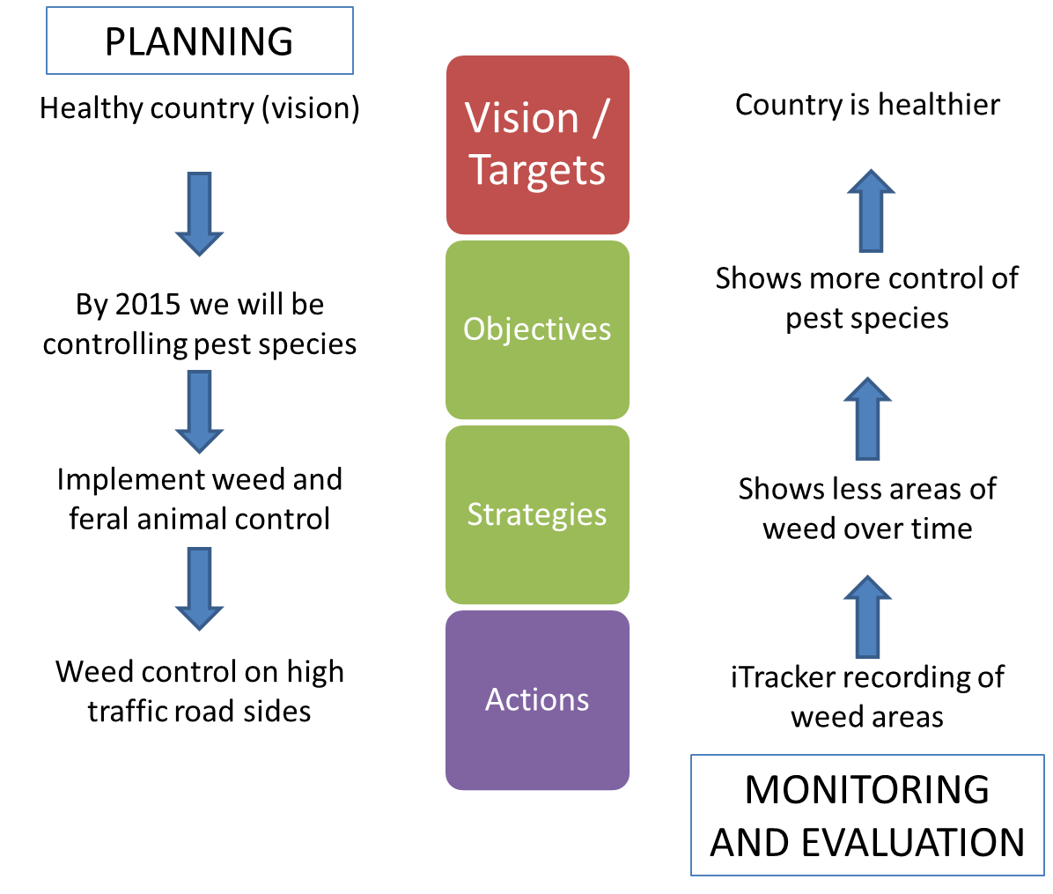
Deciding if the plan is working
Closing the Circle
Is there a monitoring and reporting structure?
Implementation – are we using the plan?
Effectiveness – Are the strategies working?
Status – Are our targets improving?
Status (every 5-10 years)
Effectiveness (every 1-3 years)
Implementation (every year)

Slide 6
Deciding if the plan is working
Closing the Circle
Nine elements are needed
 | Data / Information | Analyse | Adapt
Status |  |  | 
Effectiveness |  |  | 
Implementation |  |  | 

Slide 7

Deciding if the plan is working
Closing the Circle
Process needs
DATA CAPTURE TOOLS
DATA MANAGEMENT TOOLS
Monitoring data captured
Monitoring data stored/ retrieved
Indicators from Plan
DATA ANALYSIS TOOLS
Field work implements work plan
Actions from plan
Data prepared and analysed
Clear questions from plan
Report and adaptation
REPORTING TOOLS

Slide 8
Deciding if the plan is working
Closing the Circle
Needs
Systems for recording, storing, processing and backing up project data
Analyses of project results and assumptions
Analyses of operational and financial data
Documentation of discussions and decisions
Revised project documents (including operational plan, monitoring plan, work plans and budgets)
Communicate / document progress

Slide 9
Deciding if the plan is working
Closing the Circle
Use results chains
theory of change to guide plan development
plan review - is the theory standing up?
Status (every 5-10 years)
Are our targets improving?
Implementation (every year)
are we using the plan?
Effectiveness (every 1-3 years)
Are the strategies working?

Slide 10
Deciding if the plan is working
Closing the Circle
Where are we at?
Key questions
  Are key steps in our plan missing or needing more work?
    Self-assessment / peer review
  Are we using our plan?
    Progress reports on actions
  Is our plan logical? Does it make sense?
    Check our results chains and test our thinking
  What are our results telling us?
    Analyse our data, interpret, and adapt
  What have we learned so far and who should we tell?
    Share our learnings

Slide 11
Deciding if the plan is working
Closing the circle
Self-Assessment and Peer-Review
A chance to learn & think about improved project management approaches & tools
A chance to reflect together on how things are going and what might need to be changed
An opportunity to get assistance on specific project issues over time
A chance for peer-review team members to reflect on their own projects
A help for organisations to understand the status of their projects / activities

Slide 12
Deciding if the plan is working
Closing the circle
Self assessment questions to ask
What are the critical areas that we need to strengthen to improve our planning/management?
Do we have the resources/skills to implement plans well?
What do we need to do to complete them?
What areas may we be putting too much effort at the expense of others?

Slide 13
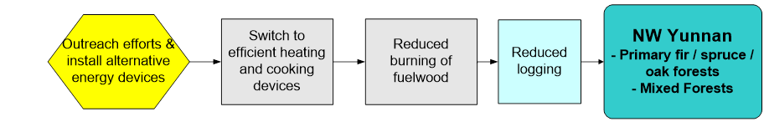
Implementation
Effectiveness
Status
What question are we asking?
Every 5-10 years - Are our targets improving?
Every year - are we using the plan?
Every 1-3 years - Are the strategies working?
Gather Indicator measurements
# proposals written
# grants received
# households contacted
# Units switched
volume of wood consumed
Changes in forest cover
- forest health indicators
Reflect and Interpret data
Are we progressing all the actions as planned? If not, why not?
Are we progressing fast enough?
What helped us?
What stopped us?
Is forest health improving?
Adapt
Do we need new actions?
Do we need more resourcing?
Do we need new strategy/action?
Do we need more resourcing?
Do we need new strategy/action?
Do we need more resourcing?

Slide 14
Deciding if the plan is working
Closing the circle
Implementing the plan
What were the key ingredients for action?
  Project ‘roadmap’
  Strategies and Actions
  Work plans
  Budget
  Measures
  Staff
  Leadership
  Indicators
  Data (e.g. Maps )
Do we have all of these or similar?
Are we using them?
If not , why not?
Clear responsibility/skills?
Adequate resources?

Slide 15
Deciding if the plan is working
Closing the Circle
Progress ratings
Done Successfully accomplished
Working well Ongoing, generally on track
Little problem that needs fixing: Ongoing, but has minor issues that need attention
Big problem that needs fixing: Ongoing, but has major issues that need attention
Abandoned No longer important
Yet to do Activity is not yet started | NA

Slide 16
Deciding if the plan is working
Closing the Circle
Opportunities for improvement
  Capacity clearly analysed
  Goals / Strategies
    effective prioritization
    Check for realism
  Risk assessment
    prevent implementation of action
    prevent effectiveness of action
    effective detection and mitigation of risks

Slide 17
Deciding if the plan is working
Closing the Circle
Common Recommendations
  Make sure the plan has at least one owner
  Take a few small steps right away
  Look for early winners / “no regret” actions
  Set up regular process checks
  Invest in capacity and build allies
  Keep your eye on the big picture
  With patience and perseverance, you will make progress

Slide 18
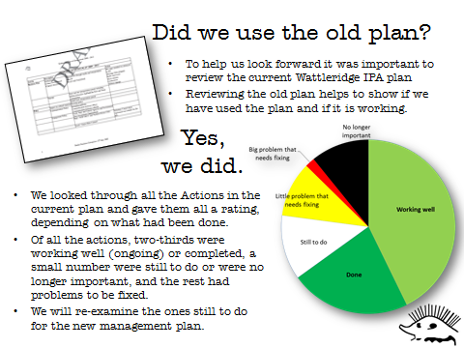
Deciding if the plan is working
Closing the circle
Mid-term reviews

Slide 19
Implementation
Effectiveness
Status
What question are we asking?
Every 5-10 years - Are our targets improving?
Every year - are we using the plan?
Every 1-3 years - Are the strategies working?
Gather Indicator measurements
# proposals written
# grants received
# households contacted
# Units switched
volume of wood consumed
Changes in forest cover
- forest health indicators
Reflect and Interpret data
Are we progressing all the actions as planned? If not, why not?
Is our data enough
Are we progressing fast enough?
What helped us?
What stopped us?
Is forest health improving?
Adapt
Do we need new actions?
Do we need more resourcing?
Do we need new strategy/action?
Do we need more resourcing?
Do we need new strategy/action?
Do we need more resourcing?

Slide 20
Deciding if the plan is working
Closing the Circle
Needs
Systems for recording, storing, processing and backing up project data
Analyses of project results and assumptions
Analyses of operational and financial data
Documentation of discussions and decisions
Revised project documents (including operational plan, monitoring plan, work plans and budgets)
Communicate / document progress

Slide 21
Deciding if the plan is working
Closing the Circle
Process needs
  Essential to capture and analyze monitoring data as part of routine project work
  Need sound data management systems in place
    Time between capture and analysis
    Changing staff
    Different people capture and review
  System should be able to clearly provide
    Your SMART goal
    recording, storing, and processing data

Slide 22
Deciding if the plan is working
Closing the Circle
Questions to ask
  Is our data adequate (right indicators, frequency of collection, type of analysis possible etc)?
  Are our results chains still relevant?
  Are our Goals still valid (feasible, useful, etc)?
  Have our threats changed?

Slide 23
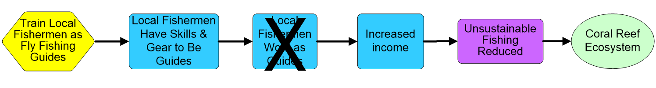
Deciding if the plan is working
Closing the Circle
Underlying Project Assumptions
The project team assumed:
  If we train local fishermen as fly fishing guides and we give them fly fishing gear, then they will have the skills and gear to be guides
  If they have the skills and gear, then they will work as fly fishing guides
  If they are able to work as fly fishing guides, then they will increase their income
  If they have increased income, they will not need to fish so much and there will be less unsustainable fishing practices
  If there are less unsustainable fishing practices, then the coral reef ecosystem will be more conserved.

Slide 24
Deciding if the plan is working
Closing the Circle
Underlying Project Assumptions
What else did the fishermen need to become fly fishing guides?
Clients – tourists and tourism operators needed to know about the fly fishing guides
English speaking skills
Etc.
X

Slide 25
Deciding if the plan is working
Closing the Circle
Reviewing effectiveness
  Decisions depend on the quality of the data and rigor or appropriateness of the analysis
  Assess effectiveness and efficiency together
  Determine progress with Goals leading to Threat reduction
  Review if the Threat has changed eg High - Medium

Slide 26
Deciding if the plan is working
Closing the Circle
Revising the Threat table
Analysis of fox control measures tells us this risk can now be changed to Medium
But we weren’t monitoring or controlling weeds here and now the threat has increased because it’s getting more recreation use

Slide 27
Implementation
Effectiveness
Status
What question are we asking?
Every 5-10 years - Are our targets improving?
Every year - are we using the plan?
Every 1-3 years - Are the strategies working?
Gather Indicator measurements
# proposals written
# grants received
# households contacted
# Units switched
volume of wood consumed
Changes in forest cover
- forest health indicators
Reflect and Interpret data
Are we progressing all the actions as planned? If not, why not?
Is our data enough
Are we progressing fast enough?
What helped us?
What stopped us?
Is forest health improving?
Adapt
Do we need new actions?
Do we need more resourcing?
Do we need new strategy/action?
Do we need more resourcing?
Do we need new strategy/action?
Do we need more resourcing?

Slide 28
Deciding if the plan is working
Closing the Circle
Questions to ask
  Similar questions and process as for effectiveness
  Focus is on Targets and Target Health
  Reviewing to see if Health has changed
  Probably needs more time / expertise / cost than previous steps
  Targets don’t usually change very quickly – do this every 5 years or so

Slide 29
Deciding if the plan is working
Closing the Circle
Updating the Health Table
Target: Maleefowl
Attribute: Population
Indicator: Number of adults in a given area.
Very Good: >101
Good: 51 - 100
Fair: 3 - 50
Poor: < 2

Slide 30
Deciding if the plan is working
Closing the Circle
Updating the Health Table
 | Conservation Targets | Landscape Context | Condition | Size | Viability Rank
 | Current Rating
1 | Eucalypt woodlands | Fair | Fair | Good | Fair
2 | Sandplain shrublands | Good | Fair | - | Good
3 | Granite exposures and breakaways | Good | Good | Good | Good
4 | Hills (Banded Ironstone Formations) | Fair | Fair | - | Fair
5 | Lake Cronin | Good | - | Fair | Good
6 | Saltlakes | Good | Good | - | Good
7 | Dingo | - | - | Fair | Fair
8 | Chuditch | - | Fair | Fair | Fair
9 | Malleefowl | - | Good | Fair | Fair
10 | Carnaby's Cockatoo | - | Fair | Fair | Fair
 | Project Biodiversity Health Rank |  |  |  | Good
Target health at start of project
Updated after 8 years monitoring
 | Conservation Targets | Landscape Context | Condition | Size | Viability Rank
 | Current Rating
1 | Eucalypt woodlands | Fair | Fair | Good | Fair
2 | Sandplain shrublands | Good | Fair | - | Good
3 | Granite exposures and breakaways | Good | Good | Good | Good
4 | Hills (Banded Ironstone Formations) | Fair | Fair | - | Fair
5 | Lake Cronin | Good | - | Fair | Good
6 | Saltlakes | Good | Good | - | Good
7 | Dingo | - | - | Fair | Fair
8 | Chuditch | - | Fair | Good | Good
9 | Malleefowl | - | Good | Good | Good
10 | Carnaby's Cockatoo | - | Fair | Fair | Fair
 | Project Biodiversity Health Rank |  |  |  | Good

Slide 31
Deciding if the plan is working
Closing the Circle
Some things to note
  Important to regularly feedback to community
  Be sensitive that ‘critique’ can be seen as ‘criticism’
  Don’t forget to include community measures in your system eg story reporting
  It will take time to build trust and understanding
  Use systems that can adapt (ie not proprietary formats)

Slide 32
Deciding if the plan is working
Closing the Circle
Culture of review
We want review to become a good habit
To do that it needs to be a regular part of business
Needs a commitment to support, review and act on outcomes
Internally driven for benefit (carrot) not compliance (stick)

Slide 33
Deciding if the plan is working
Closing the Circle
Why do it?
Make the next time better, more effective and have more impact for you and for others
To save time and mistakes – by learning from other groups facing the same challenges.
Motivation and celebration – celebrate and bask in your successes!
Failure is also very valuable

Slide 34
Deciding if the plan is working
Closing the Circle
Outputs
Regular reports or other communication to project team and key stakeholders
Development and distribution of appropriate communication products
Commitment to learning and innovation
Encourages questioning
Most important – keeps the plan ‘alive’

Slide 35
Healthy Country Plan Timeline
2007
Healthy Country Plan discussion begins
2012
2nd UMEC meeting
2013
3rd UMEC meeting
2008
Planning begins
2009
Plan completed
2011
Plan manager appointed
2012
1st UMEC meeting
2013
4th UMEC meeting
2014
5th UMEC meeting
2015
This meeting
2006
Uunguu Tourism Plan completed

Slide 36
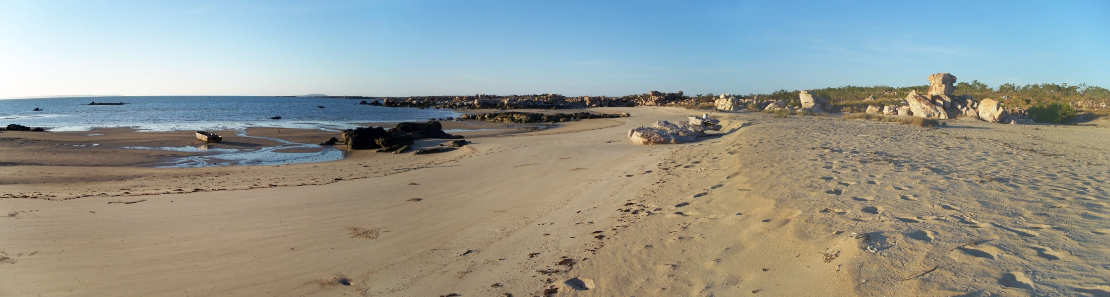
Wunambal Gaambera
Healthy Country Plan

Slide 37
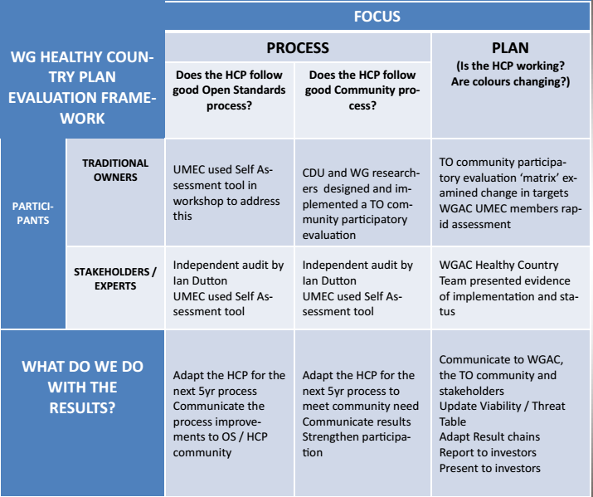

Slide 38
Deciding if the plan is working
Closing the Circle
When to review
Good times to consider what you have learnt include:
    Finishing an key activity / milestone
    Overcoming a particular challenge
    Designing a new project / funding phase
    When something goes pear shaped …

Slide 39
Deciding if the plan is working
Closing the Circle
    Make time to do it!
Decide
Learn
Share
  How will you learn?
    interviews, case study, after action review, site visit
  Who needs to know?
  team, neighbours, funders
  What will you produce?
  paper, video, song, painting
  How will you share?
  internal, meetings, conferences, site visit, reports, websites

Slide 40
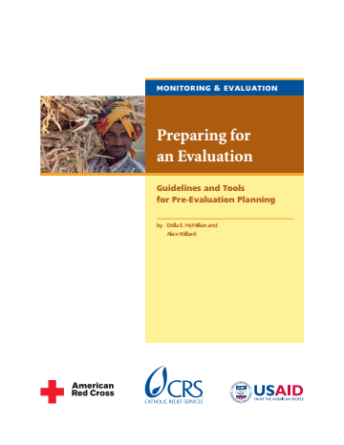
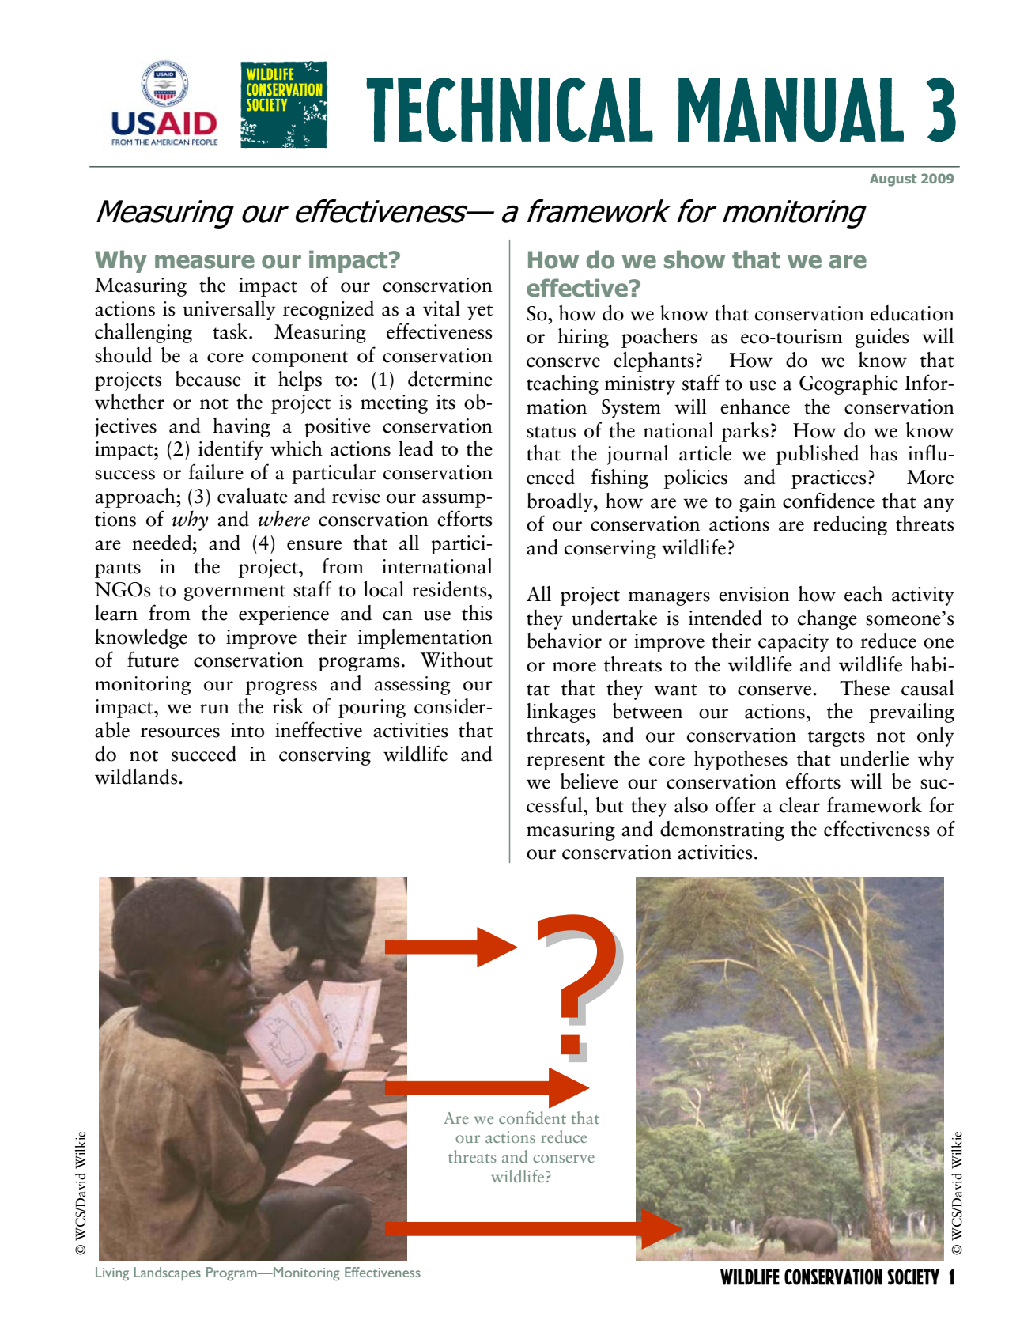

Deciding if the plan is working
Closing the Circle
Additional Resources

