Slide 1
Telling the story

Slide 2
Deciding what the plan is about
Record what we learn
Share what we learn
Help others to share what they learn
Telling ourselves and others
Making the plan
Deciding if the plan is working
Doing and monitoring the work

Slide 3
Telling the story
Communication
Why we do this step?
  To think in creative and expansive ways about how to present your work using stories that highlight the most critical and empowering messages
  To decide who we need to tell, and how we will tell them

Slide 4
Telling the story
Communication
Living documents
What most people think of as a Management Plan is really a communication document
Management Plans are ‘living’, changing constantly
The communication document tells different audiences about our plan at a particular time
We need to think about
  who we need to tell
  what we tell them
  how we tell them

Slide 5
Telling the story
Communication
Audience
Who do you need to engage and why?
Which audiences do you want to target? - your target audiences might also be plan drivers.
How can you best show respect to the individuals or groups you are trying to influence?

Slide 6
Telling the story
Communication
Create compelling messages
  What information about the problem or solution will change my audience’s perceptions?
  What information do people need about how to implement the solution?
  What information about the consequences of the desired action is not well understood?
  What do people care about? What do they want to change?

Slide 7
Telling the story
Communication
More than one communications tool
A main short plan that is strategic and adaptive with a small number of achievable strategies related to dream, targets and threats.
May have 3-5 year work / action plans which describe detailed actions and the resources needed to achieve the Plan.
Most detailed information in separate resource and supporting documents
Plain English, storybook or poster versions of the Plan as a way of engaging the whole community.
Regular updates and reports

Slide 8
Telling the story
Communication
Main short plan – typical contents
Typical contents
Vision/ dream
Maps (scope)
Targets & health
Threats
Goals
Strategies
Monitoring
Typically NOT
Situation diagram
Results chains
Work plans
Budgets

Slide 9





Slide 10


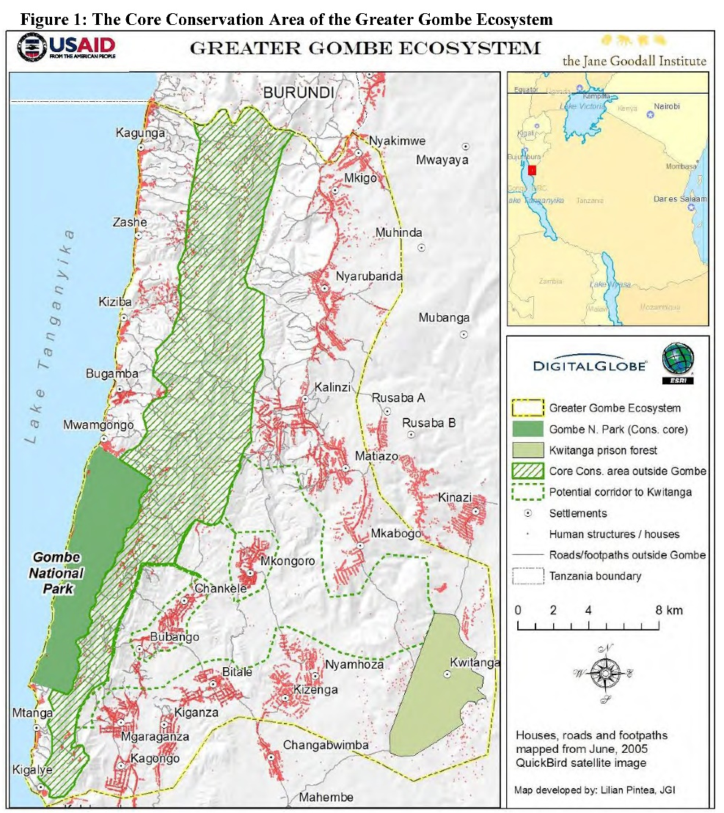


Slide 11
Telling the story
Communication
Creating the Management Plan

Slide 12
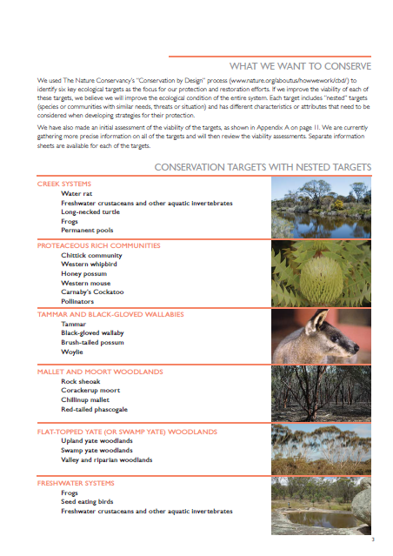
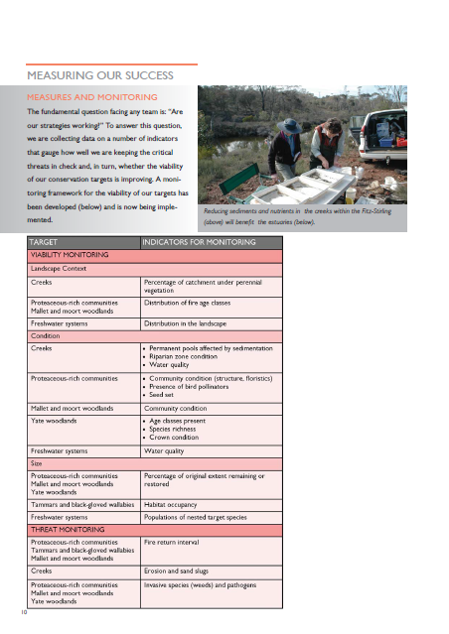
Telling the story
Communication
Summary documents

Slide 13
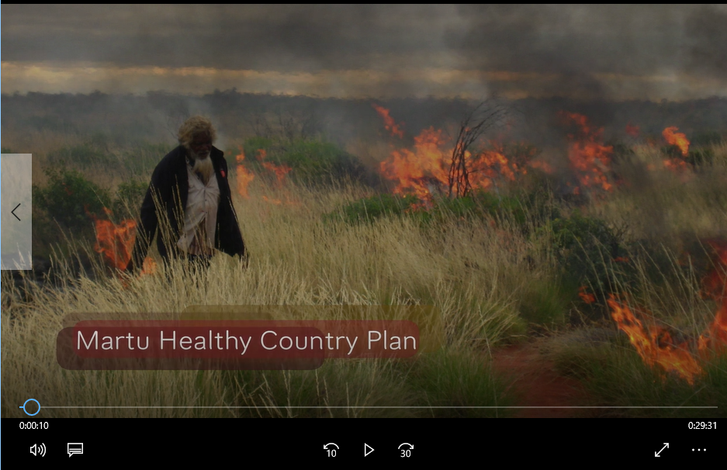
Telling the story
Communication
Video

Slide 14
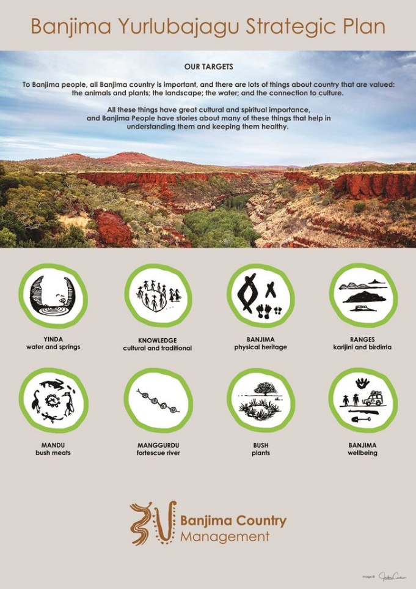
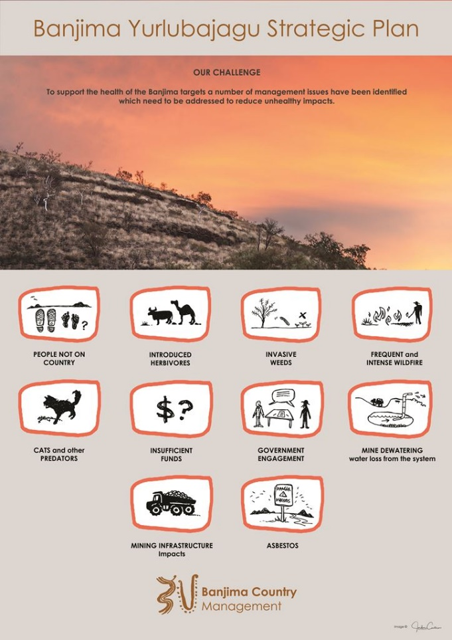
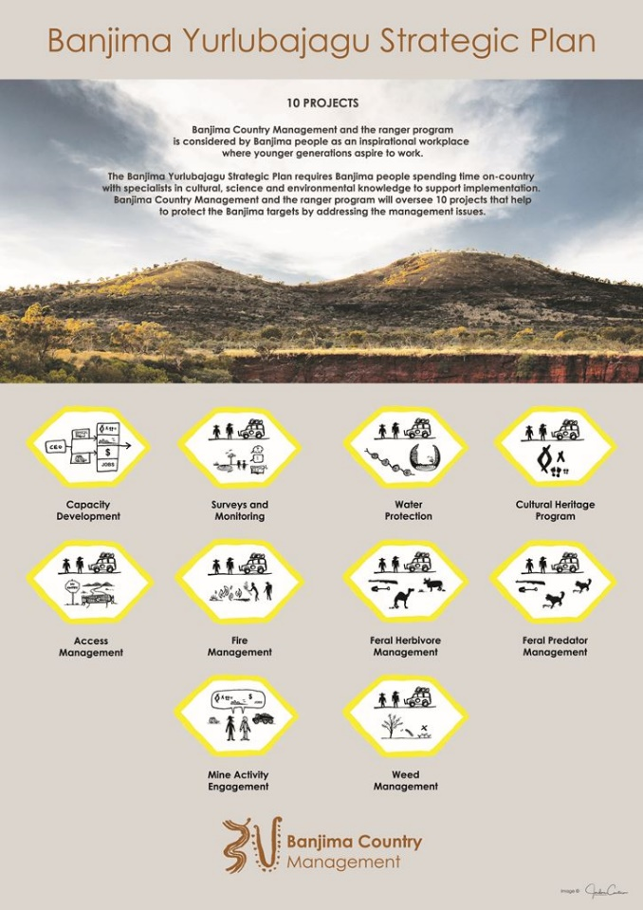
Telling the story
Communication
Posters

Slide 15
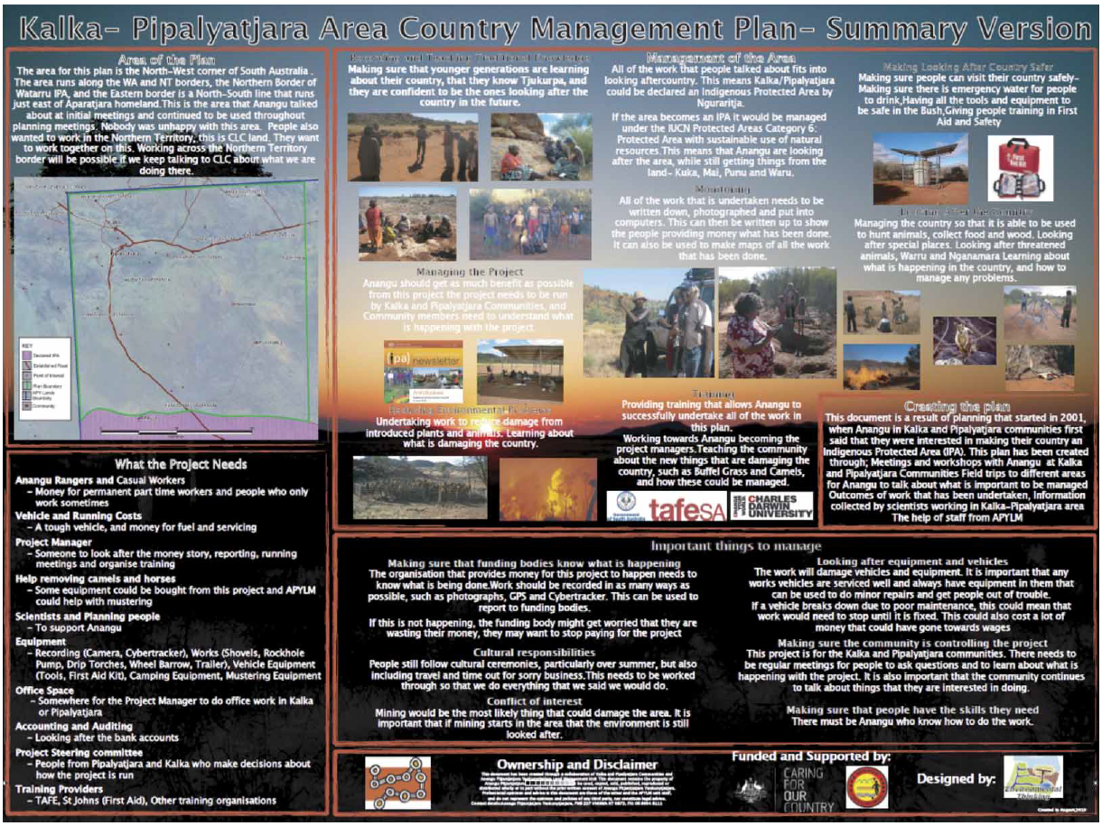
Telling the story
Communication
Posters
FROM:
Our Country Our Way: Guidelines for Australian Indigenous Protected Area Management Plans. Hill, R., Walsh F., Davies, J. and Sandford, M. 2011

