Slide 1
Other Support
When too much planning is not enough

Slide 2
Overview
Analog
  How-to Guides
  Standards
Desktop
  Excel Workbook
  Miradi Project Management
Cloud
  MiradiShare
  Conservation Gateway
  Online training
Crowd sourcing
  Coaches network
  FOS
  CMP
Other tools
  GIS / MARXAN
  INFERR / CSIRO
  I-Tracker

Slide 3
Analog

Slide 4


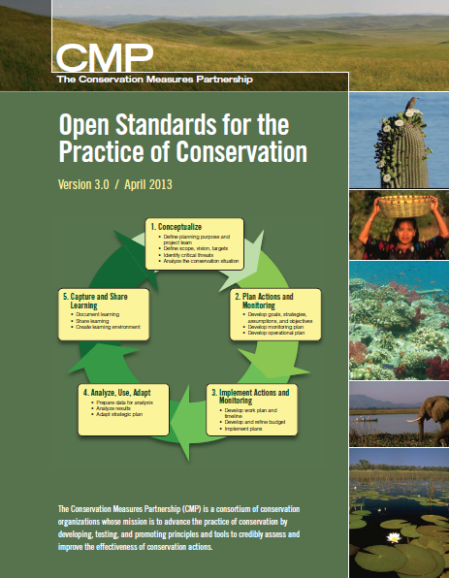
Open Standards

Slide 5
CAP workbook

Slide 6
Audubon
Tools of
Engagement

Slide 7
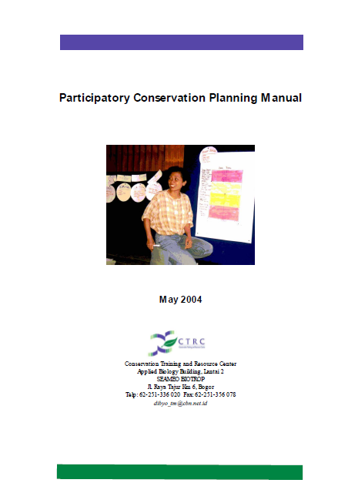
Participatory
Conservation
Planning

Slide 8
Desktop

Slide 9
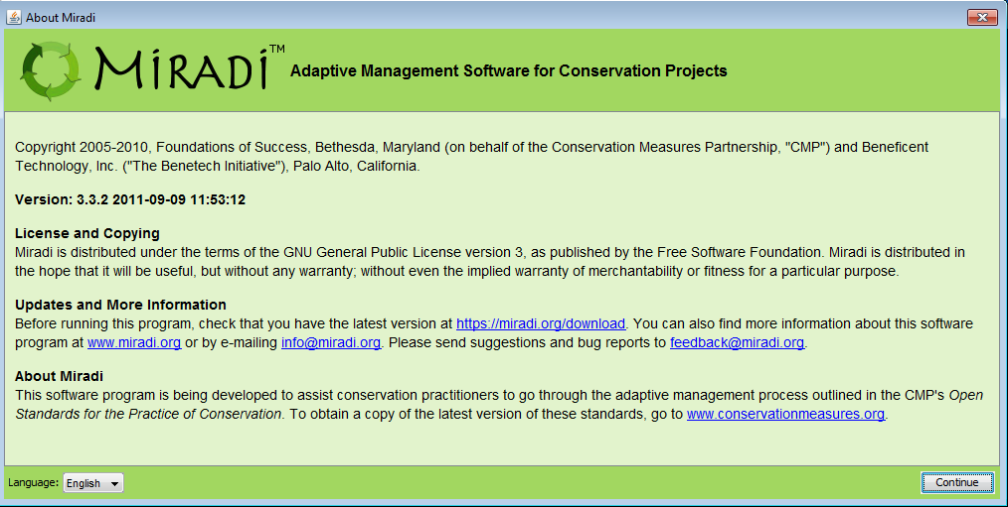
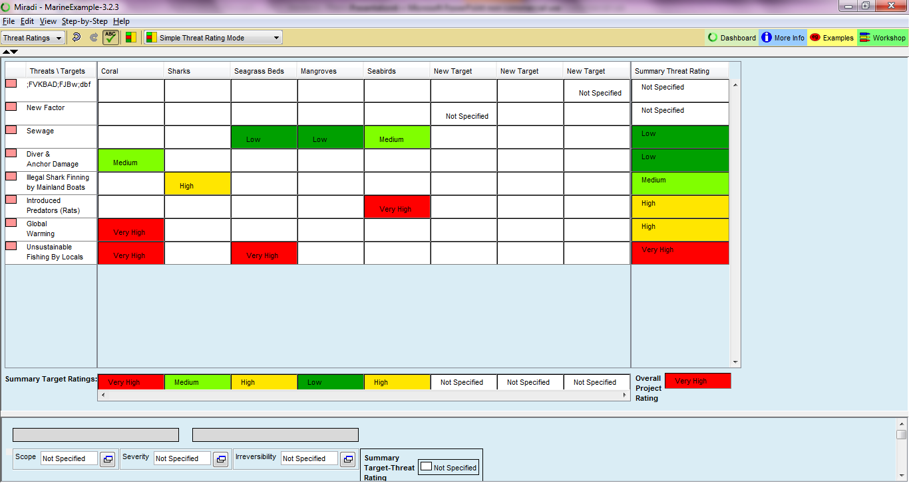
Miradi miradi.org

Slide 10
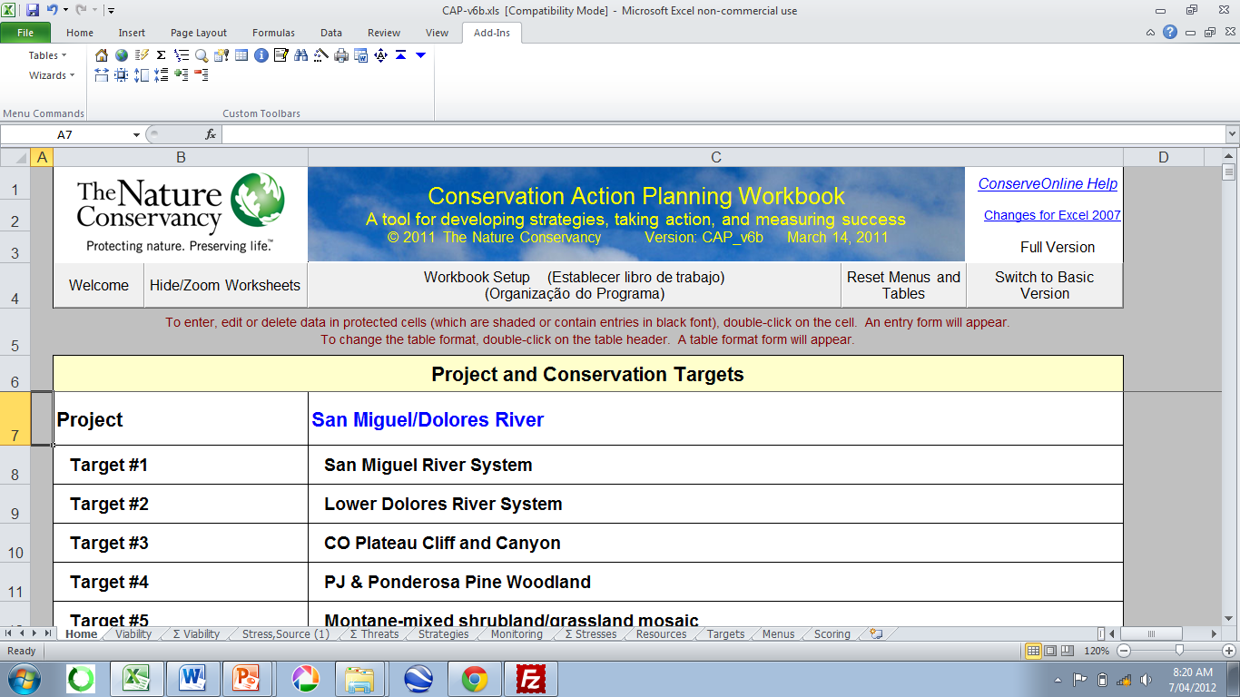
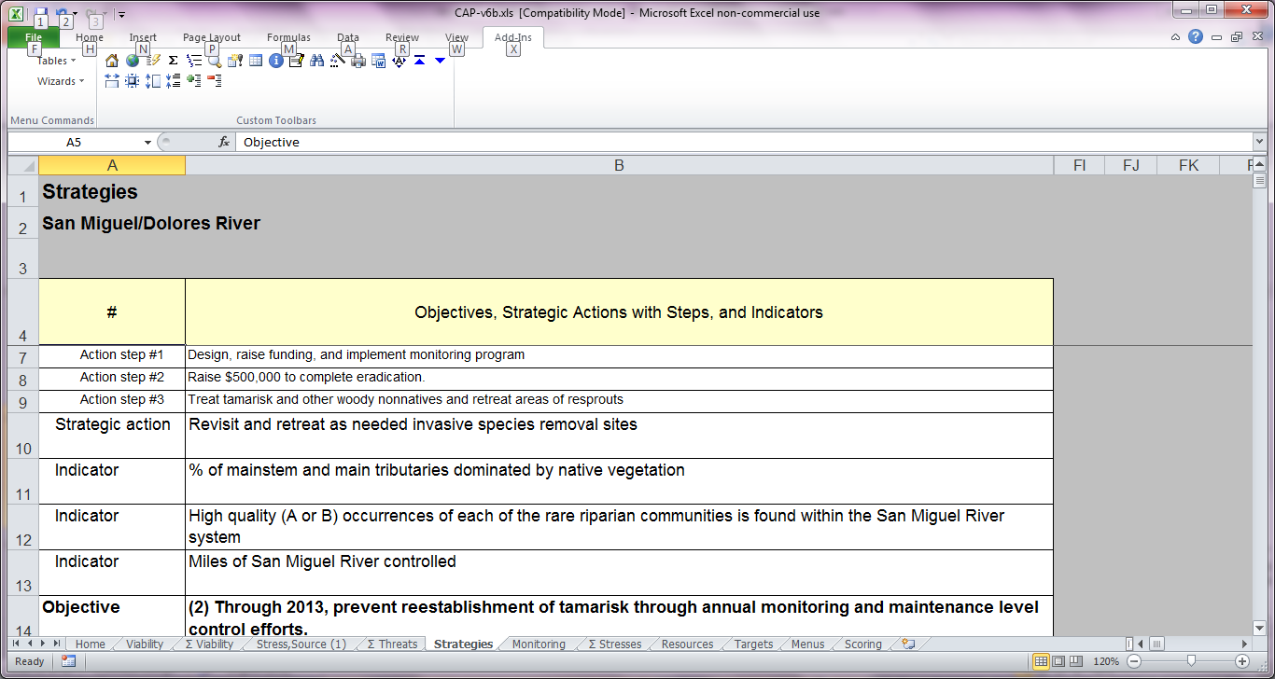
CAP Workbook www.conservationgateway.org/Documents/San%20Miguel%20CAP_v6b.zip

Slide 11
Web / Cloud

Slide 12
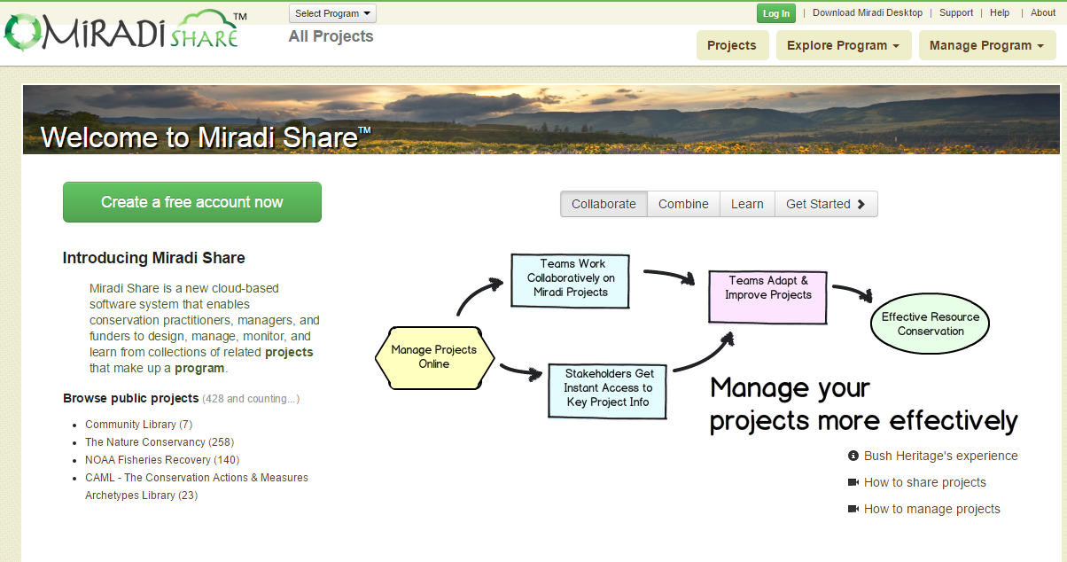
MiradiShare www.miradishare.org

Slide 13
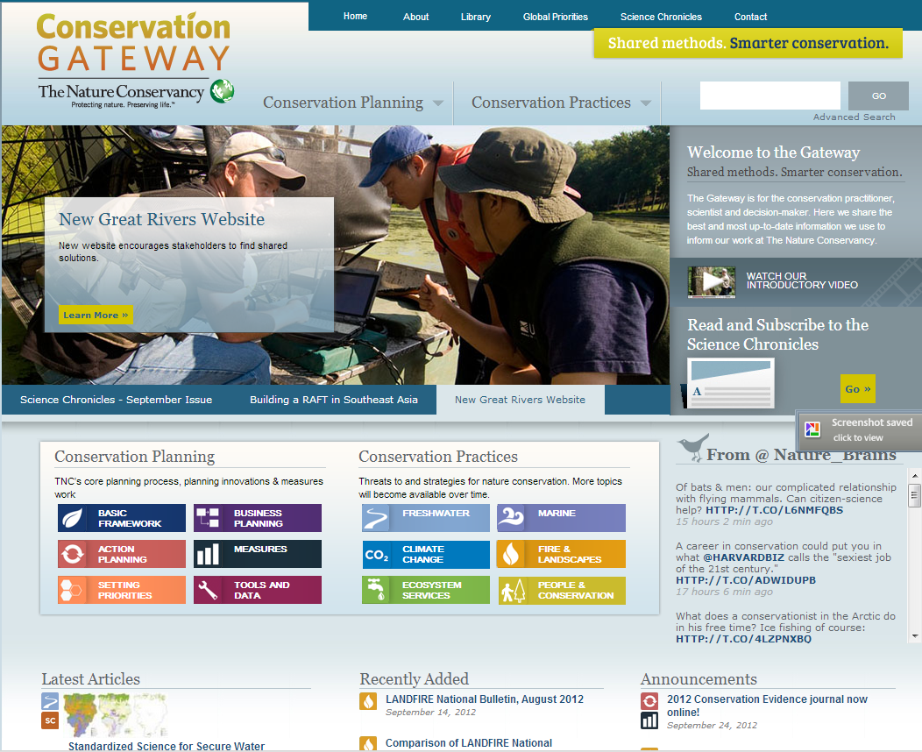
Conservation Gateway www.conservationgateway.org

Slide 14
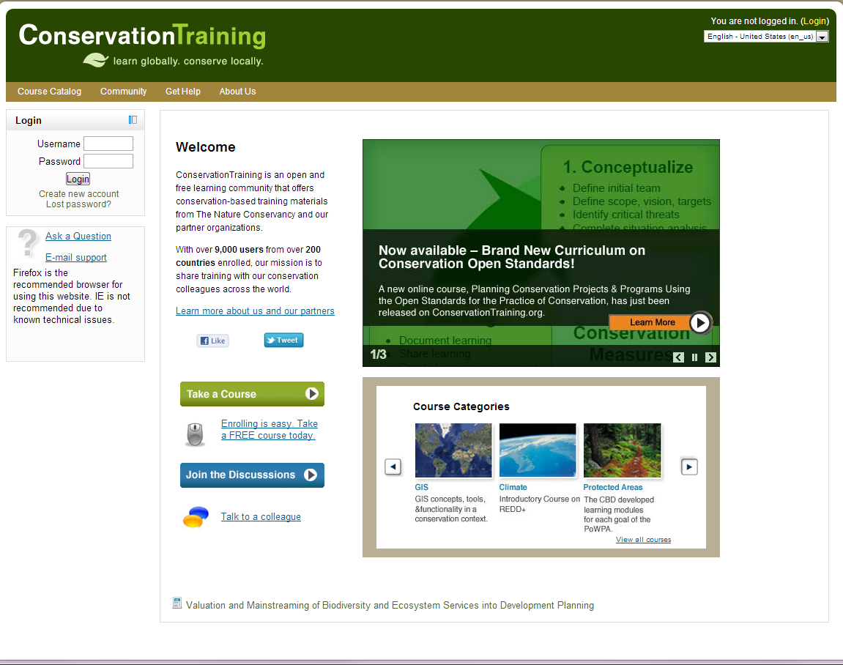
Training www.conservationtraining.org

Slide 15
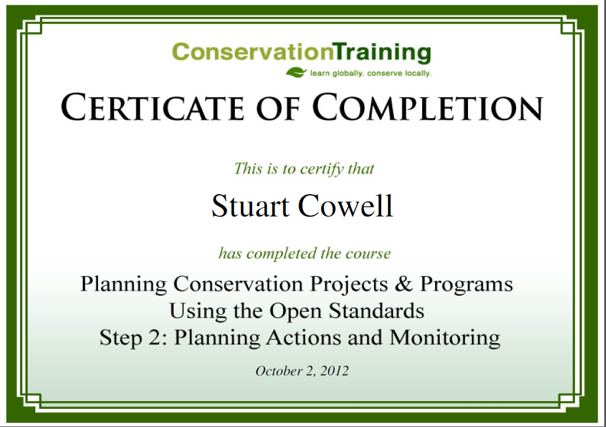

Slide 16
Crowd Sourcing

Slide 17

Conservation Coaches Network
The

Slide 18
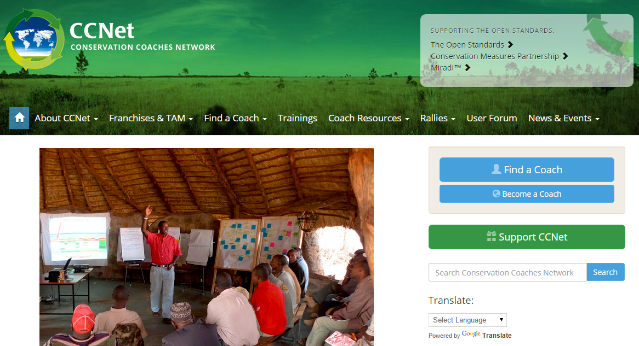
Conservation Coaches Network www.ccnetglobal.com

Slide 19

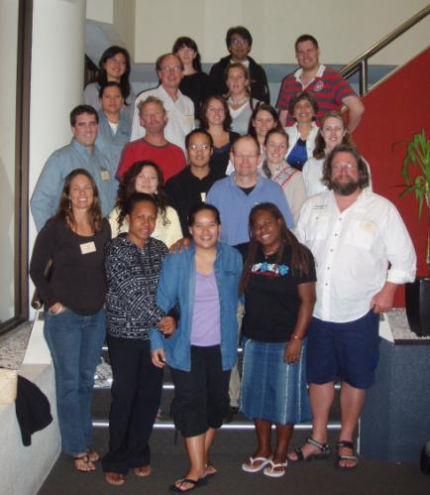
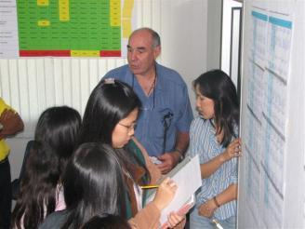
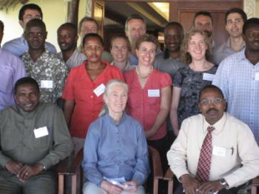
Conservation Coaches Network
Mission - catalyze effective conservation worldwide through action planning, coaching, knowledge sharing, and innovation

Slide 20
Some “stats”
1998 – 2004 Greg Low (TNC’s VP for Conservation) and a handful of people along side him supported
150 projects
Largely from the US and a few from Central America and Caribbean
2010 and 2011 Coaches supported……*
  More than 619 projects
  Involving more than 600 different organizations
  From six continents
* From a survey conducted Summer 2011 - 149 coaches responding

Slide 21
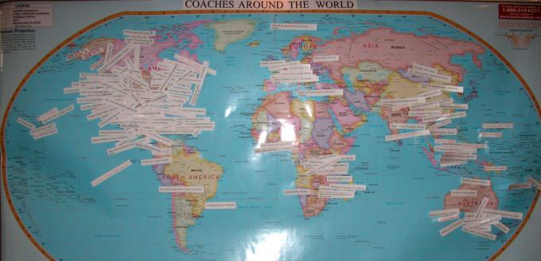
over 300 Coaches 60 Organizations
54 Countries
As of June 2012

Slide 22
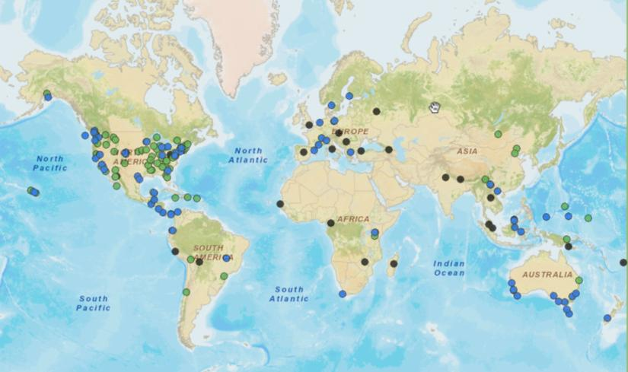
Find a Coach Map http://maps.tnc.org/ccnet/
Notes:
Conservation Coaches Network – engaged board
Active list serve
Materials accessed and downloaded - 8000 hits/month

Slide 23
Measuring Project Completeness
70-110% increase in measures, work planning and adapt and learn
when coaches are involved!
Coached (n= 65) vs. Non-coached (n= 206) projects in ConPro
Notes:
And what difference are coaches making in the practice of conservation?
This graph which was presented at the 2010 CCNet Rally shows a comparison from active and updated project records from the ConPro data-base. (Excludes placeholder records, CPI project records not edited by project staff , data effective date < 2004 not edited by project staff).
This comparison shows us that projects that have a coach assisting them are doing better are completing an adaptive management cycle.

Slide 24
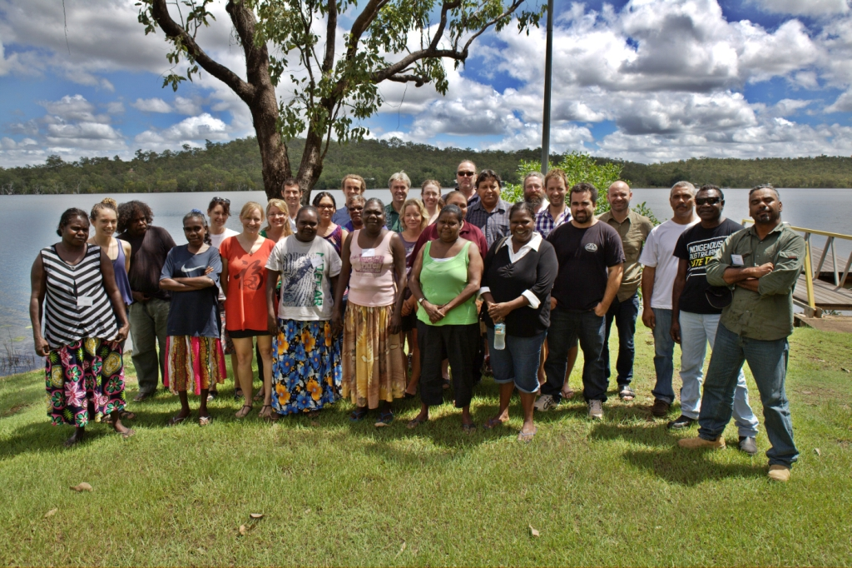
Healthy Country Planning

Slide 25
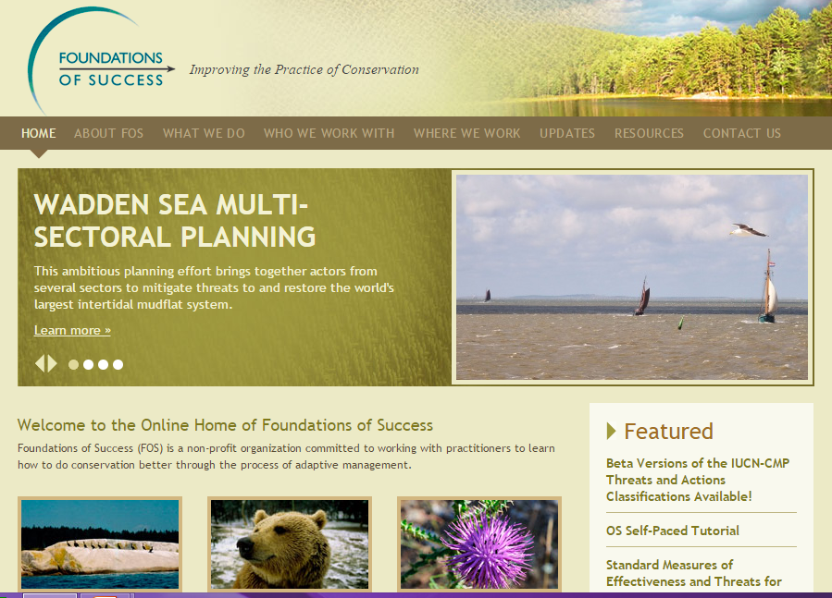
Foundations of Success www.fosonline.org/

Slide 26
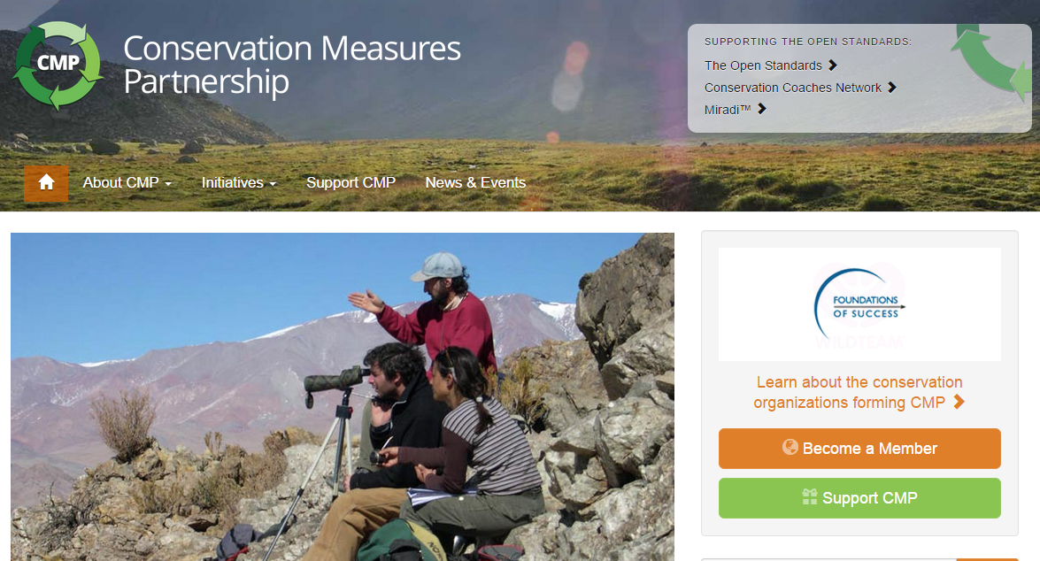
Conservation Measures Partnership www.conservationmeasures.org

Slide 27
Other Tools

Slide 28
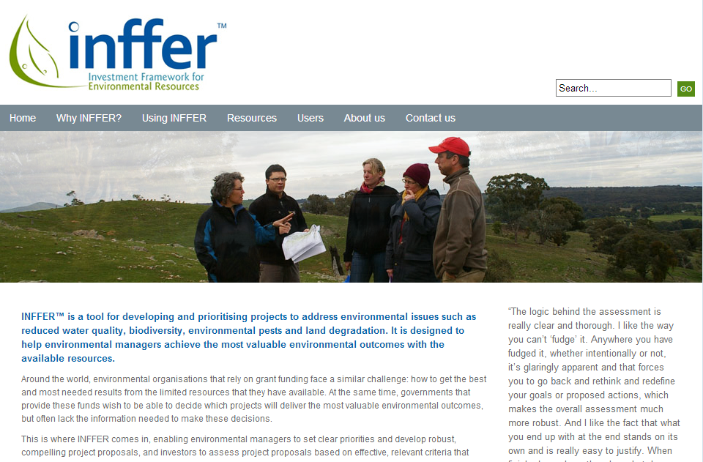
inffer www.inffer.org

Slide 29
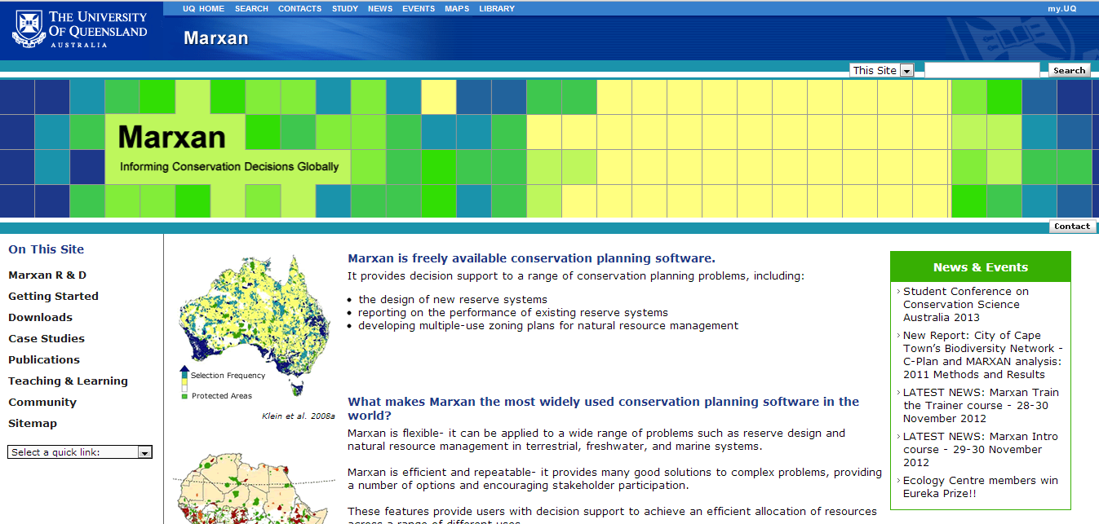
Marxan www.uq.edu.au/marxan

Slide 30
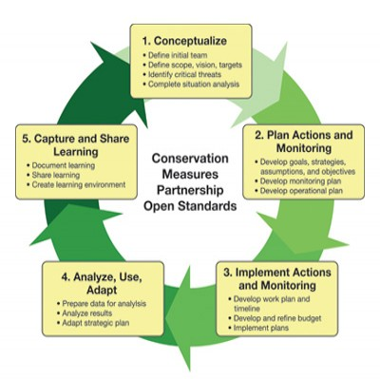



Healthy Country Planning and I-Tracker
Healthy Country Planning
Key Indicators

