Slide 1
Threat Assessment
Conservation Coaches Network New Coach Training
The Search for Critical Threats

Slide 2
Threat Assessment
Which Site is Better Conserved?

Slide 3
Threat Assessment
Which Site is Better Conserved?

Slide 4
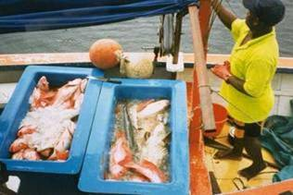
What Is The Question?
Threat Assessment
Direct Threats: Human-induced actions or events that directly degrade one or more conservation targets
Direct threats are:
usually human activities, but they can be
natural phenomena altered by human activities or whose impact is increased by human activities
(e.g., global warming; tsunami that threatens the last remaining population of an Asian rhino)
Notes:
4

Slide 5
Threat Assessment
Direct Threat vs.
Stress?
Direct threat: Human-induced actions or events that directly degrade one or more conservation targets. A direct threat has at least one actor associated with it.
Example: residential development
Stress: biophysical impact of that action on the target – a impaired aspect of a target. A single stress can be caused by multiple direct threats.
Examples: habitat fragmentation, high mortality

Slide 6
Threat Assessment
Direct Threat vs.
Stress
Direct Threat | Example Stress(es) | Example Target Affected
Dams | Altered stream flows Reduced reproductive success of fish | Rivers and streams Migratory fish
Unsustainable Logging | Erosion (Rivers and streams) Sedimentation Habitat destruction Habitat fragmentation | Rivers and streams Rivers and streams, Estuaries Forests Forests
Illegal Hunting | Altered population structure | Monkeys, Rhinos
Unsustainable Agriculture | Sedimentation Habitat destruction Habitat fragmentation | Rivers and streams, Estuaries Forests, Grasslands, Wetlands Forests, Grasslands, Wetlands
Climate change | Coral bleaching Rising sea levels Reduced rainfall | Coral reefs Shoreline habitat Forests, Grasslands, Deserts
Notes:
Point out how same stresses can be caused by 2 different threats – logging and agriculture; Dams and climate change could also both affect river levels

Slide 7
Threat Assessment
Direct Threat vs.
Indirect Threat?
Direct threat: an action taken by a human that degrades a conservation or resource management target. A direct threat has at least one actor associated with it.
Example: residential development
Indirect threat/contributing factor/driver (short definition): an economic, cultural, societal, institutional factor that influences a direct threat
Examples: need for income, lack of knowledge, poor capacity

Slide 8
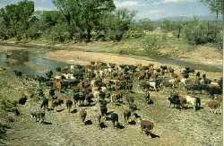
Threat Assessment
Key Points to Introduce this Step
Cows?
Cattle?
Livestock?
Grazing?
Ranching?

Slide 9
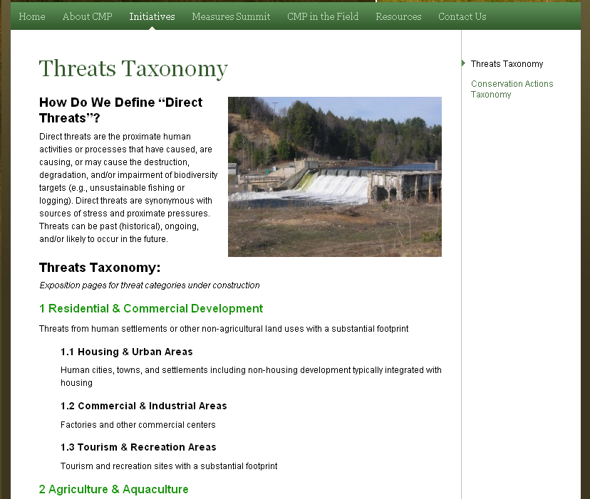
Threat Assessment
Key Points to Introduce this Step
Available at www.conservationmeasures.org
Notes:
Taxonomy helps teams consider all the direct threats that occur in their site as well as facilitate cross-project learning with a standard language.

Slide 10
Threat Assessment
Key Points to Introduce this Step
Most Common Threat Ratings:
Stress-based threat rating:
Rates the scope (or extent) and severity (magnitude) of stress to target and the contribution and irreversibility of each direct threat to stress
Simple threat rating:
Rates the scope (or extent), severity, irreversibility of direct threat only

Slide 11
Key Points to Introduce this Step
Threat Assessment
THREAT RATING SYSTEM | THREAT RATING CRITERIA
CMP e-AM / TNC Rapid CAP | Scope | Severity |  | Irreversibility
TNC 5-S | Scope (Spatial) | Severity | Contribution | Irreversibility
BSP TRA | Area | Intensity |  |  |  |  | Urgency
Birdlife | Scope | Severity |  |  |  |  | Timing
WWF RAPPAM | Extent | Impact |  | Permanence | Probability | Trend
TNC’s SE Division | Extent – % Targets | Severity
WWF Root Causes | Scope | Impact |  | Permanence
WCS Living Landscapes | Proportion of Area | Severity |  | Recovery Time | Probability |  | Urgency
Notes:
Where did the criteria come from? Once again, shows origins of the approach used by the Open Standards

Slide 12
Key Points to Introduce this Step
Threat Assessment
Miradi uses a Rule-Based system to combine scores
Scope + Severity = Threat Magnitude
 |  | Scope
 |  | Very High | High | Medium | Low
Severity | Very High | Very High | High | Medium | Low
 | High | High | High | Medium | Low
 | Medium | Medium | Medium | Medium | Low
 | Low | Low | Low | Low | Low
Threat Magnitude + Irreversibility = Threat Rating
 |  | Irreversibility
 |  | Very High | High | Medium | Low
Magnitude | Very High | Very High | Very High | Very High | High
 | High | Very High | High | High | Medium
 | Medium | High | Medium | Medium | Low
 | Low | Medium | Low | Low | Low
Notes:
Miradi combines scope and severity ratings to get the overall threat magnitude rating for each threat on each target, using the following rule-based system:
Miradi then combines the threat magnitude rating with the irreversibility rating using the following rule-based system:

Slide 13
Key Points to Introduce this Step
Threat Assessment
Miradi summarizes across the three criteria
Notes:
Finally, Miradi summarize threats at the level of the whole project, using the same 2-prime and 3-5-7 rules but applied across to the values in the far right column.
So, in this case, the 2 very high summary values for threats result in a very high score for the project as a whole.

Slide 14
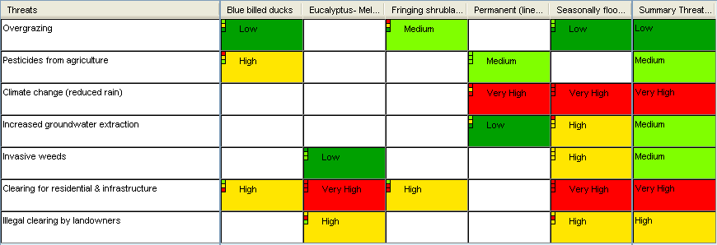
Key Points to Introduce this Step
Threat Assessment
Miradi summarizes across all targets and threats
2 Prime Rule:
Need at least 2 of a level
3-5-7 Rule:
3 Highs = 1 Very High
5 Mediums = 1 High
7 Lows = Medium
Notes:
To calculate these summaries, Miradi the 2-prime rule:
Which says, that you need at least 2 of a particular value within a row or column to receive that level as the row or column total.
This is best understood by example..
So, the threat clearing for residential developed, received a Very High summary score, because two or more targets received a very high rating for this threat.
Overgrazing, on the other hand, received a low summary score, because only one target received a score of medium. If a second target, like blue-billed ducks, had received a medium score, then the summary would also be medium. -
Within the 2-prime rule, Miradi uses a second rule called the 3-5-7 rule:
Here, 3 highs within a column or row equivalent to receiving 1 Very High value
5 mediums are equal 1 high
And 7 lows equal a medium
If these rules aren’t crystal clear to you, you read them in detail within Miradi and explore what happens when you change values.

Slide 15
Critical Questions to Ask the Team
Threat Assessment
Have they considered all threats (or KEAs if using a stress-based rating)? Anything missing?
Any surprises with the rating roll-up? Probe for ideas on why this might be the case
Probe for over-rankings
Look for “double-counting” of direct threats or stresses
Probe for specificity of High-ranked direct threats
sooner or later the devil will be in the details
Notes:
Very high remember = a threat that will eliminate or severely degrade a target across its entire range within 10 years!

Slide 16
Common Issues & Recommendations
Threat Assessment
Issue: How to deal with historic threats?
“Sins of the past” = lower viability
“Sins of the future” = threats
Notes:
“Stresses” can sometimes trip up a team. Think of these as the observed condition. E.g. “the patient has high blood pressure” Sources are the possible causitive agents (e.g. too much salt in the diet, block artery, etc.)
It is helpful to understand whether something that happened in the past but is no longer occurring is what is responsible for the lower viability scores now. If that is the case, that the actual cause of the problem is no longer at play – the action may be more about restoration than it is about addressing a current “threat.”
“Threats” are something currently occurring or likely to occur that is either actively compromising our targets or likely to be coming at them. These we would need to address at the “source”.
That is what we mean by “Sins of the past” = lower viability... Versus “Sins of the future” = threats

Slide 17
Common Issues & Recommendations
Threat Assessment
Issue: What about the 10 year guideline for ranking threats?
Works for everything but some invasive species & long-term/persistent/insidious sources like climate change

Slide 18
Common Issues & Recommendations
Threat Assessment
Issue: When to lump vs. split threats?
If in doubt, better to split initially
Split if actors are different and will require different strategies (e.g., artisanal vs. industrial fishing)
And then use IUCN “common threat taxonomy” to give the perspective that lumping can provide
Also, see if splitting artificially ‘dilutes’ threat ratings

Slide 19
Common Issues & Recommendations
Threat Assessment
Issue: Simple or Stress-based Threat Rating?
Simple rating is faster. Use it if you feel confident that this will give a good approximation of the importance of different threats.
Stress-based is more rigorous but more time-consuming. Use it when the source of the problem is not immediately clear

Slide 20
Common Issues & Recommendations
Threat Assessment
Issue: What about potential catastrophic threats of unknown likelihood and impact?
“User Override” works here – team’s best guess

Slide 21
Common Issues & Recommendations
Threat Assessment
Issue: Are natural disturbances (e.g. hurricanes) stresses?
No, unless they’ve been exacerbated by a known source (e.g., excess CO²)

Slide 22
Common Issues & Recommendations
Threat Assessment
Issue: What about cumulative impacts?
The Miradi scoring algorithm addresses a source that causes multiple stresses, but not multiple sources to multiple stresses that may have a cumulative impact

Slide 23
Helpful Hints
Threat Assessment
Use simple circles and percentages to illustrate the concepts of quantifying scope, severity, and irreversibility for the first few ratings. This can help get a team started.
Encourage teams to refer to the definitions of Very High, High, Medium, and Low as often as possible to ensure as consistent a rating as possible.
Teams often over-rank future threat by letting current ecological condition creep into their consciousness; this is already accounted for in a “Poor” or “Fair” Viability rank

Slide 24
Helpful Hints
Threat Assessment
As much as possible, explicitly describe climate change related threats in terms of how they might impact targets.
Roll up threats by targets, not by sites, to get useful information for multi-area strategies
Another test to consider for stress-based rankings...
A “Very High” stress should reduce a key attribute to “Poor”
A “High” stress should reduce a key attribute to “Fair”

