Slide 1
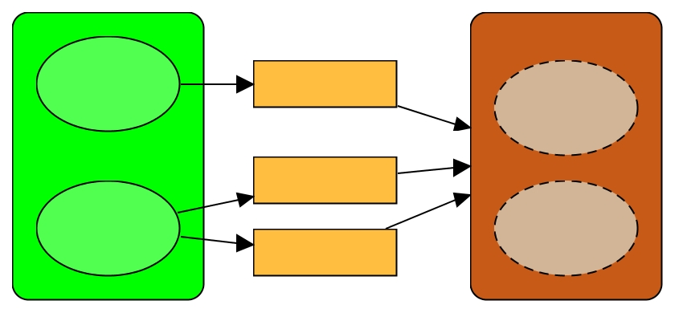
Ecosystem Services and Human Wellbeing
Conservation Coaches Network New Coach Training
Elaborating the situation analysis

Slide 2
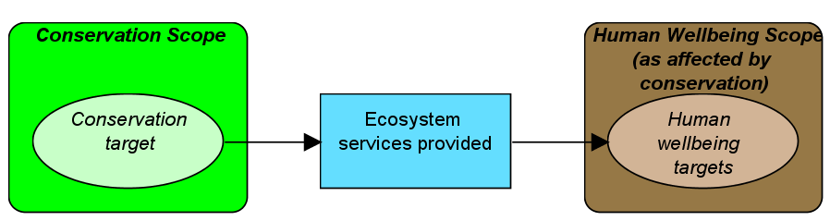
Why include Human Wellbeing & Ecosystem Services in your situation analysis?
To clarify links between conservation & human wellbeing targets via ecosystem services
Notes:
2

Slide 3
Summary of key points
Situation
Analysis
Human wellbeing targets represent the interests of humans that will be enhanced or achieved as a result of the conservation of an ecosystem, habitat, or species and its associated ecosystem services
Conservation teams often work on important social issues that have benefits beyond conservation (e.g., building capacity for good governance or promoting alternative livelihoods, even securing sustained ecosystem services). Being able to clarify these links can strengthen conservation considerably.
Notes:
MAY NOT BE NECESSARY TO INCLUDE THIS SLIDE

Slide 4
Key Points to Introduce this Step
Situation
Analysis
Human wellbeing target (HWT) definition:
Aspects of human wellbeing* that the project chooses to focus on. In the context of a conservation project, human wellbeing targets focus on those components of human wellbeing affected by the status of conservation targets.
*Millennium Ecosystem Assessment defines human wellbeing as including: 1) necessary material for a good life, 2) health, 3) good social relations, 4) security, and 5) freedom and choice

Slide 5
Key Points to Introduce this Step
Situation
Analysis
Ecosystem Services definition:
The services that intact, functioning ecosystems, species, and habitats provide and that can benefit people.
*Millennium Ecosystem Assessment offers various categories: 1) provisioning, 2) regulating, 3) supporting , and 5) cultural

Slide 6
To determine if they should include HWT and ES:
Critical Questions to Ask the Team
Situation
Analysis
Will clarification of linkages help motivate key stakeholders to participate in the project?
Do we need to clarify links to secure funds?
Do key partners need to illustrate the linkages to their constituency or by law?
Does modeling of ES and HWT help make the business case for your conservation focus?
Notes:
Steps 1 and 2 are iterative and/or parallel

Slide 7
Key Points to Introduce this Step
Situation
Analysis
Structure the process around 3 steps:
Define the social scope of your project
Identify ecosystem services linked to conservation targets
Identify human welbeing targets linked to ecosystem services

Slide 8
To define social scope:
Critical Questions to Ask the Team
Situation
Analysis
Whose wellbeing are we actually targeting?
Thematic (example: all parties along a particular supply chain?)
Geographic (example: all people that live within the Scope of the project? Wider? Global?)
What about future generations, do we include them? If so, what is the implication?
Notes:
Steps 1 and 2 are iterative and/or parallel

Slide 9
To identify Ecosystem Services:
Helpful hints
Situation
Analysis
Type | Definition | Examples
Provisioning | Products obtained from ecosystems | Food, fuelwood, water, minerals, pharmaceuticals, biochemicals, energy
Regulating | Benefits obtained from regulation of ecosystem processes | Carbon sequestration, climate regulation, waste decomposition, water/air purification, crop pollination, pest control
Supporting | Services necessary for production of all other ecosystem services | Nutrient dispersal & cycling, seed dispersal, soil formation
Cultural | Non-material benefits obtained from ecosystems through spiritual enrichment, cognitive development, reflection, recreation, and aesthetic experiences | Cultural diversity, spiritual & religious values, knowledge systems, educational values, inspiration
Source: Millennium Ecosystem Assessment
Notes:
Steps 1 and 2 are iterative and/or parallel

Slide 10
To identify Ecosystem Services:
Helpful hints
Situation
Analysis
The categories are an aid for brainstorming – getting the categories right is not important.
Identifying the ecosystem service is important!
Notes:
Steps 1 and 2 are iterative and/or parallel

Slide 11
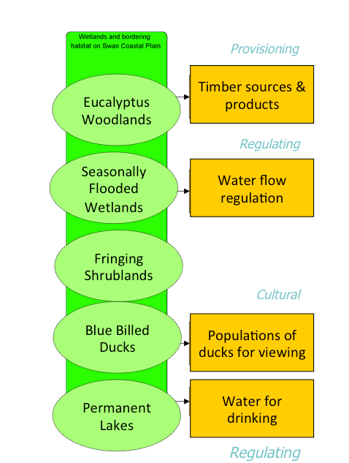
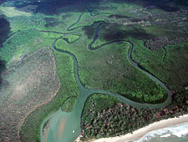
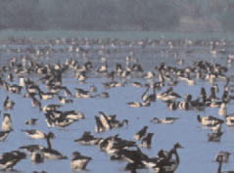
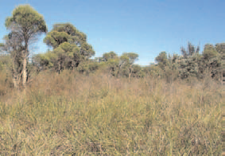
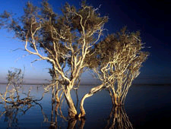
Including Ecosystem Services in your CM:
Helpful hints
Situation
Analysis
Our Example :
Swan Coastal Plain Wetlands
Notes:
Steps 1 and 2 are iterative and/or parallel

Slide 12
To identify HWT
Helpful hints
Situation
Analysis
Necessary material for a good life: including secure and adequate livelihoods, income and assets, enough food at all times, shelter, furniture, clothing, and access to goods;
Health: including being strong, feeling well, and having a healthy physical environment;
Good social relations: including social cohesion, mutual respect, good gender and family relations, and the ability to help others and provide for children;
Security: including secure access to natural and other resources, safety of person and possessions, and living in a predictable and controllable environment with security from natural and human-made disasters; and
Freedom and choice: including having control over what happens and being able to achieve what a person values doing or being
Source: Millennium Ecosystem Assessment
Notes:
Steps 1 and 2 are iterative and/or parallel

Slide 13
To identify HWT:
Helpful hints
Situation
Analysis
The categories are an aid for brainstorming – getting the categories right is not important.
Identifying the HWTs is important!
Notes:
Steps 1 and 2 are iterative and/or parallel

Slide 14
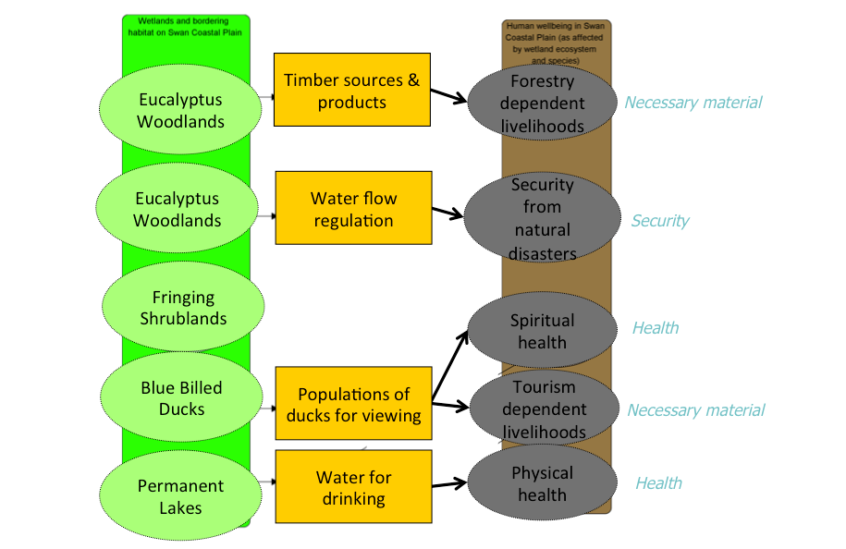
Including HWT in our CM:
Helpful hints
Situation
Analysis
Notes:
Steps 1 and 2 are iterative and/or parallel

Slide 15
Helpful Hints
Situation
Analysis
A quick-and-dirty mapping of ES and HWT can help build support from non-conservation oriented stakeholders.
Discussing the outcomes of the viability analysis and the threat ranking in relation to ES & HWT adds to the depth of understanding and helps improve strategic focus.
Teams often confuse the more non-tangible cultural/spiritual ES with their contribution to HWT (income from tourism, or contribution to human health). Help by using words as “birds as basis for bird watching”

Slide 16
Helpful Hints
Situation
Analysis
Teams are hesitant to include ES which are harder to measure or to assign an economic value to. Help the team overcome this by using “priceless” examples: landscape features as basis for a sense of belonging, silence as basis for spiritual health etc.
Teams sometimes feel uncomfortable to position HWT to the right of conservation targets and prefer to have them side by side. You can help teams avoid unnecessary confusion by separating ethics (and a perceived hierarchy between targets) and the tool (which is hierarchically neutral but geared to show linkages)

Slide 17
Issues & recommendations
Strategies & results chains
Issue: Teams sometimes loose conservation focus when also taking human wellbeing into consideration
Recommendation: help teams understand the three ways in which a conservation strategy might contribute to human wellbeing: (a) Through benefits from a socially oriented strategy; (b) via ecosystem services; ( c) through a combination of (a) and (b)

Slide 18
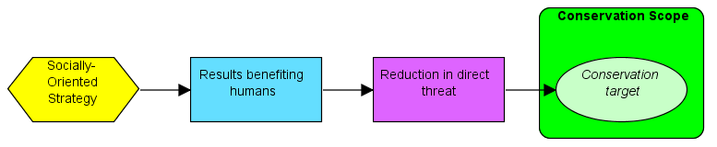
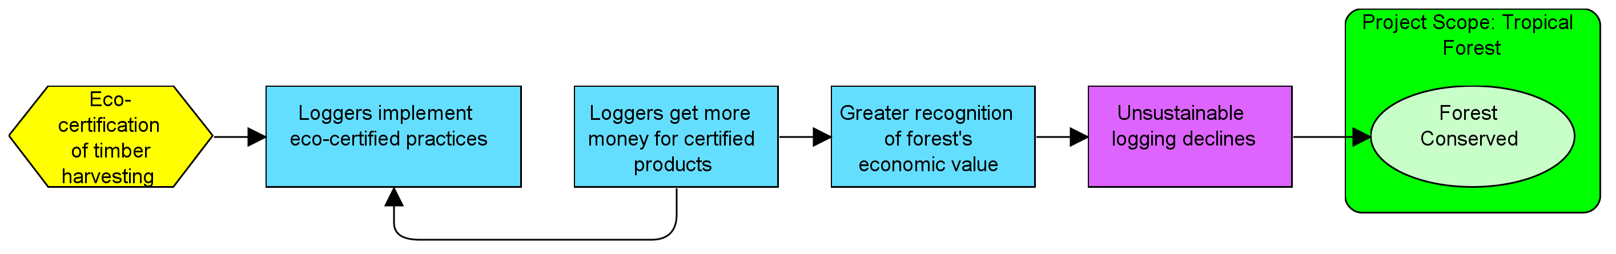
Social benefits
Strategies & results chains
Case 1: Human Wellbeing enhanced via socially-oriented strategy
General Relationship
Eco-certification of timber harvesting
Specific Example
Loggers get more money for certified products
Result directly benefiting humans
Notes:
Necessary for achieving conservation, but it also has direct social benefits
When thinking about HWB elements, should be linked to ecosystem service or conservation initiative

Slide 19
Thru Socially-oriented strategy
Strategies & results chains
Case 1: Human Wellbeing enhanced via
socially-oriented strategy
Conservation Strategy | Results benefiting humans (and necessary for achieving conservation)
Alternative livelihoods | Increased income Diversified income sources
Eco-certification | Access to niche markets Increased income
Sustainable resource management/ extraction | Improved ability to manage resources sustainably Increased yields (in some cases)
Improving governance | Increased ability to influence decision making Empowerment
Capacity building, technical assistance | Improved technical skills Improved ability to manage
Environmental education | Increased knowledge and awareness
Notes:
Necessary for achieving conservation, but it also has direct social benefits
When thinking about HWB elements, should be linked to ecosystem service or conservation initiative

Slide 20
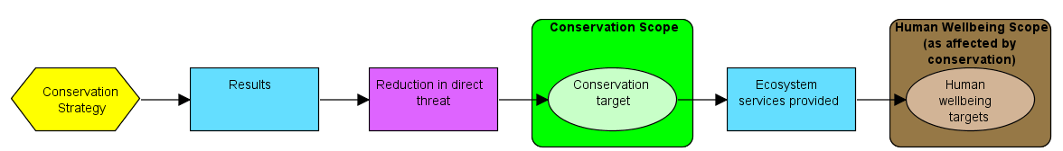
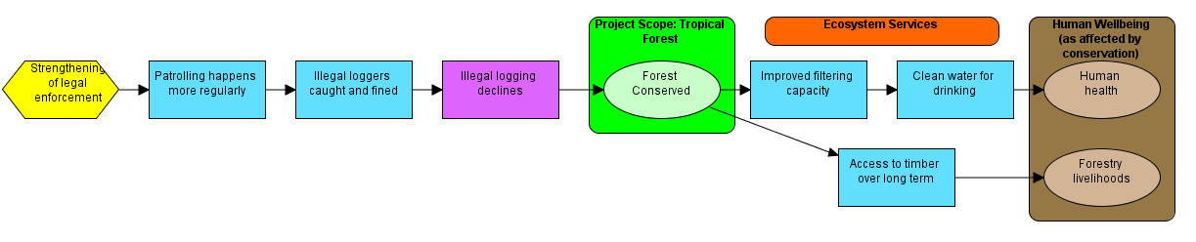
Via ecocystem services
Strategies & results chains
Case 2: Human Wellbeing enhanced via
Ecosystem Services
General Relationship
Specific Example
Strengthening of law enforcement
Patrolling happens…
Illegal loggers caught & fined
Forest conserved
Improved filtering capacity
Availability of clean water
Illegal logging declines
Human health
Access to timber over long term
Forestry livelihoods
Ecosystem service results contributing to human wellbeing

Slide 21
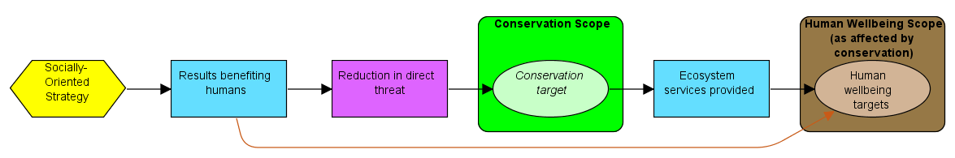
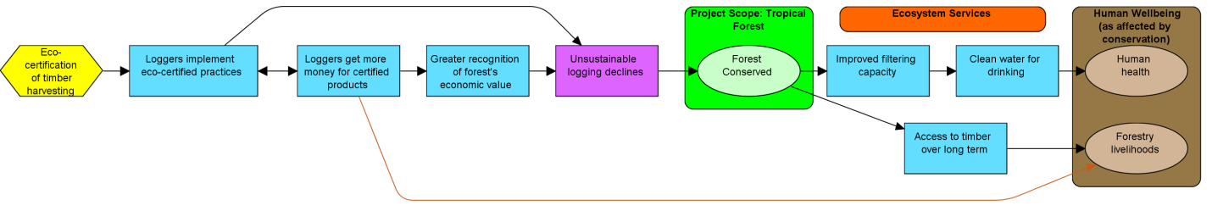
Via a combination
Strategies & results chains
Case 3: HWB enhanced via multiple avenues
General Relationship
Ecosystem service results contributing to human wellbeing
Specific Example
Eco-certification of timber harvesting
Improved filtering capacity
Availability of clean water
Loggers get more money for certified products
Human health
Result also contributing to human wellbeing
Access to timber over long term
Forestry livelihoods
Result directly benefiting humans
Notes:
Case 3: HWB enhanced via multiple avenues

Slide 22
Issues & recommendations
Strategies & results chains
Issue: Working with partners might mean that a project or programme includes work that focusses on human wellbeing targets which are not linked to conservation targets (such as illiteracy and HIV). The tools introduced here are not well suited for this as they are developed to support the practice of conservation.
Recommendation: help partners use a conceptual model to better understand how their work relates and what each partner focuses on. It is recommended to use the OS for those strategies related to conservation.

Slide 23
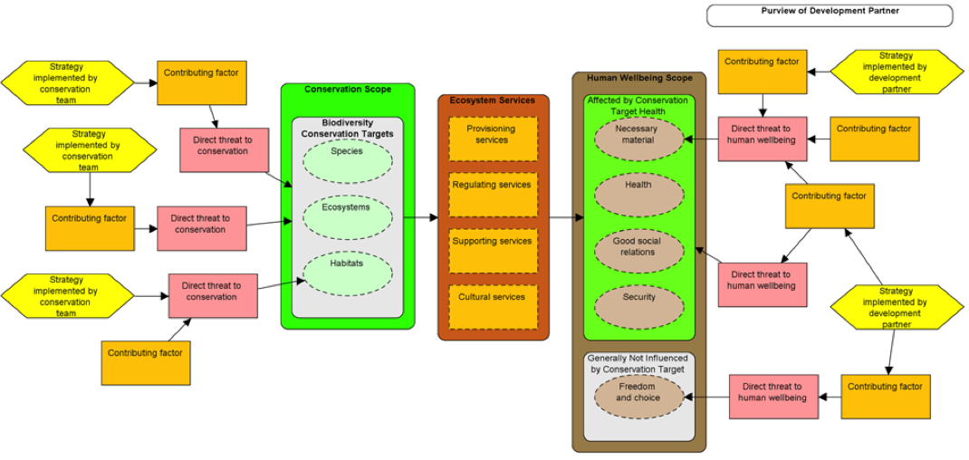
Issues & recommendations
Strategies & results chains
A conceptual model can help clarify how conservation and development work relate.

Slide 24
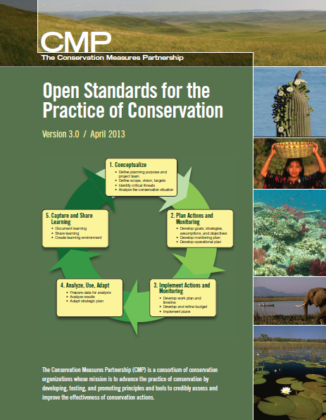
What Is in OS Version 3.0
Explicit recognition and definition of Human Wellbeing within OS
Link to conservation targets via ecosystem services
Socially beneficial results and human wellbeing targets are not the same
Parameters for HWT goals (later step!)

