Slide 1
Dream and Area
Vision and Scope

Slide 2
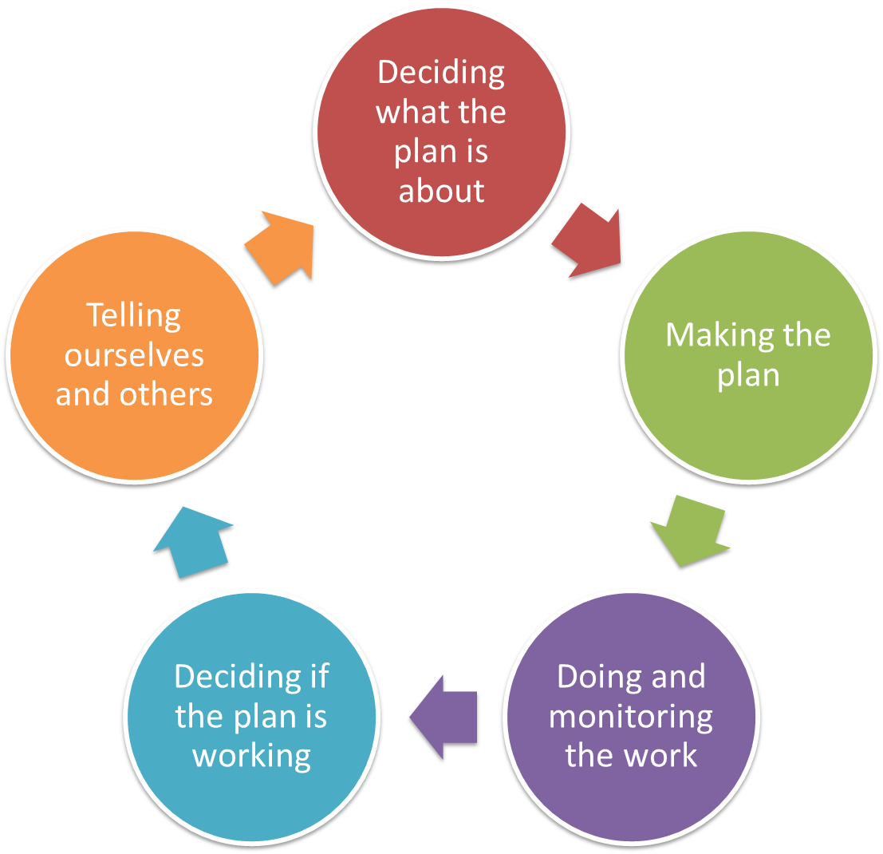
Pre-planning
Vision & Scope
Targets & Health
Threats
Situation
Notes:
Pre-planning is 1st step, irrespective of the ‘entry point’

Slide 3
Deciding what the Plan is all about
Vision/Dream
Make a statement about success
Why do this step?
  This is the first step in pointing the plan in the right direction – you need to be clear about what you want the future to look like if you are successful in making the plan work
  It is also helpful to be clear about where you are not going to be working – particularly when talking to neighbouring land holders, or other stakeholders.
  Start of process: involve the whole community

Slide 4
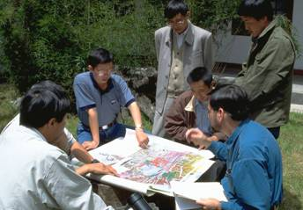

Deciding what the Plan is all about
Vision/Dream
Make a statement about success
A vision is like a lighthouse, which illuminates rather than limits, giving direction rather than destination."
-- James J. Mapes
The goal is not to find the majority opinion, but to arrive at a vision that reflects the thinking of the whole group.

Slide 5
Deciding what the Plan is all about
Vision/Dream
Make a statement about success
Dream:
A description of the desired state or ultimate condition that a project is working to achieve
A good Dream will balance the following criteria:
  Relatively general:
  Broadly defined to encompass all project activities
  Visionary:
  Inspirational in outlining the desired change in the state of the targets toward which the project is working
  Brief:
  Simple and succinct so that all project participants can remember it

Slide 6
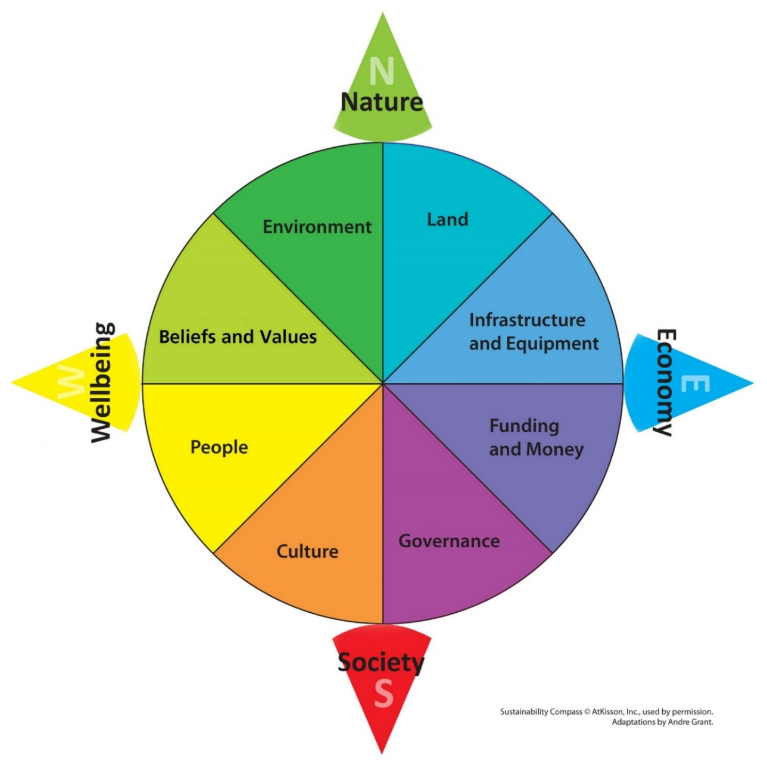
Deciding what the Plan is all about
Vision/Dream
Make a statement about success

Slide 7
Deciding what the Plan is all about
Vision/Dream
Make a statement about success
Discuss success and change as a group/groups
    Pretend the plan has been operating for 10 years – what has changed?
    It can help to ask people to think back to what things used to be like – even generations ago
Bring groups back together and report back
  Arrange similar ideas together and then make a single statement that covers each idea
      Use voting / colours / or cards and arrange
      Combine similar ideas into one thought
Get one of the team to take these ideas and build a statement
      For rapid approach, can just use small group & review existing material

Slide 8
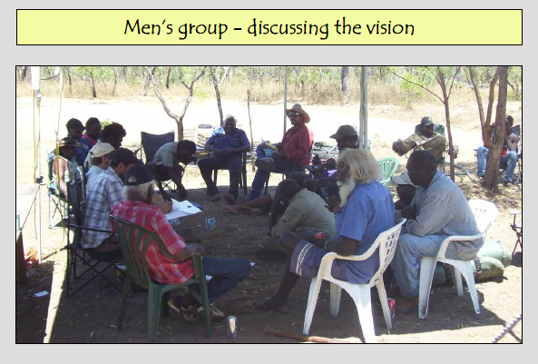
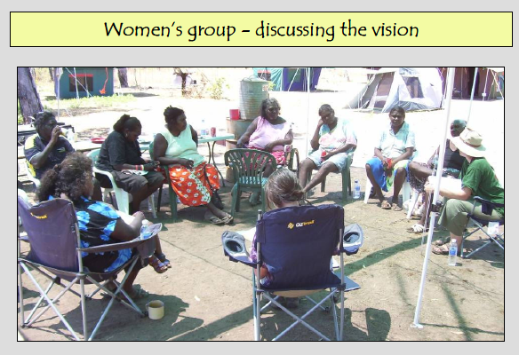
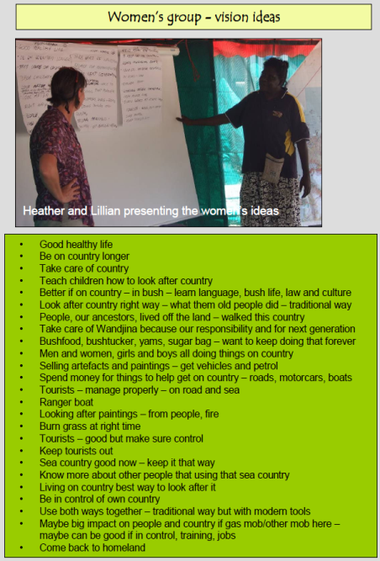
Deciding what the Plan is all about
Vision/Dream
Example – culturally sensitive groups

Slide 9
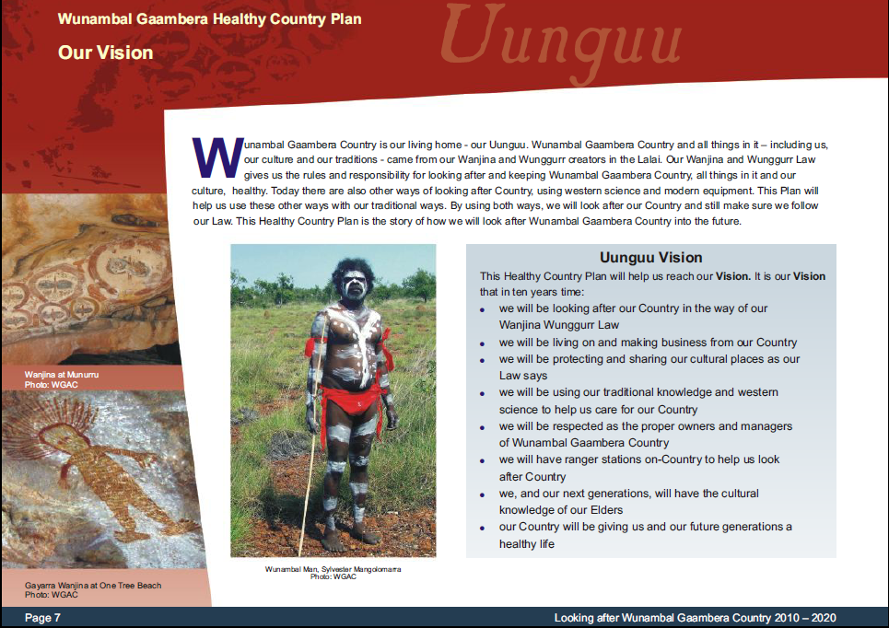
Deciding what the Plan is all about
Vision/Dream
Example

Slide 10
Deciding what the Plan is all about
Vision/Dream
Example
Yangtze Basin –
"A region where a living river links the Tibetan Plateau and the Pacific; where people thrive in harmony with nature, pandas play in the forests, children swim with dolphins and fish in the clear water, pheasants dance among the rhododendrons, and the cranes sing at sunrise. A region where natural cycles sustain a rich and ancient culture."

Slide 11
Deciding what the Plan is all about
Scope
Work out the Boundary of your Plan
Why do this step?
  Define the boundaries of your project and what you want to do
  Helpful to be clear about where you are not going to be working – particularly when talking to neighbouring land holders, or other stakeholders.
  May start with one scope as sub-set of larger process
Approaches
  Community mapping – where, what, how important – fuzzy mapping
  Background reports

Slide 12
Deciding what the Plan is all about
Scope
Work out the Boundary of your Plan
SINGLE AREA
Priority Areas
MULTIPLE AREA
Things that are in a lot of places over a large area
Wide-Ranging Species
Partnerships

Slide 13
Deciding what the Plan is all about
Scope
Work out the Boundary of your Plan
Projects occur at many scales and with many themes
  Property (eg Skullbone Plains)
  Region (eg Five Rivers area)
  Species (eg Clarence galaxias)
  Target (eg cultural landscape)
Map spatial area of Project
  Map values to manage
  Where, what, how important

Slide 14
Deciding what the Plan is all about
Scope
Work out the Boundary of your Plan
Define the boundaries of your project and what you want to do
Community mapping
  Planning more effective if people have spent time on country thinking about assets, values etc
  Then use best maps available with community
  Various methods: mud maps, remote images, GIS
Background reports
  Can also be useful to have a review of other knowledge about country ie non-Indigenous science perspective

Slide 15
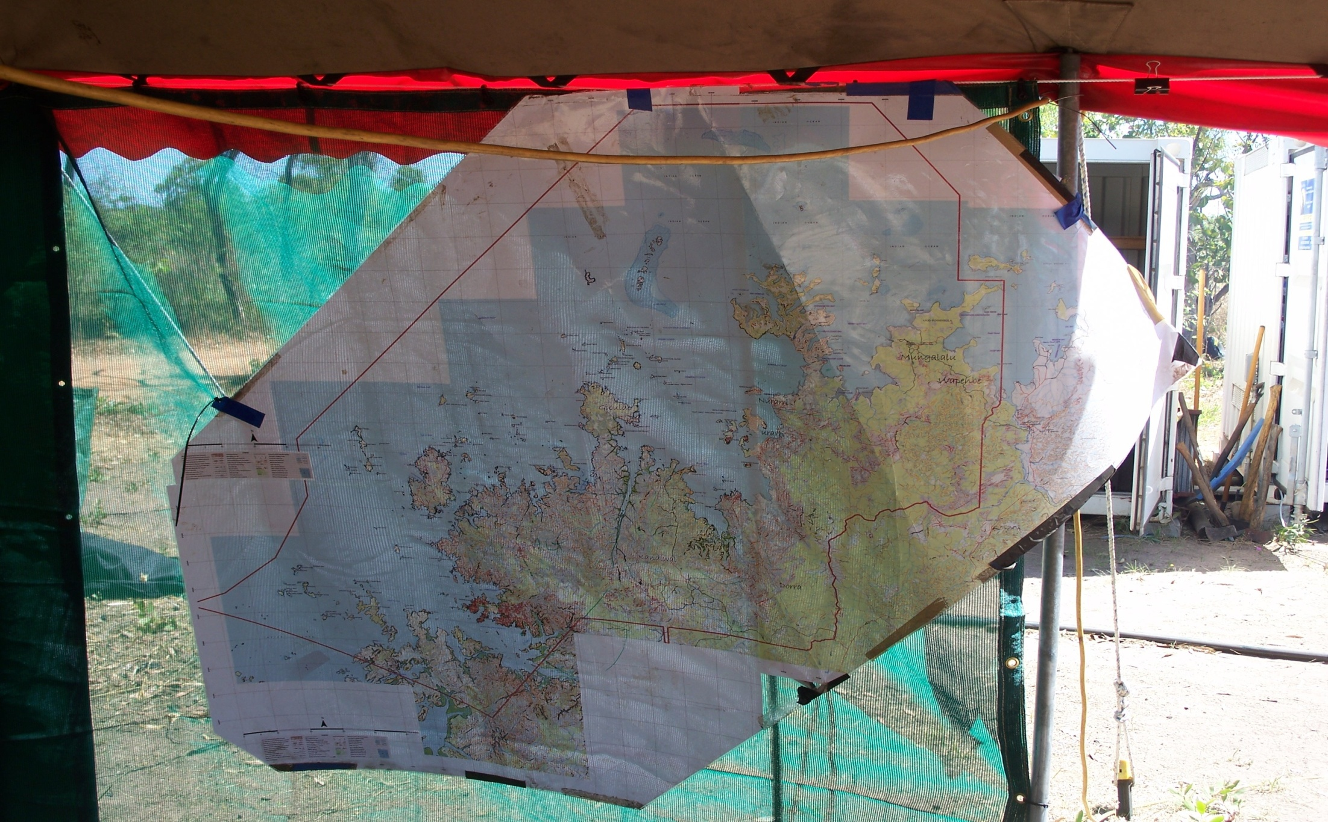
Deciding what the Plan is all about
Scope
Example

Slide 16
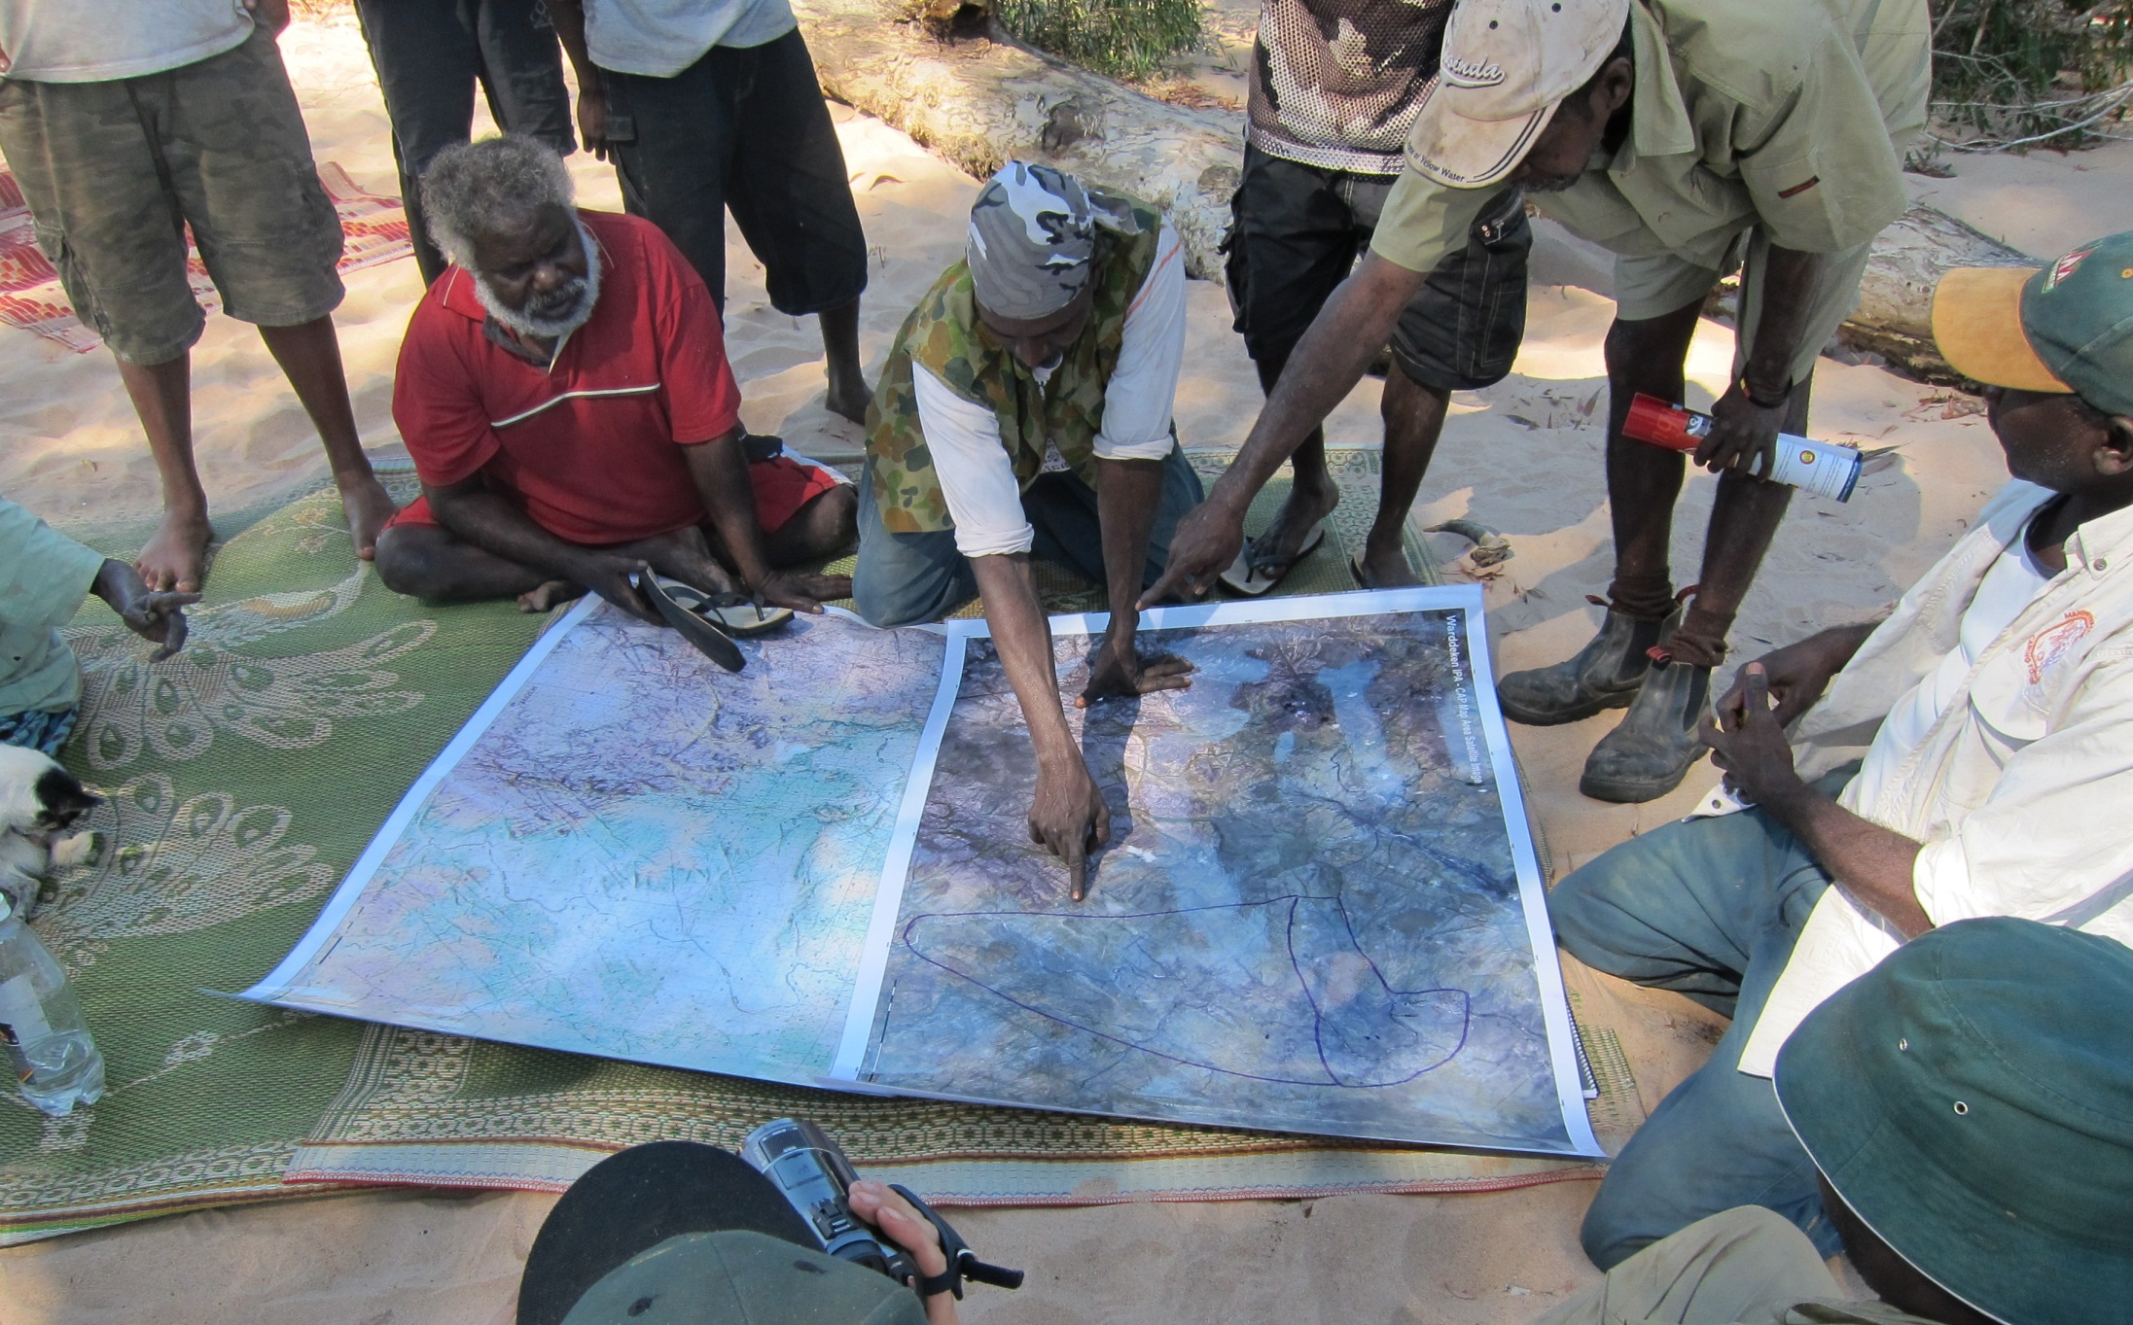
Deciding what the Plan is all about
Scope
Example

Slide 17
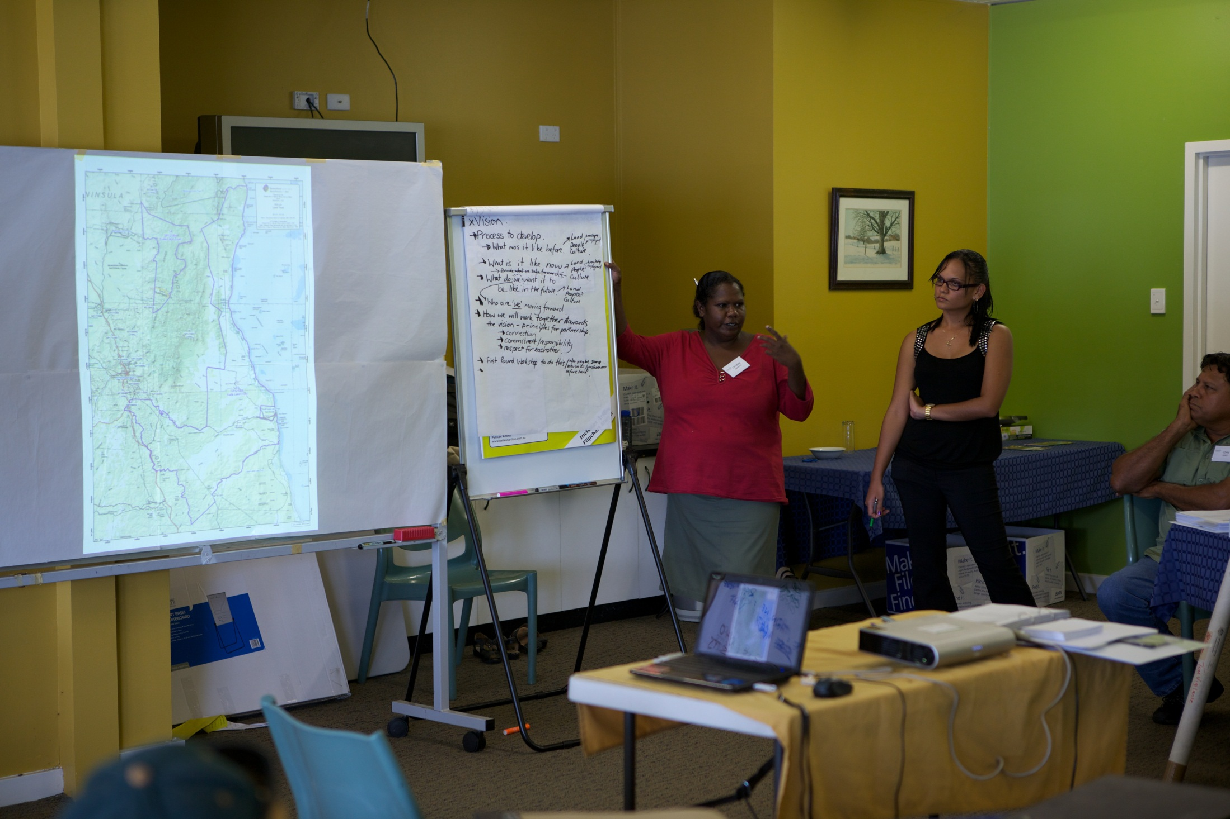
Deciding what the Plan is all about
Scope
Example

Slide 18
Deciding what the Plan is all about
Vision/Dream
Workshop Activity
Vision/Dream Write the Vision/Dream for the project area in a way that is meaningful to you. Make sure it says what success will look like. It should be Relatively general Inspirational – the heart sings! Simple and succinct so that all project participants can remember it.
Look at the exercise and consider:
  Questions that can help us in this part
  Considerations for planning on country
  What things we will need at the end of this step

Slide 19
Deciding what the Plan is all about
Scope
Workshop Activity
Area Description Write the definition of the project area in a way that is meaningful to you and potential partners
Area Map Draw a complete and clear line around the physical limits of the project (as a simple drawing)
Project Description Describe what you are trying to do

Slide 20

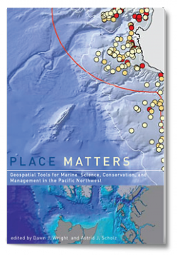

Deciding what the Plan is all about
Resources
For Area and Dream

