Slide 1
Targets
The important things to look after to make country healthy

Slide 2
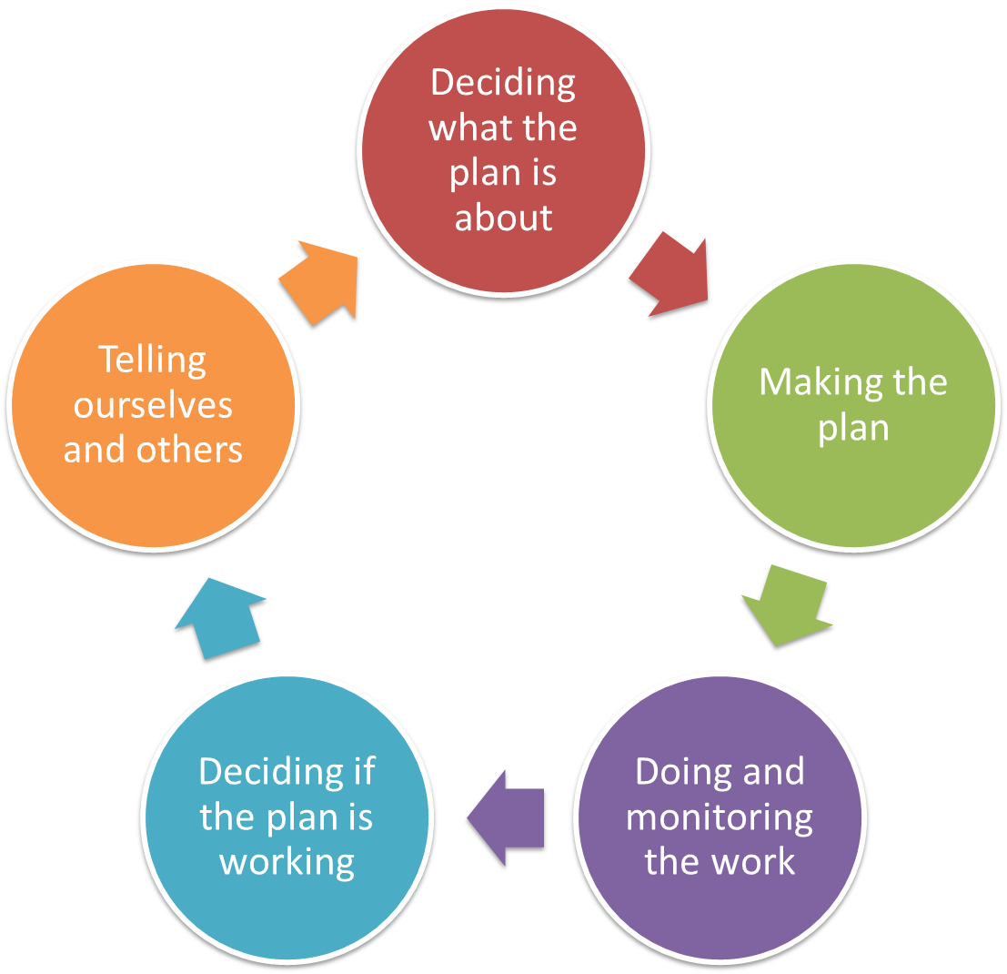
Pre-planning
Vision & Scope
Targets & Health
Threats
Situation
Notes:
Pre-planning is 1st step, irrespective of the ‘entry point’

Slide 3
Deciding what the Plan is all about
Targets
The important things that make country healthy
Why do this step?
  To be able to say what the most important things to look after to make the country healthy – people, plants, animals, places, culture, types of places
  Your targets are the values, features, assets that you most care about improving, protecting, restoring and keeping healthy.
  They will become the things to focus most of your time and effort on, as a way of keeping your plan manageable.
  Without targets to add to your vision / dreams, it will be a lot harder to put your plan into action and see if it is working.

Slide 4
Deciding what the Plan is all about
Targets
The important things that make country healthy
Targets are the things we want and value
Targets are what we are managing FOR
Targets are the main features that keep country alive and are important for people to look after, and can be about nature, culture, or people
Targets are the things we want to focus our work on
Different targets will need different management

Slide 5
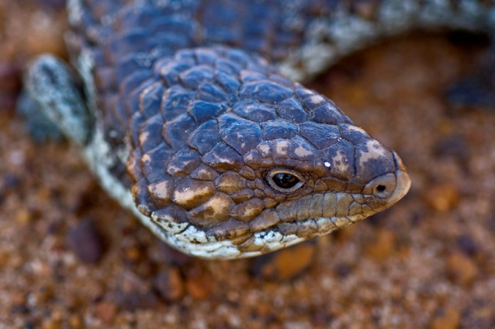
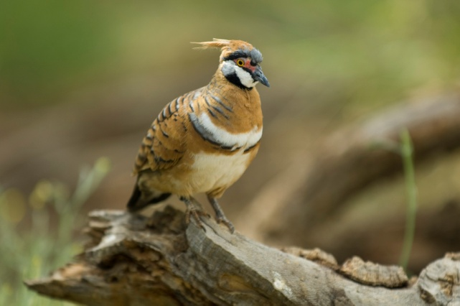
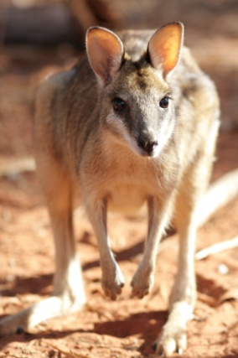
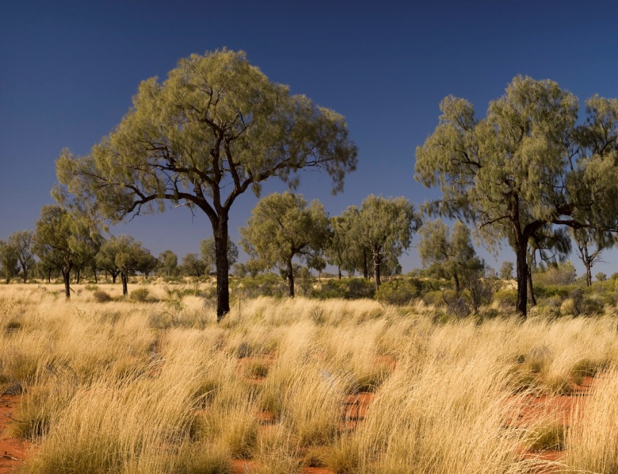
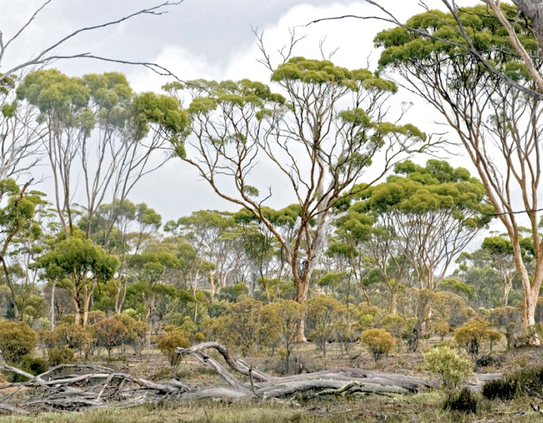
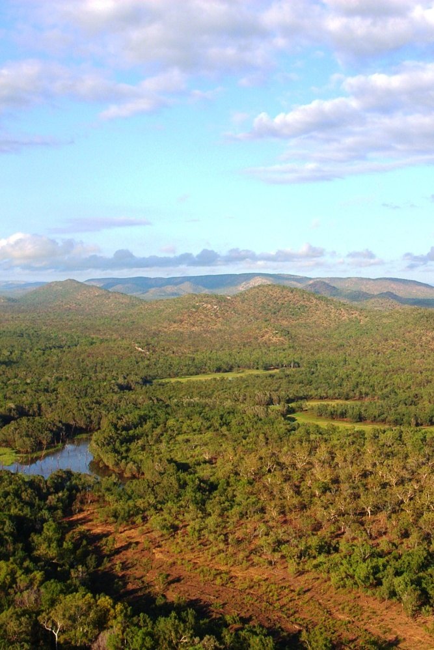
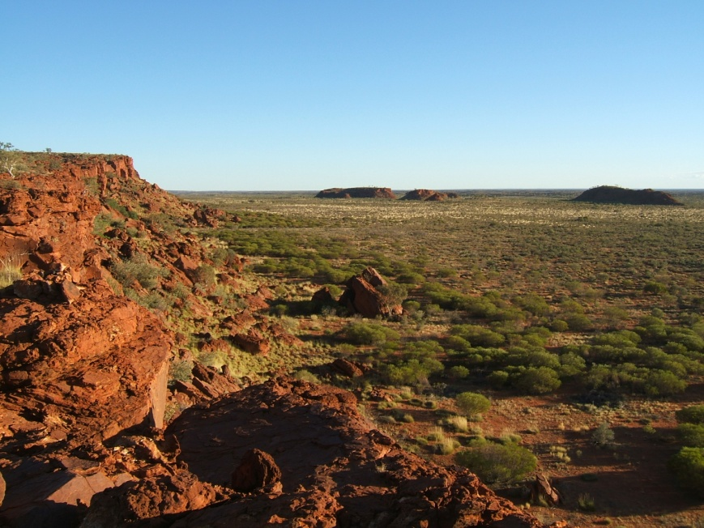
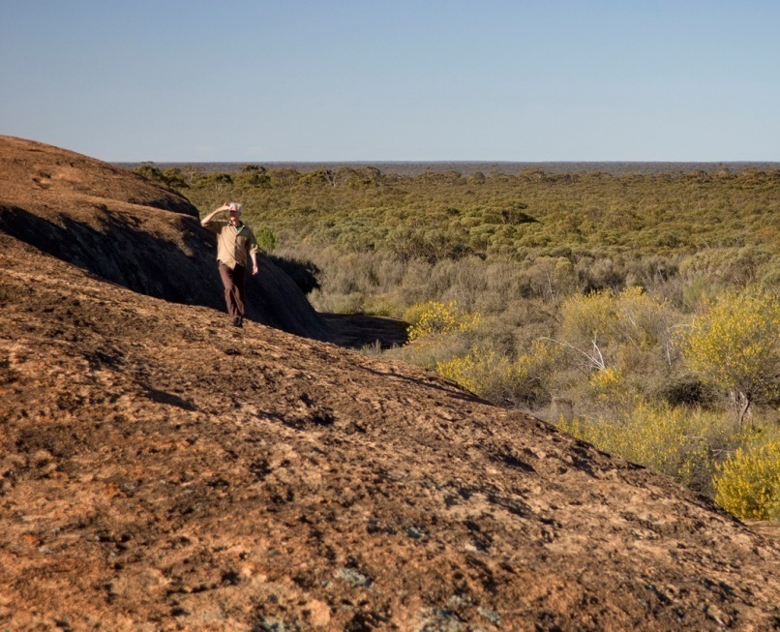
Deciding what the Plan is all about
Targets
Ecological Systems
Communities
Species
© Amy Vitale
© Mark Godfrey TNC
© Greg Holland
© Mark Godfrey TNC
© Amy Vitale
© Geoff Lipsett-Moore
© Natalie Holland
© Mark Godfrey TNC
Notes:
Photos:
Ecological Systems (L-R):
Fish River - Wetlands and savanna
Central Australia
Great Western Woodlands
Communities
Moving on to the selection of Focal Conservation Targets…
The places where we work typically include dozens and occasionally 100’s of occurrences of species, communities, and ecological systems. TNC has relied for years on the process of selecting a set of “focal conservation targets” to guide our conservation planning and measures efforts.
These focal targets can include
Species
communities,
and ecological systems.
The focal targets are selected to encompass and represent the needs of the broader set of biodiversity occurring within the project.

Slide 6
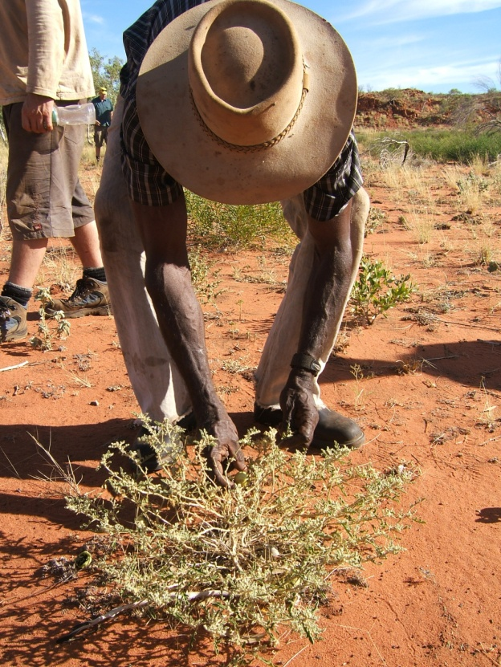
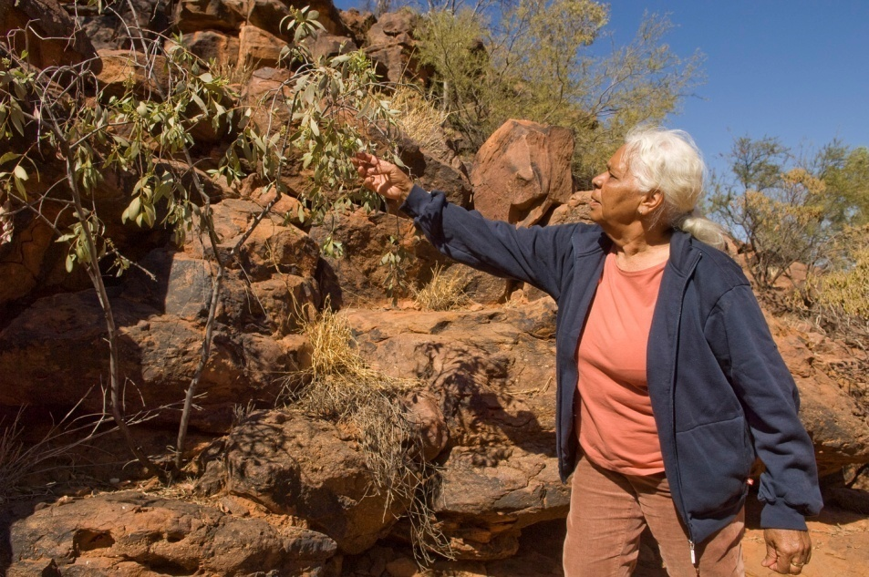
Deciding what the Plan is all about
Targets
Intangible values
  Identity / Culture / Stories
  Local/indigenous knowledge
Social institutions
  Customary law system
Spirituality
  World vision, sacred places and rituals
Oral history
Traditions
  Language, music and dances, festivals,
  gastronomy
© Natalie Holland
© Mark Godfrey TNC
Notes:
Bush Tomato
Bush food or medicinal plants

Slide 7
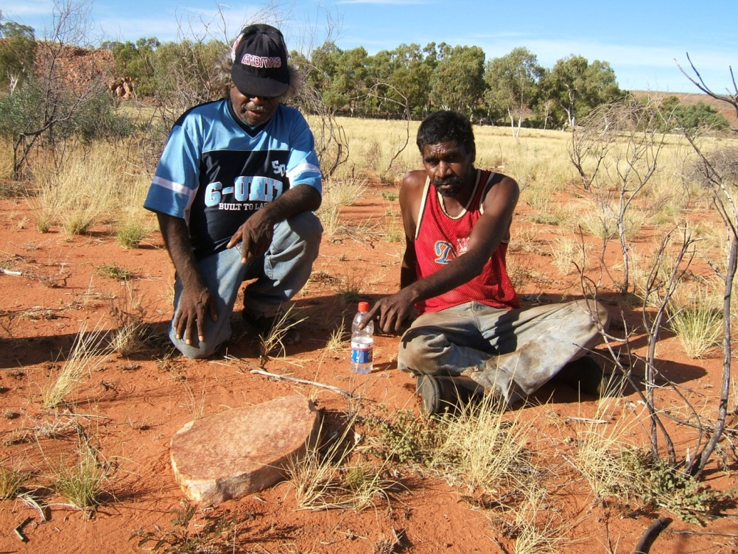
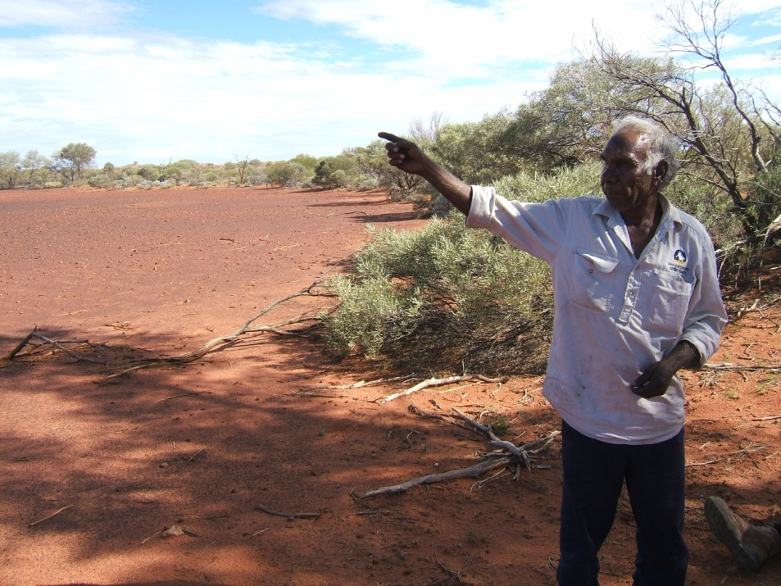
Deciding what the Plan is all about
Targets
Tangible values
  Region
  Area
  Zone
  Site
  Group of Structures
  Structure
  Movable objects

Slide 8
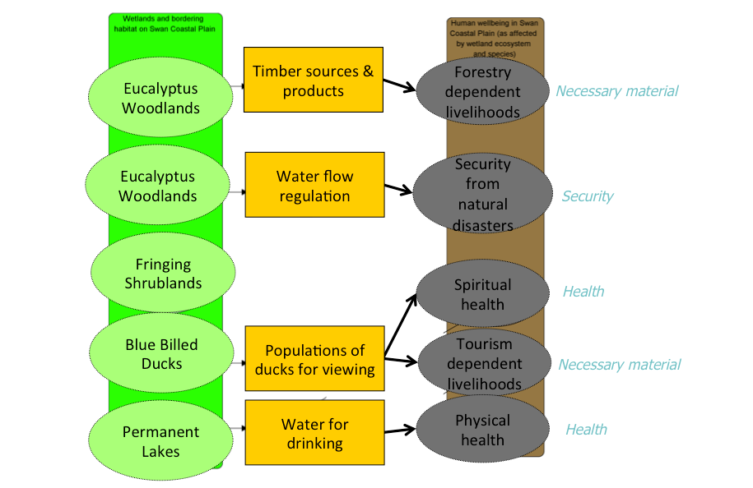
Deciding what the Plan is all about
Targets
Human Welfare Targets
  Non-biological, socio-economic targets (open space, rural lifestyle, profitable farms, clean water, etc.)
  ALWAYS Up to the team whether to include diverse target types…
  Important to be clear about the vision and scope of the project: shared vision statement
  Important to be clear about the relationship between the targets
  Note that some strategies may actually conflict

Slide 9
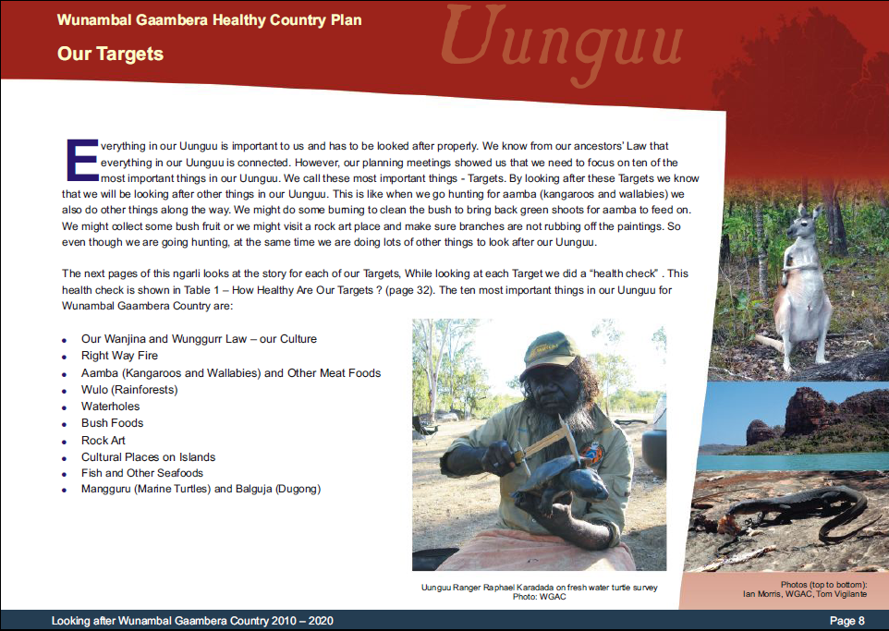

Slide 10
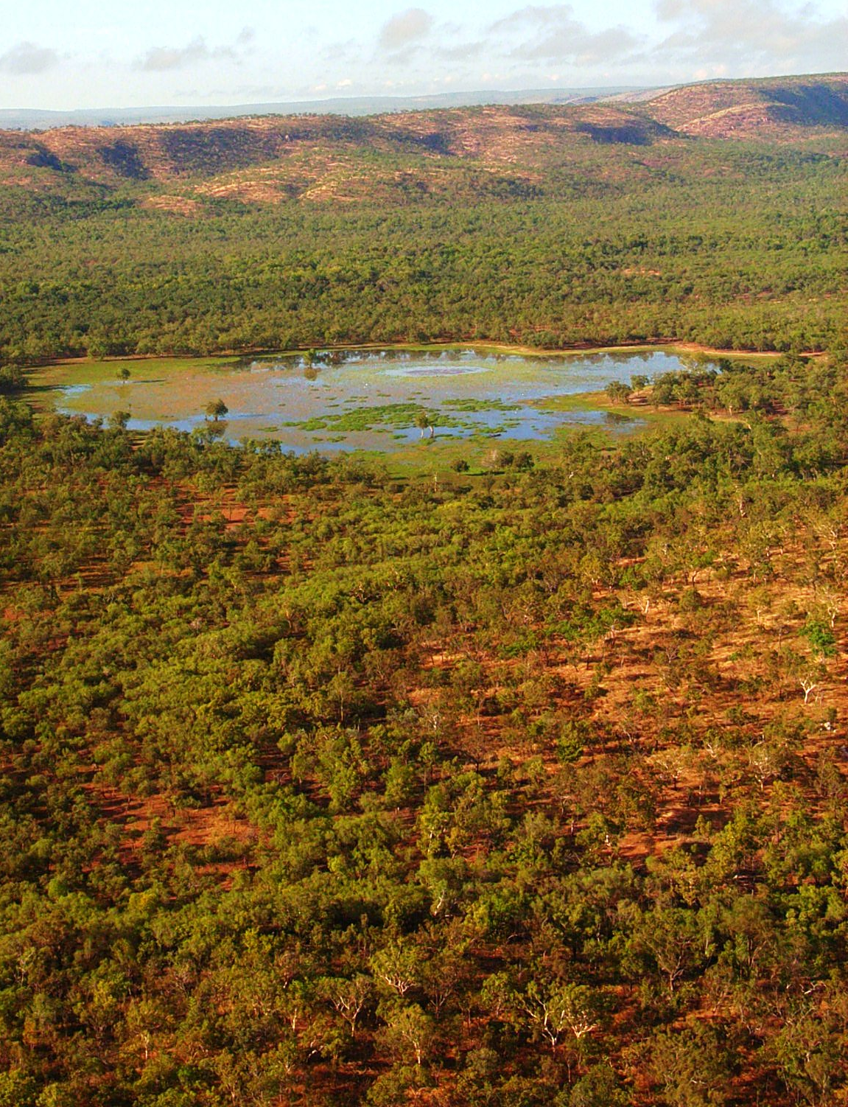
Deciding what the Plan is all about
Targets
Selecting Targets
Think about ALL the different things that are most important for country
Be as specific as possible
You will probably end up with a very long list (30+)
We want to try and end up with a list of 8-10.
We will try and ‘lump’ things together based on management
Sites
Escarpment Country
Story places
Fish species
Lillies
Water birds
Tubers
Wetland
Medicines
Grasses
Savanna Woodland

Slide 11
Deciding what the Plan is all about
Targets
Joining or Separating Targets?
Look at your ‘long’ list and see if you can join things together
“Lump” targets if they:
  Occur in the same place
  Require similar processes
  Have similar health, or one target can serve as an indicator for the other
  Have similar threats
Because then they might need the same strategies.
Examples
  Wetlands - fish and lillies
  Grasslands & grassland nesting birds
  Woodland & important plants

Slide 12
Deciding what the Plan is all about
Targets
Selecting Targets
Start with Systems or large areas
Then Screen for things that have Special Requirements
Ideally we want to end up with 8-10 Targets
Escarpment Country / Story places
Wetland
Bush foods
Savanna Woodland

Slide 13

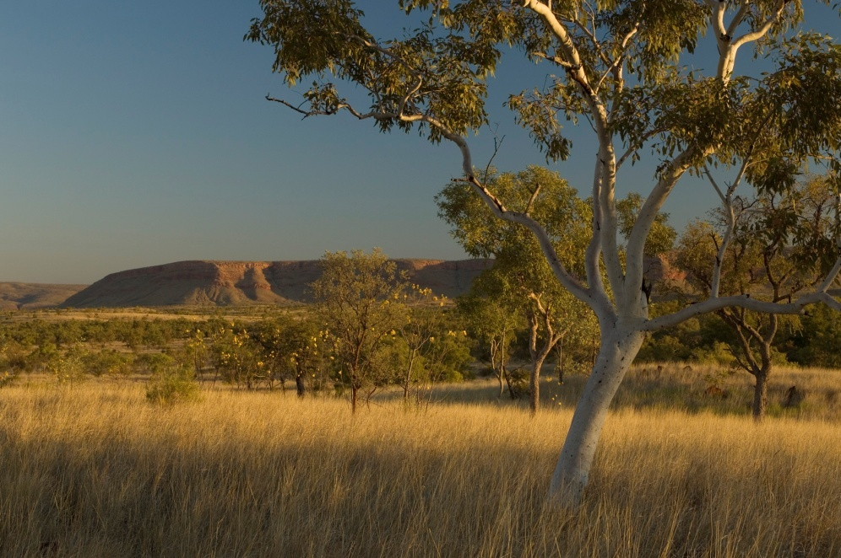
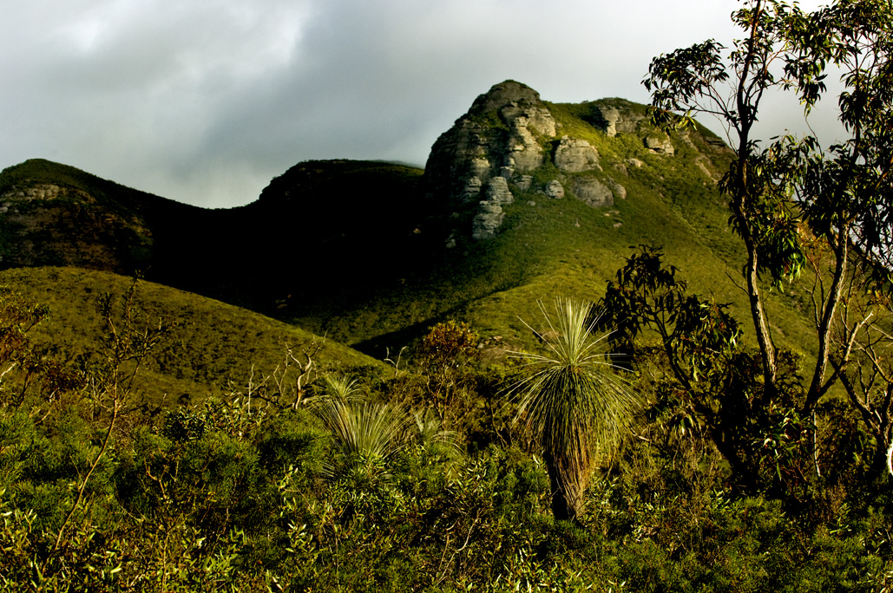
Deciding what the Plan is all about
Targets
Remember: different targets need different management
© Greg Holland
© Mark Godfrey TNC
© Amy Vitale
Notes:
Photos: clockwise from top right
Agile Wallaby
Stirling Range NP – Gondwana Link
Northern Australian savannas

Slide 14
Deciding what the Plan is all about
Targets
‘Nested’ targets
Managing the Target means we manage a lot of things
  Eg if we manage to keep rainforest patches healthy we might also then help keep individual species healthy too – fruits etc
The main thing we want to manage is our target
We don’t want to forget the other things, so we call them nested targets and record them
Nested targets are a good way to remember all the different things people talk about when they are talking about country

Slide 15
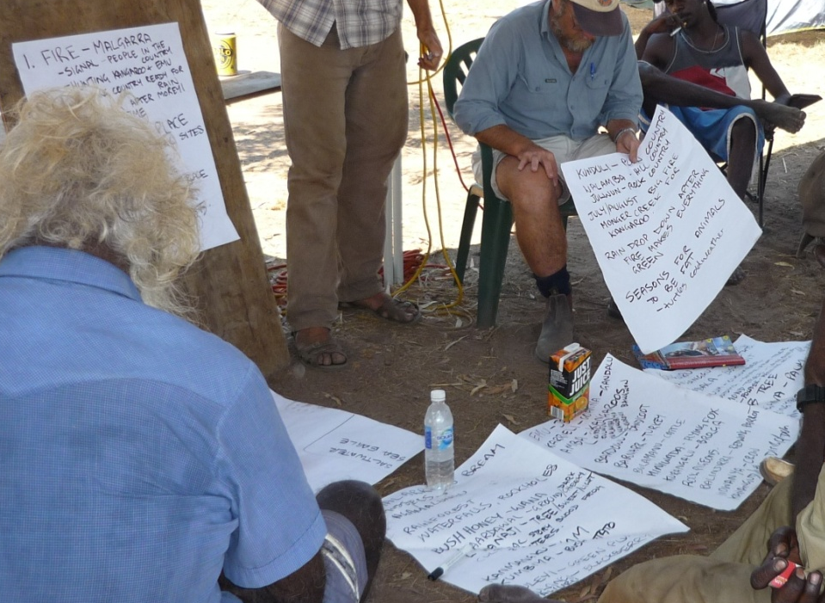
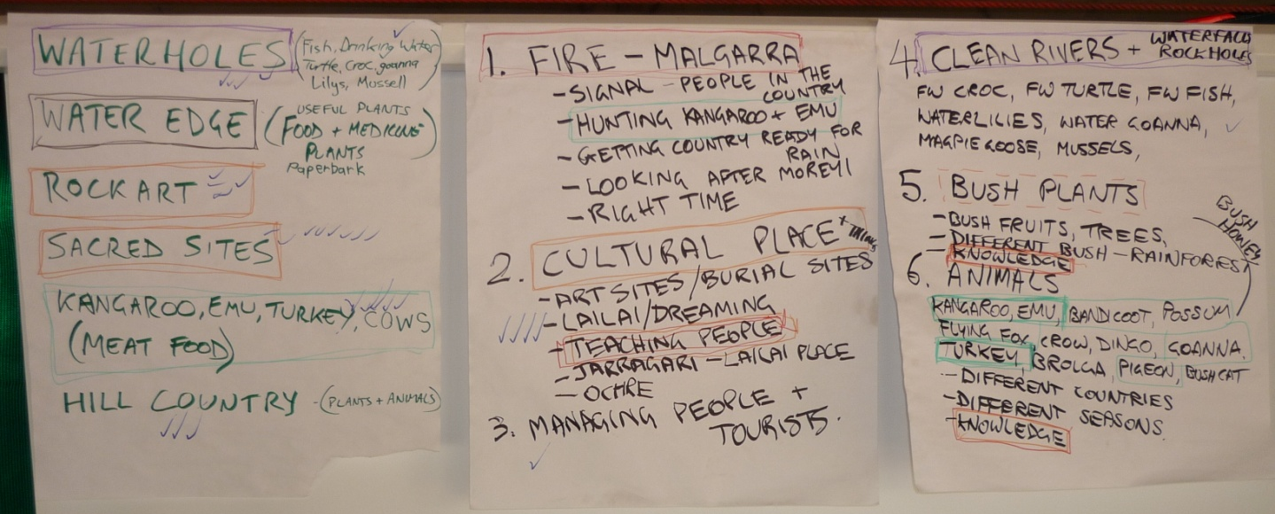
Deciding what the Plan is all about
Targets
Nested example

Slide 16
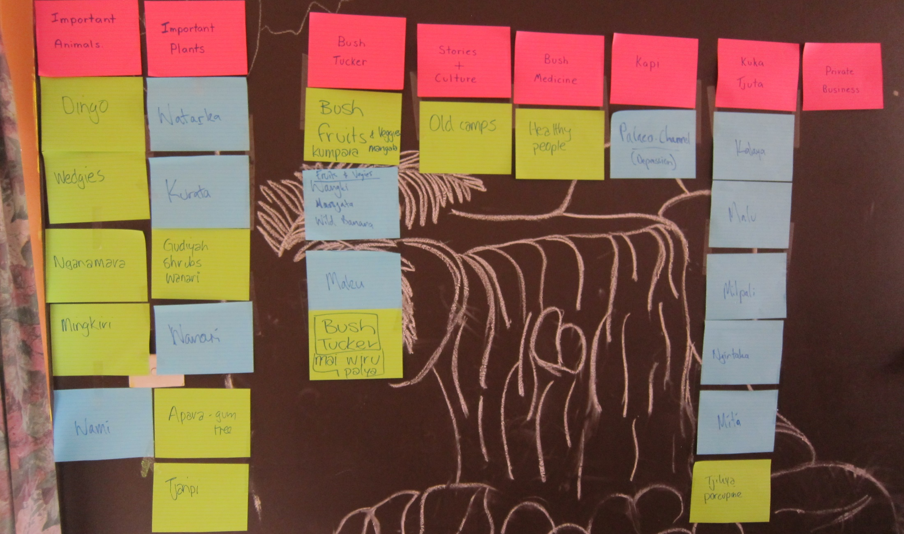
Deciding what the Plan is all about
Targets
Nested Example

Slide 17
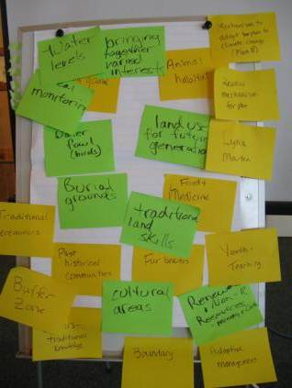
Deciding what the Plan is all about
Targets
Nested Example

Slide 18
Deciding what the Plan is all about
Targets
Selecting Targets
Your targets will change as you work on them.
First list
After looking at threats
In the Plan

Slide 19
Deciding what the Plan is all about
Targets
Map Your Targets
Coastal Dunes
Brackish Marsh
Freshwater Marsh
Riverine System
Matrix Forest
Tiger Beetle
Targets might mean that you need to work with others not on your country

Slide 20
Deciding what the Plan is all about
Targets
Community mapping
Community mapping
  Have community maps assets as best they can
  Helps to focus on ‘where, what, how important’
  Planning more effective where people spend time on country thinking about assets, values etc
  Use best maps available with community
  Various methods: mud maps, remote images, GIS

Slide 21
Deciding what the Plan is all about
Targets
Workshop activity
‘Brainstorm’ possible targets using cards
Organise cards into ‘like’ groups – these are your Targets
Copy into Table
Draw a rough map showing where these Targets occur in your project area
Decide on 4 Targets (2 natural, 2 cultural / social) which would be the focus of management for your project area for the rest of the workshop
Report back
Look at the Sheet and consider:
  Questions that can help us in this part
  Considerations for planning on country
  Products generated in this step

Slide 22
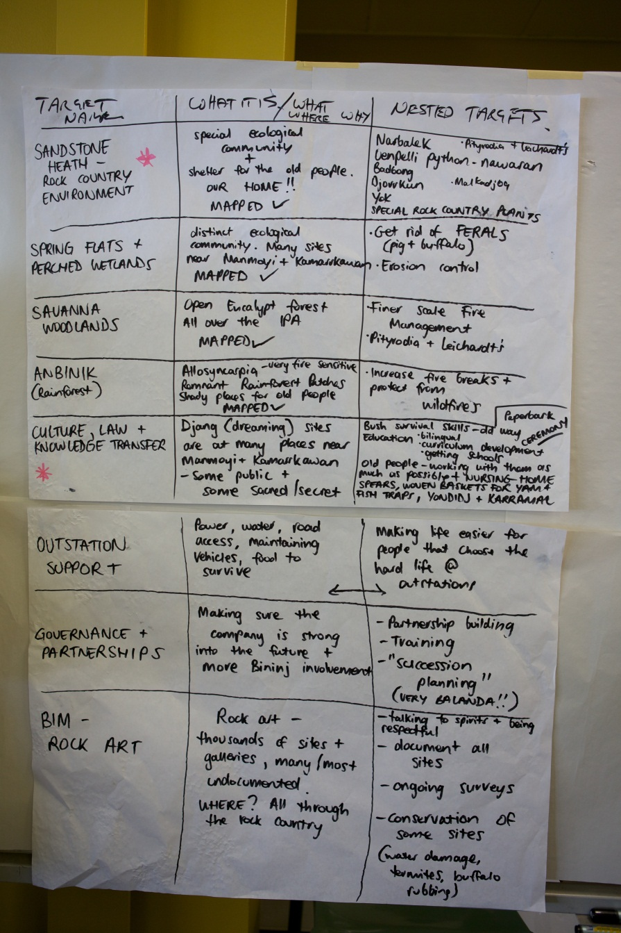
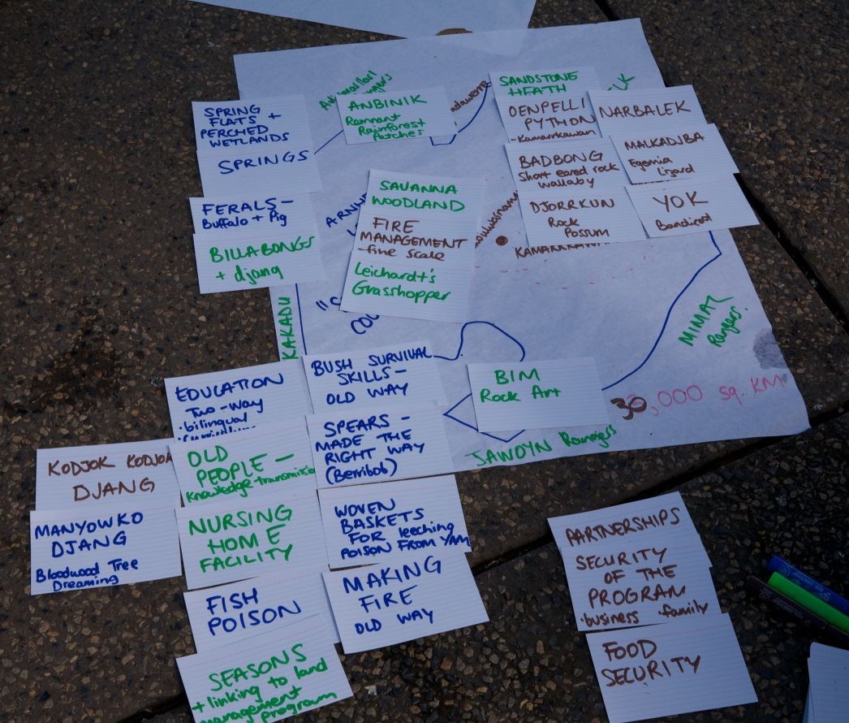
Deciding what the Plan is all about
Targets
Workshop activity
Copy in to table

Slide 23
Deciding what the Plan is all about
Targets
Workshop activity
Target Name | What is it? | Nested Targets
Target 1 | Description: what, why, where | Things also looked after by looking after this
Target 2 | Description: what, why, where | Things also looked after by looking after this
etc | etc | etc

Slide 24
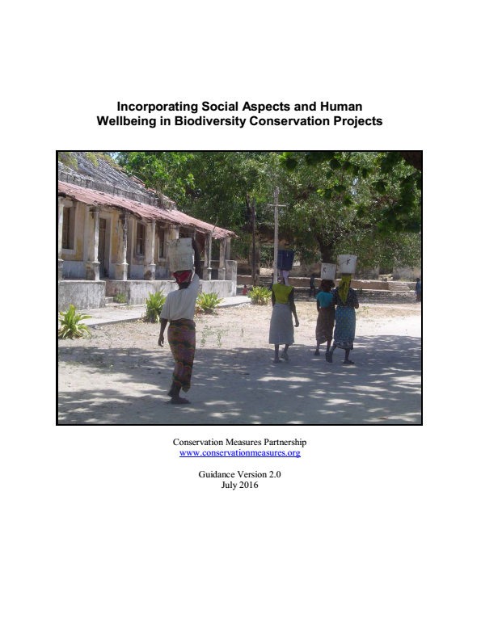

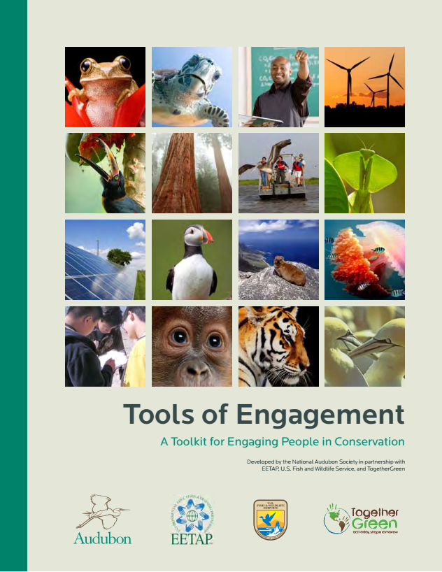
Deciding what the Plan is all about
Targets
Additional resources

