Slide 1
Target Health
Viability

Slide 2
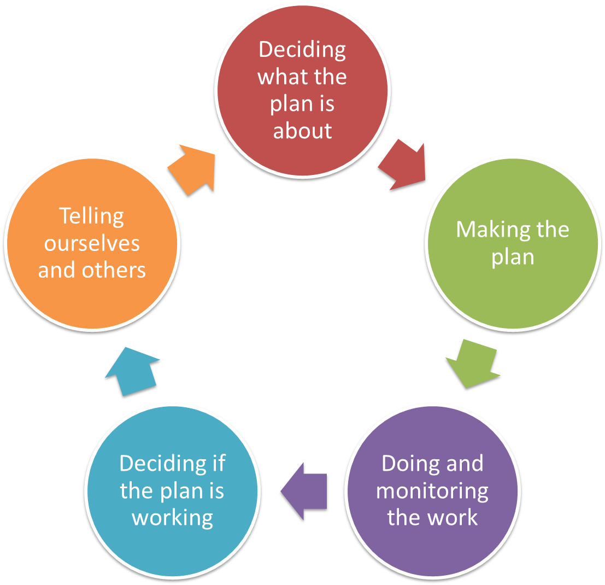
Pre-planning
Vision & Scope
Targets & Health
Threats
Situation
Notes:
Pre-planning is 1st step, irrespective of the ‘entry point’

Slide 3
Deciding what the Plan is all about
Target Health
The important things that make targets healthy
Why do this step?
  To be able to say what makes the targets healthy, how we will measure that, and if they are getting better or worse
  This step will take some time and requires a bit of organisation.
  Work here will make the next steps easier and more focused
    Overall Health tells you what to work on first
    Attributes help you work out threats
    Indicators tell you what to measure and monitor

Slide 4
Deciding what the Plan is all about
Target Health
Health (Viability) and Attributes
The ability of a target to withstand or recover from disturbances or survive in hard times and continue to exist is its health
Its attributes are the things we use to talk about the health of the target
Attributes are the main things used to ‘diagnose’ that health eg like a doctor would check your circulatory system to gain insight into your health

Slide 5
Deciding what the Plan is all about
Target Health
Attributes and Indicators
Indicators are the things that can be
measured to tell us if our attributes are viable
    Eg pulse, blood pressure
‘Things we measure’
Indicators tell us:
  Signs of good health
  Signs of bad health

Slide 6
Deciding what the Plan is all about
Target Health
Why assess health?
Helps to clearly define targets
Foundation for establishing what the health is now of a target and setting what we want the health to be
Helps to identify threats to each target and understand exactly how these threats hurt the target
Assists in developing good goals and strategies
Guides the design of monitoring protocol and measures of success
Helps identify critical knowledge gaps about the system

Slide 7
Deciding what the Plan is all about
Target Health
Who/how?
Planner / facilitator
People who can speak for country / have traditional responsibility for places
People who know the landscape well, its features and how it works
Scientists and specialists
Usually repetitive and iterative
Better to use small groups/individuals

Slide 8
Deciding what the Plan is all about
Target Health
Health analysis has four steps
Step 1: Select Attributes
Step 2: Identify indicators for the Attributes
Step 3: Rate the indicators (good, fair, etc)
Step 4: Assign current status

Slide 9
Deciding what the Plan is all about
Target Health
Step One – Select Attributes
Characteristics of the target
that if eliminated or significantly altered, would see the target being unhealthy or would shift it into something quite different.

Slide 10
Deciding what the Plan is all about
Target Health
Ways to think about Attributes
Size
  Area or abundance
Condition
  Composition (e.g native vs. introduced)
  Structure (e.g age)
Context
  Processes (e.g fire)
  Connectivity (e.g access to habitats/resources)
Culture
  Traditional knowledge and meaning
Notes:
Don’t “worry” about these categories or obsess about whether something belongs in one category or another.
We just use these to prompt and organize our ideas.

Slide 11
Deciding what the Plan is all about
Target Health
Tips for Selecting Attributes
Pick things that are critical for long-term health…
  eg if degraded, would seriously jeopardize the target’s ability to be healthy for 100+ years?
When in doubt, pick things that can be or are likely to be affected by human activities
Look for a few really key attributes
    NOT lots of desirable or descriptive characteristics
    NB these will need to be measured

Slide 12
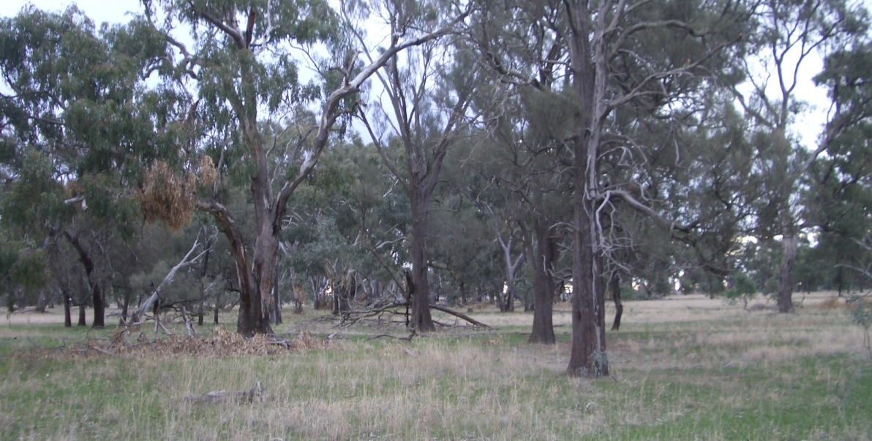
Target: Eucalypt Woodland
Deciding what the Plan is all about
Target Health
Example Attributes
Attribute: Fire Regime

Slide 13
Deciding what the Plan is all about
Target Health
Step Two - Select Indicators
Indicators are measurable parts of the Attribute that inform us of its status or “health”
Key Attribute: Circulatory system
Indicator: Blood pressure
Indicators are what you measure

Slide 14
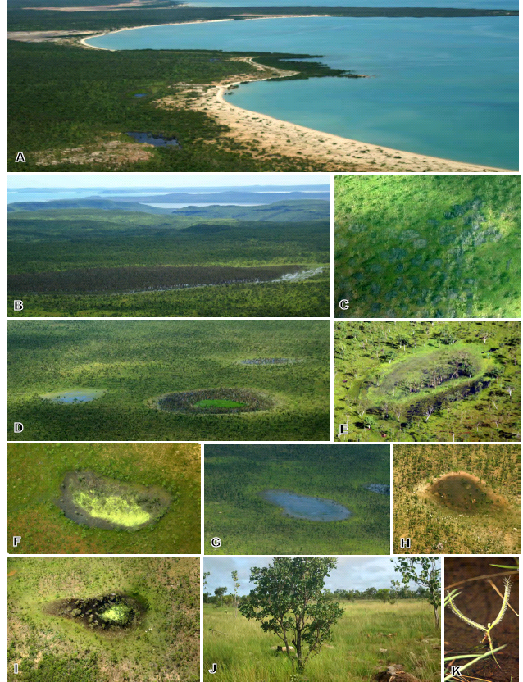
Deciding what the Plan is all about
Target Health
Look for indicators that ...
Use indicators that community members (landowners and managers) will and have used for millennia
Fat on the tail of kangaroo
How kangaroo/meat tastes
Knowledge of stories

Slide 15
Deciding what the Plan is all about
Target Health
Look for indicators that ...
  Strongly relate to the health of the attribute
  Are efficient & affordable to measure
  Where you can reasonably define what “Good” is
  Desirable indicators ...
    Might provide an early warning to serious threats
    Might assess two or more attributes
        e.g. Presence of young cypress in a floodplain forest as an indicator for both water regime & reproduction of important species

Slide 16
Making the Plan
Target Health
A good indicator
A good indicator should meet the following criteria:
Measurable: you can record something & analyze it.
Precise: Defined the same way by all people.
Consistent: Consistent over time so that it always provides comparable measurements.
Sensitive: Changes in response to actual changes in what you are measuring.
Sustainable: able to be used with the
resources you have

Slide 17
Target: Eucalypt Woodland
Deciding what the Plan is all about
Target Health
Example Indicators
Attribute: Fire Regime
Indicator: Percent of woodland with right fire frequency.

Slide 18
Deciding what the Plan is all about
Target Health
Step Three - “Ranking” Target Health
Very Good:
Most desirable status; Requires little intervention for maintenance
Good:
Indicator within acceptable range of variation; Some intervention required for maintenance
Fair:
Outside acceptable range of variation; Requires human intervention
Poor:
Restoration very difficult; May result in extinction
Notes:
We identify targets, select key ecological attributes within the categories of size, condition, and landscape context, then select Indicators that are the Measurable entities used to assess the status of key ecological attributes
•Indicator Rating Categories are described based on Criteria that objectively define an indicator into 1 of 4 categories corresponding to Poor, Fair, Good, and Very Good viability status
The guidance for defining different indicator ratings is centered on the concept of acceptable ranges of variability.
Indicators in a “Good” status are within an acceptable range of variation; Some intervention is required for their maintenance
Very Good is an Ecologically desirable status; Requires little intervention for maintenance
Fair status indicates a key attribute that is Outside acceptable range of variation; Requires human intervention
Poor status represents a situation where Restoration increasingly difficult and the current conditions may lead to the extirpation of the target

Slide 19
Deciding what the Plan is all about
Target Health
Example Ranking and Status
Target: Eucalypt Woodland
Attribute: Fire Regime
Indicator: Percent of woodland with right fire frequency.
Very Good: Frequency of 3-8 years and most of area burnt
Good: Frequency of 3-8 years and large percentage of area burnt
Fair: Frequency of 8-15 years and/or less than 50% of area burnt
Poor: >15 years and <50% of total area burnt
Current status

Slide 20
Deciding what the Plan is all about
Target Health
Example Ranking and status
Target: Art site
Attribute: Cleanliness of site
Indicator: Amount of disturbance by introduced animals
Very Good: No visible disturbance
Good: TBD
Fair: TBD
Poor: Animals using site for camp
Current status

Slide 21
Deciding what the Plan is all about
Target Health
The important things that make targets healthy
Wunambal Gaambera example

Slide 22
Deciding what the Plan is all about
Target Health
The important things that make targets healthy
A process that lets you adapt as you learn more
  Begin with the best information you have today
    Identify 4 really key attributes for each target (maybe one each for size, condition, context and culture)
    Determine what you’ll measure for each attribute – the indicator
    Discuss and describe what a “good” rating would be
    Say what you think the “Current Status” would be, based on informed expert opinion + available information
    Get some feedback and see if others agree
  As you learn more you can improve
  how certain you are

Slide 23
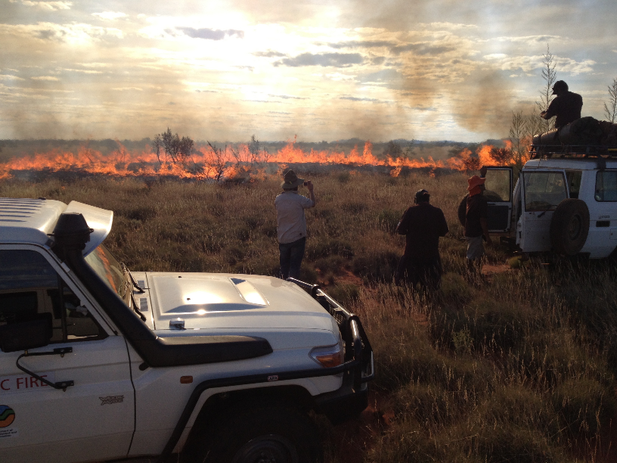
Deciding what the Plan is all about
Target Health
Flexible level of detail
Target | Attribute | Indicator | Poor | Fair | Good | Very Good
grassland - Type X | fire regime | fire frequency |  | not enough fire
grassland - Type X | fire regime | fire frequency |  | > 10 years | 5-10 years
grassland - Type X | fire regime | % grassland with 5-10 yr fire return | <25% | 25-50% | 51-75% | >75%
1
2
3
The project team could have used any one of these
- and changed over time

Slide 24
Deciding what the Plan is all about
Target Health
Incomplete is ok
How important is it to fill out all ratings where current & desired status is Very Good?
Probably not important!
  Unless grassland area is threatened by large-scale habitat destruction.
  In this case, determining the Fair rating might guide efforts to determine how much to save

Slide 25
Deciding what the Plan is all about
Target Health
General Guidance
View main purpose as capturing the current state of knowledge
Don’t worry about information gaps
Don’t focus on filling out all indicator ratings
Can return during later planning stages to add more detail (if necessary)
Accept uncertainty!

Slide 26
Deciding what the Plan is all about
Target Health
Workshop activity
‘Brainstorm’ possible attributes using sticky notes
Organise into ‘like’ groups – these are your attributes
Copy into table
Then for each attribute
  Talk about how people know they are healthy (indicators)
  Talk about how healthy they are now and what the trend is (ranking)
Copy into Table
Look at the Sheet and consider:
  Questions that can help us in this part
  Considerations for planning on country
  Products generated in this step

Slide 27
Deciding what the Plan is all about
Target Health
Example Step 1

Slide 28
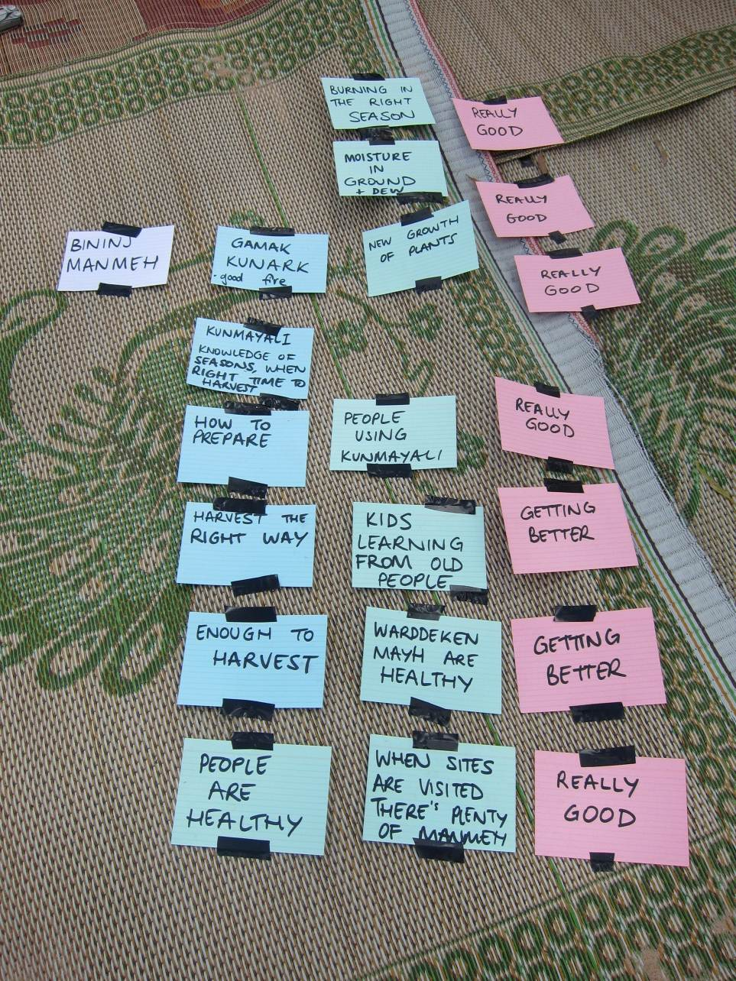
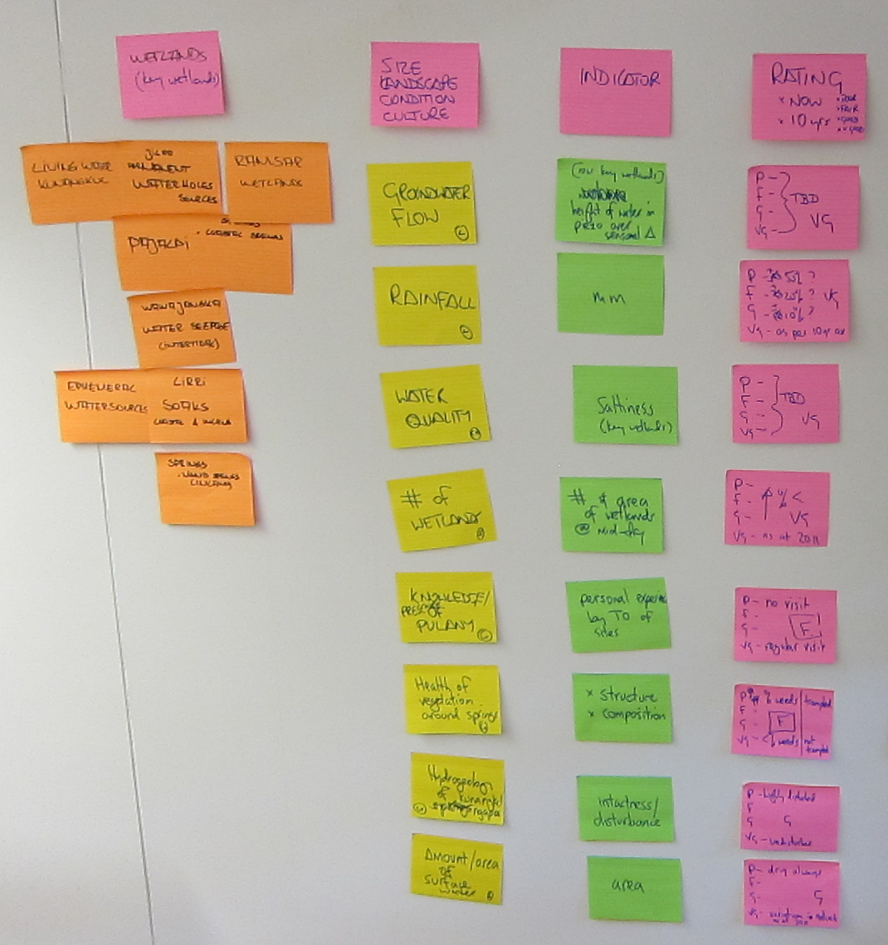
Deciding what the Plan is all about
Target Health
Example Step 2

Slide 29
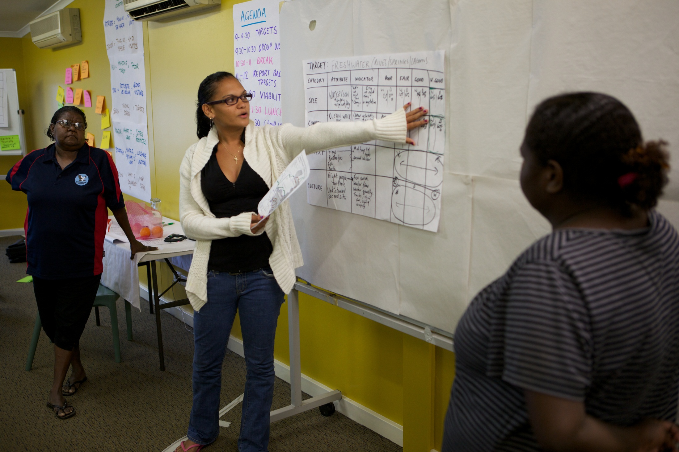
Deciding what the Plan is all about
Target Health
Example Step 2

Slide 30
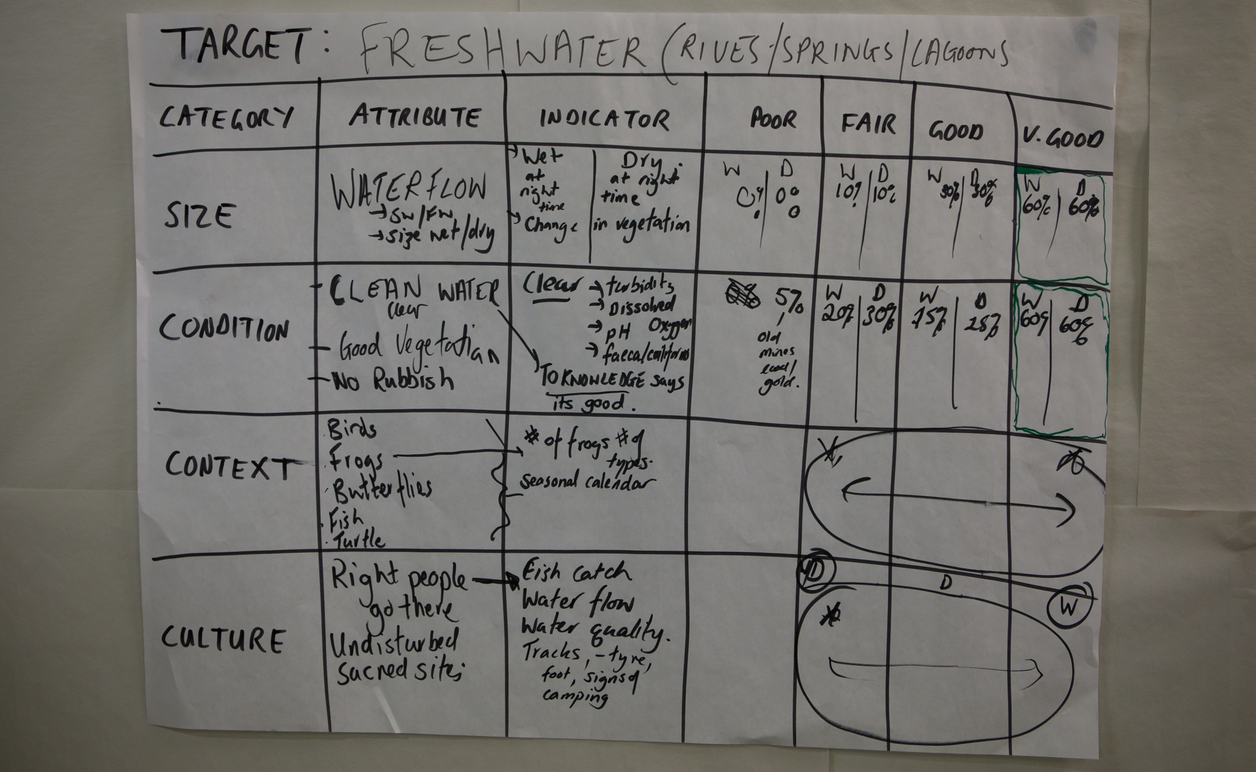
Deciding what the Plan is all about
Target Health
Example Step 3

Slide 31
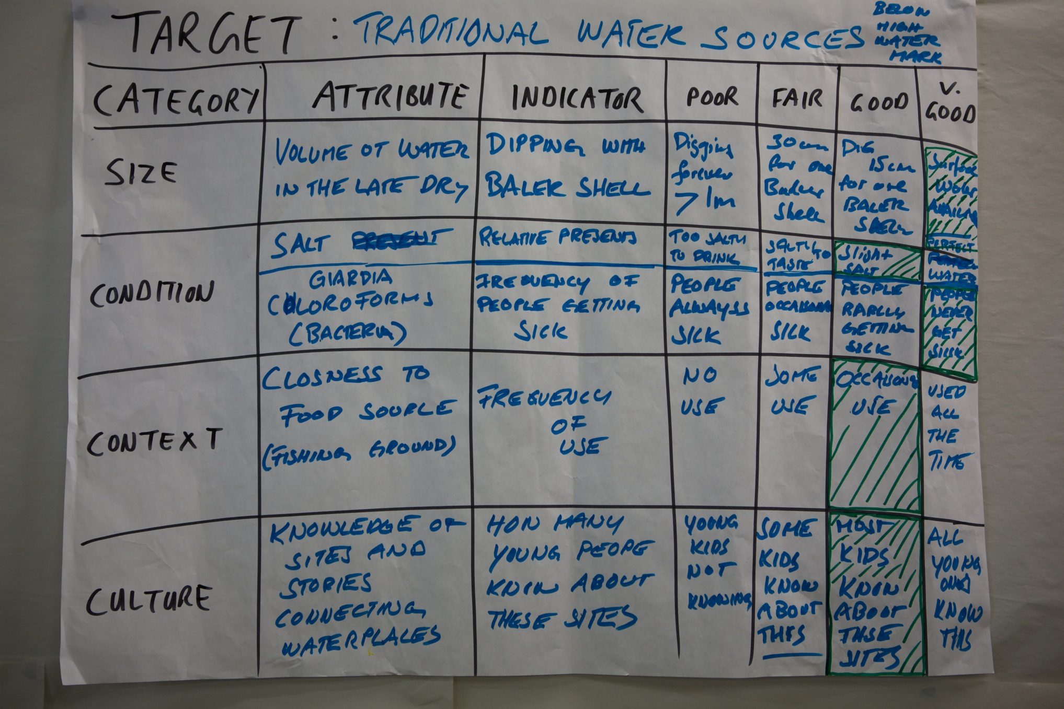
Deciding what the Plan is all about
Target Health
Example Step 3

Slide 32
Deciding what the Plan is all about
Target Health
Approach # 2 – PCP Method
This is a simplified approach to talking about the health of a target
For each Target draw a diagram like this one, showing time on the bottom axis, and ranking on the side
Have the team start by nominating current condition, then 10 years ago, and then in 10 years if nothing is done
Grasslands
Very Good
Good
Fair
Poor
 |  |  | What is v good
 |  |  | What is good
 |  |  | What is fair
 |  |  | What is poor
10 years ago | Now | In 10 years

Slide 33



Deciding what the Plan is all about
Target Health
Additional resources

